Slide 1
RNAseq Workshop
AIM: to get an overview of differential gene expression
Identify genes most highly differentially expressed between a condition

Slide 2
Software that will help you …
All users: Filezilla https://filezilla-project.org/download.php please install this. You can always remove it later.
Windows: Notepad++ (this is the King of Editors). https://notepad-plus-plus.org/downloads/ (This software understand Linux line ending)
Windows (optional): Mobaxterm Home edition (free) https://mobaxterm.mobatek.net/download.html

Slide 3
R studio : essential …
All users: R studio (choose the free version https://rstudio.com/products/rstudio/download/)
(open R studio) Install the package:
install.packages("BiocManager")
BiocManager::install("edgeR")
# load the package to check it worked
library("edgeR")
BiocManager::install("DEXSeq")

Slide 4
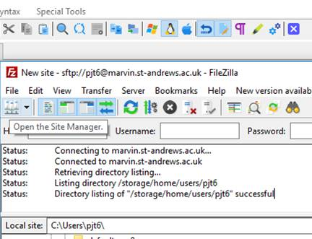
Downloading: transfer files Filezilla https://filezilla-project.org/download.php
Step 1. Open host

Slide 5
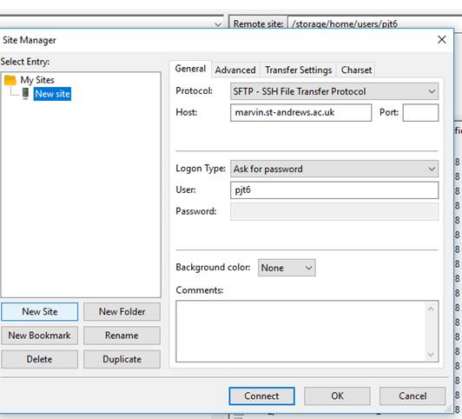
Downloading: transfer files Filezilla
2) When the next dialogue page comes up, click on “new site” (button , not the folder). Change the Protocol to SFTP. This is essential. Fill out the rest, use this host and port: 22.
Once connected, you can drag and drop files from one window to the next.
sfpt
Once connected: You can drag the files from the right hand window (this is Marvin) to the left window – this is your computer. Where ever you want the files to go!!!

Slide 6
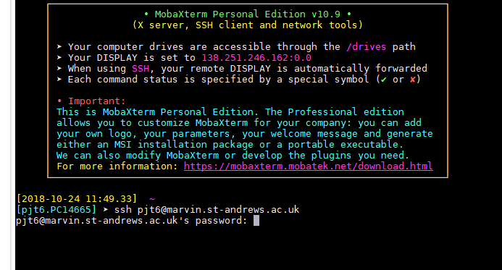
QUICK start - Getting connected:
ACTIVITY
Type: ssh USERNAME@marvin.st-andrews.ac.uk (whatever your username is)
Then enter your password (when prompted). This is the same way for all the programs (Windows/ MAC/ Linux).
This is mobaxterm for windows

Slide 7
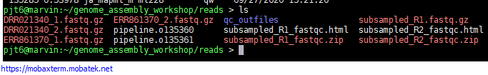
QUICK start: copy paste
Copy: If you highlight (drag over, or double click) something in a terminal – this is now copied to your clipboard.
Paste: this is different for different programs. But Right click, or the middle button on a mouse…

Slide 8
2) Getting connected: getting the files
IF YOU ARE GOING TO RUN THIS ON MARVIN (Marvin single core CPU is slow!)
Paste the following into the terminal to copy all the data to your home directory.
cp -rv /shelf/Computational_Genomics/RNAseq_workshop/ ~/
Make sure you have the software ready to use (note dot space):
. /shelf/apps/pjt6/conda/etc/profile.d/conda.sh
conda activate trinity

