Slide 1
6) RNAseq analysis
You can run this on Kennedy cluster if your laptop does not work:
See next slide: (make it so you can use my software)
git pull https://github.com/peterthorpe5/RNAseq_workshop.git (this will pull the latest version of the course, with the files you need
Type (once you have the software in your PATH):
R (not this is a capital letter, to open up an R terminal. )

Slide 2
Get the software and start R
Paste the following into the terminal to copy all the data to your home directory.
cp -rv /gpfs1/scratch/bioinf/BL4273/RNAseq_lecture_workshop/ ~/scratch/bioinf/${USER}
Make sure you have the software ready to use (note dot space):
This is for the DE exon software
export PATH=/gpfs1/scratch/bioinf/BL4273/conda/envs/DE_X/bin/:$PATH
For the DE gene analysis
export PATH=/gpfs1/scratch/bioinf/BL4273/conda/envs/DE_X/bin/:$PATH
cd into the DE_gene/three_bio_reps folder (tab auto complete!!)
R (not this is a capital letter, to open up an R terminal. )

Slide 3


6) RNAseq and differential expression
RNAseq: is used to measure the “expression” of genes (or exons).
If you plan you experiment, you can compare conditions A versus B (or way more complex if you wish), and obtain and list of candidate genes which may be causative of the observed phenotype.
To use a obvious example: If eyes were dissected out of human heads, sequenced and compared to the sequencing output of the liver. You would expect to find eye specific gene expression in one sample and liver specific expression in the other. (plus some genes that are the same “housekeeping” genes)
vs

Slide 4
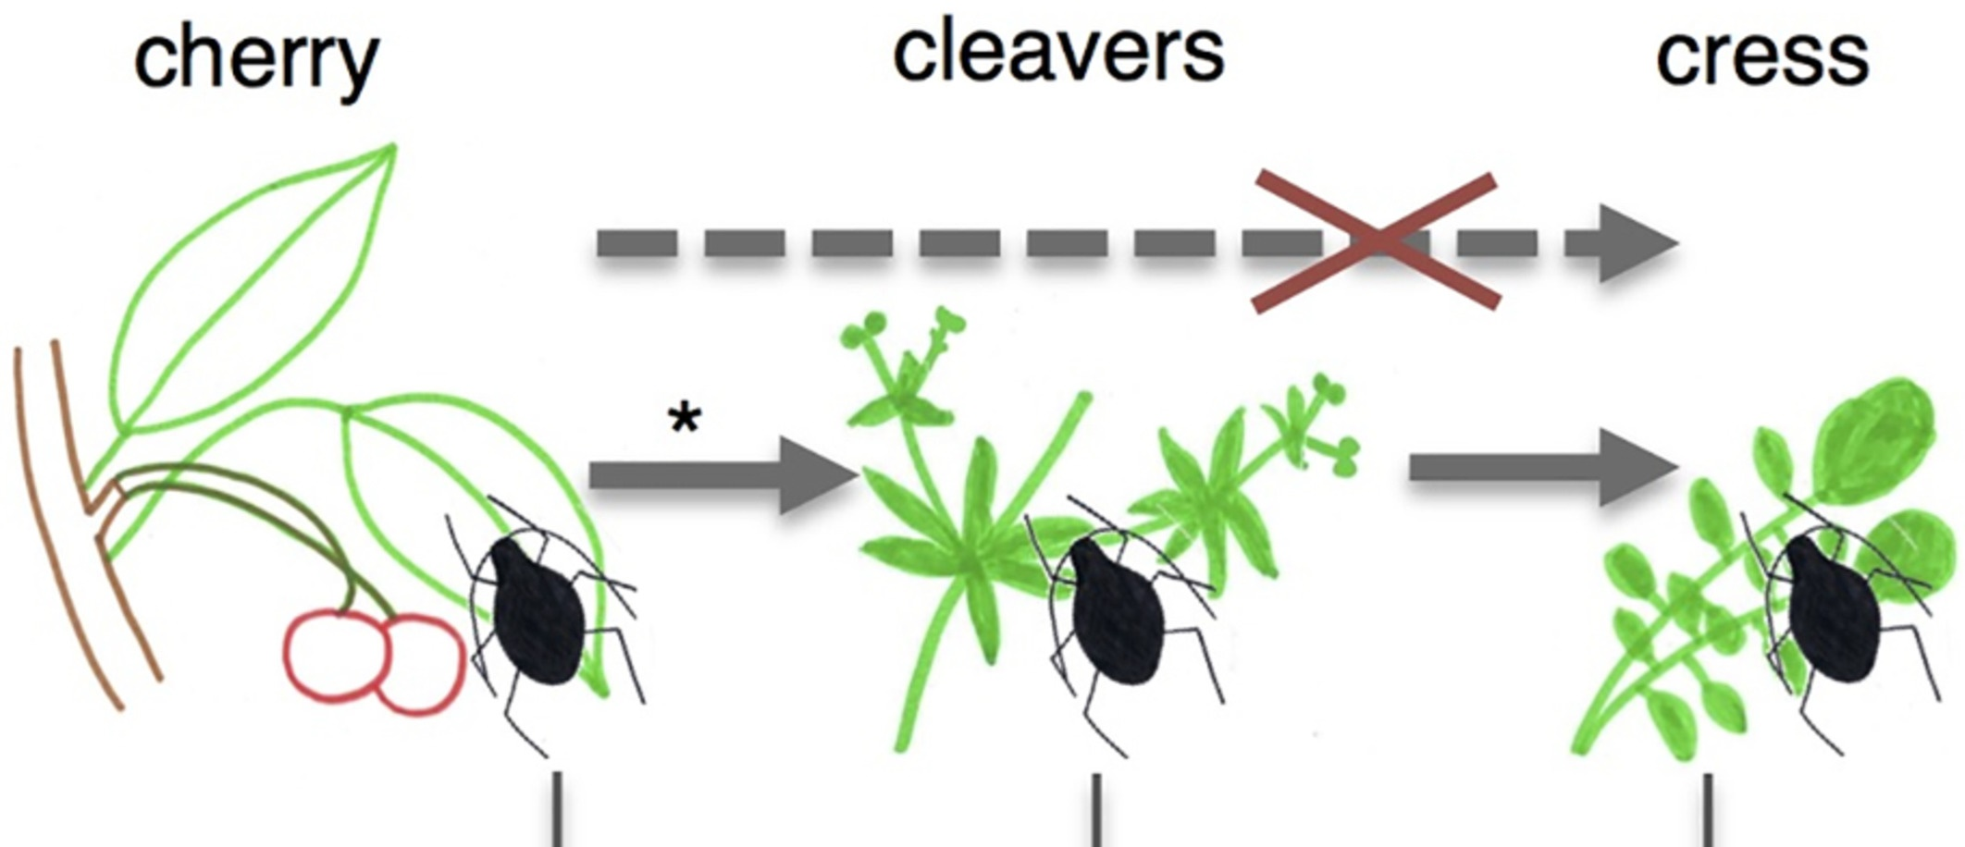
6) RNAseq and differential expression
We have aphid samples (Myzus cerasi) reared of different plant hosts. (plant pathogens/ pests use secreted proteins, termed effectors to manipulate their host to result in a compatible interaction).
The null hypothesis is there is no difference between the samples. However, we would not have sequenced this is we believed that ☺
Lets investigate – does the aphid uses different genes or exons on the different hosts????
gallium

Slide 5
RNAseq simplified work flow: Blue = workshop
Differential gene expression
Alignment free quantification
Get the counts
Quality control
Quality trim
Quality control
Map to genome
Get the counts
Differential gene expression
Differential exon expression

Slide 6
6) Prepare data (already done)
Quality control and read trimming has been already performed (to save time!). Please see this if you would like a reminder: https://github.com/peterthorpe5/genome_assembly_workshop/blob/master/powerpoint/6_assembly.pptx
plus for me, trimming reads and QC is now like watching paint dry!
Quality control
Quality trim
Quality control
Map to genome
Get the counts
Differential gene expression
Differential exon expression

Slide 7
6) Map to the genome(already done)
Mapping to the genome would take over an hour and to “get the counts” also take ~ 2 hours …. So I have done this. How?
Mapping: spice aware aligner called STAR was used. (see shell scripts folder) https://github.com/alexdobin/STAR/blob/master/doc/STARmanual.pdf
Counts: HTseq counts (https://htseq.readthedocs.io/en/release_0.11.1/count.html)
Differential gene expression
Quality control
Quality trim
Quality control
Map to genome
Get the counts
Differential exon expression

Slide 8
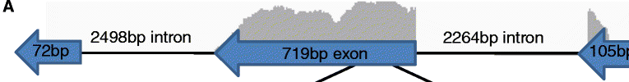
Counts – what are they?
In summary the number of reads that map to the gene. Htseq will quantify reads the only map to that gene and not others
E.g. gene 1 count have 100. Gene 2 100000. Gene 3 zero.
This example below would get a single value for the entire gene (for gene counts!). But can see the mapping is not uniform
RNAseq reads mapped on to gene. They stack up as there are so many

Slide 9
Background info: What is a read: Fastq format (Illumina output)
The input to most of the following steps, are the fastq (or compressed fastq.gz) files.
@ERR861370.21 M00596:40:000000000-A712Y:1:1101:11010:1548/1 (unique read name)
GTCCAGAACTGTCTTCTGTAAATCTTTCTTGTACCTCCTGCAGTAT (sequence)
+ (+)
-B@C<8<@CF9FEFFFGAF9<<EEFGGEFF9E9CCC,CF<,,C,,< (ascii quality score encoding)
Each base is “quality scored” based on a probability score of it being correct.
Q15: p = 0.03
Q30: p = 0.001
Read more: https://en.wikipedia.org/wiki/FASTQ_format

Slide 10
Background info: assembly: output format (fasta)
The main file you will work with is called assembly.fa or some programs will output a XYZ.fasta . This is like so:
>NAME_OF_CONTIG_1
ATTAGGGGGGGCGGA … etc seq
>NAME_OF_CONTIG_2
ATTACCCCCCCCCCCGGA … etc seq
>NAME_OF_CONTIG_3
ATTTTTTTTTTTTTGA … etc seq
Each > is a new contig. There can be many many thousands of these.
A contig is an assembled part of the genome containing zero NNNs (N is an unknown base, which cannot be resolved).
Scaffolds are collections of 2 or more contigs separated by NNNs.

Slide 11
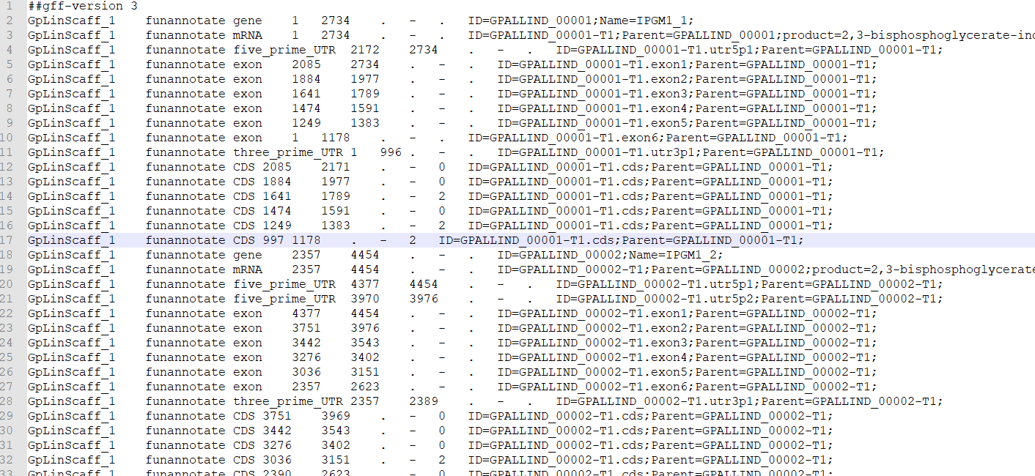
Background info: genome feature file format
This is the file where gene locations are specified
The main file you will work with is called name.gff or some programs will output a XYZ.gff3 .

Slide 12
6) Your work starts from here
We will start with differential exon expression. Try to identify exons that are DE between the conditions.
This will yield a lovely click and browse output! Which is quite intuitive.
I know from the feedback, some did not like to be over reliant on copy and paste. But you cannot be expected to be able to do this … sorry, copy and paste is going to happen.
Differential gene expression
Quality control
Quality trim
Quality control
Map to genome
Get the counts
Differential exon expression

Slide 13
6) DE exon expression
Why is this cool? – well in a DE gene analysis, the counts (number of reads mapping to) across the whole gene is taken as a single value. E.g. gene1 has 200 reads mapping to it.
Therefore, any exons spiced out/ in or transcript, or isoform changes, are missed These may not alter the “value” assigned to the gene (gene1 could still be 200) – and therefore this gene will be ignored (not significantly changed) in any DE gene analysis.
Consider the following:
Condition A 0 100 100 0 0 TOTAL = 200
Condition B 40 40 40 40 40 TOTAL = 200
Condition C 40 40 40 40 40 TOTAL = 200
gallium
Think about the real example before with the uneven mapping …

Slide 14
6) DE exon expression
This example clearly show some exons which are condition specific. (In fact in this example exon 2 has an alternative start codon, thus the genes do not always have to start at exon 1)
Lets look at some real data (Aphids reared on three different plants) - this is cool. There are going to be loads of graphical output to look at
Condition A 0 100 100 0 0 TOTAL = 200
Condition B 40 40 40 40 40 TOTAL = 200
Condition C 40 80 0 40 40 TOTAL = 200
gallium

Slide 15
6) DE exon expression: Aphids reared on three different plants
This a real example: Myzus cerasi has a primary host (cherry) and a limited few others. In this example gallium (also known as cleavers, sticky weed …) and cress.
gallium
RNA extraction -> Illumina lib prep ->
QC/trim/ map to genome -> get exon counts using Htseq
Lets analyse the counts. Then we will compare this to DE gene expression

Slide 16
6) DE work flow .. Sort of …
Overview of the process
# load the R package that does the DE exon analysis
library("DEXSeq")
Load the package
Load counts + gff
Set up a table and the exp design
Load the package
Load counts + gff
Normalisation of the data and gain an estimate of the dispersion
Test for DE
Write out results and plots

Slide 17
6) DE exon expression
From the downloaded data from https://github.com/peterthorpe5/RNAseq_workshop
Go into the “DE_exon” folder
Decompress all the files: Linux terminal: gunzip *.gz
# further reading: https://bioconductor.org/packages/release/bioc/vignettes/DEXSeq/inst/doc/DEXSeq.html
Open R studio
#to install the DEXSEQ package:
if (!requireNamespace("BiocManager", quietly = TRUE))
install.packages("BiocManager")
BiocManager::install("DEXSeq")

Slide 18
6) DE exon expression
Open the DE_exon_R_commands.sh script. Note, this is not a shell script, but for me Notepad++ colours the text in a way that agrees with me
You will have to change the paths in this script to work for you.
STEPS:
Set the working directory
State the “in_directory” ….. Lets follow the script ……
Load the package
Load counts + gff
Set up a table and the exp design
Load the package
Load counts + gff
Normalisation of the data and gain an estimate of the dispersion
Test for DE
Write out results and plots

Slide 19
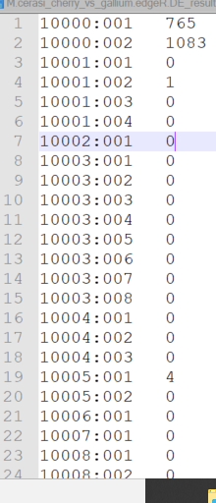
6) DE exon expression
Load the counts files: 1 files pre sample, per rep as so:
Gene:exon_number counts
countFiles = list.files(inDir, pattern=".exon.counts$",
full.names=TRUE)
flattenedFile = list.files(inDir, pattern="gff$", full.names=TRUE)
Load the package
Load counts + gff
Set up a table and the exp design
Load the package
Load counts + gff
Normalisation of the data and gain an estimate of the dispersion
Test for DE
Write out results and plots

Slide 20
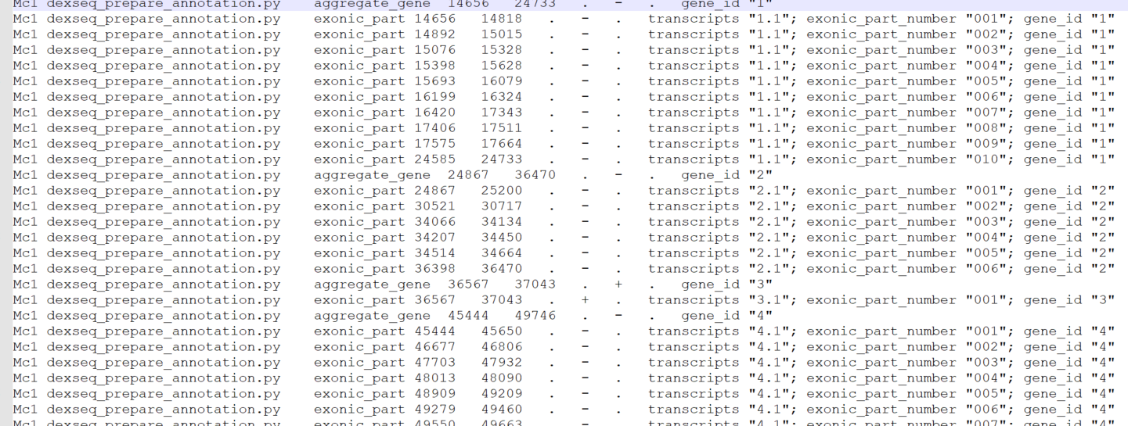
6) DE exon expression
Load the gff: The original gene names are lost, which is very irritating. But that is Bioinformatics for you!! - this was pre-prepared for you.

Slide 21
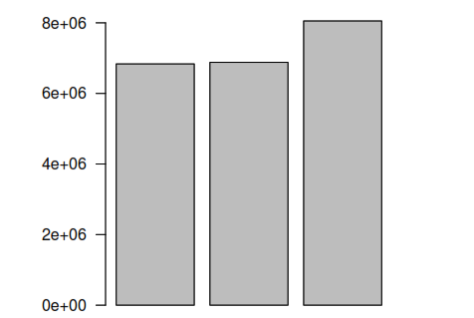
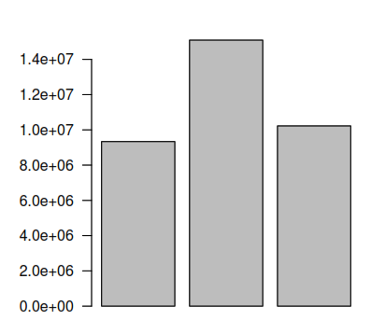
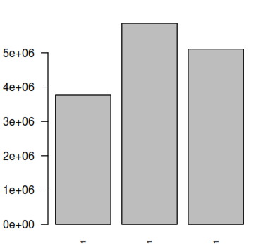
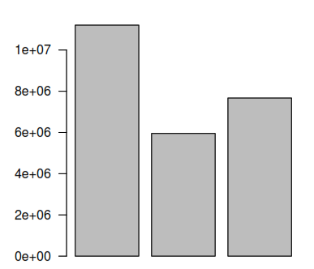
6) DE work flow .. Sort of …
These steps should be obvious from the script now…..
Sum of fragment for replicas: real dataset, you can see the need to normalise between them.
group A (3 reps) groupB (3 reps) groupC (3 reps) groupD (3 reps)
Load the package
Load counts + gff
Set up a table and the exp design
Load the package
Load counts + gff
Normalisation of the data and gain an estimate of the dispersion
Test for DE
Write out results and plots

Slide 22
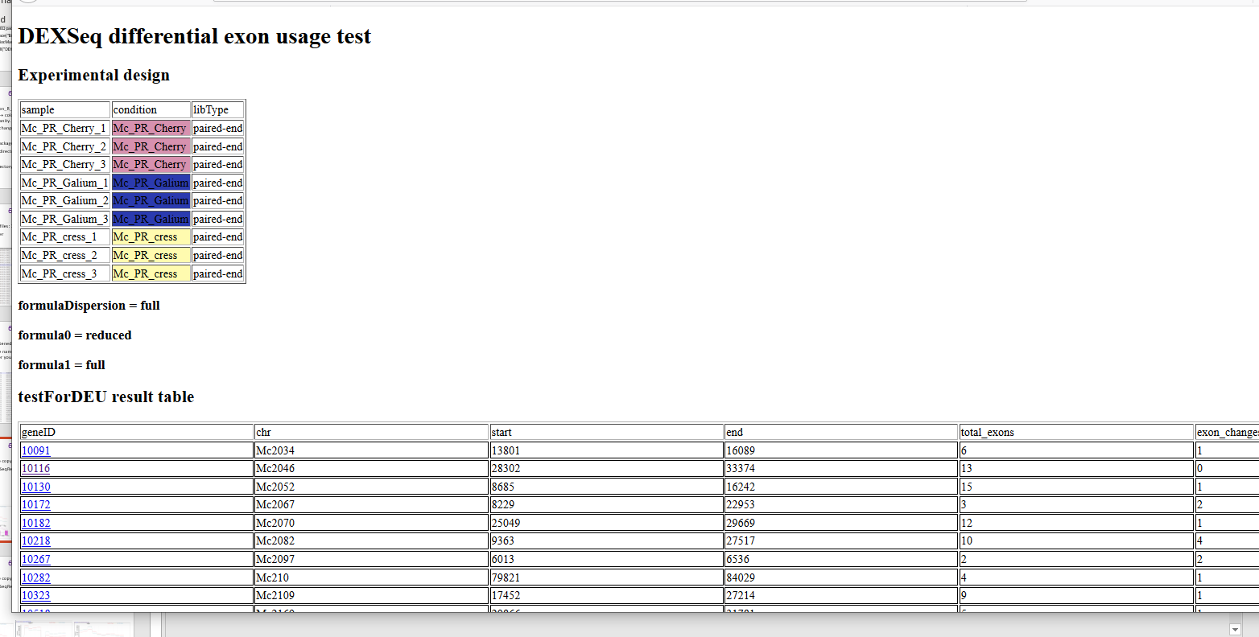
6) DE exon expression
At the end of the “copy and paste” session.
go into the "DEXSeqReport" folder. Open the html with firefox - GO WILD!
The 22 Mb text file has loads on info too….
Colours per host plant
Number of exons changed
Click on one of these that has many exons changed

Slide 23
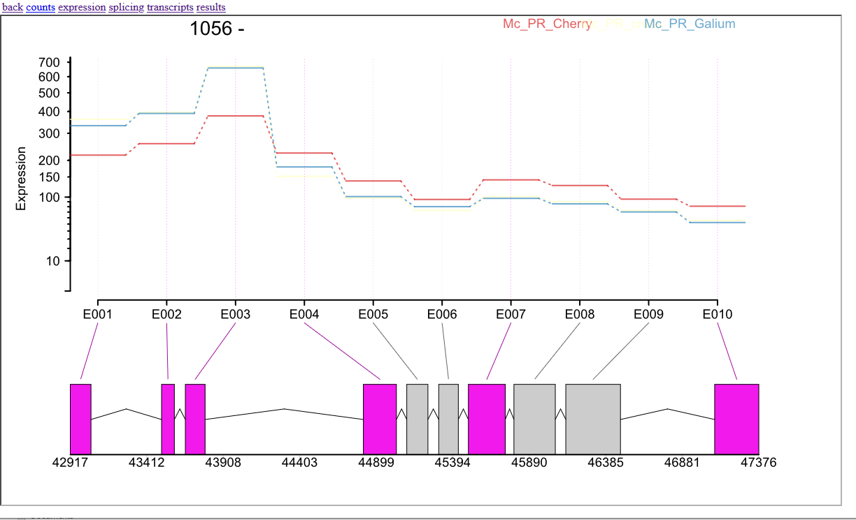
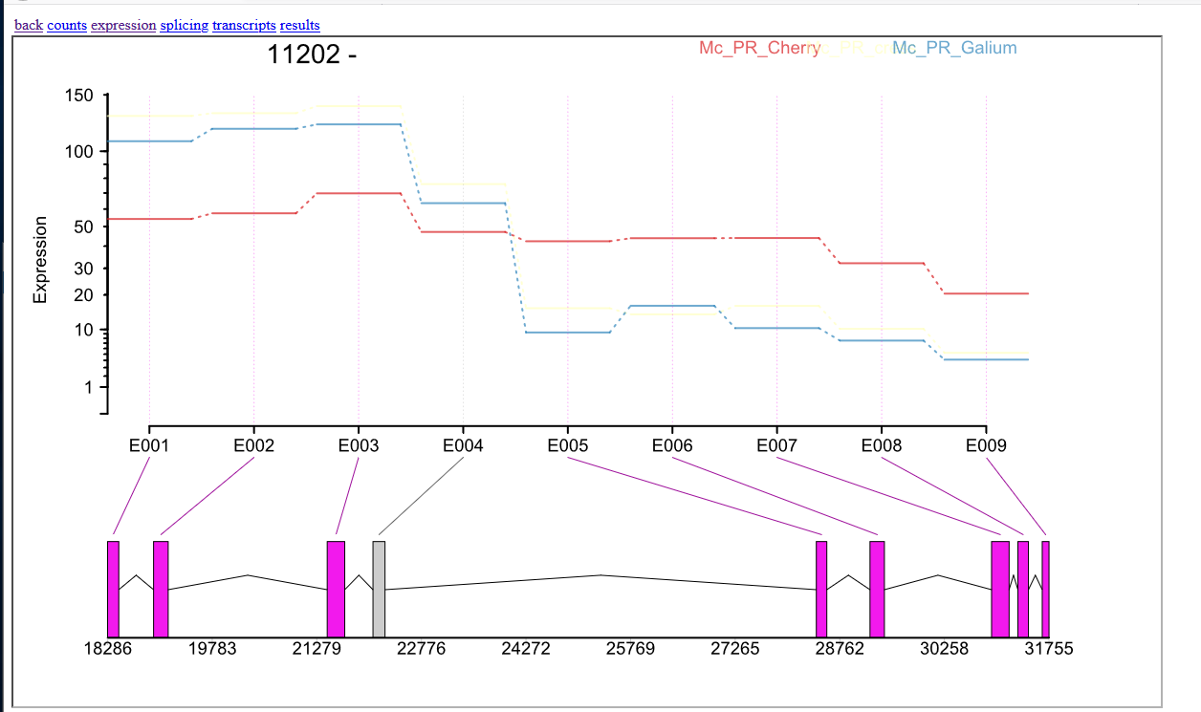
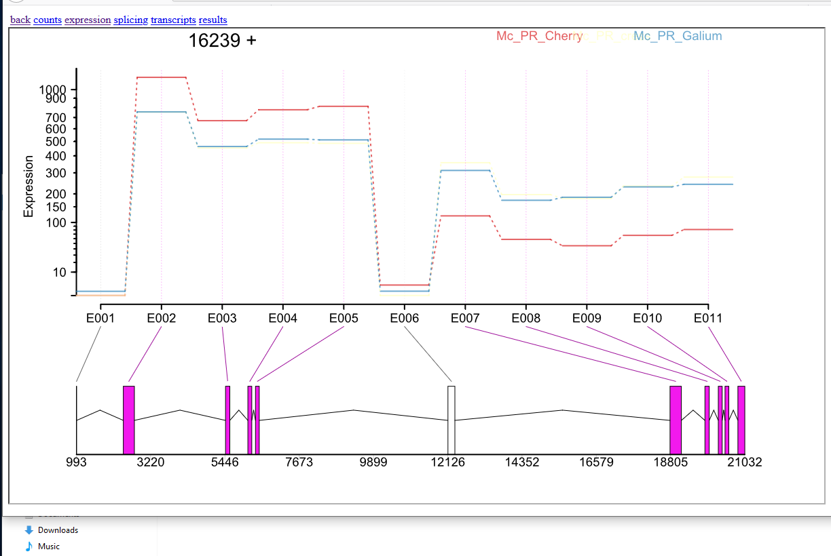
6) DE exon expression
Exons changed in pink.
Exons 1 and 6 hardly used (splicing!). Alternative start?
Isoform switch

Slide 24
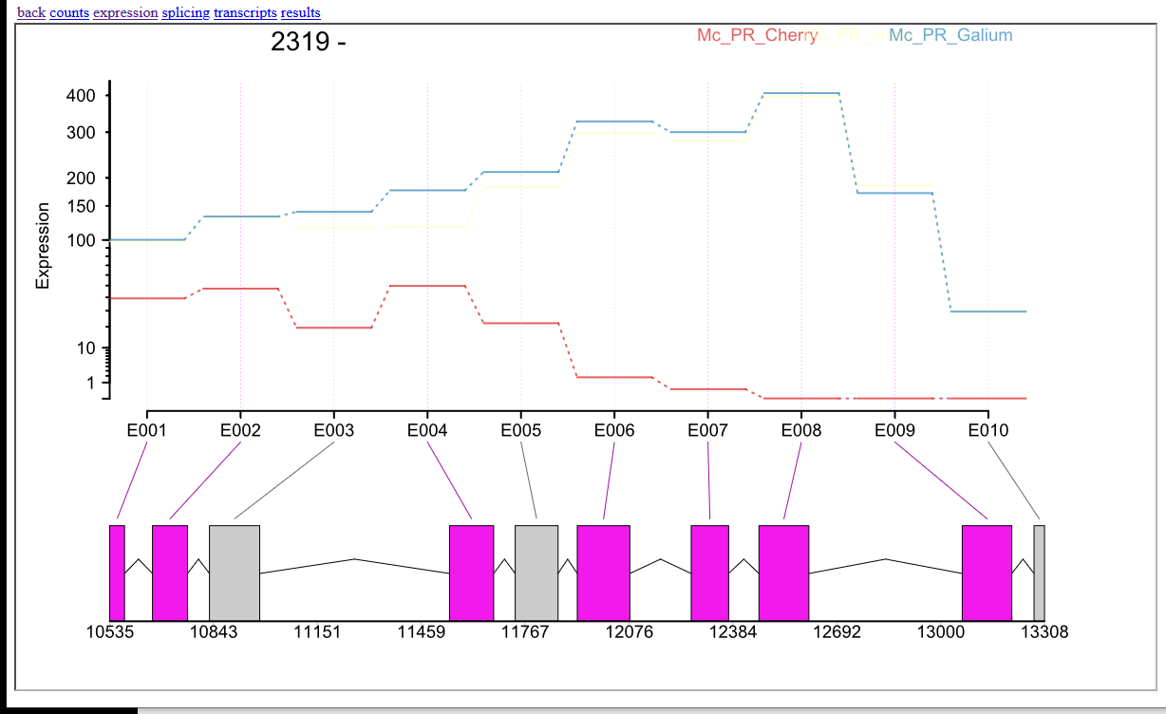
How cool is that!!! ☺
gallium
THIS IS THE END OF DE EXON SECTION

Slide 25
6) DE gene: A vs B (cherry vs gallium as a host)
gallium
We will now do differential gene expression. Try to identify genes that are DE between the conditions.
Differential gene expression
Quality control
Quality trim
Quality control
Map to genome
Get the counts
Differential exon expression

Slide 26
6) DE gene expression
From the downloaded data from https://github.com/peterthorpe5/RNAseq_workshop
PCA and heatmap functions were from Trintiy by Brian Haas
Go into the “DE_gene” folder, then go into “two_bio_reps” folder
Open the file DE_gene_R_commands.sh - again this is not a shell script. I just like the colours
------------------------------------------------------------------------------------------
Do this for the three reps data too:
Go into the “DE_gene” folder, then go into “three_bio_reps” folder
Open the file DE_gene_R_commands.sh - again this is not a shell script. I just like the colours

Slide 27
6) DE gene expression: Multi condition
If we have time … got into the “RNentropy_example” folder.
This will have to be done on Marvin. Unzip the data and run this on Marvin.
The .pfd explains how these result are outputted/ displayed. Sorry no graphics!

