Slide 1
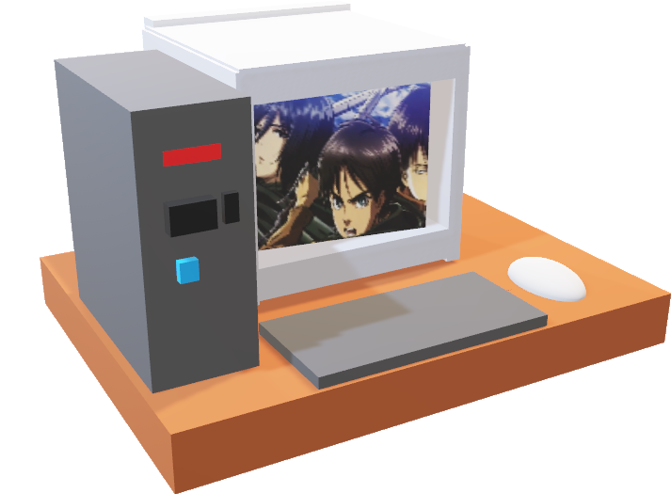
2) Getting connected
Windows:
Putty https://www.putty.org/
WinSCP https://winscp.net/eng/download.php,
Mobaxterm https://mobaxterm.mobatek.net/,
Cyberduck https://cyberduck.io/
command line
Samba does not currently work on Windows (for us)
Mac/ Linux:
Cyberduck https://cyberduck.io/
samba (http://stab.st-andrews.ac.uk/wiki/index.php/Mounting_marvin_remotely)
command line
Other programs recommended to have: Filezilla, Python 3, Editor or choice (Windows: Notepad++, Linux gedit)

Slide 2
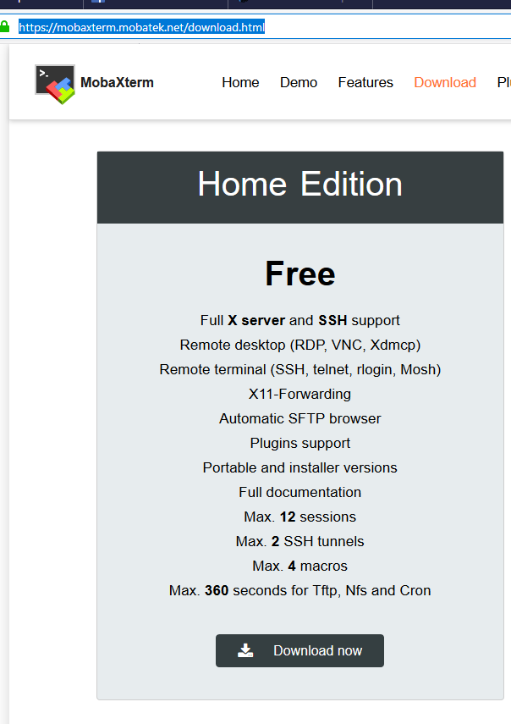
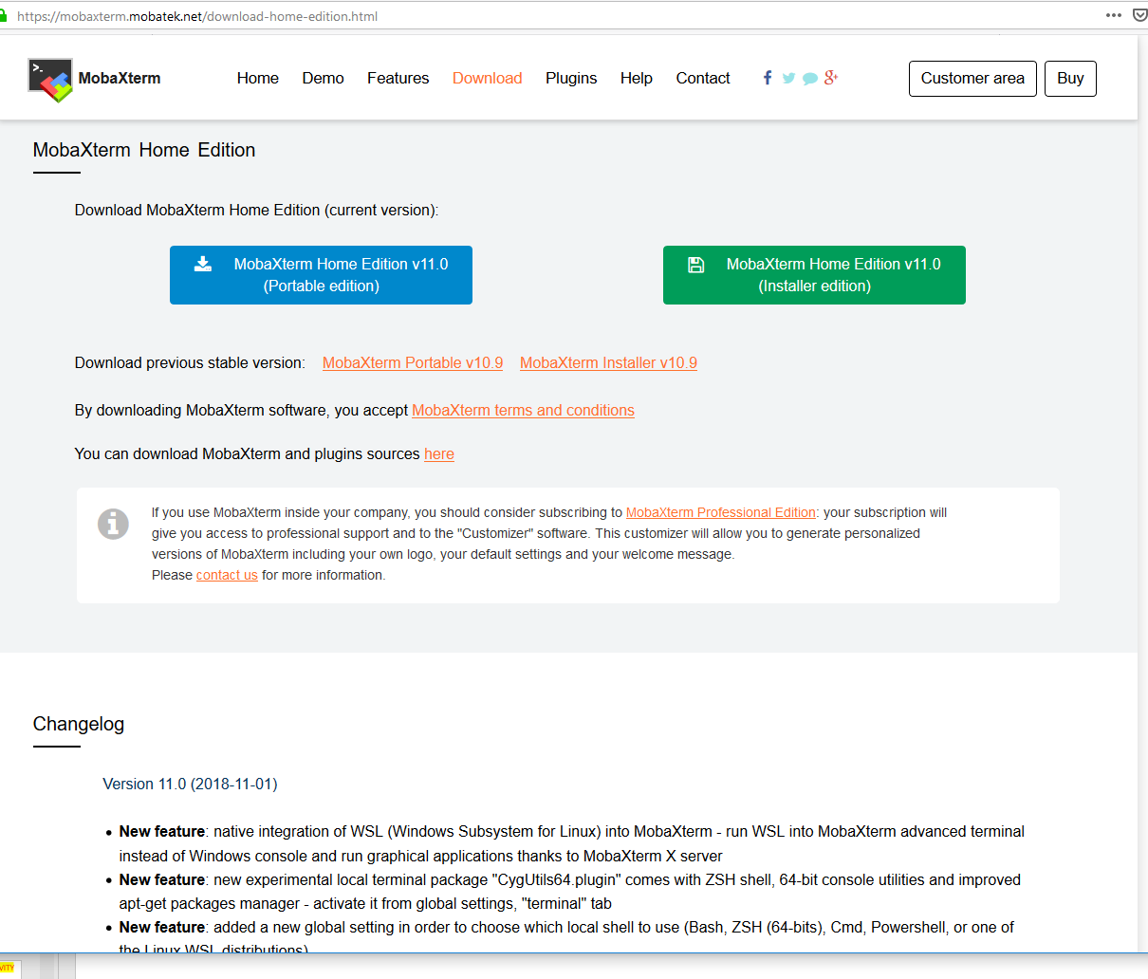
2) Getting connected: Mobaxterm
1
(Without admin access)
3
2

Slide 3
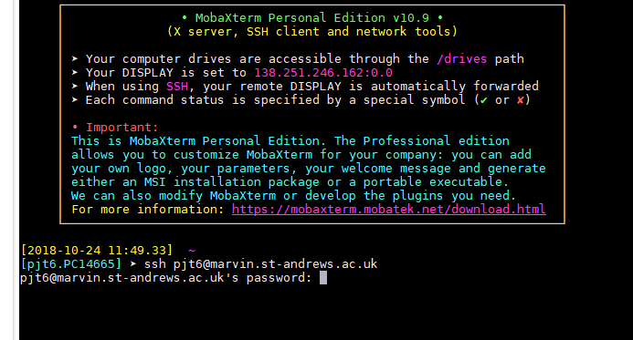
2) Getting connected: Example using Mobaxterm
ACTIVITY
Type: ssh USERNAME@marvin.st-andrews.ac.uk
Then enter your password (when prompted). This is the same way for all the programs.

Slide 4
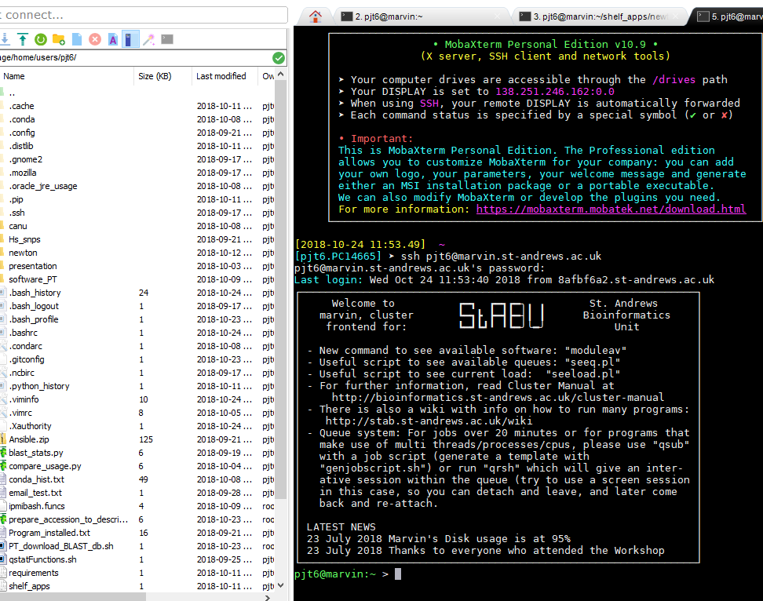
2) Getting connected: You are logged in
You will see your files on the left and a terminal on the right.
You automatically log into your home directory ($HOME, ~)
Although example is Moba, WinSCP is REALLY good!

Slide 5
2) Getting connected: getting the presentation
We are going to download the PowerPoint and pdf files to your current computer desktop.
If you struggle with the next slide – You can just wait until a bit later where there is a “drag and drop” option.

Slide 6
2) Getting connected: Download the powerpoint presentation (* is a wild card for all): From a host terminal, not logged onto Marvin
ACTIVITY
scp username@marvin.st-andrews.ac.uk:/shelf/training/powerpoint/*.pptx /Users/username/Desktop
Download the pdf cheat sheets
scp username @marvin.st-andrews.ac.uk:/shelf/training/powerpoint/*.pdf /Users/username/Desktop
To download the whole folder (-r):
scp -r username @marvin.st-andrews.ac.uk:/shelf/training/ /Users/username/Desktop

Slide 7
2) Getting connected: to disconnect
ACTIVITY
Simply close the program down using the red cross
Type: logout
Or ctrl + d

