Slide 1
5) qsub: This is the official way to submit jobs

Slide 2
5) qsub: lets qsub it so we don’t break the head node.
qsub is basically a queue manager for jobs.
You must qsub your jobs!!!
Full help man qsub
Or https://www.uibk.ac.at/zid/systeme/hpc-systeme/common/tutorials/sge-howto.html
Easiest method is to just:
qsub script.sh (this only asks for a single core!) you need to check how many cores your tools wants to use, or tell it how many to use.

Slide 3

5) qsub: What is qsub doing?
X
Node 1: Full
X
Node 2: NOT enough RAM
Head node: Receives qsub job command from you
X
Node 3: Not enough cores
Node 4: empty
… job runs on here
Node …..
qsub will run jobs depending on the load: Waiting jobs = qw jobs in error state = Eqw dead jobs = d (these error will make sense in a few slides time)

Slide 4
5) qsub: qsub multi cores
ACTIVITY
To ask for multicore job, e.g. 4 cores:
qsub -V -pe multi 4 script.sh
To see the available queues for the cluster type seeq.pl
High memory q
qsub -q highmemory.q -V -pe multi 4 script.sh
Is it running? – type:
qstat

Slide 5
5) qsub: Special commands at the top of shell #$
#!/bin/bash
#$ -V # pass all environment variables to the job
#$ -N Mapping # job name
#$ -cwd # Execute from the current working directory
#$ -q highmemory.q # queue name
#$ -pe multi 4 # how many core (4)

Slide 6
Cluster will email when jobs are done
Emailing you when jobs are started/ error/ finished see below for further info. You have 3 options to make it email you:
Add the commands to your shell script at the top:
#$ -m e
#$ -M youmail@st-andrews.ac.uk
nano .bash_profile ( add these two lines to it so you never have to do it again. A bit dangerous if you have lots of jobs!!)
# alias so I get emails when job are done.
alias qsub='qsub -m e -M youremail@st-andrews.ac.uk'
add it to the command line when you qsub a job
qsub -V -m e -M whatever@st-andrews.ac.uk shellscript.sh
Email can be sent in the following situations:
-m b|e|a|s|n,...
Defines or redefines under which circumstances mail is to be sent to the job owner or to the users defined
with the -M option described below. The option arguments have the following meaning:
‘b’ Mail is sent at the beginning of the job.
‘e’ Mail is sent at the end of the job.
‘a’ Mail is sent when the job is aborted or
rescheduled.
‘s’ Mail is sent when the job is suspended.
‘n’ No mail is sent.
-M user[@host],...

Slide 7
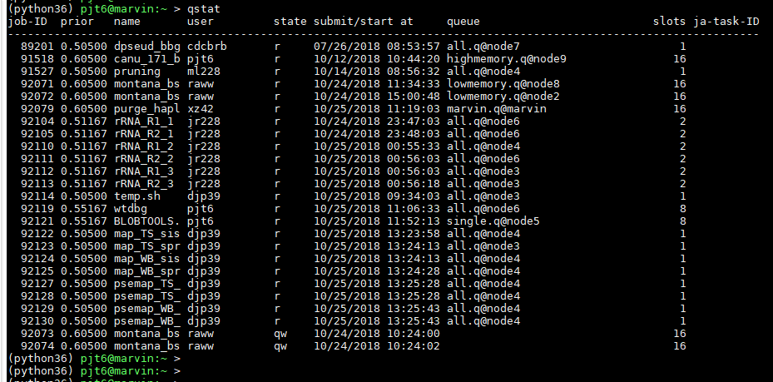
5) qsub: qstat
ACTIVITY
Job ID
Num cores
In queue waiting
waiting: Waiting jobs = qw jobs which are in error state = Eqw dead jobs = d

Slide 8

5) qsub: More qsub/ qstat stuff
To delete a job: qdel job_ID (you can only delete you own)
qstat -f give a full qstat output.
qhost give you the status of the servers to see if there is anything wrong

Slide 9
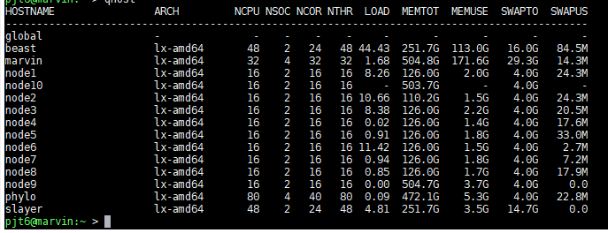
5) qhost
qhost is useful

Slide 10
5) qsub: qsub output files .o and .e files
Each time you run a job you get 2 output file.
.o files have normal output from whatever tool is being used.
.e are errors or warnings. This is useful to track errors and find out why your tool is not working.
TRUST me this will be useful

Slide 11
5) qsub: qrsh - interactive qsub
ACTIVITY
Log in to a node so you can work at the command line.
This is the official way:
qrsh
To get to a specific node:
qrsh -l hostname=“node3”
Multi core qrsh job
qrsh -pe multi 4
logout or Ctrl+d (to log out)
For really long jobs, you should use screen
https://linuxize.com/post/how-to-use-linux-screen/
This is beyond a beginners course.

Slide 12
qsub - requesting memory
-q highmem.q
-l h_vmem=memory
-l hostname=node9 (easiest)
This is per-core memory, so 10 cores of 1Gb is a total of 10Gb. Worth noting that as if you want 500Gb total, and request 500Gb, you're actually requesting 5000Gb (with 10 cores).

