Slide 1
Genome assembly Workshop
AIM: Assemble an unknown bacterial genome
….. Refine to get good results
Identify what you have just assembled.

Slide 2
Software that will help you …
All users: Filezilla https://filezilla-project.org/download.php please install this. You can always remove it later.
Windows: Notepad++ (this is the King of Editors). https://notepad-plus-plus.org/downloads/ (This software understand Linux line ending)
Windows (optional): Mobaxterm Home edition (free) https://mobaxterm.mobatek.net/download.html

Slide 3
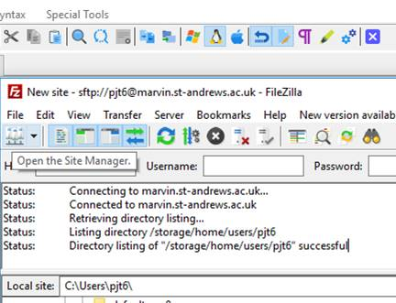
Downloading: transfer files Filezilla https://filezilla-project.org/download.php
Step 1. Open host

Slide 4
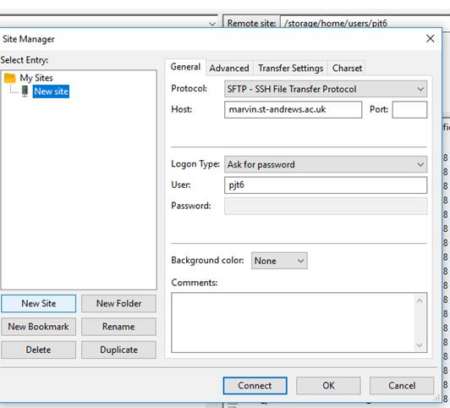
Downloading: transfer files Filezilla
2) When the next dialogue page comes up, click on “new site” (button , not the folder). Change the Protocol to SFTP. This is essential. Fill out the rest, use this host and port: 22.
Once connected, you can drag and drop files from one window to the next.
sfpt

Slide 5
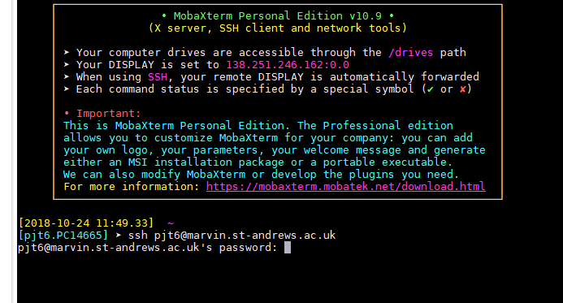
QUICK start - Getting connected:
ACTIVITY
Type: ssh USERNAME@marvin.st-andrews.ac.uk (whatever your username is)
Then enter your password (when prompted). This is the same way for all the programs (Windows/ MAC/ Linux).

Slide 6
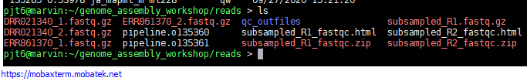
QUICK start: copy paste
Copy: If you highlight (drag over, or double click) something in a terminal – this is now copied to your clipboard.
Paste: this is different for different programs. But Right click, or the middle button on a mouse…

Slide 7
2) Getting connected: getting the files
Paste the following into the terminal to copy all the data to your home directory.
cp -rv /shelf/Computational_Genomics/genome_assembly_workshop/ ~/
Make sure you have the software ready to use (note dot space):
. /shelf/apps/pjt6/conda/etc/profile.d/conda.sh

