Slide 1
7) Conda: This is the future

Slide 2
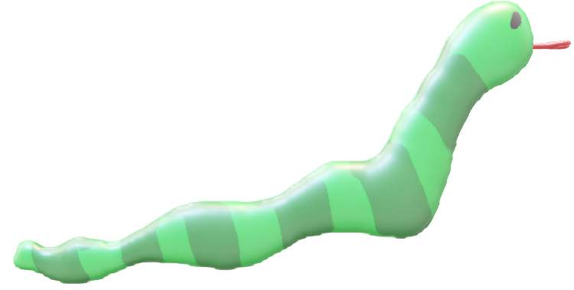
7) Conda: This is the future
ACTIVITY
Conda is a new package manager, it should install all dependencies for you.
Type:
install-bioconda (only do this once, or you will get weird error msgs)
This will install you a version of Conda, therefore you can install what you want…
Log out and back in again, or type:
source ~/.bashrc

Slide 3
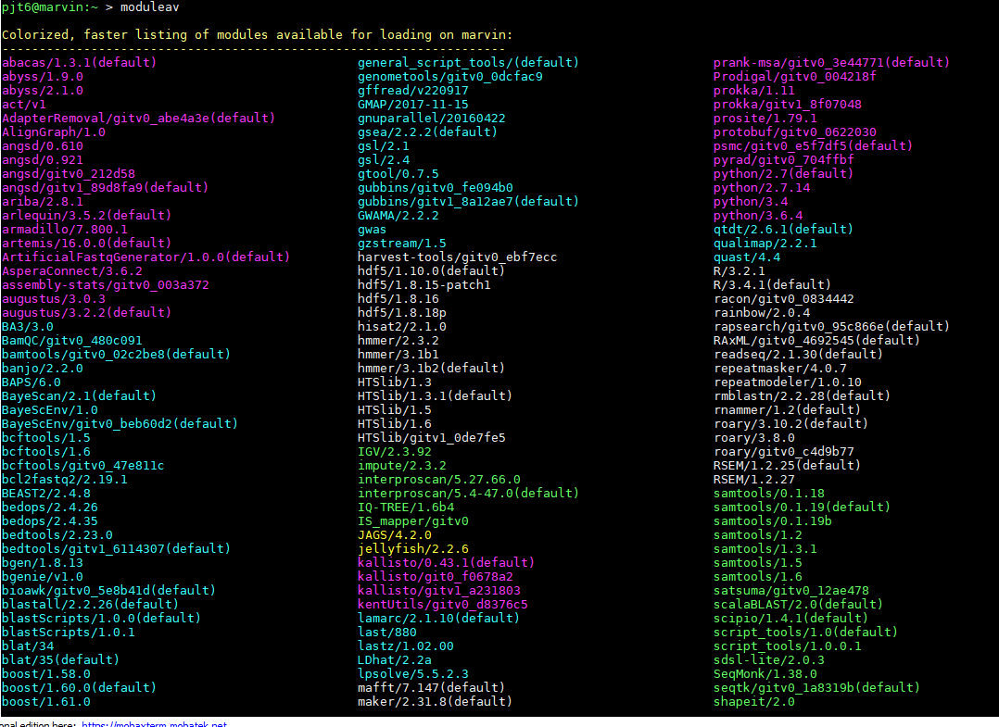
7) Conda: This is the future
You remember the modeulav thing? ~200 software packages, some really hard to install (dependencies or dependencies ….)
When we update Redhat 6 to Redhat7, which needs doing!!! These will break.
It will take ~years to re install. So get used to Conda!! We wont re-install tools that are in Conda.

Slide 4
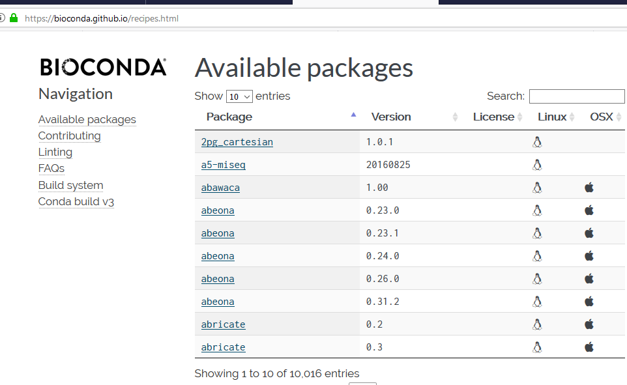
7) Conda: Google search bioconda (available packages)
NOW CALLED: https://bioconda.github.io/conda-recipe_index.html
10,000 packages available!!!!!!! (Sep 2018)

Slide 5
7) Conda: Google search bioconda (available packages)
just google search: conda install TOOL_OF_INTEREST
This will search all channels, not just bioconda. Which is good.
NOW CALLED: https://bioconda.github.io/conda-recipe_index.html

Slide 6
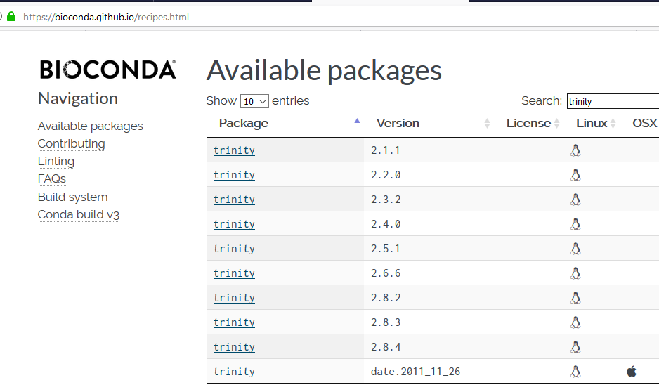
7) Conda: Search “trinity”: RNAseq assembly package
In the search bar, pick a tool you want
Click on this, it will tell you how to install it ….
But …. Wait ....

Slide 7
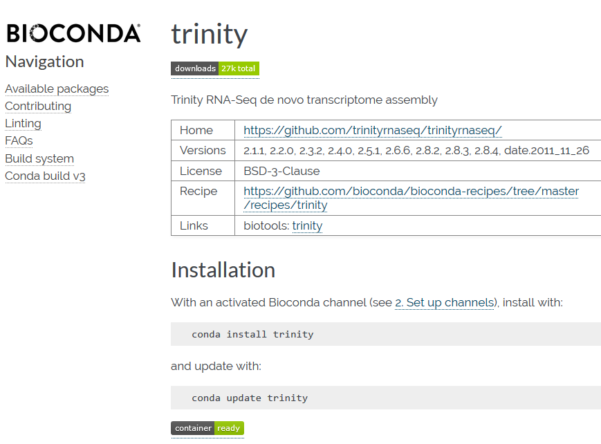
7) Conda: installing software
We recommend using an “environment” as tools already installed may be downgraded or upgraded which will break other things that have been installed.
If you ignore my advise:
conda install trinity

Slide 8
7) Conda: installing in an “env”
ACTIVITY
We strongly advise using environments: https://conda.io/docs/user-guide/tasks/manage-environments.html .
e.g. conda create -n ENV PACKAGE (or even a list of tools )
conda create -n trinityENV trinity (make an env with everything needed)
What is an environment: you can think of it as a self contained “draw” which other things cannot open or interact with.
To install the things you need for this workshop:
conda install -c conda-forge mamba
mamba create -n genome_workshop -c bioconda fastqc trimmomatic velvet spades unicycler prokka

Slide 9
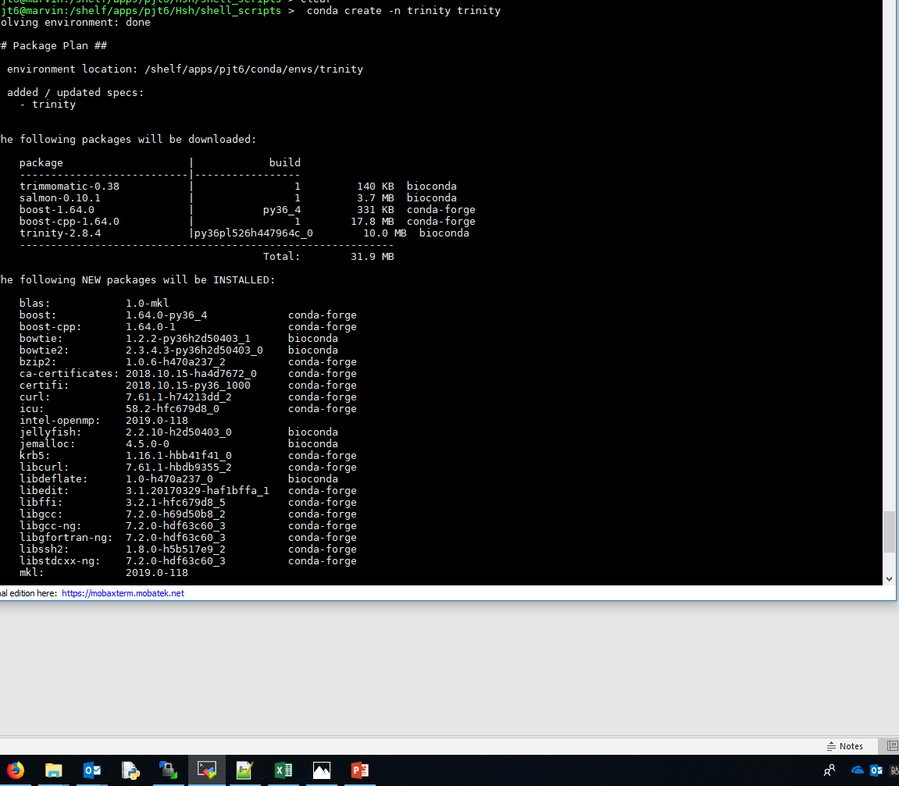
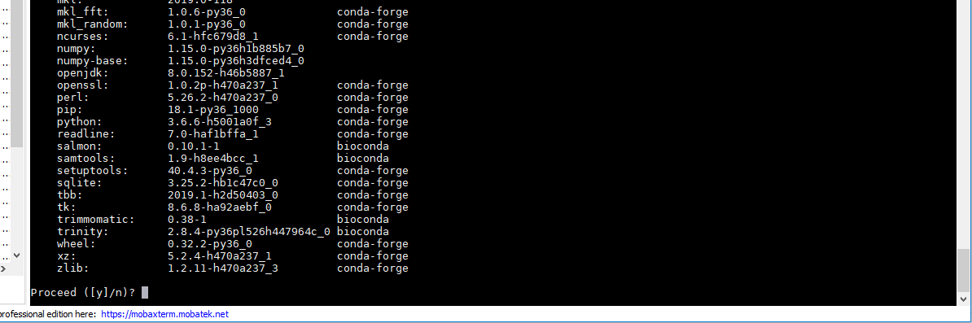
Proceed?
Y or n if you change your mind.

Slide 10
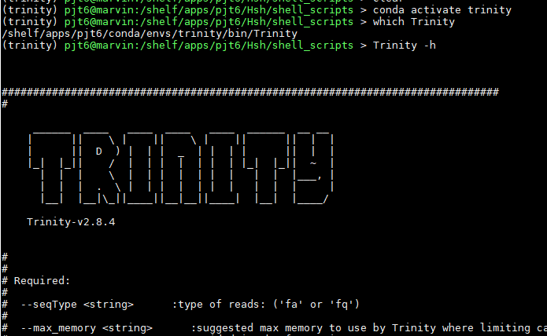
7) Conda: installing in an “env”
conda activate trinity (you have to activate it to use it)
Name of env

Slide 11
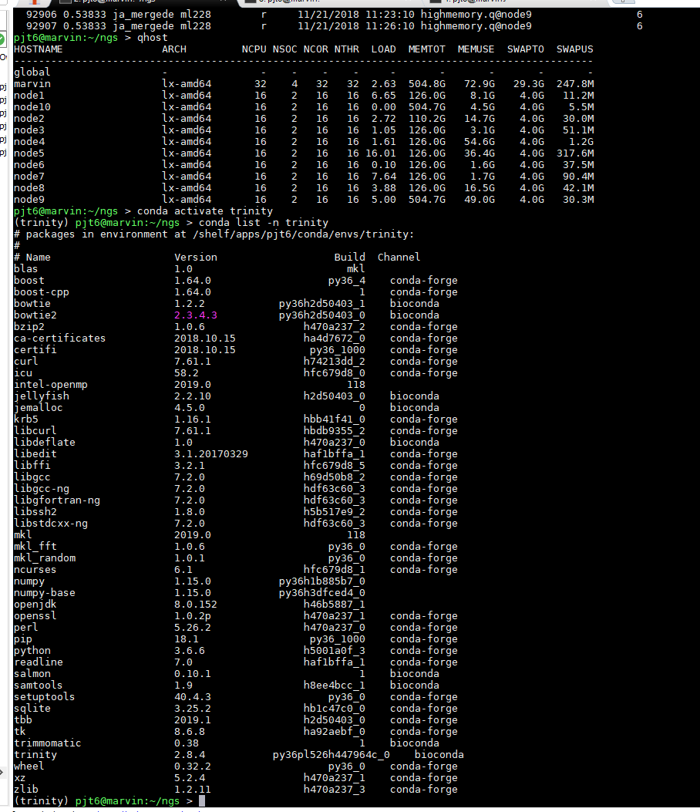
7) Conda: list program install in the “env”
conda list -n envname
Sometimes some of the dependencies installed can be a treasure chest of tools.
e.g. jellyfish

Slide 12
7) Conda: installing in an “env”
ACTIVITY
conda deactivate (deactivate so program versions in here don’t interfere with other tools)

Slide 13
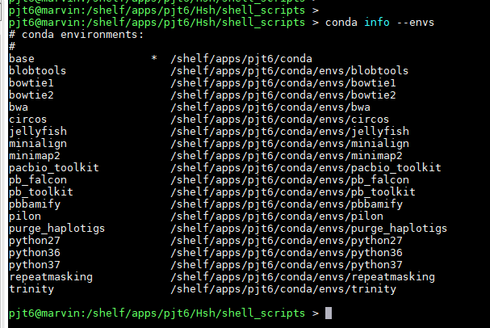
7) Conda: show me all envs I have
ACTIVITY
After a while, you will forget, or forget the names:
conda info --envs

Slide 14
7) Conda: installing multiple tools at once: specific python version
conda create -n python36_bioperl python=3.6 perl-bioperl mummer scipy numpy biopython matplotlib

Slide 15
7) Conda: errors
If you get errors please contact the developers of the package via their gihub pages, or any other contact details they provide. They will be better suited to find errors in their software that us.

Slide 16
7) Conda: known errors
conda and samtools problems
Basically sometimes this get installed from the wrong channel. This may happen with other tools. We haven't come across this yet.
The problem will look like this if you try to use samtools:
samtools: error while loading shared libraries: libcrypto.so.1.0.0: cannot open shared object file: No such file or directory).
install from the bioconda channel: -c bioconda
conda install -c bioconda samtools
or specifically the problem was found with unicycler: remove the old unicycler failed install:
conda remove --name unicyclerENV --all
remake this env from the bioconda channel:
conda create -n unicyclerENV -c bioconda unicycler

Slide 17
7) Conda: Error messages, qsub temp fix
Currently if you run module load tool, then use conda activate env
This comes back with error messages.
To fix this. Log out and back in again.
sbatch, activate the ENV first
Remember qsubbing with a conda package:
conda activate env
then sbatch name.sh

Slide 18
Install a package to work on our genome
Now we know Conda, lets install a tool to predict genes
Back to section 6 - assembly

Slide 19
7) Not part of presentation: Conda: full slide
We strongly advise using environments: https://conda.io/docs/user-guide/tasks/manage-environments.html .
You can do this in many ways. Please see the link for more details
(here you can specify exact version etc ..). The easiest usage would be:
e.g. conda create -n NAME_OF_ENV PACKAGE_TO_INSTALL (pick a package you are interested in from here: installing packages: https://bioconda.github.io/recipes.html ).
Roary is a package name as an example.
conda create -n roary roary
conda activate roary
You are now ready to use this package.
Conda deactivate to leave this environment.
To list all the environments you have created:
conda info –envs

