Slide 1
6) assembly: Bacterial genome assembly

Slide 2
6) assembly: Bacterial genome assembly
As an example we will assembly a bacterial data set.
You will tell me what it is after.
This is not the best approach, but a fast and resource savvy approach for training purposes.

Slide 3
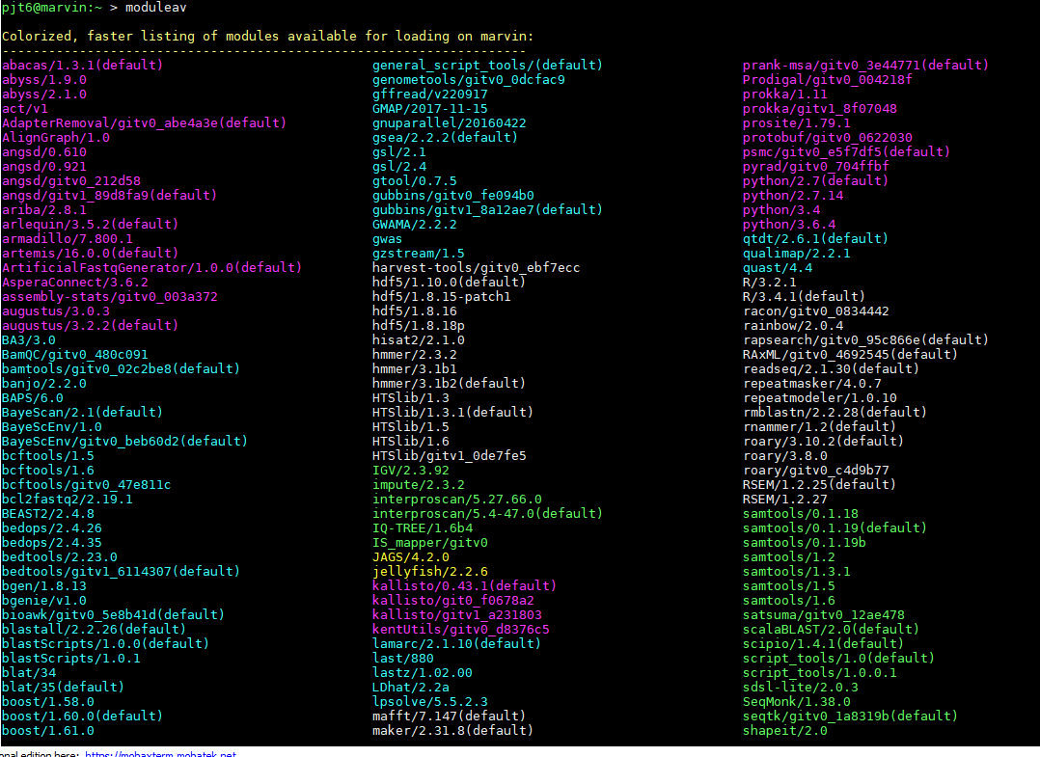
6) assembly: fastqc
ACTIVITY
Fastqc on real Illumina data. Open the FastQC.sh file
moduleav (see a list of pre installed programs/ modules).
To load any of these programs from the list, e.g.
module load name_of_package
module load MUMmer/3.23

Slide 4
4) Shell scripting/ qsub: Run something useful
ACTIVITY
Submit this by typing:
qsub FastQC.sh (Don’t forget tab competition!)
Fastqc output files are in ./reads/
Download these from a Windows terminal and view them in Firefox/ or other:
scp -r $USER@marvin.st-andrews.ac.uk:~/ngs/reads/*.zip /Users/username/Desktop
Or drag and drop from Mobaxterm

Slide 5
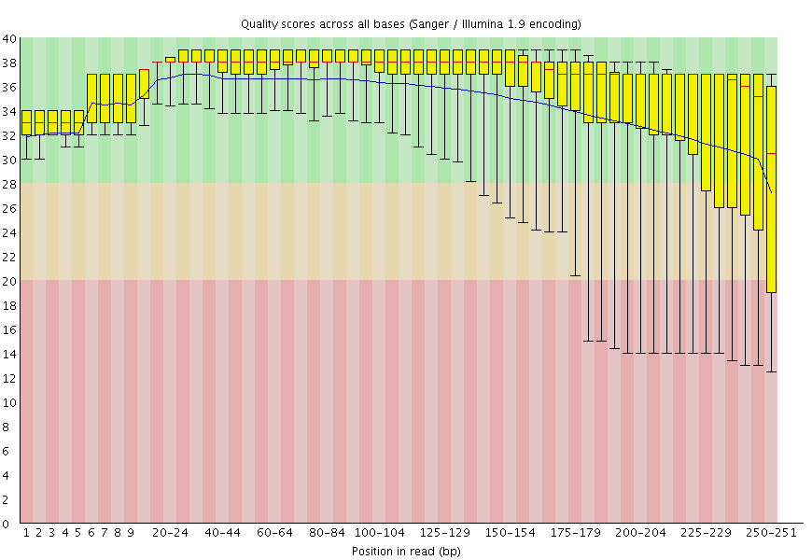
4) Fastqc output
ACTIVITY
https://en.wikipedia.org/wiki/FASTQ_format

Slide 6
6) assembly: QC trim (10 mins)
ACTIVITY
We are going to show you how to download software yourself here:
wget http://www.usadellab.org/cms/uploads/supplementary/Trimmomatic/Trimmomatic-0.38.zip
Unzip Trimmomatic-0.38.zip
This should create a folder called Trimmomatic-0.38. Go into it, look at what files are in there.

Slide 7

6) assembly: Trim reads for quality
ACTIVITY
The avoid assembling errors, or low quality bases - trim the reads before using them, using tools such as:
trimmomatic/0.38: http://www.usadellab.org/cms/?page=trimmomatic
Trim command: qsub -V -pe multi 2 trimmmomatic.sh
java -jar /shelf/training/Trimmomatic-0.38/trimmomatic-0.38.jar PE -summary trim_summary.txt -threads 2 -phred33 ./reads/subsampled_R1.fastq.gz ./reads/subsampled_R2.fastq.gz subsampled_R1_paired.fastq.gz subsampled_R1_unpaired.fastq.gz subsampled_R2_paired.fastq.gz subsampled_R2_unpaired.fastq.gz ILLUMINACLIP:/shelf/training/Trimmomatic-0.38/adapters/TruSeq3-PE.fa:2:30:10 LEADING:3 TRAILING:3 SLIDINGWINDOW:4:15 MINLEN:45
Min Q value
*Note in the shell script line lines are split up with \ character

Slide 8
6) assembly: Fastqc Trim reads
ACTIVITY
First look at the trim summary file.
Run fastqc on the trimmed reads
Input Read Pairs: 500000
Both Surviving Reads: 487861
Both Surviving Read Percent: 97.57
Forward Only Surviving Reads: 10907
Forward Only Surviving Read Percent: 2.18
Reverse Only Surviving Reads: 692
Reverse Only Surviving Read Percent: 0.14
Dropped Reads: 540
Dropped Read Percent: 0.11

Slide 9

6) assembly: Assemble these reads with Velvet
ACTIVITY
This takes a while, so get it going!!!!
qsub -V assembly.sh
Velvet is the only purely De Bruijn graph assembler.
This is quick, so good for training. BUT may not the best for your real data.
Other programs depend on your dataset. 2X100 or 2X150bp SPAdes, SOAP, ABYSS. 2X250bp DISCOVAR. Unicycler for bacteria
Also massively depends on your data, one tool may be good another not so …

Slide 10
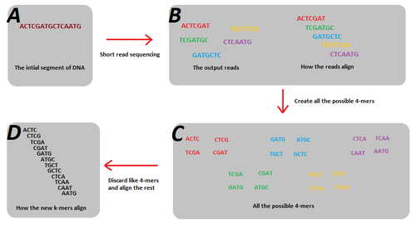
6) assembly: Velvet assembly.
ACTIVITY
What is a kmer (split the sequence into kmer_length chunks):

Slide 11
6) assembly: Velvet assembly.
ACTIVITY
(make sure you module load velvet/gitv0_9adf09f)
https://en.wikipedia.org/wiki/Velvet_assembler
Edit this: assembly.sh
velveth -h
velveth directory kmer_length -shortPaired -fastq R1.fastq.gz R2.fastq.gz
velvetg directory
Do this with :
1) the raw reads
2) the quality trimmed reads … does this impact the assembly?
Alter the shell script and qsub it. Everyone pick a different kmer size (have to be an odd number, and less than read length of 250, velvet max 197)

Slide 12

6) assembly: Kmer length: kmergenie to pick
Kmer length too low: not enough unique kmers, fragmented incomplete assembly. Too many connections.
Kmer length too high: Not enough coverage. Kmers too many unique, not enough connections.
Tool to help pick the best kmer:
http://kmergenie.bx.psu.edu/

Slide 13
6) assembly: Velvet assembly, N50?
ACTIVITY
Lets get some N50 scores:
perl ./scripts/scaffold_stats.pl -f contigs.fasta
Save the results to a file (anything printed to screen.. > ):
perl ./scripts/scaffold_stats.pl -f contigs.fasta > contig_K_len.stats.txt
The N50 is defined as the sum of the lengths of all contigs of size N50 or longer contain at least 50 percent of the total genome sequence.
Scaffold stats script: https://github.com/blaxterlab/scripts/tree/master/tools

Slide 14
Pause the assembly training for something cool
Ok, so we need to take a break here to introduce to you a package manager tool
Conda
Open the conda PowerPoint (7_Conda.pptx) ( we wont do this, but feel free to read!!)

Slide 15
6) assembly: Predict the genes from our assembly.
ACTIVITY
Lets install Prokka to predict the bacterial genes:
Create an env with prokka installed
conda create -n prokkaENV prokka
conda activate prokkaENV

Slide 16
6) assembly: Predict the genes from our assembly.
ACTIVITY
Have a look at the shell to run prokka (https://github.com/tseemann/prokka):
nano predict_genes.sh
The command in the shell is : prokka --cpu 2 contigs.fasta
After you have activated the env, qsub with the -V option to submit with prokka
conda activate prokkaENV
qsub -V -pe multi 2 predict_genes.sh

Slide 17
Prokka output
PROKKA_11122018.err PROKKA_11122018.ffn PROKKA_11122018.fsa PROKKA_11122018.gff PROKKA_11122018.sqn PROKKA_11122018.tsv
PROKKA_11122018.faa PROKKA_11122018.fna PROKKA_11122018.gbk PROKKA_11122018.log PROKKA_11122018.tbl PROKKA_11122018.txt

Slide 18
6) assembly: BLAST a seq against GenBank nt
ACTIVITY
Blast is not fast.
Blastn - nucleotide versus nt
https://blast.ncbi.nlm.nih.gov/Blast.cgi
Look at this website for different BLAST tools. And output formats
blastn -help
If you search against a Protein database: diamond-blast is the king. ~30,000 X faster than BLASTp You can install this through conda. (https://github.com/bbuchfink/diamond)

Slide 19
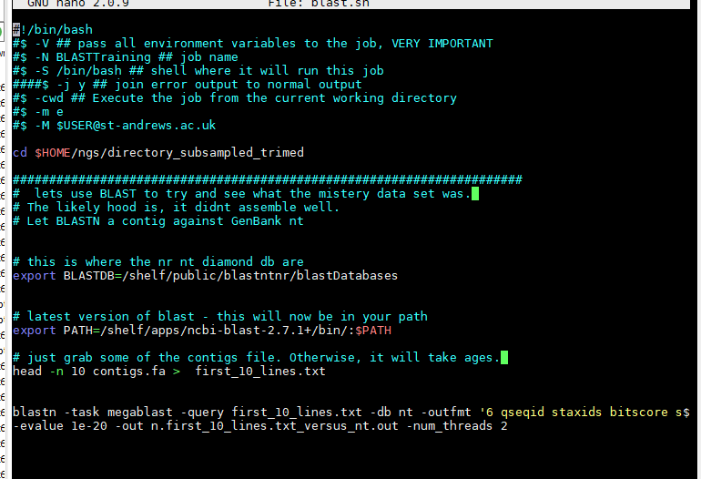
6) assembly: BLAST a seq against GenBank nt
ACTIVITY
Blast is not fast.
Blastn - nucleotide versus nt
https://blast.ncbi.nlm.nih.gov/Blast.cgi
nano ./shell_scripts/blast.sh
Blast database location
GeneBank: nr, nt, swissprot, human and these as Diamond databases

Slide 20
6) assembly: BLAST a seq against GenBank nt
ACTIVITY
Blast is not fast.
Blastn - nucleotide versus nt
https://blast.ncbi.nlm.nih.gov/Blast.cgi
Blast database location
Blast software
Get a snippet from the assembly
Blastn command

Slide 21
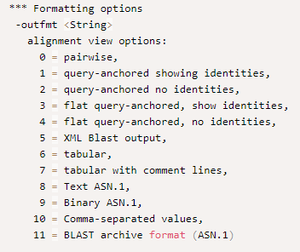
6) assembly: BLAST a seq against GenBank nt
ACTIVITY
Change the output format:
blastn -query seq.fa -db nt -outfmt 1 -evalue 1e-40 -out file.out -num_threads 4
Outfmt 6 is the most useful: http://www.metagenomics.wiki/tools/blast/blastn-output-format-6

Slide 22
6) assembly: BLAST a seq against GenBank nt
ACTIVITY
Change the output format:
blastn -task megablast -query first_10_lines.txt -db nt -outfmt '6 qseqid staxids bitscore std scomnames sscinames sblastnames sskingdoms stitle' -evalue 1e-20 -out n.first_10_lines.txt_versus_ntOutfmt6.out -num_threads 4
Outfmt 6 is the
most useful: http://www.metagenomics.wiki/tools/blast/blastn-output-format-6

