Slide 1
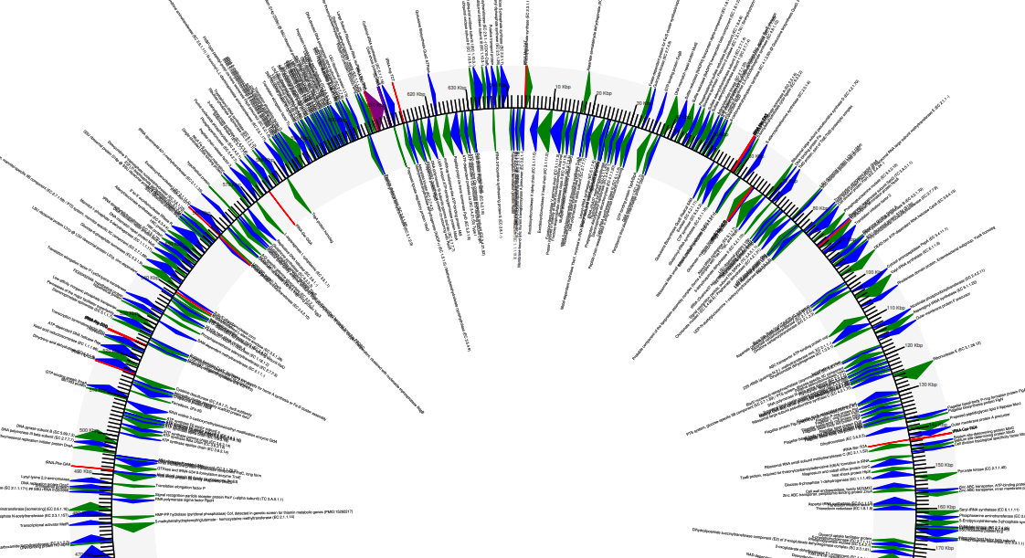
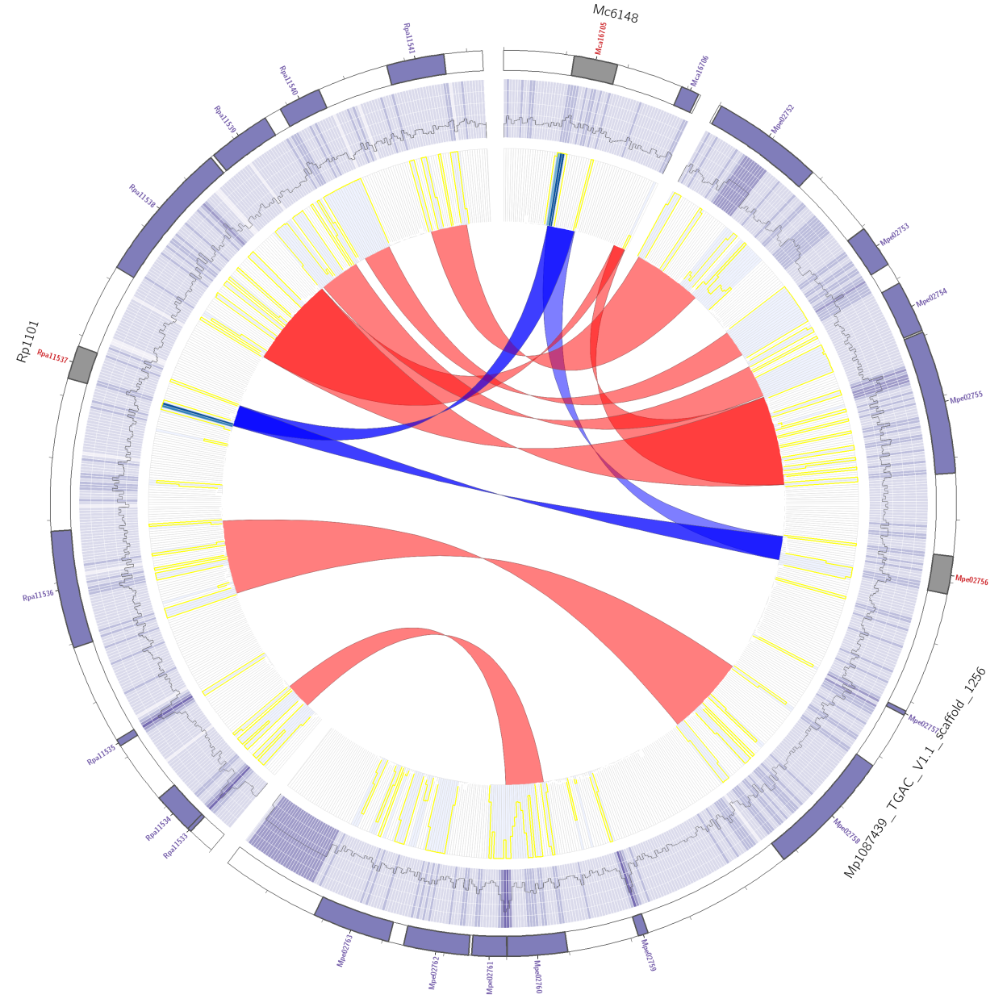
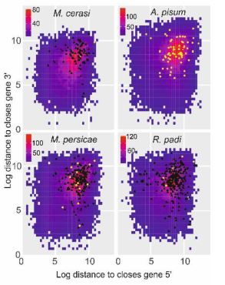
Kmers and graphs
Unknown Illumina bacterial assembly.

Slide 2
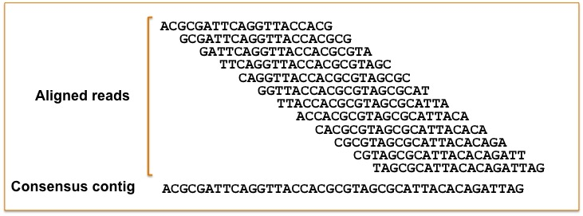
Why not just do overlap assembly
Old methods was just to simply overlap the data, where it matches you can just keep extending ….
Well, that worked with Sanger sequencing. For Illumina, it is estimated this would take a good cluster 100 years!!
Illustration of overlap consensus assembly
https://contig.wordpress.com/2010/02/09/how-newbler-works/

Slide 3
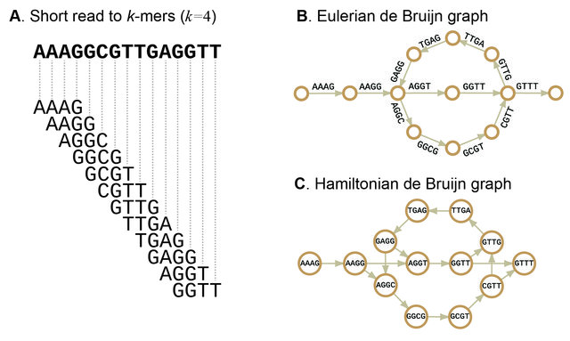
Why not just do overlap assembly
Solution kmers and de bruijn graph
Sohn, J.I. and Nam, J.W., 2018. The present and future of de novo whole-genome assembly. Briefings in bioinformatics, 19(1), pp.23-40.

