Slide 1
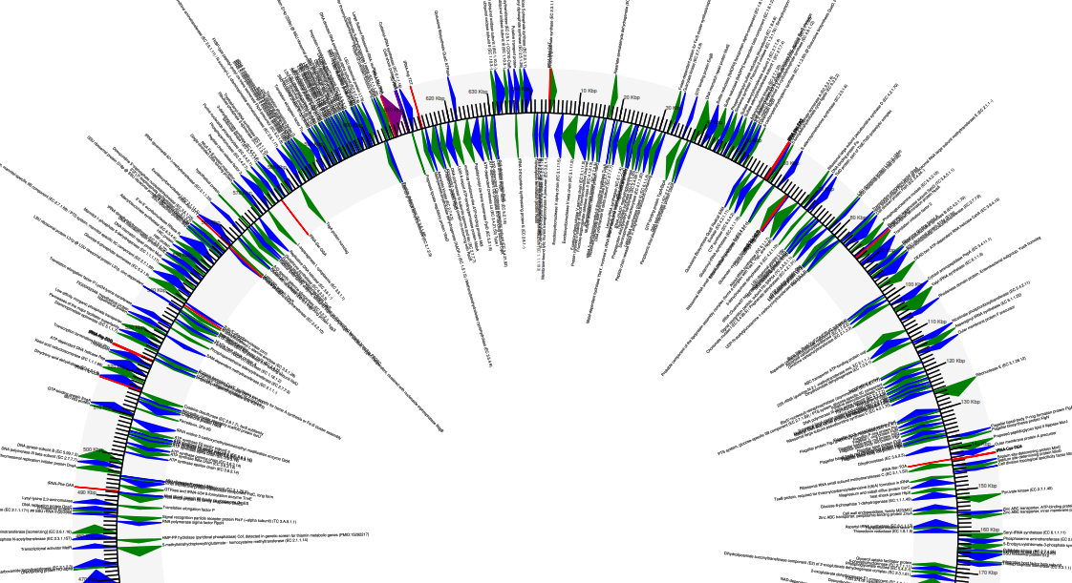
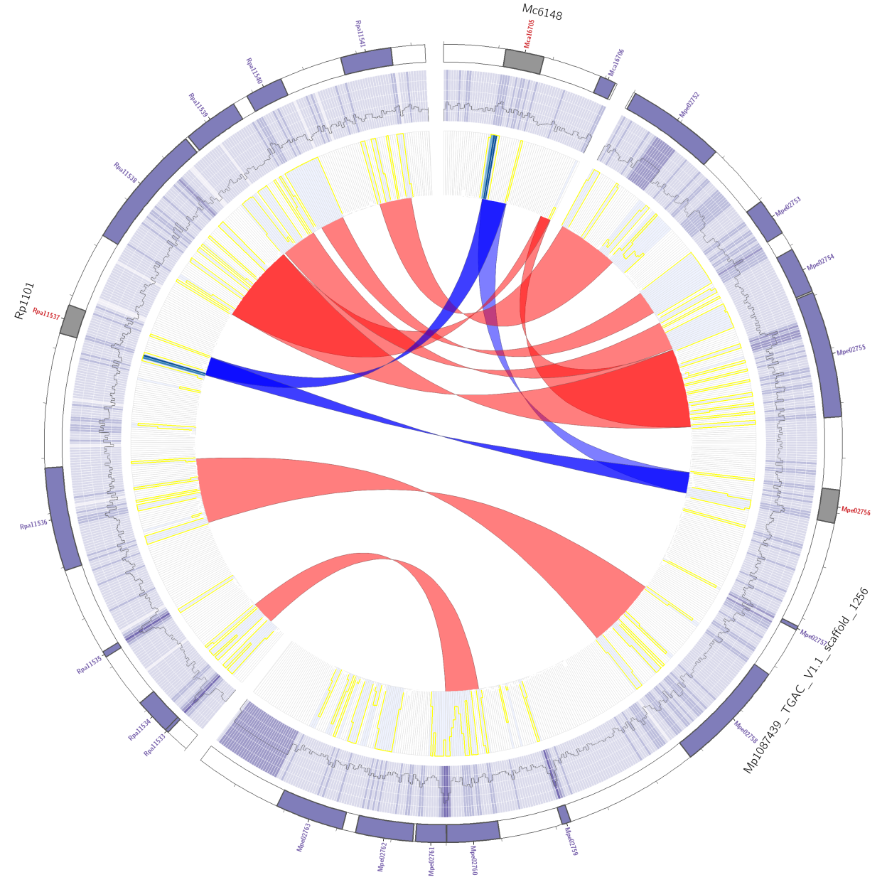
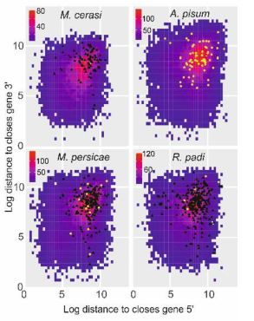
Data analysis on the cluster
NGS and third generation sequence analysis

Slide 2

1) Cluster overview: Getting help
There is going to be too much in here for you to remember. So you can:
Look back at this presentation
Website: http://stab.st-andrews.ac.uk/wiki/index.php/Main_Page
Google is amazing! - I have to look up stuff ALL the time

Slide 3
2) Getting connected
Open this power point (you wont be able to yet!). Learn how to connect to Marvin (2_Getting_connected.pptx)

Slide 4
3) Basic UNIX: open the PowerPoint
Short practical, basic UNIX commands (3_basic_UNIX.pptx)

Slide 5
4) Shell scripting: open the PowerPoint
Here we learn how to “talk to the computer” (4_Shell_scripting.pptx)

Slide 6
5) qsub: submitting jobs to the server.
Now we have learnt how to write shell scripts, we can now submit jobs to the cluster via qsub
Open 5_qsub.pptx

Slide 7
Moving on to an actual example
I know there was a lot of background … but…
Now we know how to write shell script.
Lets do a bacterial genomes assembly as an example
We have already looked at fastqc to qc our read files.
Open 6_assembly.pptx

Slide 8
6) Pull it all together: A full pipeline?
ACTIVITY
Activity:
write a single shell script that does all the following tasks and emails you when it is done:
Downloads some reads
trims the raw reads at a strict Q30 and keeps only read with a min len of 147bp
Assemble these Q30 reads with a long kmer. You choose.
Produce assembly stats using the perl script,
Blast a bit of it to find out what it was

Slide 9
8) Downloading: scp - transfer files
scp <filename> <username>@marvin.st-andrews.ac.uk:~
To copy an entire directory, you need to add the -r to the scp command above-
Copy something FROM marvin TO your machine. For this, the reverse
enter marvin and type:
scp -rp <directoryname> <username_on_your_computer>@<IP_number_of_your_computer>:/</desired/path_on_your_computer>

Slide 10
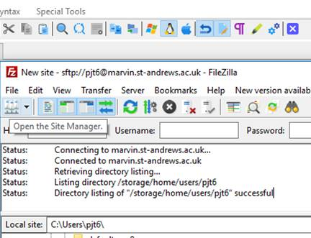
8) Downloading: transfer files Filezilla https://filezilla-project.org/download.php
Step 1. Open host

Slide 11
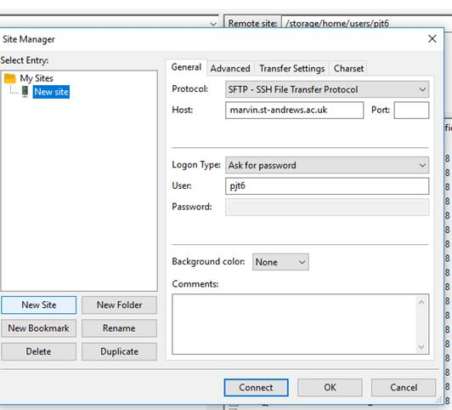
8) Downloading: transfer files Filezilla
2) When the next dialogue page comes up, click on “new site” (button , not the folder). Change the Protocol to SFTP. This is essential. Fill out the rest, use this host and port: 22.
Once connected, you can drag and drop files from one window to the next.
sfpt

Slide 12
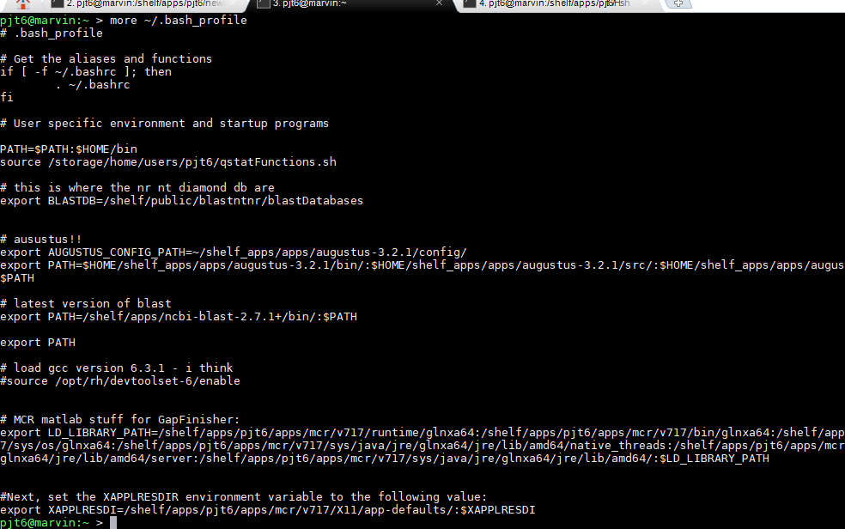
9) Advanced: .bash_profile
ACTIVITY
This is beyond a beginners course, but just to make you aware of it…
Type: more ~/.bash_profile
This is where you can tell the server to
“look for programs”, set environmental
variables, and other magic!!
I put the latest BLAST in, with db:
export PATH=/shelf/apps/ncbi-blast-2.7.1+/bin/:$PATH
# this is where the nr, nt, diamond db are
export BLASTDB=/shelf/public/blastntnr/blastDatabases

Slide 13

9) Advanced: Installing software:
Please try yourself. This is good for you.
Try conda first (see earlier slides).
If not on conda: read their README
and follow their instructions.. But …
If you need a newer GCC:
Type:
source /opt/rh/devtoolset-6/enable
gcc -v
gcc version 6.3.1 (GCC)

Slide 14
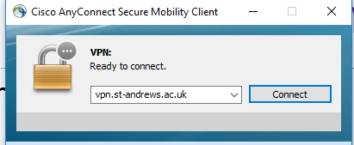
Connecting off site
Use the University VPN connection.
It will ask you for your user name and password. Then you can work as if you are on site.
Students may need to request access from central IT

Slide 15

The end
Remember all bioinformatics is, it repeatedly pressing the red button and everything just happens

Slide 16
Appendix: E. coli reads - how I prepared the data
wget ftp://ftp.sra.ebi.ac.uk/vol1/fastq/DRR021/DRR021340/DRR021340_1.fastq.gz
wget ftp://ftp.sra.ebi.ac.uk/vol1/fastq/DRR021/DRR021340/DRR021340_2.fastq.gz
pigz -d *.gzconda activate python27 python Filter_fastq_for_every_nth_sequence.py -i DRR021340_1.fastq -n 50 -o subsampled_R1.fastqpython Filter_fastq_for_every_nth_sequence.py -i DRR021340_2.fastq -n 50 -o subsampled_R2.fastq
python ../scripts/Filter_fastq_for_every_nth_sequence.py -i illumina_R1.fq -n 5 -o subsampled_R1.fastqpython ../scripts/Filter_fastq_for_every_nth_sequence.py -i illumina_R2.fq -n 5 -o subsampled_R2.fastq
pigz *

Slide 17
Vim - command line editor
Command line editing is horrible. Sorry!
Type
vim name_of_file
Press the i key to insert. Now you can delete, type or whatever.
To save: ESC (Key), : then wq

