Slide 1
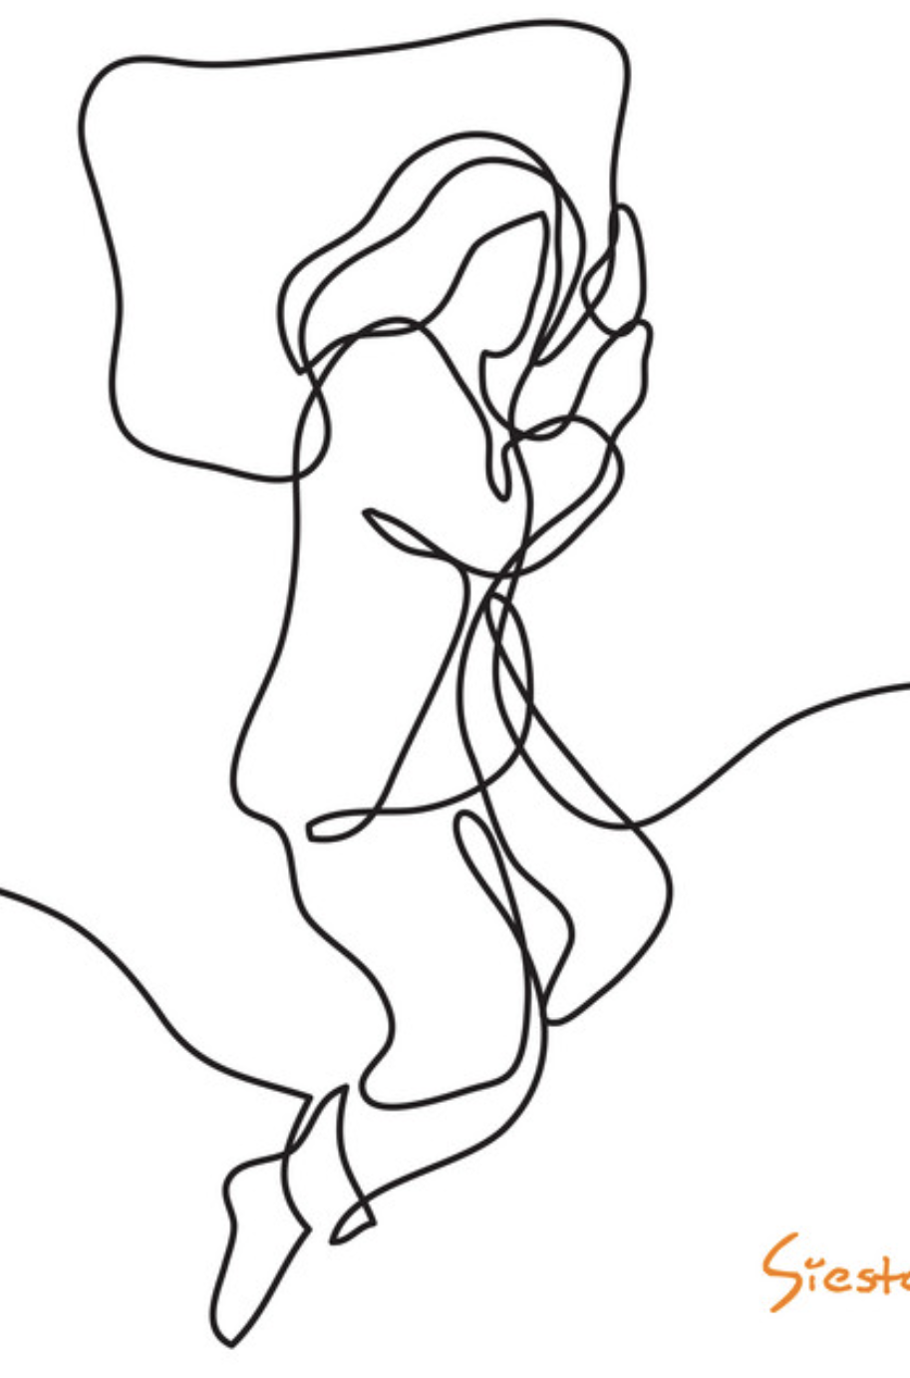
Using Machine Learning to
Predict the Risk of Sleep Disorders Based on
Individuals’ Lifestyle and Health Conditions
Peter Tran | Youxia Zhao
COMPSCI 524
Notes:
Good afternoon, everyone.
I’m Youxia Zhao, 【I’m Peter Tran】
Our project will explore how to use Machine Learning to Predict the Risk of Sleep Disorders Based on Individuals’ Lifestyle and Health Conditions

Slide 2
Presentation Outline
1. Project Background and Motivation
2. Project Objectives
3. Dataset and Features Selection
a. Dataset Description
b. DAG Analysis
4. Data Cleaning and Preprocessing
5. Methodology and Results
a. Logistic Regression as baseline model
b. Exploration of Random Forest Classifier (RFC)
c. Exploration of Support Vector Machine (SVM)
6. Conclusion and Challenges
7. Healthcare Significance
Notes:
This is the Outline. And let's dive into the details of each section.

Slide 3
1. Project Background and Motivation
Pervasive
Issue
Grave
Impact
Untapped
Potential
Notes:
For the Project Background and Motivation, we have 3 key words:
The first one is that the sleep disorder is a Pervasive Issue.
- In the modern era, lifestyle changes have led to a surge in sleep-related issues.
- Taking sleep apnea as an example, recent data indicates a prevalence affecting nearly 1 billion people worldwide.
The second one is that Sleep disorders can have grave consequences on physical and mental well-being.
- Conditions like depression, and an increased risk of chronic diseases.
The last one is there's untapped potential in research, because Current research on sleep disorders mainly focuses on examining the linear impact of one of individual features on the occurrence of sleep disorders. However, there is a notable scarcity of studies that integrate multiple features of an individual to predict the risk of sleep disorders comprehensively

Slide 4
1. Project Background and Motivation
Pervasive
Issue
Grave
Impact
Untapped
Potential
*Pervasive Issue:
A new data analysis from the ATS International Conference indicates that the prevalence of sleep apnea impacts nearly 1 billion people worldwide—nearly 10 times greater than previous estimates.
Notes:
For the Project Background and Motivation, we have 3 key words:
The first one is that the sleep disorder is a Pervasive Issue.
- In the modern era, lifestyle changes have led to a surge in sleep-related issues.
- Taking sleep apnea as an example, recent data indicates a prevalence affecting nearly 1 billion people worldwide.
The second one is that Sleep disorders can have grave consequences on physical and mental well-being.
- Conditions like depression, and an increased risk of chronic diseases.
The last one is there's untapped potential in research, because Current research on sleep disorders mainly focuses on examining the linear impact of one of individual features on the occurrence of sleep disorders. However, there is a notable scarcity of studies that integrate multiple features of an individual to predict the risk of sleep disorders comprehensively

Slide 5
1. Project Background and Motivation
Pervasive
Issue
Grave
Impact
Untapped
Potential
*Grave Impact:
Increased risk of Chronic Conditions, Weakened Immune System, Increased risk of Depression and Anxiety
Notes:
For the Project Background and Motivation, we have 3 key words:
The first one is that the sleep disorder is a Pervasive Issue.
- In the modern era, lifestyle changes have led to a surge in sleep-related issues.
- Taking sleep apnea as an example, recent data indicates a prevalence affecting nearly 1 billion people worldwide.
The second one is that Sleep disorders can have grave consequences on physical and mental well-being.
- Conditions like depression, and an increased risk of chronic diseases.
The last one is there's untapped potential in research, because Current research on sleep disorders mainly focuses on examining the linear impact of one of individual features on the occurrence of sleep disorders. However, there is a notable scarcity of studies that integrate multiple features of an individual to predict the risk of sleep disorders comprehensively

Slide 6
1. Project Background and Motivation
Pervasive
Issue
Grave
Impact
Untapped
Potential
*Untapped Potential:
Eg.:Jian Liu, John Hay, and Brent E. Faught1 "The Association of Sleep Disorder, Obesity Status, and Diabetes Mellitus among US Adults—The NHANES 2009-2010 Survey Results" International Journal of Endocrinology, 2013.
Notes:
For the Project Background and Motivation, we have 3 key words:
The first one is that the sleep disorder is a Pervasive Issue.
- In the modern era, lifestyle changes have led to a surge in sleep-related issues.
- Taking sleep apnea as an example, recent data indicates a prevalence affecting nearly 1 billion people worldwide.
The second one is that Sleep disorders can have grave consequences on physical and mental well-being.
- Conditions like depression, and an increased risk of chronic diseases.
The last one is there's untapped potential in research, because Current research on sleep disorders mainly focuses on examining the linear impact of one of individual features on the occurrence of sleep disorders. However, there is a notable scarcity of studies that integrate multiple features of an individual to predict the risk of sleep disorders comprehensively

Slide 7
2. Project Objectives
Stress anxiety
By embracing a
multifaceted perspective,
we seek to develop a machine learning model to provide a scientific foundation for the early prediction and intervention of sleep disorders
Chronic diseases
Dietary habits
Excessive caffeine
Obesity
Enviro-nment
Physical activity
Smoking
Alcohol
Notes:
So,
- Our research aims to consider the intricate combination of lifestyle and health conditions.
- Develop a machine learning model for early prediction and intervention in sleep disorders.

Slide 8
3. Dataset and Features Selection
Dataset
National Health and Nutrition Examination Survey (NHANES) 2015-2016 and 2017-2018
How to define the “sleep disorders” labels?
The ICSD-2 lists the 81 disorders major sleep disorders in 8 major categories:
The insomnias, The sleep-related breathing disorders, The hypersomnias of central origin, The circadian rhythm sleep disorders, The parasomnias, The sleep-related movement disorders, Isolated symptoms, Others.
“Ever told a doctor you had trouble sleeping?” | “How often do you snort or stop breathing?” | Labels
YES | YES | 1: Sleep disorder(1474)
YES | NO
NO | YES
NO | NO | 0: No sleep problems(1580)
Notes:
For Dataset, we utilized the National Health and Nutrition Examination Survey (NHANES) 2015-2016 and 2017-2018.
How to define the “sleep disorders” labels?
There are more than 8 major categories for sleep disorders and We will only focus on “The insomnias, The sleep-related breathing disorders” these two more public categories, which correspond to our questionnaire questions: “Ever told a doctor you had trouble sleeping?”, “How often do you snort or stop breathing?”. An individual who does not categorize in the items above is labeled as a negative case of sleep disorder. Others are all positive.

Slide 9
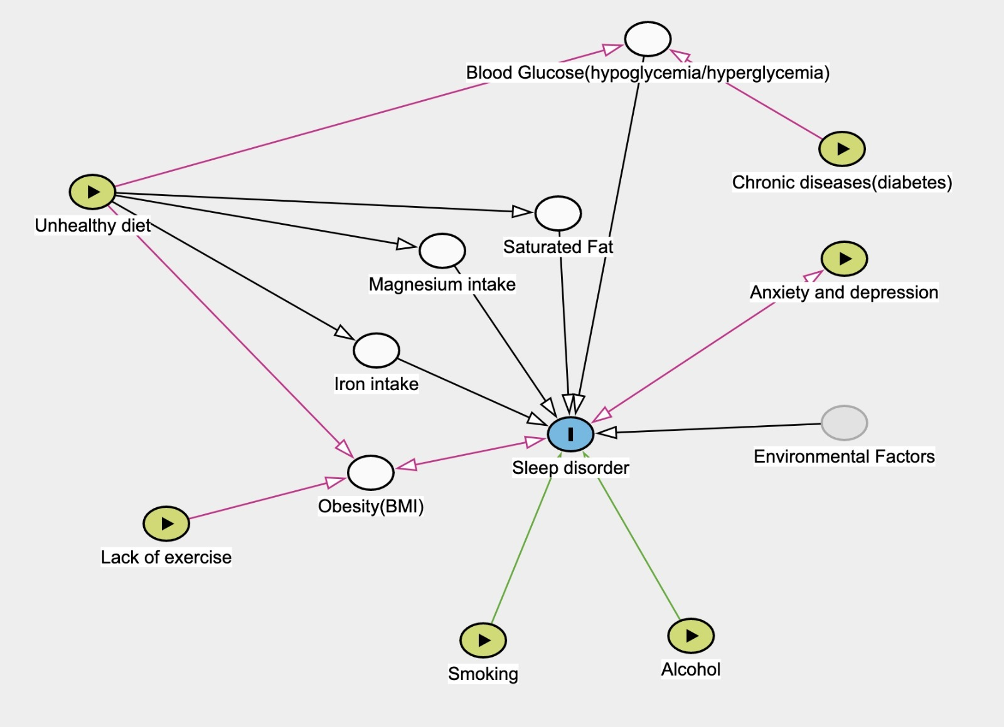
3. Dataset and Features Selection
DAG analysis
Some connections between observable habits and the underlying factors contributing to sleep disorders.
E.g.: How do we discern which dietary habits may influence or contribute to sleep disorders?
Notes:
We started from observable external factors, many connections may not be immediately evident. For instance, how do we discern which dietary habits influence or contribute to sleep disorders? Through an extensive review of relevant literature, we found that the relationship between diet and sleep disorders is nuanced. Key factors include the blood sugar, the types of fats, and the intake of trace elements such as magnesium and iron. These findings position these internal indicators as manifestations of dietary habits, effectively serving as features within our model.
Then finally, our dataset has 21 features and 3054 entries before encoding.

Slide 10
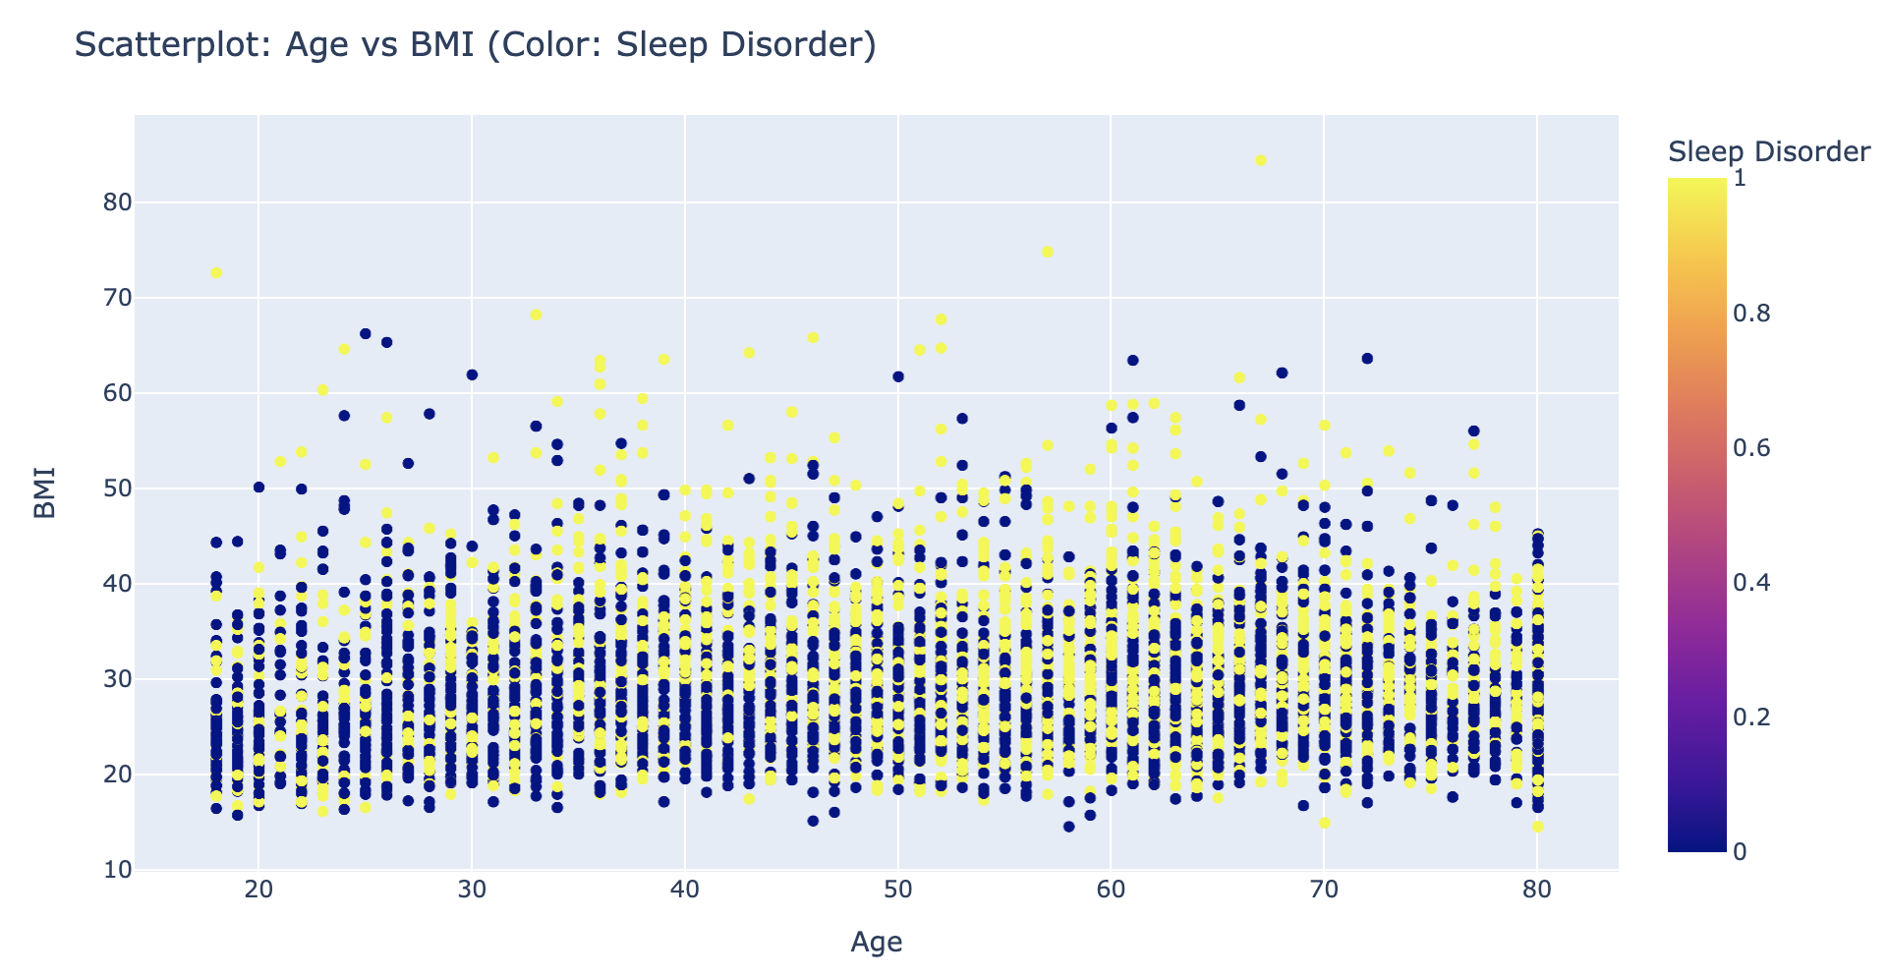
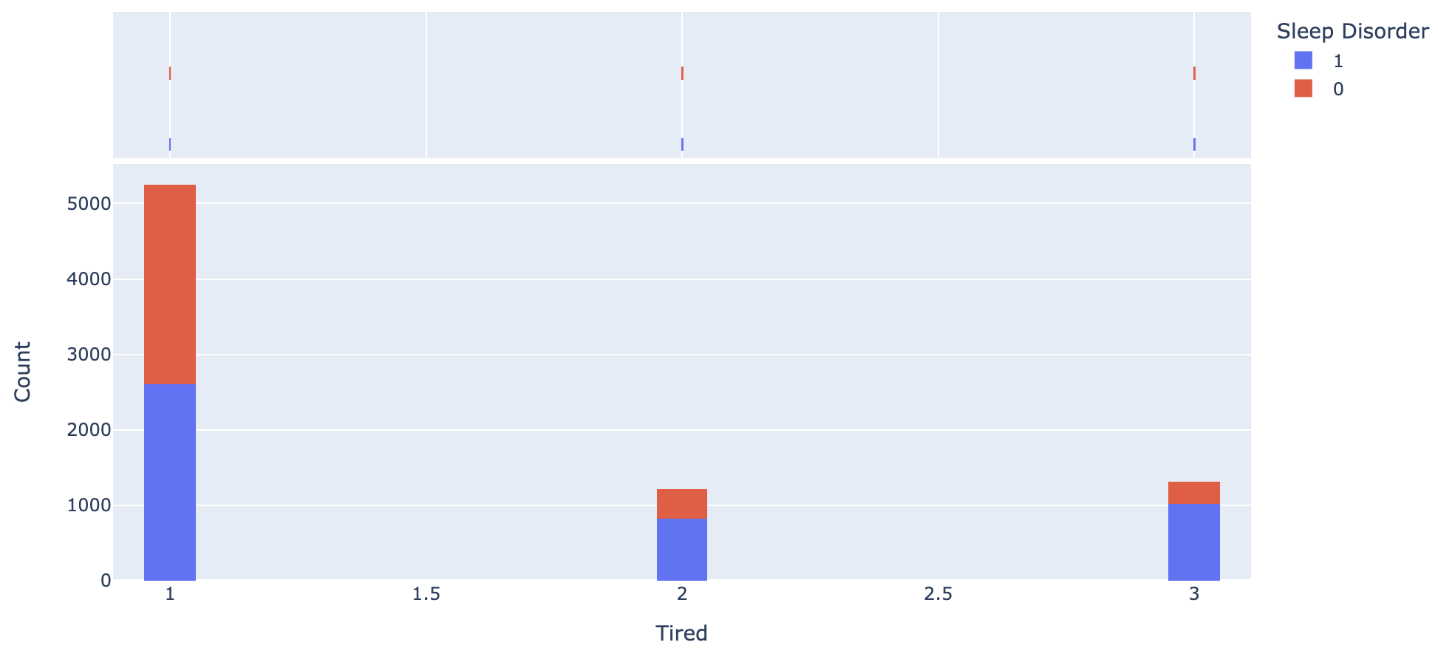
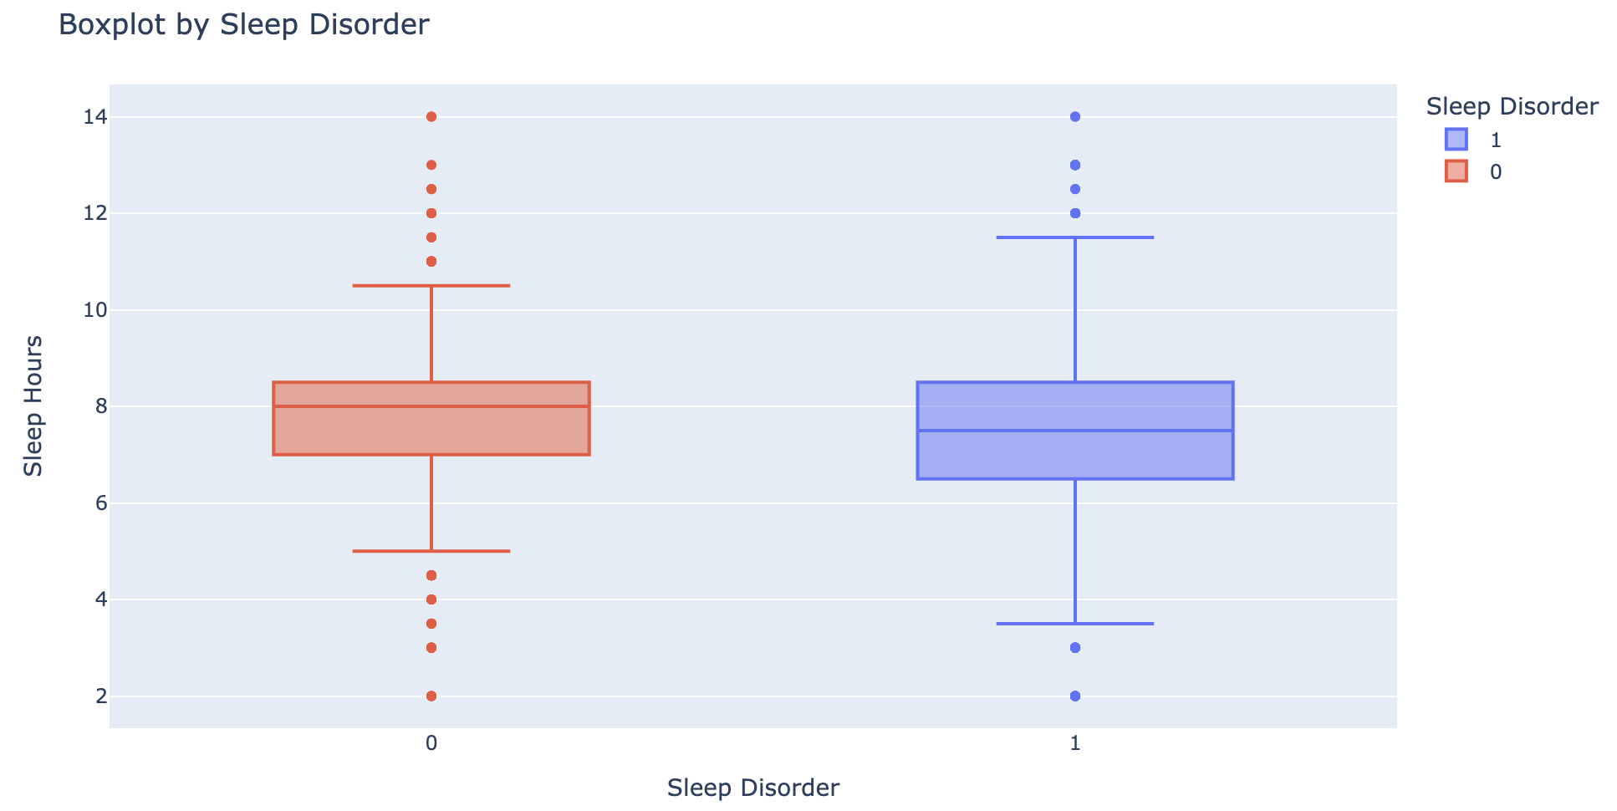
3. Dataset and Features Selection
Age VS BMI (Sleep Disorder: Yellow)
Tired/Depression
Sleep Hours
Features Selection
Removed some features that not demonstrate a significant influence on sleep disorder in our dataset.
Prior to encoding, our dataset has 16 features and 1136 entries.
No sleep disorder
Sleep disorder
DAG analysis
Some connections between observable habits and the underlying factors contributing to sleep disorders.
E.g.: How do we discern which dietary habits may influence or contribute to sleep disorders?
Notes:
Based on the DAG analysis, we explored the representation of all possible features in the data and investigated their relationships with sleep disorder. We found that not all potential features are reflected in our dataset in terms of their impact on sleep disorder. Therefore, we removed some features, such as smoking and alcohol, as they did not demonstrate a significant influence on sleep disorder in our dataset."
Then finally, our dataset has 16 features and 1136 entries before encoding.

Slide 11
4. Data Cleaning and Preprocessing
NHANES 2015 – 2016 and 2017 – 2018
Removed records where patient age is under 18
Removed records where patient is pregnant
Conversion to Binary Categorical Data
Diabetes
Current Smoking Habits
Alcohol Consumption in past 12 months
15 alcoholic beverage/day or more is considered excessive drinking
Physical Exercise
Moderate to Vigorous physical activity for at least 10 minutes
Filtering data for 'Missing', 'Refused', 'Don't Know'
1136 records remaining
805 with sleep disorders, 331 with no sleep disorder
Feature Normalization on Numerical Attributes
Mental Health ~ Depression and Anxiety
Dietary Data ~ Magnesium, Iron, Saturated Fat, Monounsaturated and Polyunsaturated Fat

Slide 12
5. Methodology - Summary
Train Validation Test Split
Train: 70%
Validation: 15%
Test: 15%
Our goal is to improve the learning of our model over the Training Set
Kernel Density Estimation (KDE) makes an estimate of the underlying distribution
Keep data that are likely to come from the densest regions of the distribution
Strengthen the observed characteristic for each class
Tuning Hyperparameters over the Validation Set
Visualize Evaluation Metrics over the Testing Set

Slide 13
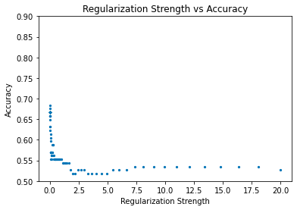
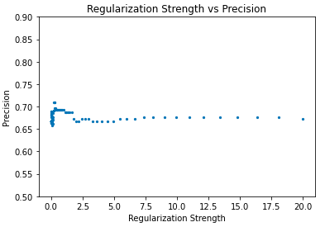
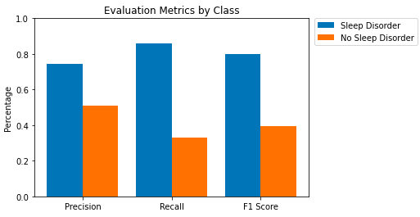
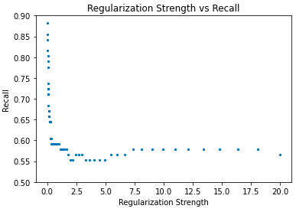
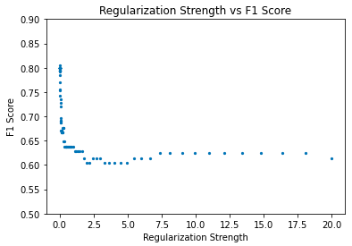
5. Methodology – Logistic Regression (LR)
Tuning for Regularization Strength
Evaluation Results
ACC ~ 67% (over 20 iterations)
LR performs much better with the majority class
Kernel Density Estimation: class-wise tuning
Kept top 80% of minority class
Kept top 50% of majority class
More exploration with relevant feature selection
Notes:
ACC ~72%, but more helpful to look at class-wise metrics
LR performs much better with the majority class
Kernel Density Estimation: class-wise tuning
Drop bottom 10%, or kept top 90% of minority class
Drop bottom 50%, or kept top 50% of majority class
More exploration with relevant feature selection

Slide 14
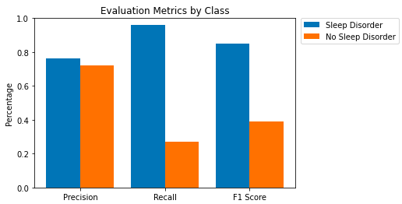
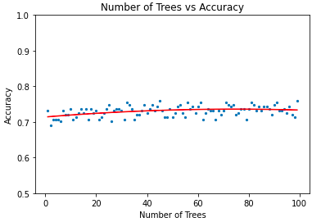
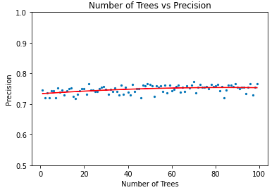
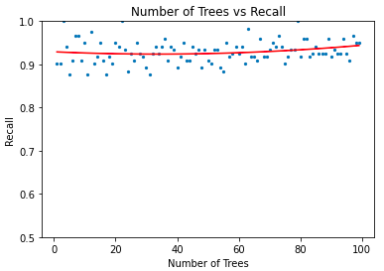
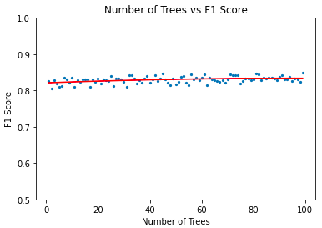
5. Methodology – Random Forest Classifier (RFC)
Tuning for Number of Decision Trees
(maximum depth = 10)
Evaluation Results
ACC ~ 72% (over 50 iterations)
RF performs much better with the majority class
Kernel Density Estimation: class-wise tuning
Kept top 50% of minority class
Kept top 50% of majority class
More exploration with node splitting criterions: entropy and log loss
Notes:
ACC ~75%, but more helpful to look at class-wise metrics
RF performs better with the majority class
Kernel Density Estimation: Drop bottom 60% of data, or kept top 40%
Drop Too Much -> Overfitting for majority class, underfitting for minority class
Drop Too Little-> Underfitting for majority and minority class
More exploration with node splitting criterions: entropy and log loss

Slide 15
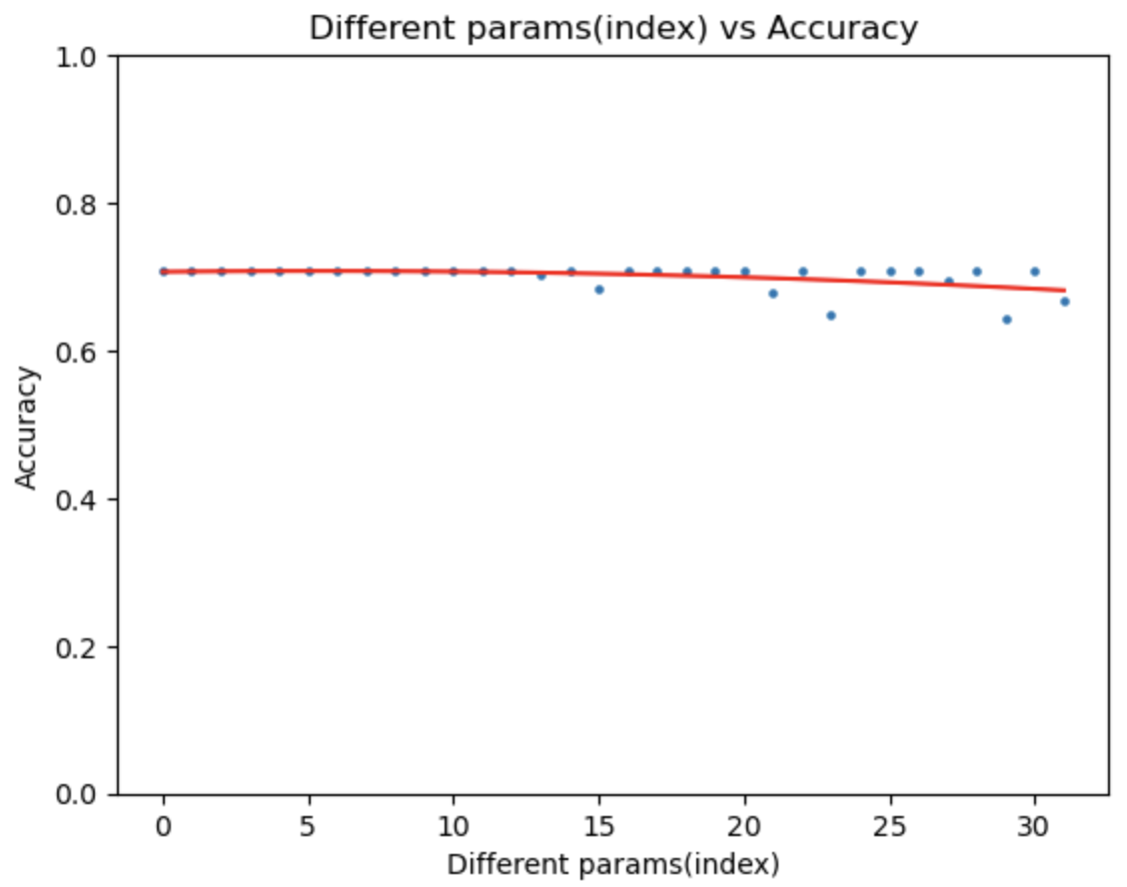
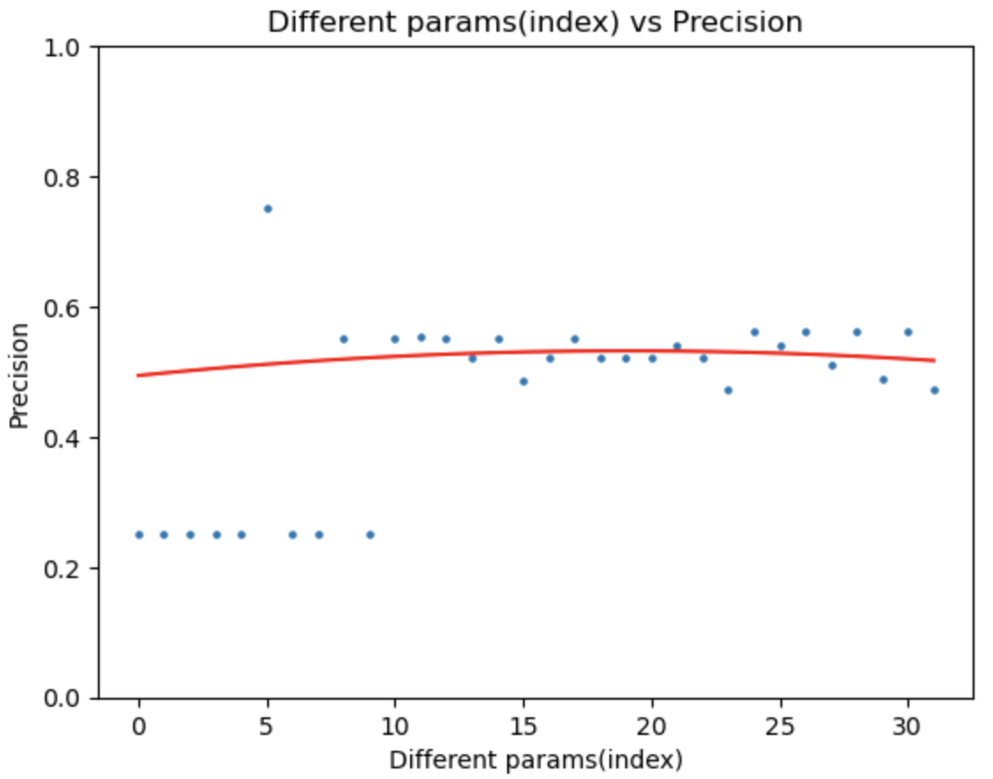
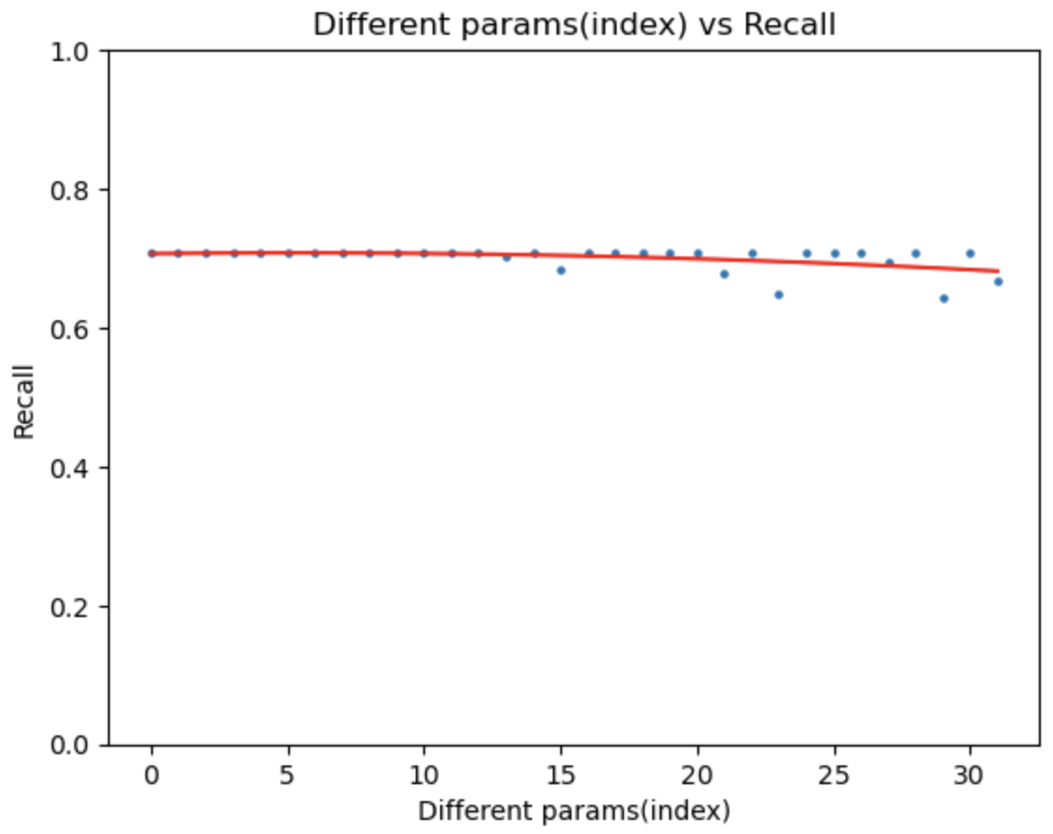
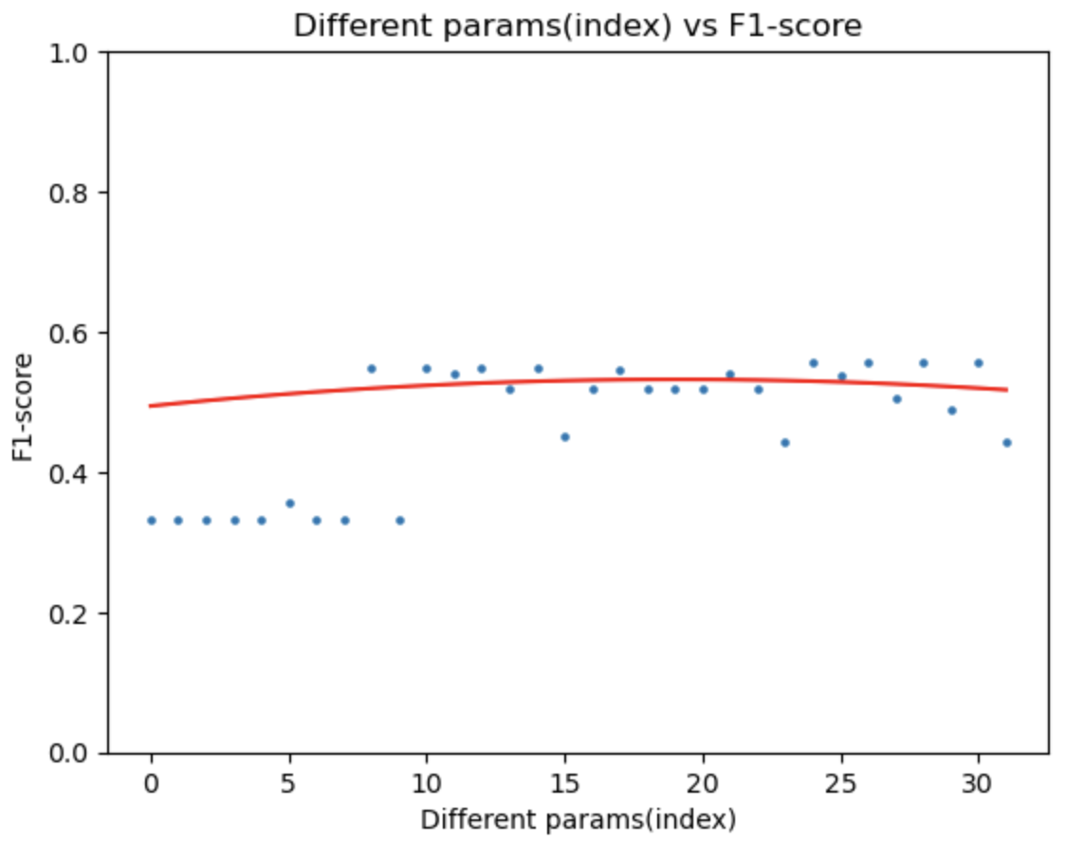
5. Methodology – Support Vector Machine (SVM)
Evaluation Results
Grid Search for Best Parameters
param_grid = {'C': [0.1, 1, 10, 100],
'kernel': ['linear', 'rbf'],
'gamma': [0.01, 0.1, 1, 10]}
Best one: {'C': 1, 'gamma': 0.1, 'kernel': 'linear'}
Performance Evaluation
ACC ~ 70.8%
SVM performs much better with the majority class
Kernel Density Estimation: class-wise tuning
Kept top 50% of minority and majority class
Notes:
ACC ~75%, but more helpful to look at class-wise metrics
RF performs better with the majority class
Kernel Density Estimation: Drop bottom 60% of data, or kept top 40%
Drop Too Much -> Overfitting for majority class, underfitting for minority class
Drop Too Little-> Underfitting for majority and minority class
More exploration with node splitting criterions: entropy and log loss

Slide 16
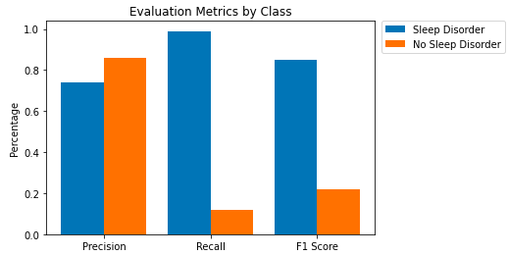
6. Conclusion
Logistic Regression
Support Vector Machine
Random Forest
What is most important?
Ideally, we would appreciate good ability to detect both classes
However, we care that an individual with a sleep disorder is accurately diagnosed
LR or RF would the best model

Slide 17
7. Healthcare Significance
Early Intervention and Prevention
By developing predictive models, healthcare professionals can identify early signs and risk factors, enabling targeted interventions to prevent the onset or progression of sleep disorders.
Personalized Treatment Plans
Predictive research allows for the customization of treatment plans based on an individual's specific risk factors and patterns. Personalized interventions can include lifestyle modifications, behavioral therapies, and tailored medication regimens, optimizing treatment efficacy and improving patient adherence.
Public Health Impact
By implementing predictive models on a larger scale, public health initiatives can be designed to target specific populations at risk, promoting preventive measures and reducing the overall burden of sleep disorders on society.

Slide 18
Thank You!
Peter Tran | Youxia Zhao
COMPSCI 524

Slide 19
Using Machine Learning
to Predict the Risk of Sleep Disorders
Based on Individuals’ Lifestyle and Health Conditions
Peter Tran | Youxia Zhao
COMPSCI 524

Slide 20
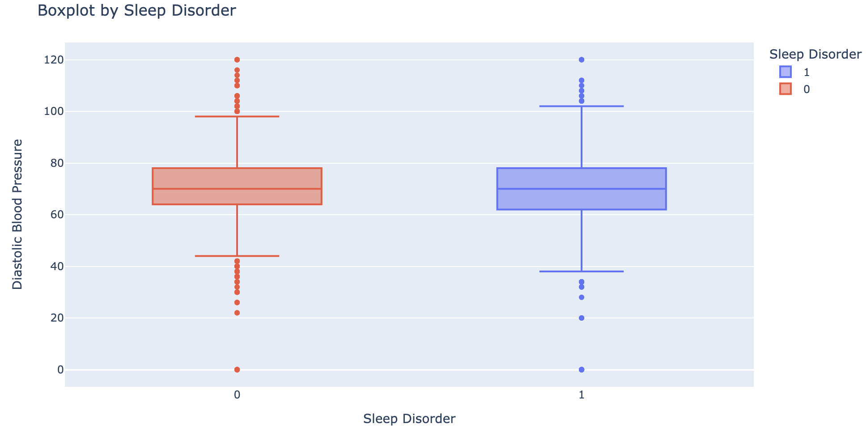
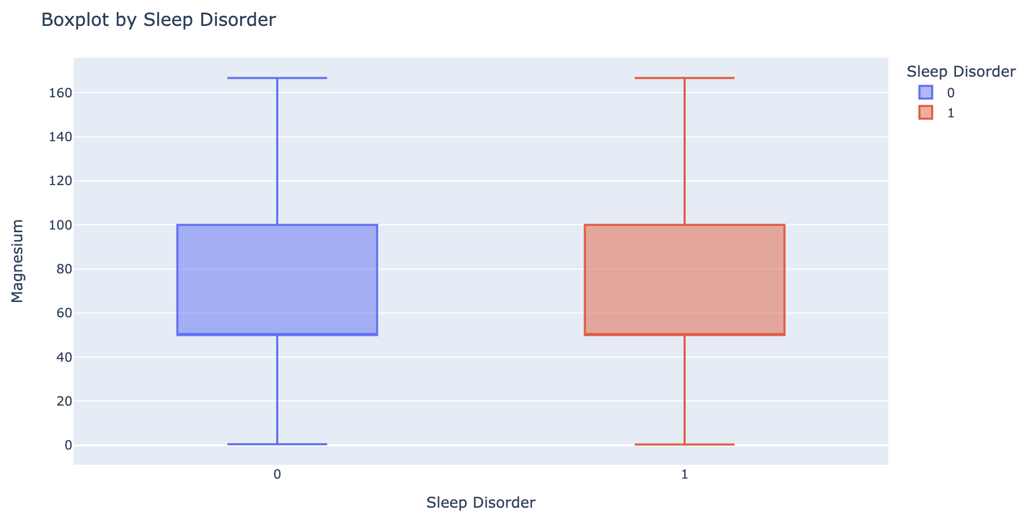
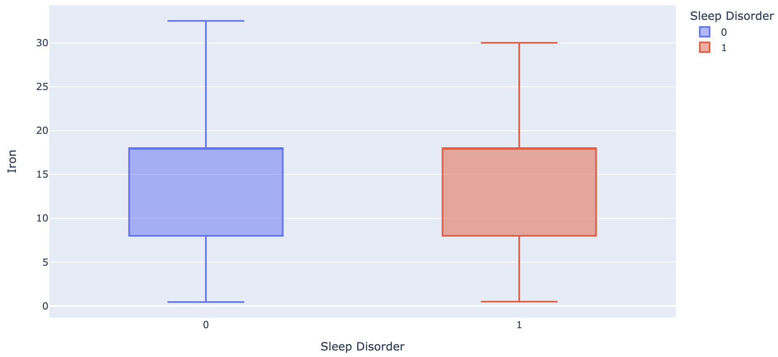
3. Dataset and Features Selection
Blood Pressure
Magnesium
Iron
Notes:
We started from observable external factors, many connections may not be immediately evident. For instance, how do we discern which dietary habits influence or contribute to sleep disorders? Through an extensive review of relevant literature, we found that the relationship between diet and sleep disorders is nuanced. Key factors include the blood sugar, the types of fats, and the intake of trace elements such as magnesium and iron. These findings position these internal indicators as manifestations of dietary habits, effectively serving as features within our model.
Then finally, our dataset has 21 features and 3054 entries before encoding.

