Slide 1
Github Link
https://github.com/petertzelios/Adapting-ESM-2-to-Predict-the-Effect-of-Multiple-Interacting-Mutations-.git

Slide 2
Figure 1
Full Model Pipeline
Secondary Model Architectures
Input: Amino Acid Sequences (265 AAs)
Flat
Global and Local Features Flattened (16 K Features)
150 M Parameter ESM2 Model Embeddings (265 AAs X 640 Emb. Dimension)
All Feature Ridge Regression
All Feature MLP
or
Global Mean (640 Emb.)
Local Mutation Window (24 AAs X 640 Emb.)
Fused
Global Mean (640 Emb.)
Local Mutation Window (24 AAs X 640 Emb.)
+
Secondary Model (see RHS for architectures)
Global Feature MLP
Local Model – One of:
MLP
CNN
MHA + FF
Predicted Sequence Fitness (1 Fitness Value)
Fusion MLP (Combines output of global and local models)

Slide 3
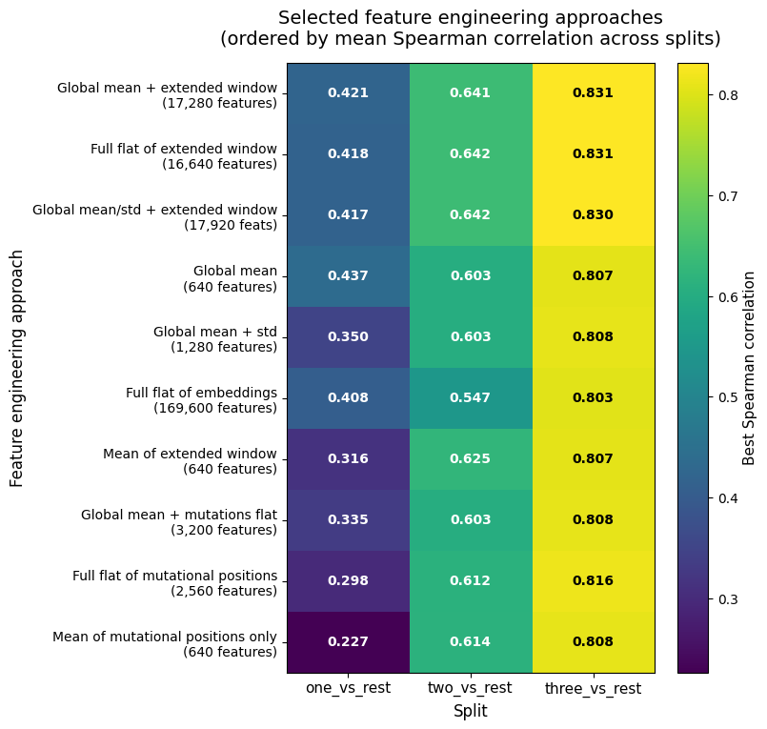
Figure 2

Slide 4
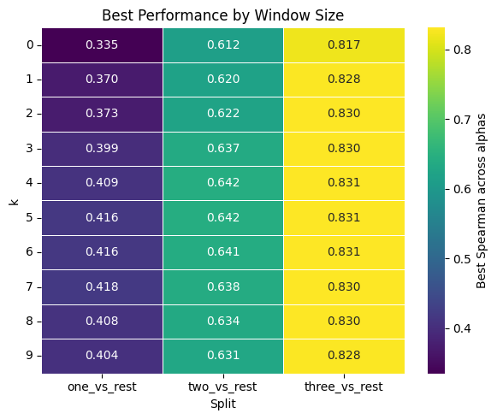
Figure 3

Slide 5
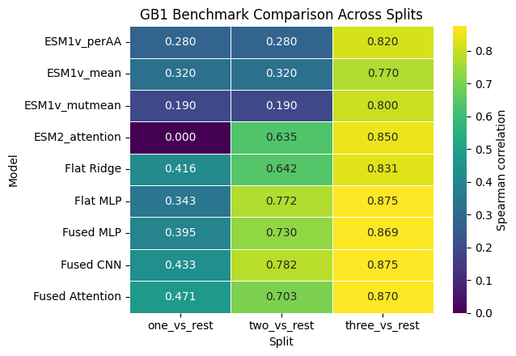
Figure 4

Slide 6
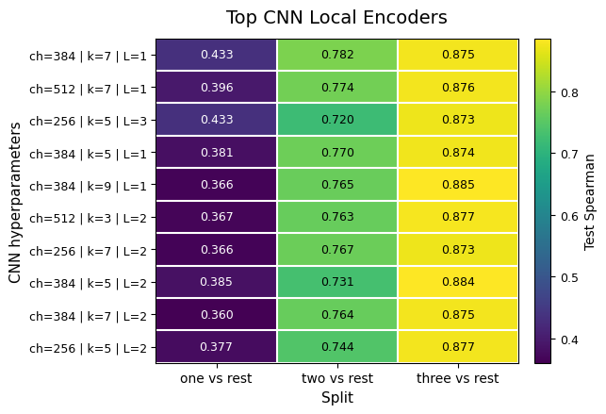
Figure 5

Slide 7
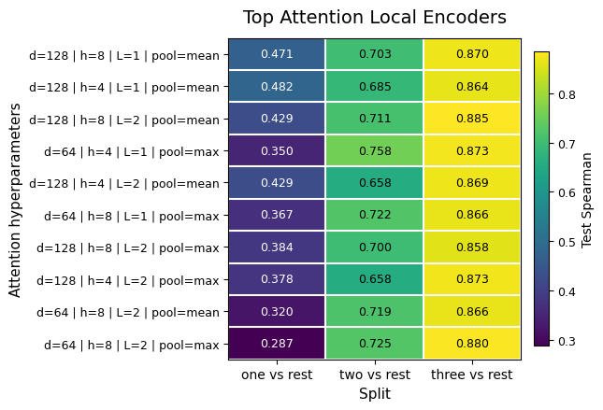
Figure 6

Slide 8
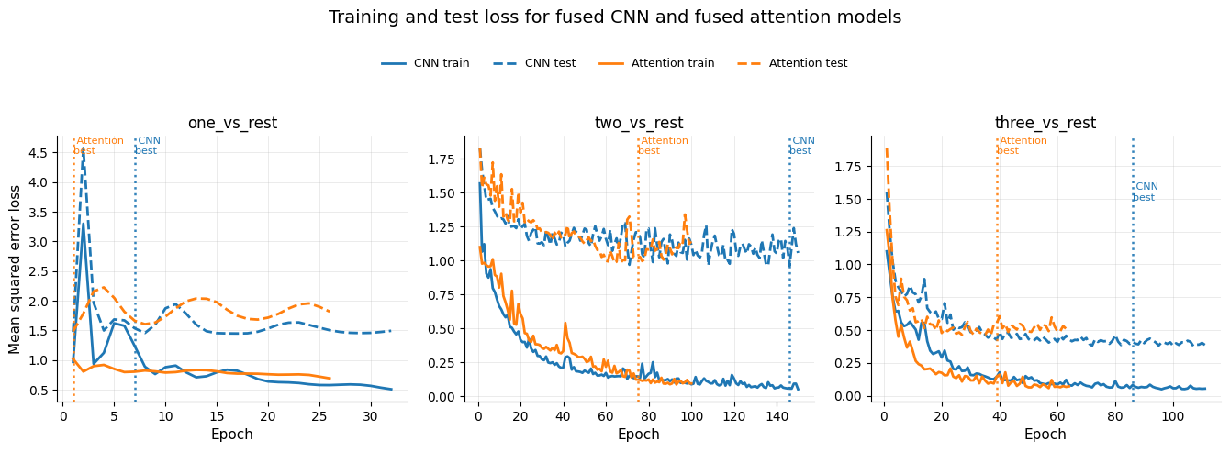
Figure 7

