Slide 1
SeasonSense Analytics: Seasonal Agriculture Performance Analysis
Name : Likhitha
College : GuruNanak Institute of Technology
AICTE STU ID : STU69b56c18e2ec81773497368

Slide 2
Problem Statement :
Agricultural activities are influenced by seasonal variations in environmental conditions, farming practices, resource availability, and market conditions. As a result, agricultural performance may differ from one season to another. However, raw agricultural data does not clearly explain how agricultural performance changes across seasons or what patterns can be observed in different seasonal conditions.
The project aims to analyze the given agricultural dataset and investigate seasonal differences in agricultural performance by identifying meaningful patterns, trends, relationships, and variations within the available data.

Slide 3
Project Discription :
SeasonSense Analytics is a data visualization project designed to analyze seasonal agricultural performance using the provided agricultural dataset. The project explores how agricultural performance varies across different seasons by examining factors such as crop production, environmental conditions, farming practices, resource availability, and related agricultural indicators.
An interactive dashboard is used to visualize the data through KPIs, charts, filters, and insights, helping users identify meaningful patterns, trends, relationships, and variations in agricultural performance across seasons.

Slide 4
Who Are the End Users ?
• Farmers – To understand seasonal patterns and agricultural performance.
• Agricultural Analysts – To analyze trends and relationships in agricultural data.
• Agricultural Researchers – To study seasonal variations and identify useful patterns.
• Government & Agricultural Departments – To support data-driven agricultural planning and decision-making.
• Agribusiness Stakeholders – To understand production, resource, and seasonal trends.

Slide 5
Technology Used
Programming Language: Python
Data Analysis: Pandas, NumPy
Data Visualization: Plotly, Matplotlib
Dashboard: Lovable
Data Source: Agricultural Performance Dataset (CSV)
Development Tools: Jupyter Notebook, GitHub

Slide 6
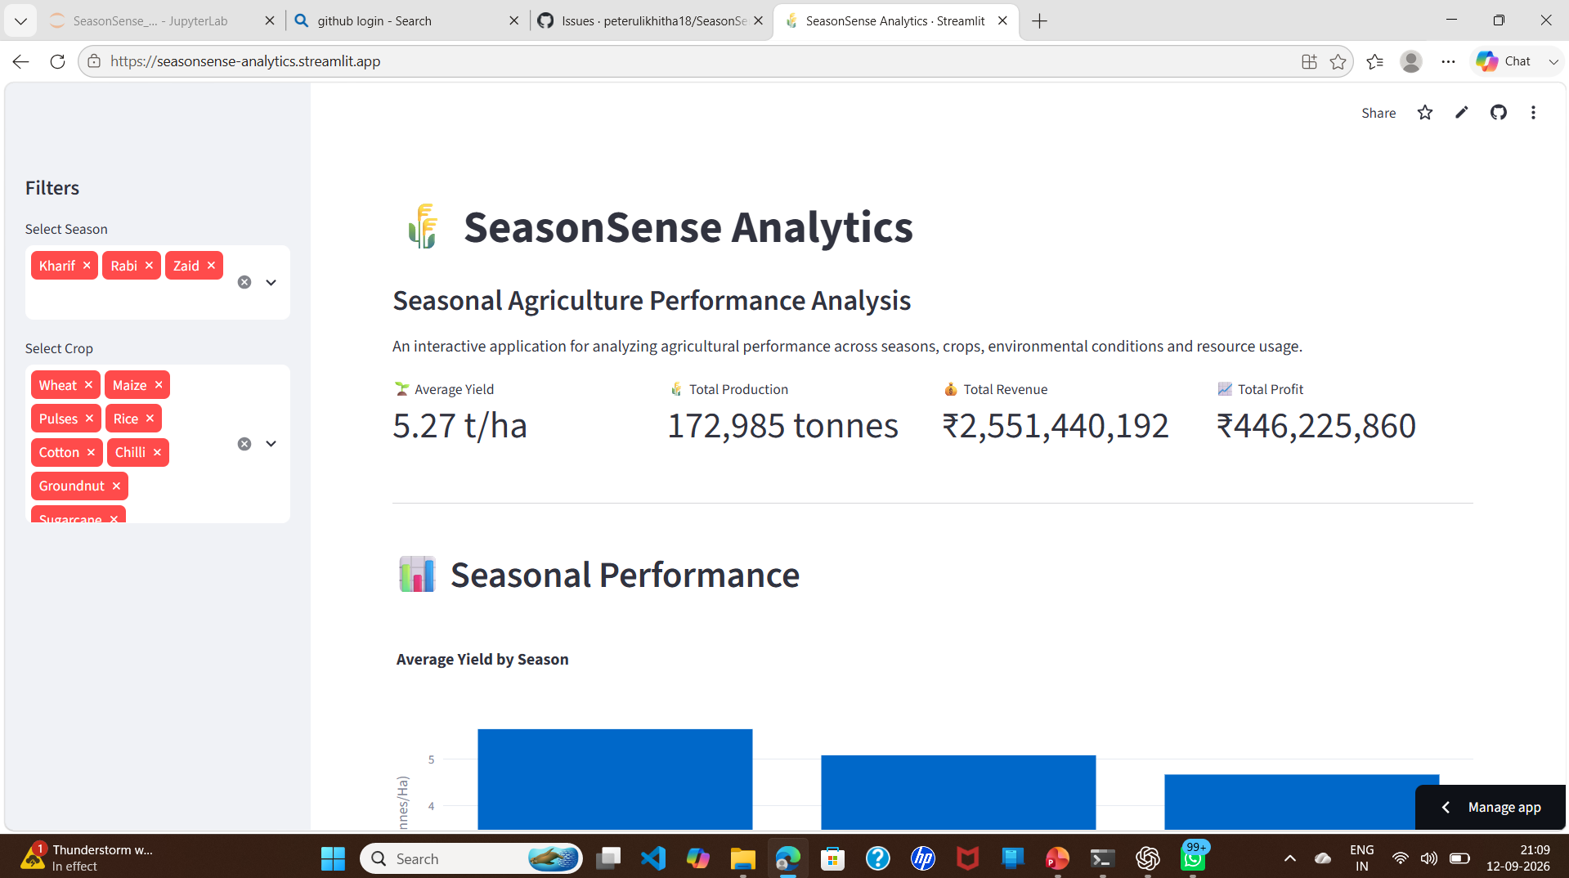
RESULTS

Slide 7
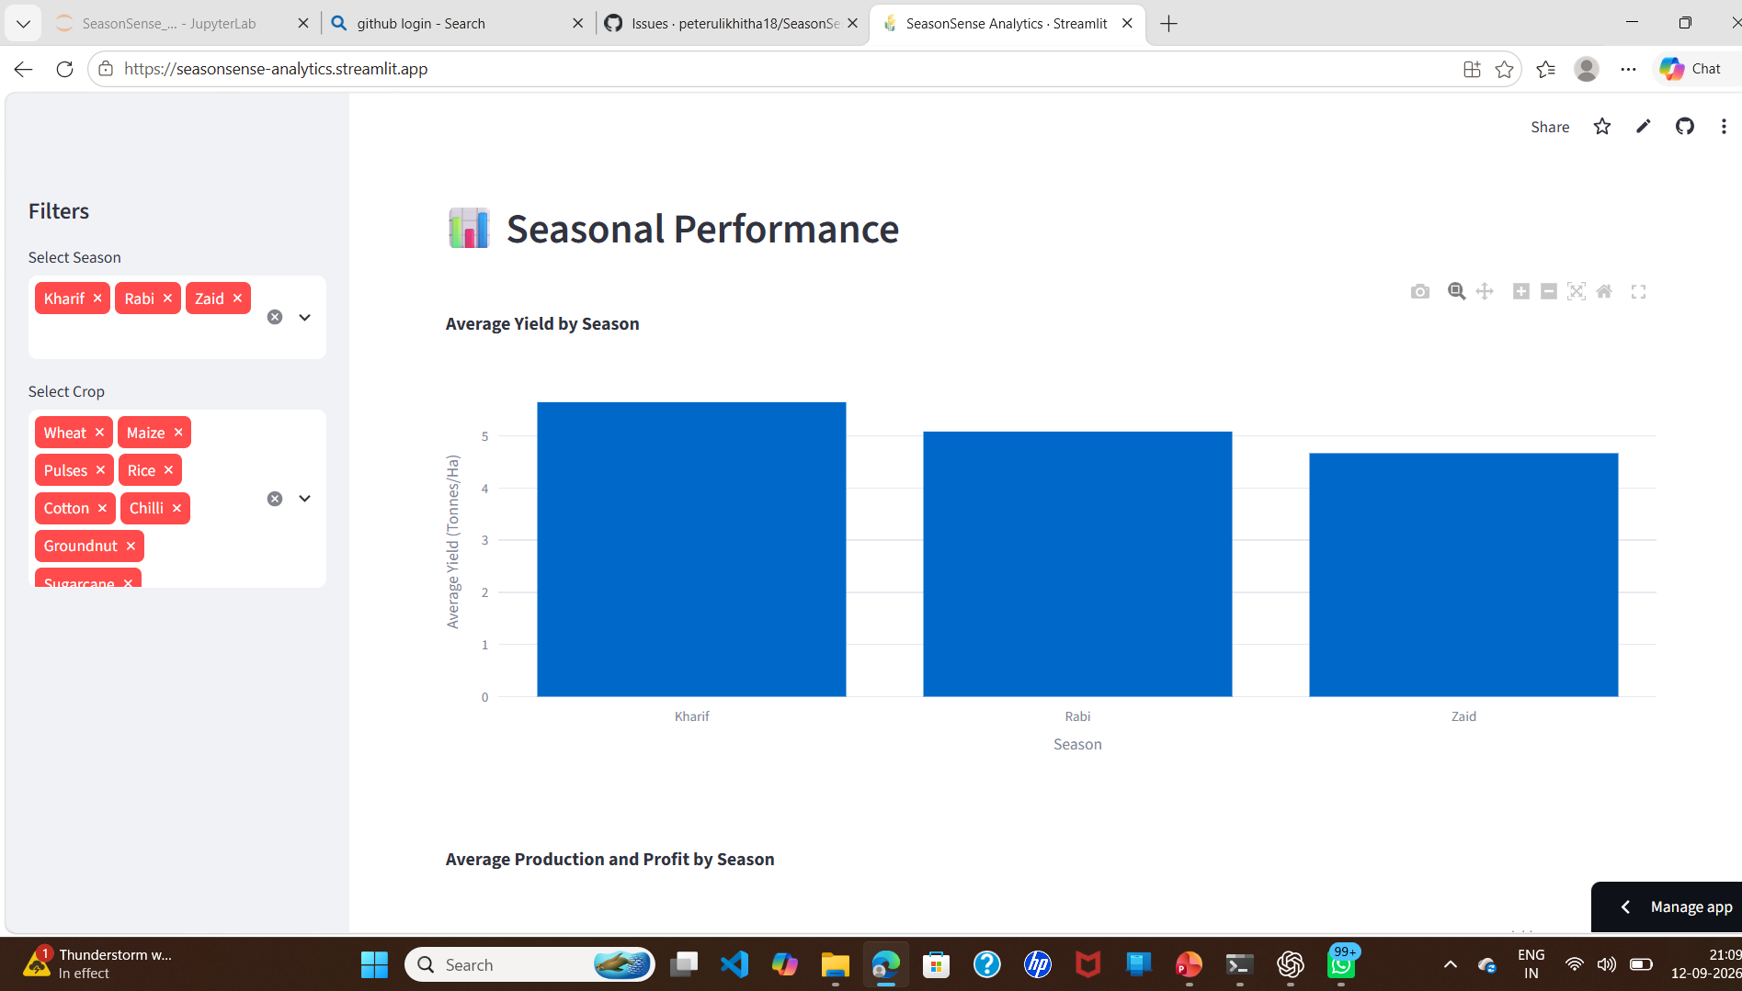
RESULTS

Slide 8
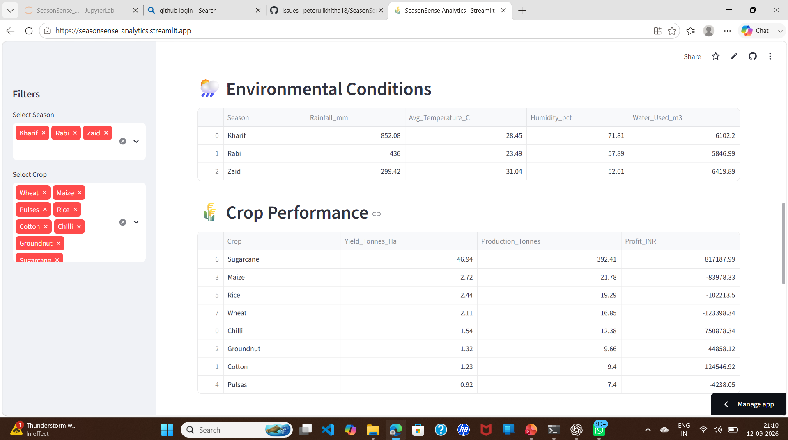
RESULTS

Slide 9
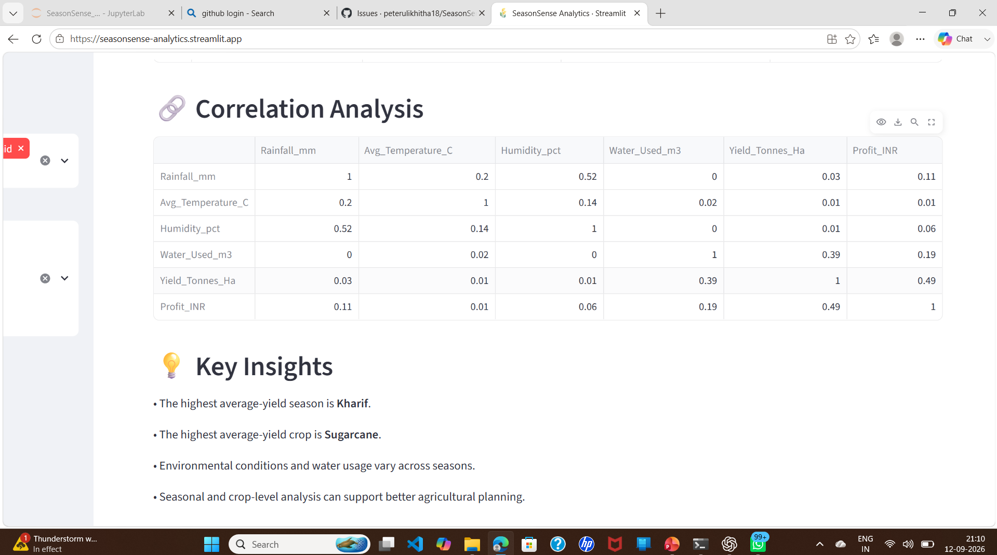
RESULTS

Slide 10
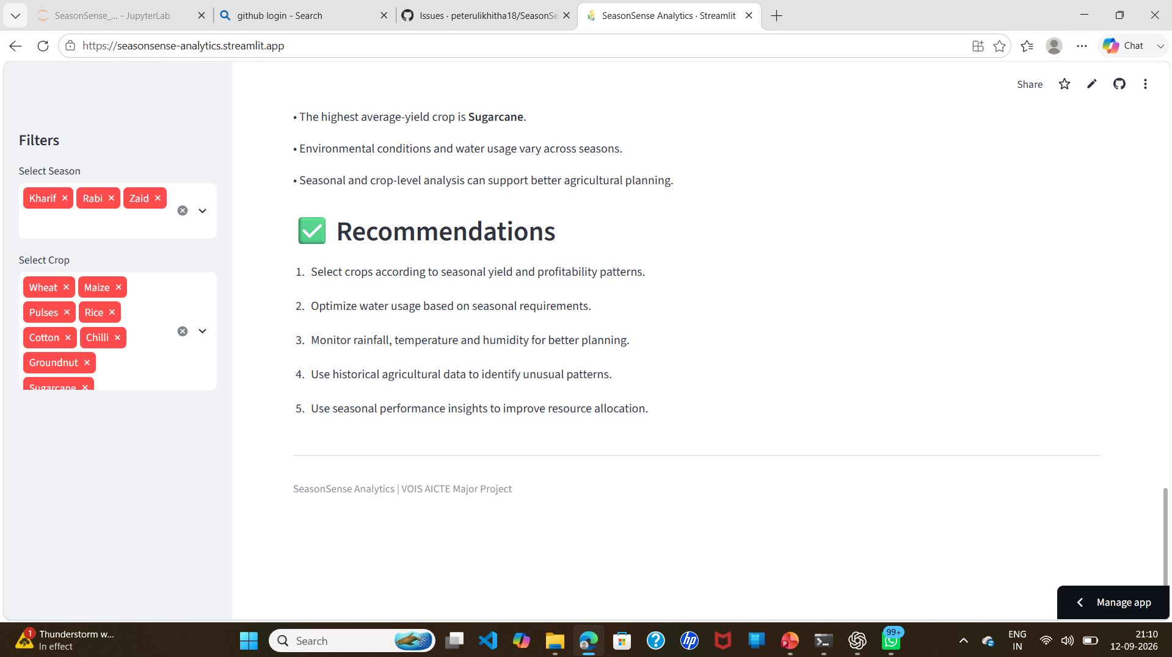
RESULTS

Slide 11
Future Scope
• Integrate real-time agricultural and weather data.
• Add advanced predictive analytics for crop performance.
• Provide more detailed regional and crop-level analysis.
• Develop mobile-friendly access for farmers and agricultural stakeholders.
• Enhance the dashboard with additional interactive visualizations and decision-support features.

Slide 12
GitHub Link
https://github.com/peterulikhitha18/SeasonSense_Analytics

Slide 13
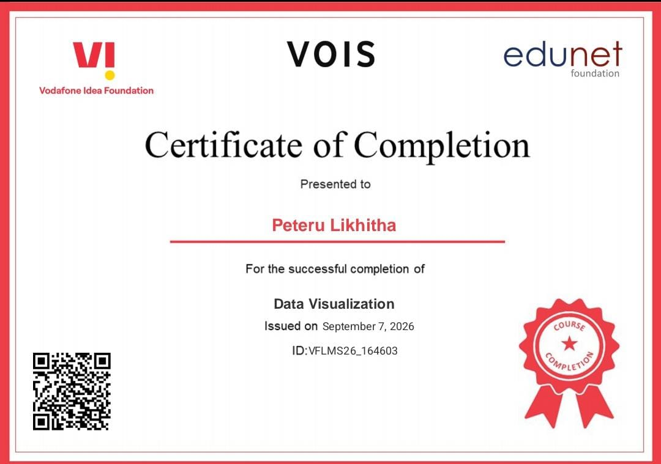
VOIS Data Visualization course completion certificate.

Slide 14
Thank You

