Slide 1



Hamarosan kezdünk…
Adatbázis programozás JPA alapokon haladóknak
Peter Veres
peter_veres2@epam.com
2016

Slide 2
Adatbázis programozás JPA alapokon haladóknak
7. nap
Peter Veres
peter_veres2@epam.com
2016

Slide 3
Java Persistence
Management of persistent data
Data is stored in a (relational) database
But we use Java (objects in the memory)

Slide 4
Overview
What is an entity?
Peter Chen (1976): „Things that have attributes and relationships.”
The expectation is that „the attributes and relationships would be persisted in a relational database.”

Slide 5
JPA - Overview
JPA is
Entity metadata (@Annotations)
API
Queries (JPQL, criteria)

Slide 6
JPA - Relations
@Entity
public class Employee {
@ManyToOne
private Department department;
}
@Entity
public class Department {
@OneToMany(mappedBy = "employee")
List<Employee> employees;
}
@Entity
public class Employee {
@OneToOne
private ParkingPlace parkingPlace;
}
@Entity
public class ParkingPlace {
@OneToOne(mappedBy = "parkingPlace")
private Employee employee;
}
@Entity
public class Employee {
@OneToMany
private List<Phone> phones;
}
@Entity
public class Employee {
@ManyToMany
private List<Project> projects;
}
@Entity
public class Project {
@ManyToMany(mappedBy = "projects")
private List<Employee> employees;
}

Slide 7
Entity object life-cycle
NEW
MANAGED
Database
persist
new
find/query
persist
remove
flush/commit
DETACHED
REMOVED
clear/close/...

Slide 8
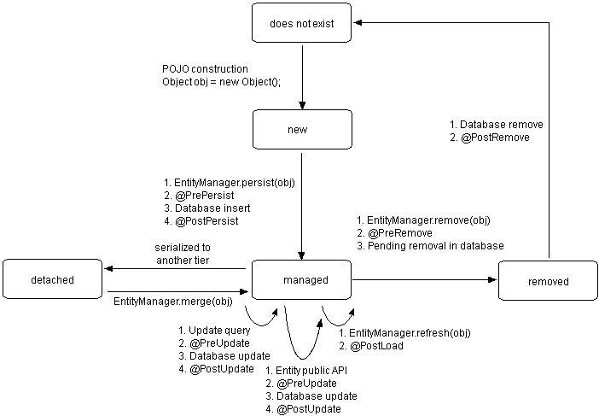
JPA – Lifecycle events

Slide 9
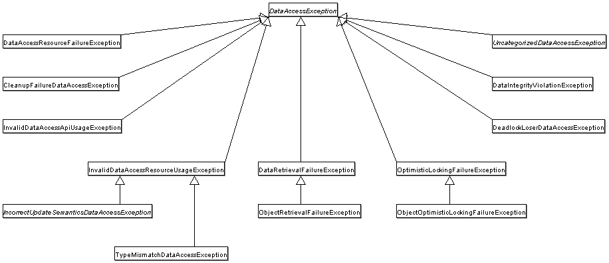
JPA - @Repository

Slide 10
Szünet,
Hamarosan folytatjuk
Adatbázis programozás JPA alapokon haladóknak
Peter Veres
peter_veres2@epam.com
2016

Slide 11
Köszönöm a figyelmet!
Adatbázis programozás JPA alapokon haladóknak
Peter Veres
peter_veres2@epam.com
2016

