Slide 1
Digital Media Technology Week 9: Introduction to SQL

Slide 2
Last week’s lecture
Databases
DBMS
Relational data model
Entity Relationship Diagrams
Phases:
Design
Implementation
Data entry
Data analysis

Slide 3
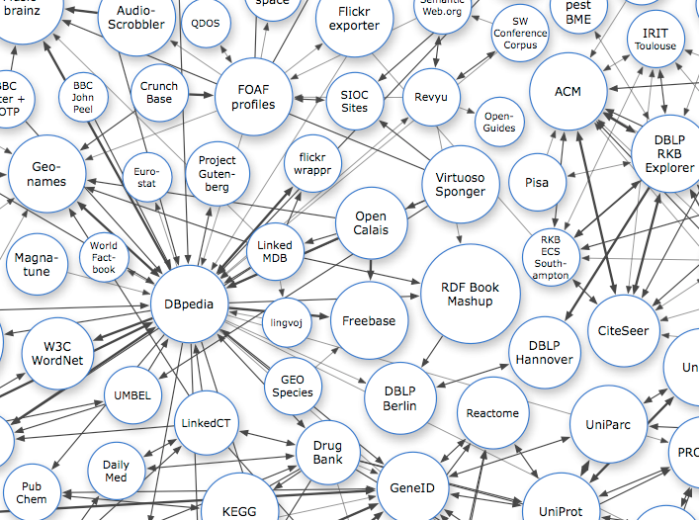
e.g. Bestsellers data from The Guardian

Slide 4
Da Vinci Code,The | Dan | Brown | 5,094,805 | Transworld Grp | 2004 | Crime, Thriller & Adventure
Harry Potter and the Deathly Hallows | J.K. | Rowling | 4,475,152 | Bloomsbury Grp | 2007 | Children's Fiction
Harry Potter and the Philosopher's Stone | J.K. | Rowling | 4,200,654 | Bloomsbury Grp | 1997 | Children's Fiction
Harry Potter and the Order of the Phoenix | J.K. | Rowling | 4,179,479 | Bloomsbury Grp | 2003 | Children's Fiction
Fifty Shades of Grey | E.L. | James | 3,758,936 | Random House Grp | 2012 | Romance & Sagas
Harry Potter and the Goblet of Fire | J.K. | Rowling | 3,583,215 | Bloomsbury Grp | 2001 | Children's Fiction
Harry Potter and the Chamber of Secrets | J.K. | Rowling | 3,484,047 | Bloomsbury Grp | 1999 | Children's Fiction
Harry Potter and the Prisoner of Azkaban | J.K. | Rowling | 3,377,906 | Bloomsbury Grp | 2000 | Children's Fiction
Angels and Demons | Dan | Brown | 3,193,946 | Transworld Grp | 2003 | Crime, Thriller & Adventure
Harry Potter and the Half-blood Prince:Children's Edition | J.K. | Rowling | 2,950,264 | Bloomsbury Grp | 2005 | Children's Fiction
Fifty Shades Darker | E.L. | James | 2,479,784 | Random House Grp | 2012 | Romance & Sagas
Twilight | Stephenie | Meyer | 2,315,405 | Little, Brown Book Grp | 2006 | Young Adult Fiction
Girl with the Dragon Tattoo,The:Millennium Trilogy | Stieg | Larsson | 2,233,570 | Quercus Grp | 2008 | Crime, Thriller & Adventure

Slide 5
AUTHOR
PUBLISHER
AUTHOR_ID
PUBL_ID
BOOK
GENRE
B_ID PUBLISHER (FK) AUTHOR (FK) GENRE (FK) SOLD
GENRE_ID

Slide 6
Look-up tables
code | name
uk | United Kingdom
fr | France
ne | The Netherlands
be | Belgium
(based on ISO 3166-1993 )

Slide 7
Note the “direction” of the relation

Slide 8
STUDENT
COURSE

Slide 9
Atomic values
Year_birth | 1865
Year_death | 1937
lived | 1865 - 1937
place | London, United Kingdom
city | London
country | United Kingdom
Students_enrolled | s1 ; s2 ; s3 ; s4

Slide 10
ID First Name Last Name Course ECTS
Id1 StudentF1 StudentL1 DMT 5
Id2 StudentF2 StudentL2 DMT 5
Id3 StudentF1 StudentL1 NMS 5
Id4 StudentF4 StudentL4 NMS 5
Id5 StudentF2 StudentL2 L 5

Slide 11
STUDENT
COURSE
S_ID
?
C_ID
[ DETAILS ]
[ DETAILS ]
many
many
Students_enrolled | s1 ; s2 ; s3 ; s4

Slide 12
COURSE
STUDENT
S_ID
?
C_ID
[ DETAILS ]
[ DETAILS ]
many
many
ENROLMENT
E_ID
S_ID
C_ID
[ DETAILS ]
many
many

Slide 13
Referential Integrity
Each foreign key should correspond to an existing primary key
Most DBMSs take measures to prevents users or applications from entering inconsistent data

Slide 14
Data Analysis
SQL: Structured Query Language
Supported by most DBMSs
Makes use of regular English words

Slide 15
Open vs. Proprietary Standards
Open standards
Adopted and maintained by an authorised standisation organization
Documentation is fully available
No constraints on the use or the re-use of the standard (interoperability)
Proprietary standards
Risk of “vendor-lock in”
Migration and system integration is often complicated

Slide 16
CREATE TABLE TREASURE
(
TREASURE_ID INT (4) NOT NULL AUTO_INCREMENT,
TITLE VARCHAR (150),
CREATOR INT,
LIBRARY CHAR(6),
SUBJECT CHAR(3),
YEAR INT (4),
PRIMARY KEY (TREASURE_ID),
FOREIGN KEY (CREATOR) REFERENCES CREATOR ON DELETE RESTRICT ON UPDATE CASCADE,
FOREIGN KEY (LIBRARY) REFERENCES LIBRARY ON DELETE RESTRICT ON UPDATE CASCADE,
FOREIGN KEY (SUBJECT) REFERENCES SUBJECT ON DELETE RESTRICT ON UPDATE CASCADE
);

Slide 17
INSERT INTO CREATOR VALUES ('1','Baudelaire','Charles','1821','1867','FR'), ('2','Mozart','Wolfgang Amadeus','1756','1791','AT'), ('3','Bruegel The Elder','Pieter','1525','1569','BE'), ('4','Sadler','William','1782','1839','IE'), ('5','Tiemann','Walter','1876','1951','DE'), ('6','Macchiavelli','Giacomo','1756','1811','IT'), ('7','Galilei','Galileo','1564','1642','IT'), ('8','Parker','Matthew','1504','1575','GB'), ('9','Wittel','Caspar van','1655','1736','NL'), ('10','Molyneux','Daniel','1568','1632','IE') ;
UPDATE CREATOR
SET NAME_LAST='Charles Pierre'
WHERE PID= 1 ;

Slide 18
DELETE DATABASE TREASURE ;
DROP TABLE CREATOR ;

Slide 19
SELECT TITLE, YEAR
FROM TREASURE ;
TITLE | YEAR
Sidereus Nuncius | 1610
Requiem KV 626 | 1791
Rabbit Hunt, in the lower left Brueghel 1560. | 1560
De antiquitate Britanicae Ecclesiae | 1572
Vedute di Roma con scene di costume | 1810
Corrected page proofs of 'Les Fleurs du mal' | 1857
Vinegar Hill, charge of the 5th Dragoon Guards | 1880
Poster of "Internationale Ausstellung für Buchgewerbe und Graphik" | 1914
Fontana dei Fiumi a Piazza Navona | 1734

Slide 20
SELECT * FROM TREASURE ;
treasure_id | title | year | creator | library | subject
1 | Sidereus Nuncius | 1610 | 7 | 7 | SCI
2 | Requiem KV 626 | 1791 | 2 | 1 | MUS
3 | Rabbit Hunt, in the lower left Brueghel 1560. | 1560 | 3 | 3 | ART
4 | De antiquitate Britanicae Ecclesiae | 1572 | 8 | 4 | ART
5 | Vedute di Roma con scene di costume | 1810 | 6 | 6 | HIS
6 | Corrected page proofs of 'Les Fleurs du mal' | 1857 | 1 | 2 | HIS
7 | Vinegar Hill, charge of the 5th Dragoon Guards | 1880 | 4 | 5 | HIS
8 | Poster of "Internationale Ausstellung für Buchgewerbe und Graphik" | 1914 | 5 | 8 | ART
9 | Fontana dei Fiumi a Piazza Navona | 1734 | 9 | 6 | ART

Slide 21
SELECT TITLE, YEAR FROM TREASURE ORDER BY YEAR ;
TITLE | YEAR
Rabbit Hunt, in the lower left Brueghel 1560. | 1560
De antiquitate Britanicae Ecclesiae | 1572
Sidereus Nuncius | 1610
Fontana dei Fiumi a Piazza Navona | 1734
Requiem KV 626 | 1791
Vedute di Roma con scene di costume | 1810
Corrected page proofs of 'Les Fleurs du mal' | 1857
Vinegar Hill, charge of the 5th Dragoon Guards | 1880
Poster of "Internationale Ausstellung für Buchgewerbe und Graphik" | 1914

Slide 22
SELECT NAME_LAST, NAME_FIRST, (YEAR_OF_DEATH - YEAR_OF_BIRTH) AS AGE FROM CREATOR ;
NAME_LAST | NAME_FIRST | AGE
Baudelaire | Charles | 46
Mozart | Wolfgang Amadeus | 35
Bruegel The Elder | Pieter | 44
Sadler | William | 57
Tiemann | Walter | 75
Macchiavelli | Giacomo | 55
Galilei | Galileo | 78
Parker | Matthew | 71
Wittel | Caspar van | 81
Molyneux | Daniel | 64

Slide 23
SELECT TITLE, YEAR
FROM TREASURE
WHERE YEAR > 1800 ;
TITLE | YEAR
Vedute di Roma con scene di costume | 1810
Corrected page proofs of 'Les Fleurs du mal' | 1857
Vinegar Hill, charge of the 5th Dragoon Guards | 1880
Poster of "Internationale Ausstellung für Buchgewerbe und Graphik" | 1914

Slide 24
SELECT DISTINCT SUBJECT
FROM TREASURE ;
SUBJECT
ART
HIS
MUS
SCI

Slide 25
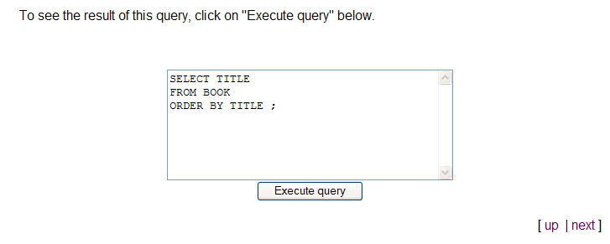

Slide 26

MySQL: open source RDBMS
Extensive documentation on MySQL website
Databases are built using SQL queries

Slide 27
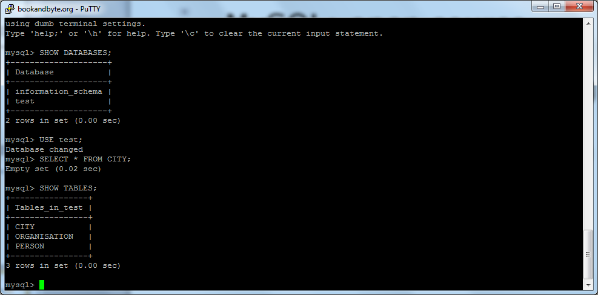
MySQL may be used via command prompt;
Databases can also be accessed, for instance, via PHP (PHPmyAdmin)

Slide 28
PHP: Hypertext Preprocessor
<html> <head> <title></title> </head> <body> <?php $time = date("h") ; if ( $time < 12 ) { print "Good morning!" ; } elsif ( $time < 18) { print "Good afternoon!" ; } else { print "Good evening!" ; } ?> </body> </html>

Slide 29
PHP
http
HTML
HTML
CLIENT
SERVER

Slide 30
PHP
http
HTML
db
HTML
MySQL
CLIENT
SERVER

Slide 31
The year of the oldest treasure in the database
Query:
SELECT MIN(YEAR)
FROM TREASURE ;
Result:
1560

Slide 32
The number of countries in the table CREATOR
Query:
SELECT COUNT( DISTINCT COUNTRY_BORN )
FROM CREATOR ;
Result:
8

Slide 33
The number of persons for each country in the table CREATOR
Query:
AT
BE
DE
FR
GB
IE
IE
IT
IT
NL
1
1
SELECT COUNTRY_BORN , COUNT(*) FROM CREATOR
GROUP BY COUNTRY_BORN ;
1
1
1
2
2
1

Slide 34
Libraries that are represented by two or more treasures.
Query:
SELECT LIBRARY , COUNT(*) FROM TREASURE
GROUP BY LIBRARY
HAVING COUNT(*) >= 2 ;
Result:
6 | 2

Slide 35
Joining tables
After “FROM”: Mention the two tables that you want to join
After “WHERE”: Explain HOW the tables are related (PK = FK)
INNER JOIN May result in a loss of information

Slide 36
Subjects that have been assigned to two or more treasures in the database
Query:
SELECT S.SUBJECT , COUNT(*) FROM TREASURE T, SUBJECT S
WHERE T.SUBJECT = S.CODE
GROUP BY S.SUBJECT HAVING COUNT(*) > 1
Result:
Art and architecture | 4
History | 3

Slide 37
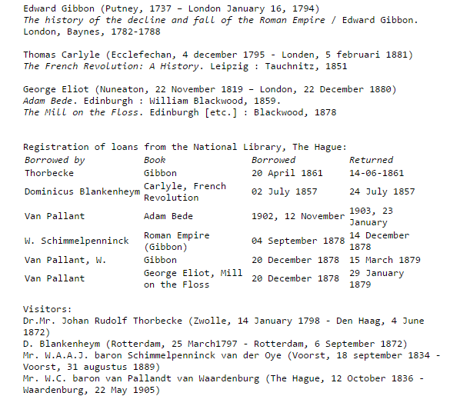

Slide 41
