Slide 1
Digital Media Technology Week 4: Introduction to XSLT

Slide 2







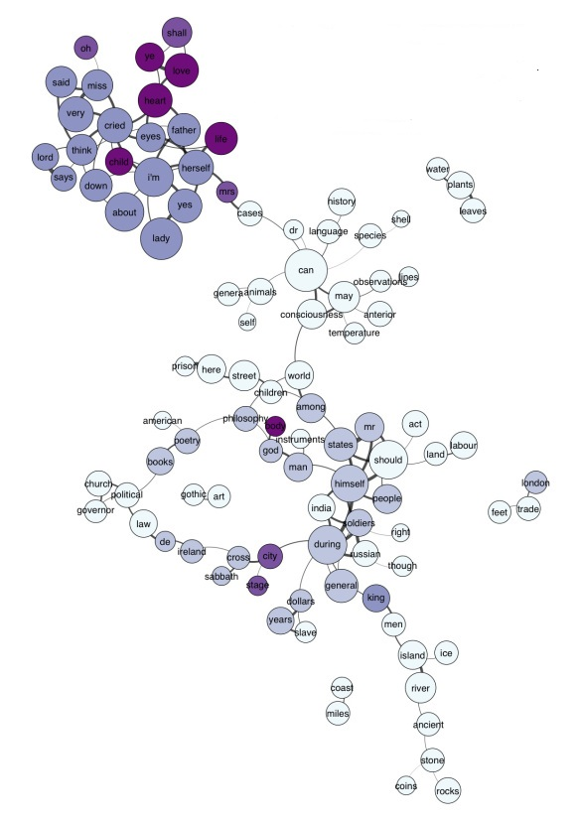

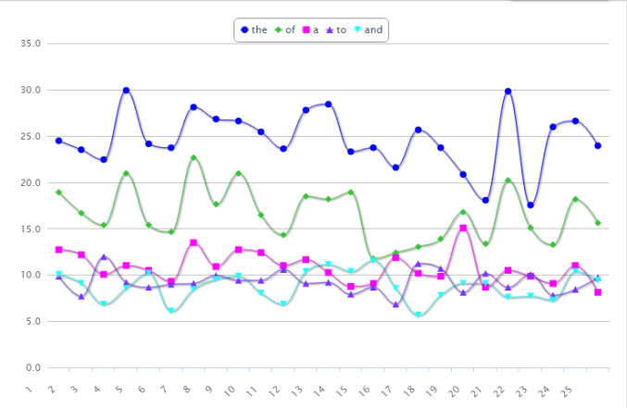
Unprecedented growth in volume of digital data
Combined with growing sophistication of algorithms and tools

Slide 3



Slide 4
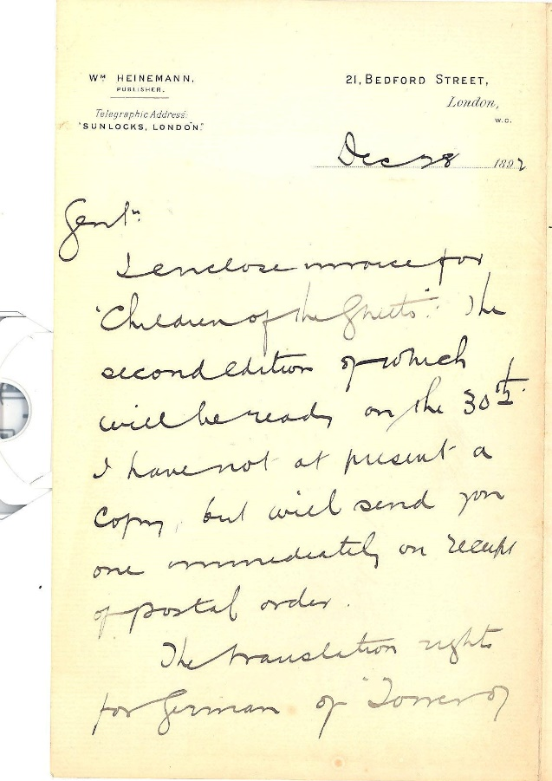
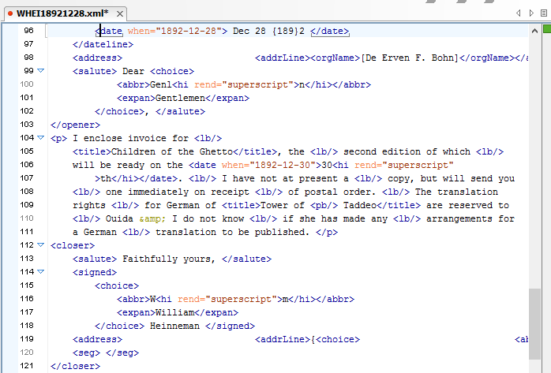

Slide 5
Characteristics of digital models
“a set of ontological commitments”
Expressed in a “formal language”
Based on a “fragmentary theory of intelligent reasoning” and “shaped by the need for efficient computation”
John Unsworth, “What is Humanities Computing and What is Not?”, 2002.

Slide 6
“a set of ontological commitments” > DTD
Expressed in a “formal language” > XML
Based on a “fragmentary theory of intelligent reasoning” and “shaped by the need for efficient computation” > XSLT

Slide 7
Writing an XSLT stylesheet
Study the structure of the source tree (make a tree diagram)
Plan the result tree
Create the <xsl:stylesheet> root element
Add a first template (<xsl:template>) whose match attribute point to the root element of the source tree
Set up basic HTML page

Slide 8
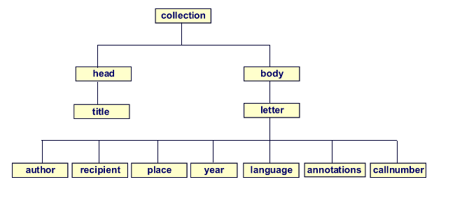
<xsl:template
match=“collection” > </xsl:template>

Slide 9
Copying and pasting text
Use <xsl:value-of> to select text from the XML source.
<xsl:value-of select=“body/letter/author”/>

Slide 10

Computational thinking: the capacity to formulate solutions to problems in such a way that they can be carried out by a machine
Needed to build algorithms

Slide 11
Algorithms
Term derived from Muhammad Al-Khwārizmī, who wrote Al-Kitab al-mukhtasar fi hisab al-jabr wa'l-muqabala (”The book on Calculations using the Numbers of the Indians”)
Unambiguous description of the steps that need to followed to arrive at a specific result

Slide 12
Program Structure Diagram
Algorithms can be described in program structure diagrams
First developed by Ben Schneiderman and Isaac Nassi
Three basis building blocks: sequence, selection and iteration
Calculating the square of a number via actions in sequence:
a = 4
Print a * a

Slide 13
Sequence
How many seconds are there in a day?
Minute = 60
Hour = 60
Day = 24
Print Day * Hour * Minute

Slide 14
Selection
Greeting based on time of day
Find current time
Time before 12:00?
Y
N
Print “Good Morning!”
Print “Good Afternoon!”

Slide 15
Given two numbers, find the minimum
a = 8
b = 12
min = a
b < a?
Y
N
min = b

Slide 16
Iteration
Find and replace text
Read full text
While full text contains “2018”
Replace with “2019”

Slide 17
Print the multiplication table of 5
For i in 1 … 10
Print i times 5 = i * 5

Slide 18
Example from PHP
hour = date('h') ;
if ( hour < 12) {
print “Good morning!” ;
} else {
print “Good afternoon!” ;
}

Slide 19

Iteration: <xsl:for-each>
Use <xsl:for-each> to select all the elements of the same type on a certain level
Takes @select, to point to the node
Note: <xsl:for-each> changes the context of its children!

Slide 20
<xsl:sort>
Use <xsl:sort> to sort a list alphabeticaly or numerically, by the element in the @select attribute
<xsl:sort> must be the direct child of <xsl:for-each> (or <xsl:apply-templates>)
<xsl:for-each select=”item”>
<xsl:sortselect=”fullTitle/title”/>
<xsl:value-of select=“fullTitle”/>
</xsl:for-each>

Slide 21
Two types of components in
programming languages
Statements: instructions which perform/execute an action. For example: a calculation or printing output
Flow control: structural components which determine when and how statements are executed

Slide 22
<xsl:value-of select=“imprint/place” />
<xsl:text>: </xsl:text>
<xsl:value-of select=“imprint/publisher”/>
<xsl:text>, </xsl:text>
<xsl:value-of select=“imprint/date” />
<imprint>
<publisher>Cambridge University Press</publisher>
<date>1983</date>
</imprint>

Slide 23
Selection: <xsl:if>
Takes @test, which specifies a criterion
<xsl:if test = “imprint/place” />
<xsl:value-of select=“imprint/place” />
</xsl:if>

Slide 24
XPath
Language for finding information in an XML document
Nodes and tokens
Xpath expressions are always interpreted in a context
All @select and @test attributes are followed by Xpath expressions

Slide 25
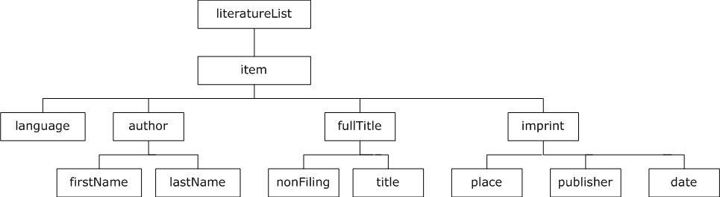
If context is set at “literatureList”: item/fullTitle/title

Slide 26
Selecting the value of an attribute: item/language/@languageCode

Slide 27
<xsl:for-each select=”item”>
<xsl:if test=“language/@languageCode = ‘eng’”/>
<xsl:value-of select=“fullTitle”/>
</xsl:if>
</xsl:for-each>

Slide 28
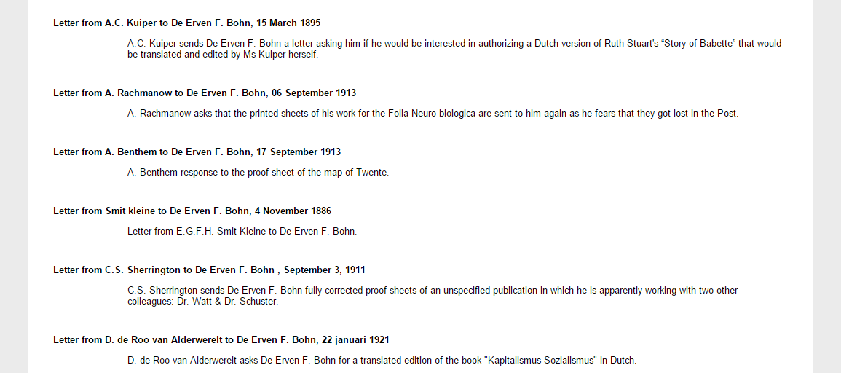
Filtering

Slide 29
Operators and operands
Operators are tokens which represent specific actions
Mathematical operators or Boolean operators
The values that these operators work on are called the operands
Mathematical operators
+
-
*
/
Boolean operators
<
>
=

Slide 30
Expressions
Combination of operands and operators
Boolean expressions can be either true or false; they do not perform any action in themselves
Two or more expressions can be combined using ‘and’ or ‘or’
5 < 8
a > 12
(t > 12) and (t < 18)

Slide 31
<xsl:for-each select=”item”>
<xsl:if test=“imprint/date &gt; 1900 “>
<xsl:value-of select=“fullTitle”/>
</xsl:if>
</xsl:for-each>

Slide 32
count() function
Counts the number of elements on a particular location
<xsl:value-of select=“count(item)” />

Slide 33
