Slide 1
Digital Media Technology Week 9: Introduction to Relational Databases

Slide 2
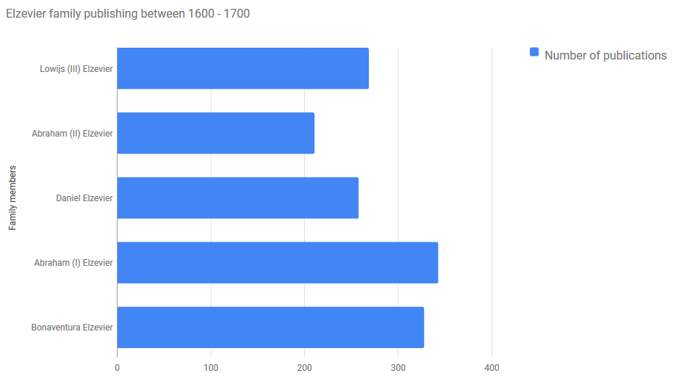
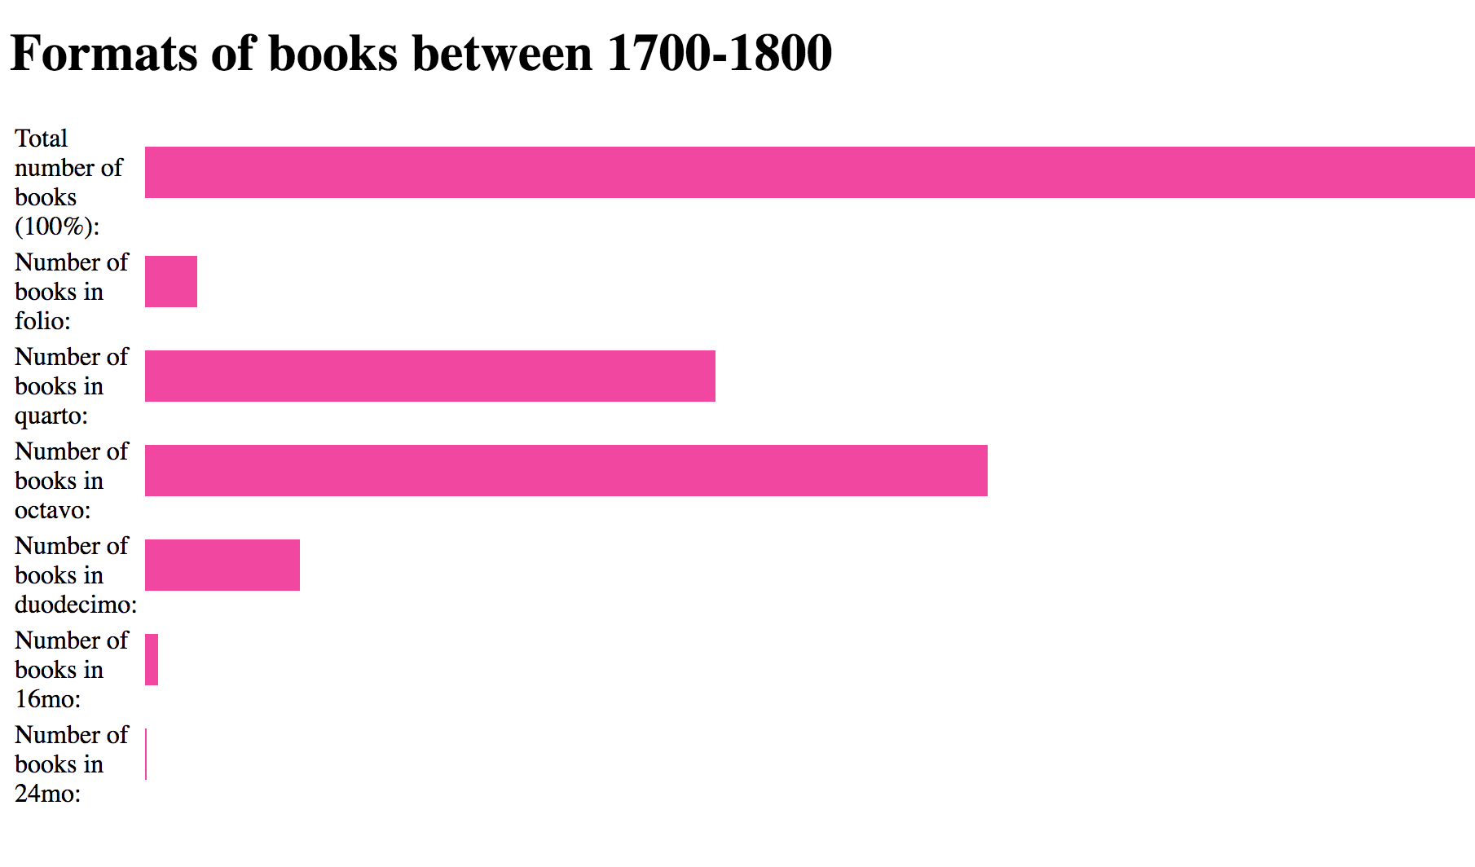

Slide 3
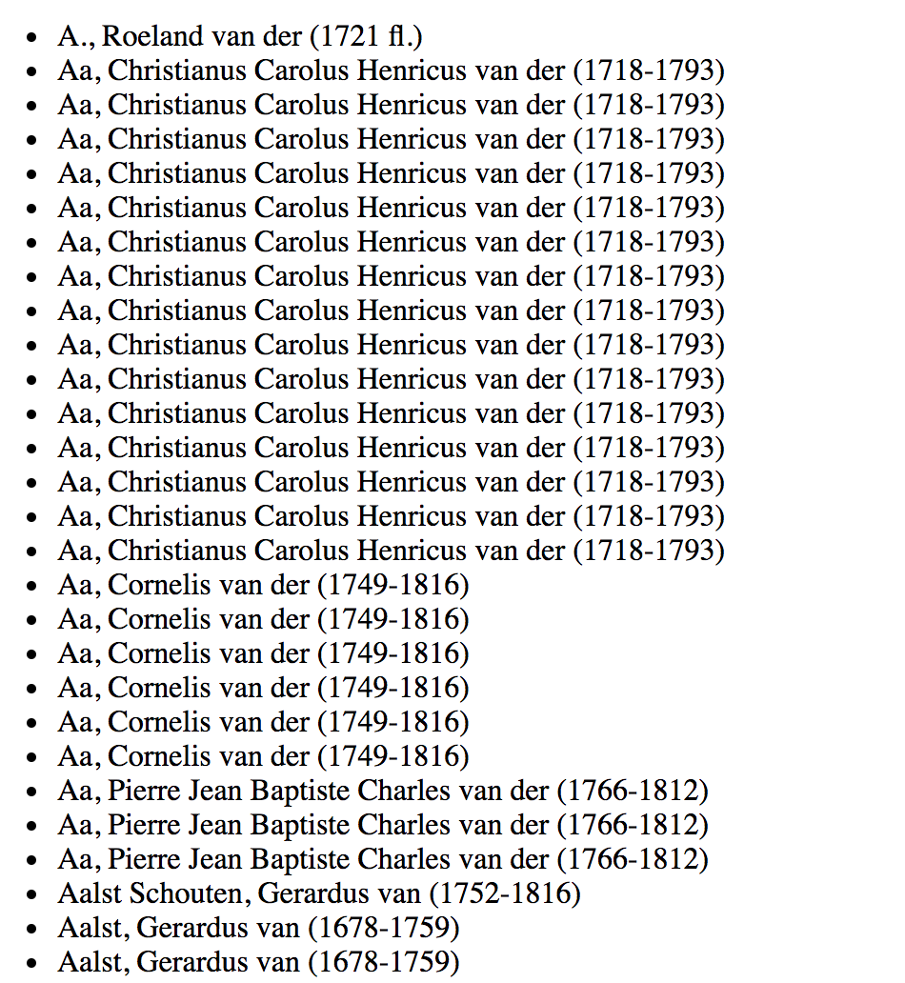
Which publishers were the most productive?
Which authors wrote the highest number of titles?

Slide 4
For each book, list the publisher
Sort the list alphabetically
Create groups, based on unique values (each publisher is a separate group)
Count the number of items in each group
Rank the groups, based on these counts

Slide 5
XSLT and data processing
Strengths
Creation of lists
Filtering a list
Counting the number of items in a list
Weaknesses
Finding the unique values in a list
Count the number of items for each of these unique values

Slide 6
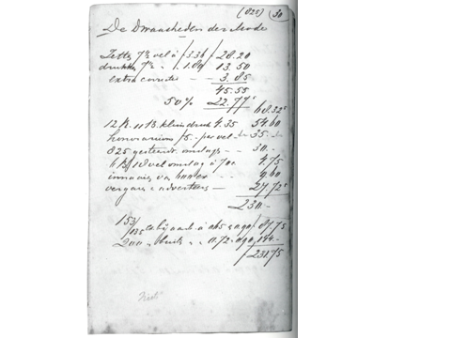
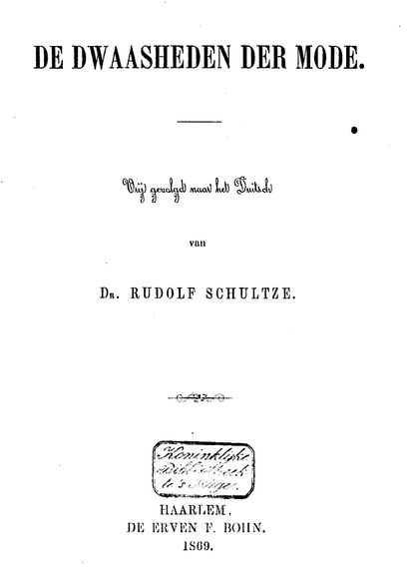

Slide 7
Linearity
The import of books from Britain into the Netherlands between 1850 and 1879 increased from f 21,085 to f 161,925, or some 760% in a 29-year period. By comparison, overall book imports in the same period went from f 341,449 to f 1,509,732 or almost 440%. In other words, if import of foreign books was booming generally, the British share in this import grew even faster. In 1850 it amounted to just over 6% of all book imports, growing to a full 10% in 1879. By 1939 the figure for books and periodicals are separate. British books by then account for 18% of all book imports; British periodicals for 43% of all periodical imports. Thus, the average of books and periodicals is 23%.We can put this remarkable growth in perspective by comparing it with the book title production within the Netherlands itself, which went up from 1732 titles in 1850 to almost 3000 (2948) in 1900: an increase of less than 200% over a 50-year period, compared to the 760% over a 29-year period in the case of British imports.

Slide 8
Structure
Date,Author last name,Author first name,Title,Vols,No. printed,No. sold,Mudie's subs,Mudie's %
Jan. 1858,Eliot,George,Scenes of Clerical Life,2,1050,1006,350,35
Dec. 1858,Lytton,Edward Bulwer,What Will He Do With It?,4,4200,3801,1725,45
Jan. 1859,Eliot,George,Adam Bede,3,3416,3304,1500,45
June 1863,Speke,John Hanning,What Led to the Discovery of the Nile,1,1575,922,100,11

Slide 9
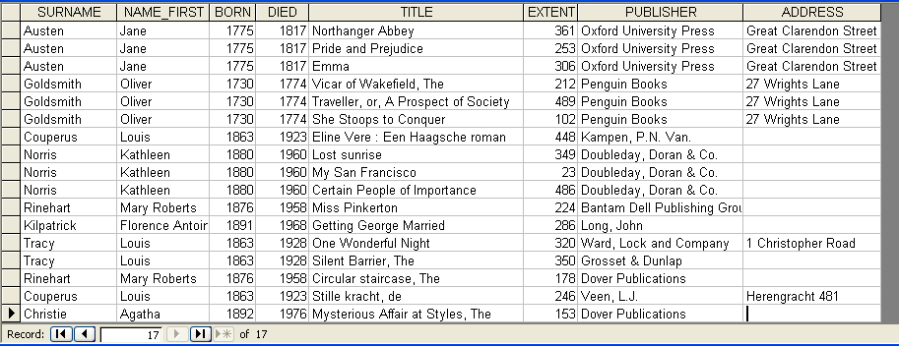
Efficiency

Slide 10
A database is a collection of structured and related data which
is organised in a structured way
allows for random access because of its non-linear nature
ideally maximises storage and retrieval efficiency by avoiding data redundancy
is persistent and durable
Database management system (DBMS): computer program that enables users to store, modify, and extract information from a database

Slide 11
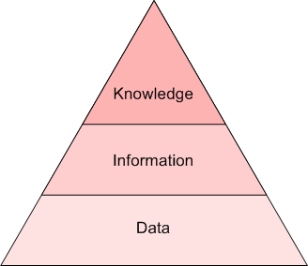
Interpretation continuum
DIKW Pyramid (Ackoff)
Data
Information

Slide 12
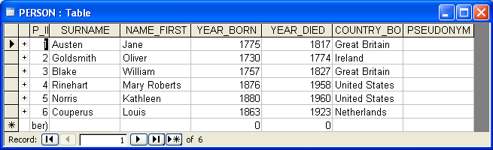
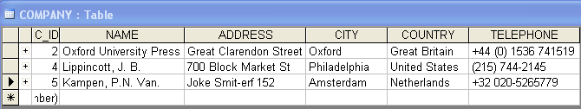
Tables, Rows, Columns
Fields (columns)
Records (rows)
Records (rows)

Slide 13
Flat File Database
AUTHOR_ID | LAST_NAME | FIRST_NAME | YEAR_OF_BIRTH | YEAR_OF_DEATH | NATIONALITY
1 | Austen | Jane | 1775 | 1817 | uk
2 | Goldsmith | Oliver | 1730 | 1774 | ie
3 | Beckett | Samuel | 1906 | 1989 | ie
4 | Shaw | George Bernard | 1856 | 1950 | ie
5 | Pinter | Harold | 1930 | 2008 | uk
6 | O'Neill | Eugene | 1888 | 1953 | us

Slide 14
CRUD: Create, Retrieve, Update, Delete
LAST_NAME | FIRST_NAME | YEAR_OF_BIRTH | YEAR_OF_DEATH | NATIONALITY | TITLE | PUBLISHER | YEAR | EXTENT
Austen | Jane | 1775 | 1817 | uk | Mansfield Park | Cambridge University Press | 2005 | 738 p.
Austen | Jane | 1775 | 1817 | uk | Persuasion | Cambridge University Press | 2006 | 392 p.
Beckett | Samuel | 1906 | 1989 | ie | Endgame : a play in one act | Faber and Faber | 1965 | 60 p.
Beckett | Samuel | 1906 | 1989 | ie | Molloy | Calder | 1997 | 176 p.
Beckett | Samuel | 1906 | 1989 | ie | Watt | Calder | 1963 | 225 p.
Goldsmith | Oliver | 1730 | 1774 | ie | She stoops to conquer | Oxford University Press | 1995 | 120 p.
Goldsmith | Oliver | 1730 | 1774 | ie | The vicar of Wakefield | George Routlede and Sons | 1886 | 320 p.
O'Neill | Eugene | 1888 | 1953 | us | Strange interlude : a play | Cape | 1965 | 348 p.
O'Neill | Eugene | 1888 | 1953 | us | Long day’s journey into night | Cape | 1966 | 156 p.
Heaney | Seamus | 1939 |  | ie | Death of a Naturalist | Faber and Faber | 1966 | 67 p.
Heaney | Seamus | 1939 |  | ie | Seeing Things | Faber and Faber | 1991 | 78 p.
Shaw | George Bernard | 1856 | 1950 | ie | Major Barbara | Penguin | 1957 | 153 p.

Slide 15
AUTHOR_ID | LAST_NAME | FIRST_NAME | YEAR_OF_BIRTH | YEAR_OF_DEATH | NATIONALITY
1 | Austen | Jane | 1775 | 1817 | uk
2 | Goldsmith | Oliver | 1730 | 1774 | ie
3 | Beckett | Samuel | 1906 | 1989 | ie
4 | Shaw | George Bernard | 1856 | 1950 | ie
5 | Pinter | Harold | 1930 |  | uk
6 | O'Neill | Eugene | 1888 | 1953 | us
Shared values
foreign key
primary key
BOOK_ID | TITLE | AUTHOR_ID | PUBLISHER | YEAR | EXTENT
1 | Mansfield Park | 1 | Cambridge University Press | 2005 | 738 p.
2 | Persuasion | 1 | Cambridge University Press | 2006 | 392 p.
3 | Long day’s journey into night | 6 | Cape | 1966 | 156 p.
4 | Strange interlude : a play | 6 | Cape | 1965 | 348 p.
5 | Molloy | 3 | Calder | 1997 | 176 p.
6 | The caretaker | 5 | Methuen | 1960 | 78 p.
7 | She stoops to conquer | 2 | Oxford University Press | 1995 | 120 p.
8 | The vicar of Wakefield | 2 | George Routlede and Sons | 1886 | 320 p.
9 | Endgame : a play in one act | 3 | Faber and Faber | 1965 | 60 p.
10 | Watt | 3 | Calder | 1963 | 225 p.
11 | The homecoming | 5 | Methuen | 1972 | 67 p.
12 | Major Barbara | 4 | Penguin | 1957 | 153 p.

Slide 16
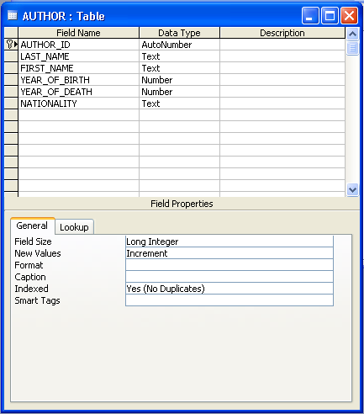
Primary Key

Slide 17
E.F. Codd, “A Relational Model of Data for Large Shared Data Banks” (1970)
Peter Chen, “The Entity-Relationship Model: Toward a Unified View of Data” (1976)

Slide 18
Entity-Relationship Modelling
Technique to visualise the various relationships between the entities in a database
Steps:
(1) Identify entities
(2) Identify attributes
(3) Establish relationships and cardinalities
(4) Remove many-to-many relationships

Slide 19
PUBLISHER
AUTHOR
BOOK

Slide 20
AUTHOR
P_ID
FIRST_NAME LAST_NAME DATE_OF_BIRTH DATE_OF_DEATH NATIONALITY
Attributes
PK is underlined

Slide 21
writes
AUTHOR
BOOK
is enrolled in
STUDENT
COURSE
works for
EMPLOYEE
COMPANY
owns
LIBRARY
BOOK

Slide 22
Cardinality
How many instances of the entity can be related to how many instance of another entity?
The answer to this question should be one of the following: one-to-one, one-to-many, many-to-one, many-to-many.

Slide 23
one-to-one
COUNTRY
CAPITAL
one-to-many
AUTHOR
BOOK
many-to-many
STUDENT
COURSE

Slide 24
Many-to-many relationships
Person1 Company1
Person2 Company1
Person1 Company2
Person3 Company2
Person2 Company3
Person3 Company3

Slide 25
COMPANY
PERSON
(employee)
(employer)
P_ID
?
C_ID
[ DETAILS ]
[ DETAILS ]
many
many
EMPLOYMENT
E_ID
P_ID
C_ID
[ DETAILS ]

Slide 26
Important Principles
There must always be a one-to-one relationship between an entity’s primary key and its descriptive attributes.
There can only be one-to-many relationships between different entities.
In the case of many-to-many relationships, a separate table must be created (a linking table) in order to record information about this relationship.

