Slide 1
Digital Media Technology Week 7: XSLT 3

Slide 2
Requirements for DMT
Assignment 1 on XML Deadline: 15 October
Assignment 2 on XSLT Deadline: 12 November
Assignment 3 on SQL Deadline: 18 December
Take home exam: combination of all topics Deadline: 25 January

Slide 3
Taking a certain list of titles as input, display only those titles written after the year 2000
While there are titles in the bibliography
Published before 2000?
Y
N
Print author name, title, imprint

Slide 4
Iteration
<xsl:template match=“literatureList”>
<xsl:for-each match=“item”>
</xsl:for-each>
</xsl:template>

Slide 5
Selection
<xsl:template match=“literatureList”>
<xsl:for-each match=“item”>
<xsl:if test=“imprint/year &gt; 2000”>
</xsl:if
</xsl:for-each>
</xsl:template>

Slide 6
XPath
Language for finding information in an XML document
@select and @test attributes all take Xpath expressions
It represent an XML file as a collection of nodes (elements and attributes). These nodes are represented using specific tokens.
Xpath expressions are always interpreted within a certain context

Slide 7
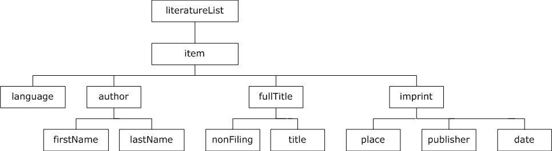
Selecting the value of an attribute: item/language/@languageCode

Slide 8
Selection
<xsl:template match=“literatureList”>
<xsl:for-each match=“item”>
<xsl:if test = “language/@languageCode = ‘eng’”>
</xsl:if
</xsl:for-each>
</xsl:template>

Slide 9
Namespaces
Element prefixes which indicate the ‘source’ of each element: which DTD/Schema does it belong to?
Namespace declaration in root element, e.g. xmlns:xsl="http://www.w3.org/1999/XSL/Transform"
They help with disambiguation
Examples: xsl:value-of, tei:teiHeader, tei:p, html:p

Slide 10

Counting elements
The count() function counts the number of elements on a particular location
For example: count( letter) results in the number 8

Slide 11
<xsl:template match=“literatureList”>
<xsl:value-of select=“count(item)”/>
<!–- this shows the total number
of items in the list -->
</xsl:template>

Slide 12
<xsl:template match=“literatureList”>
<xsl:value-of select=
“count( item[imprint/year &gt; 2000] )”/>
<!–- this shows the number
of titles published after 2000 -->
</xsl:template>

Slide 13
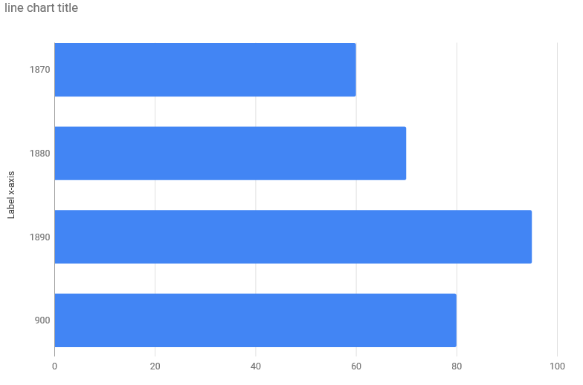
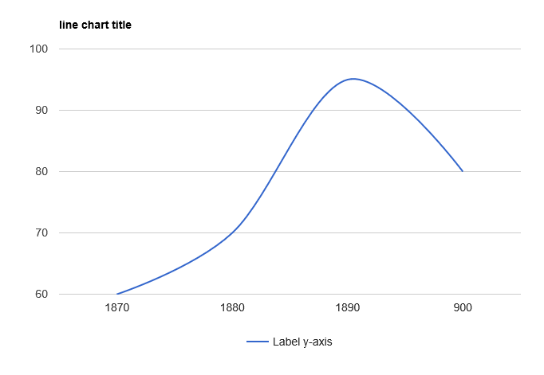
Data about TEI files
Abstracts
Counting the number of words
Visualising encoding
N.B. The ontology determines what we can visualise

Slide 14
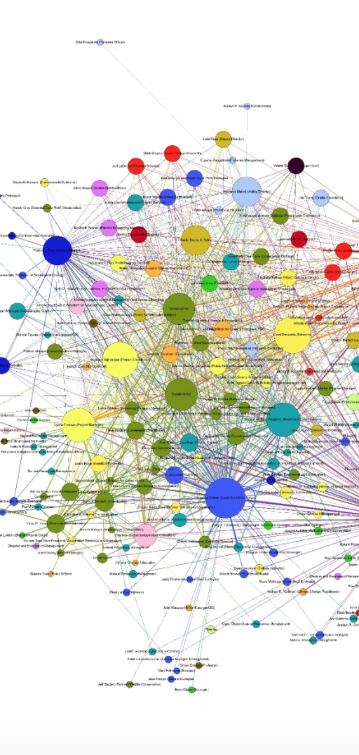
Distant reading
Term coined by Franco Moretti to describe collaborative research
Similar concepts expressed by Matthew Jockers (“Macroanalysis”) and by Martin Mueller (“Scalable readng”)
Used commonly in DH research to refer to resources which present textual material in an abstract, non-textual manner

Slide 15
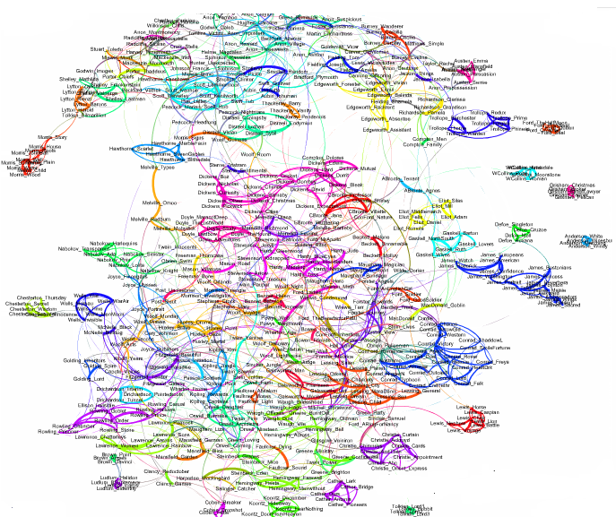
600 novels
Source: Jan Rubicky, Visualising Literature

Slide 16

Not Reading
“A book is an element in the vast ensemble I have called the collective library, which we do not need to know comprehensively in order to appreciate any one of its elements… The trick is to define the book’s place in that library, which gives it meaning in the same way a word takes on meaning in relation to other words”

Slide 17



Scalable Vector Graphics
<svg width="400" height="110"> <rect width="300" height="100" /> </svg>

Slide 18
API
An Application Programming Interface is a definition of an application which can be used to make specific functions of this application or specific data sets available for external services
Request + key
User
API
Service
XML / JSON

Slide 19
Example 1
The NYT The Books API enables you to get data about books reviews and bestseller lists.
Lists of bestsellers can be retieved using the following base URL: http://api.nytimes.com/svc/books/v3/lists
To find a specific bestseller list, provide the date of of the list in the format YYY-MM-DD, and use the name of the list, in combination with the required data format.
For example: http://api.nytimes.com/svc/books/v3/lists/2018-03-01/combined-print-and-e-book-fiction.xml?api-key=cda705355dc731a3b819ac80ce02578b:15:72378286

Slide 20
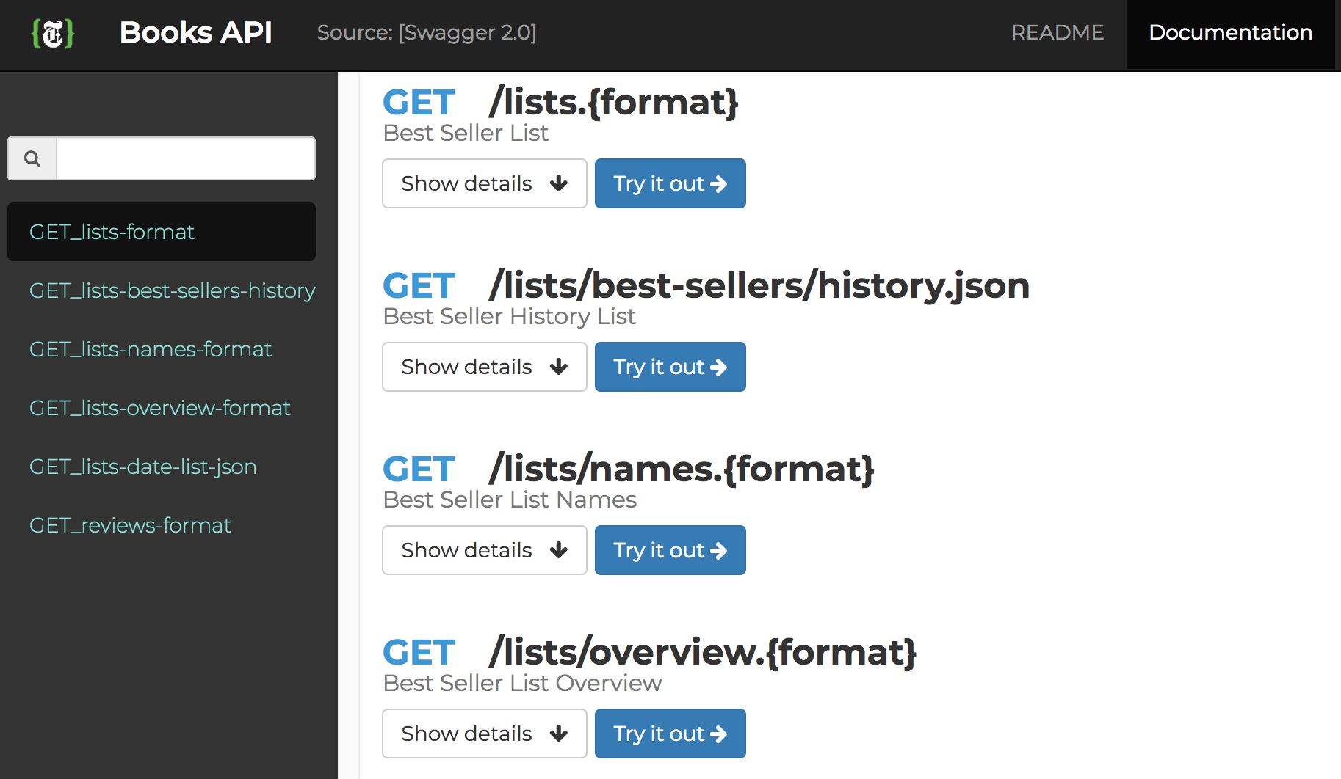
Components
Base URL
Verb
Parameters
Key

Slide 21
Example 2
You can use the GoodReads API to get data about book titles, ratings, reviews and related titles, among many other data.
Base URL: https://www.goodreads.com/book/
You can use the ISBN function to get the review statistics for a given book, using its ISBN.
Example: https://www.goodreads.com/book/isbn/9780385537148?key=yZUIiWVAZOHzCFlFwIOTXA

Slide 22
Example 3: IIIF
https://media.nga.gov/iiif/public/objects/1/0/6/3/8/2/106382-primary-0-nativeres.ptif/full/full/0/default.jpg
https://media.nga.gov/iiif/public/objects/1/0/6/3/8/2/106382-primary-0-nativeres.ptif/full/400,/90/default.jpg
https://media.nga.gov/iiif/public/objects/1/0/6/3/8/2/106382-primary-0-nativeres.ptif/3500,2600,3400,2000/400,/0/default.jpg
https://media.nga.gov/iiif/public/objects/4/6/3/0/3/46303-primary-0-nativeres.ptif/full/full/0/default.jpg
https://media.nga.gov/iiif/public/objects/1/1/3/8/1138-primary-0-nativeres.ptif/full/full/0/default.jpg

