Slide 1
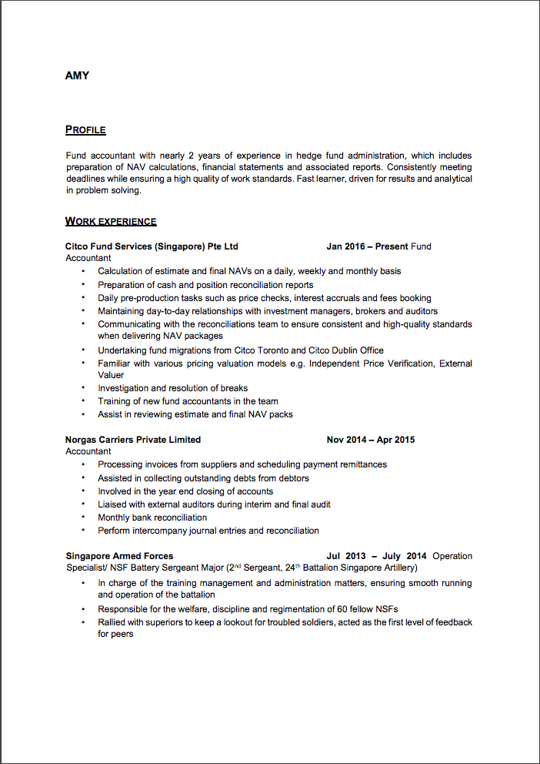

HAVE YOU NOTICED “KEYWORD STUFFING" IN RESUMES?
Group 9
Job candidates hide transparent key words on their resumes to:
Ensure the online screening process rank their resumes with high relevance
Avoid being caught by human eyes afterwards
Qualified Resume?
Not
Really!
Why ‘Keyword Stuffing’ Hurts?
Waste hiring managers time
Lower opportunities of other qualified job candidates
WE CAN HELP IDENTIFY POTENTIAL RESUME FRAUDS NOW!

Slide 2


SIMPLE ALGROTHMN, BIG BENEFITS
1
Convert
PDF
into doc File
Scan resume via DOCX Package to reveal hidden words
2
3
Flag cheated resumes in ranking system
Resume Fraud Detection Services
Phone: (123) 456 7890
Email: resumedection@umn.edu
Members: Boyang (Peter) Wei, Yuankun (Tyler) Huang, Xu Lin, Yi (Elizabeth) Zhu, Chuchen (Leo) Xiong, Yi-Li (Matt) Yu

