Slide 1
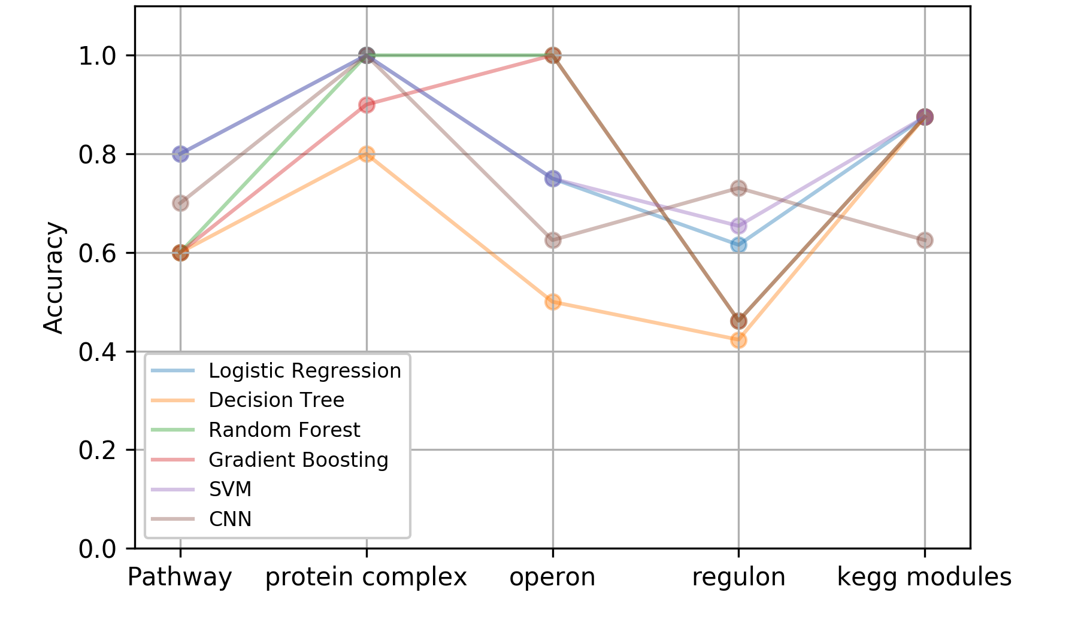
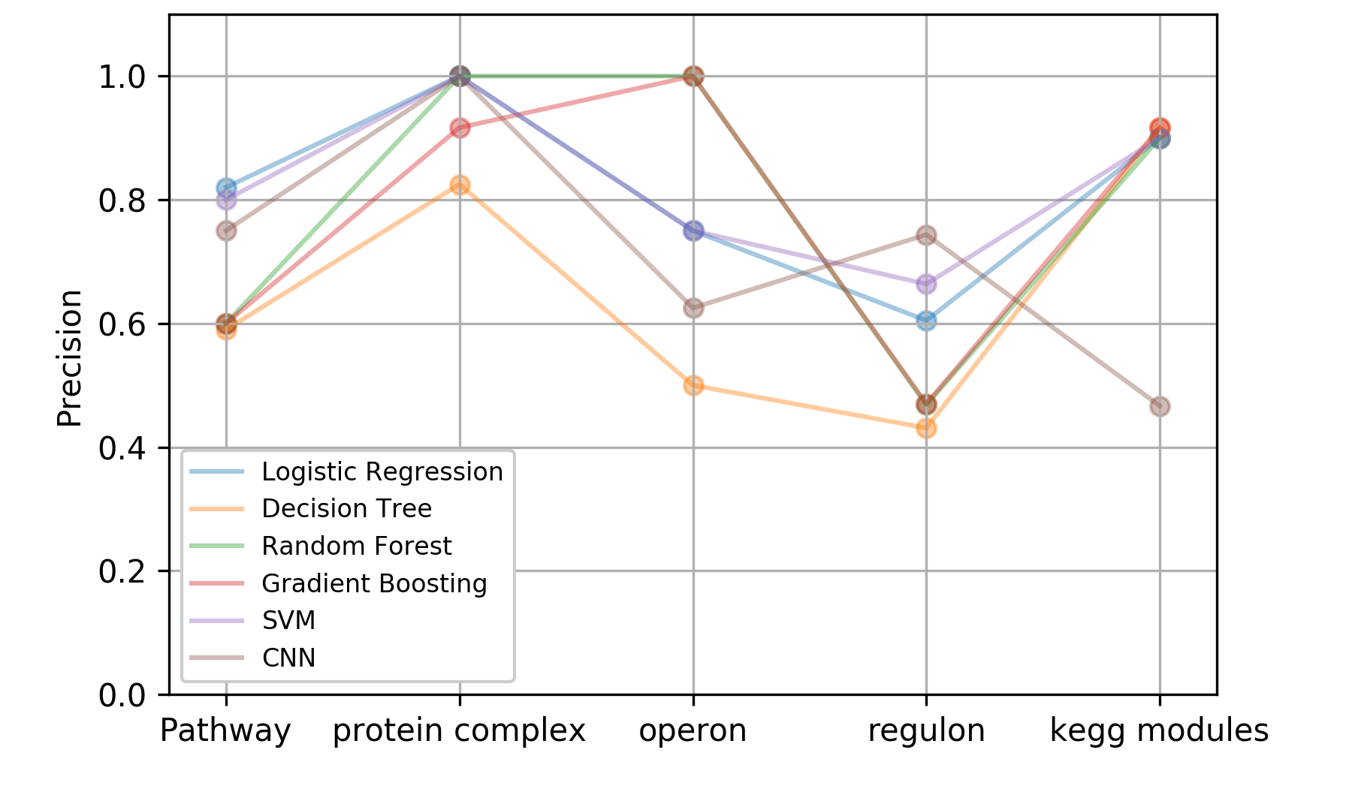
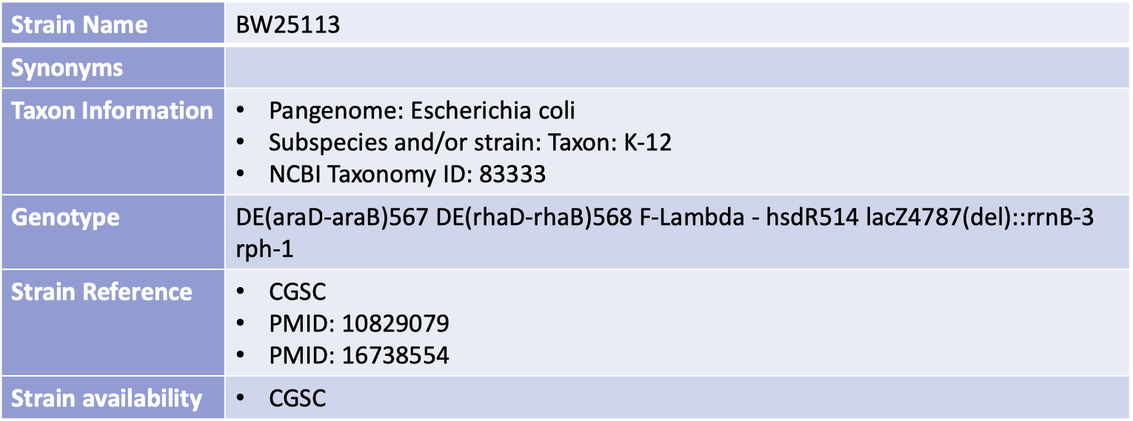
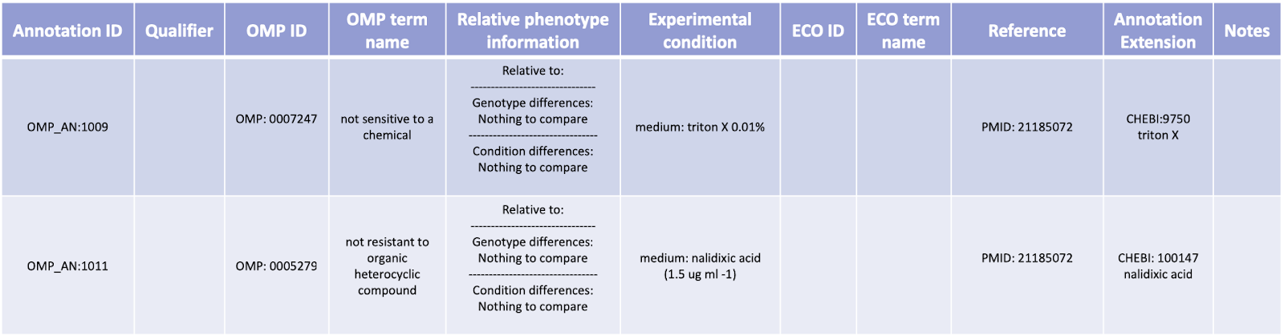
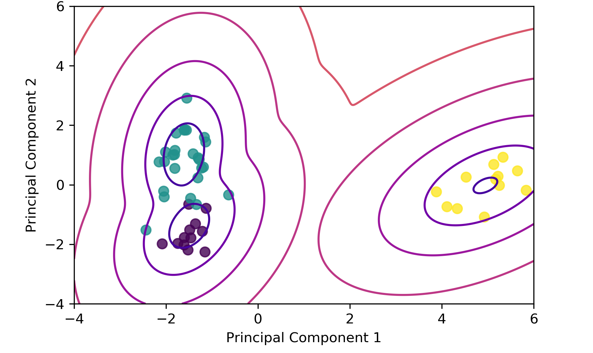
Machine learning on microbial phenotypes to classify gene functions
Peter I-Fan Wu¹, Chiou-Jiin Huang², Hao-Yu Miao³, Bobak Mortazavi³ and Jim Hu¹ ¹Dept. of Biochemistry and Biophysics, ²Dept. of Information and Operations Management and ³Dept. of Computer Science and Engineering, Texas A&M University, College Station, TX
Abstract
Methods
Discussion and future directions
High-throughput studies of microbial phenotypes hold the potential in elucidating the functions of genes. Here we combined 2 high-throughput phenotype datasets with 5 categories of annotations as labels to classify genes with distinct functions. Preliminary results using complete phenotype data yielded mediocre performance, possibly resulted from incomplete annotations and/or non-separable nature of functional associations of our genome-wide studies. However, selecting small numbers of mutually exclusive classes significantly improves the performance, indicating that the power of high-throughput phenotyping can be coupled with machine learning to associate genes that are functionally connected.
From each annotation, 3 classes of functions are selected and used as the target variable, while the other genes that don’t belong to the 3 classes are omitted. Features were used from two high-throughput phenotype dataset (Reference 4., 5.).
Various supervised and unsupervised machine learning methods were used extensively for all annotation sets. In supervised learning, 80% - 20% training/test split with 3-fold inner cross-validation was applied.
Small subsets of data picked by biochemical knowledge guarantee enough samples which are mutually exclusive under distinct labels, therefore resulted in descent performance to learn functions via phenotypes. However, the impact of using machine learning on complete phenotype data with better labeling is yet to be done. We have tired to reduce the dimensions of annotations by hierarchical clustering and separate genes into distinct categories. However, we obtained almost no separation by PCA, t-SNE or self-organizing map, and poor performance on all the supervised learning methods we tried (~40% accuracy. Data not shown). Hopefully, with more annotations become available in the future, the genome-wide phenotypic data we have shown here can be much better exploited.
The Hu lab under Biochemistry is mapping various high-throughput phenotype data into Ontology of Microbial Phenotypes (microbialphenotypes.org). We expect that re-annotating the phenotypes into a better-defined lexical structure can facilitate the utility of them in terms of associating functions. Also, this allows not only the phenotypes from E. coli, but also other microorganisms such as bacillus, yeasts, to be compared altogether.
Results
For each selected category of annotations, 6 supervised learning techniques were applied. Maximum performance for each annotation ranges from 73% to 100% for both accuracy and precision. Overall, the phenotype data used here seem to be most effective in learning genes that constitute the same protein complex, and worst in genes that are co-regulated. This result is reasonable since the deletion of any subunit in a protein complex is very likely to cause the same malfunction and downstream phenotypes, while co-regulated genes might perform utterly different functions from different operons.
Accuracy
Background
Phenotypes play important roles in understanding functions of genes, leading to better understanding of disease models and thus contribute to new drug discoveries. Among model organisms that can be easily manipulated to test hundreds of thousands of phenotypes in parallel, E. coli serves as one of the best. We here would like to combine 2 different datasets that contain all phenotype data under mutation of almost every single gene of E. coli as the features (486 features for 3525 genes) and use 5 sets of gene annotations as the target variables to classify genes of similar functions.
Precision
An example annotation from E. coli BW25113
Intersections of the 5 annotations sets on ~3500 genes
GMM with EM after PCA
References
1. Gama-Castro, S., Salgado, H., Santos-Zavaleta, A., Ledezma-Tejeida, D., Muniz-Rascado, L., Garcia-Sotelo, J. S., . . . Collado- Vides, J. (2016). RegulonDB version 9.0: high-level integration of gene regulation, coexpression, motif clustering and beyond. Nucleic Acids Res, 44(D1), D133-143. doi:10.1093/nar/gkv1156
2. Kanehisa, M., Sato, Y., Kawashima, M., Furumichi, M., & Tanabe, M. (2016). KEGG as a reference resource for gene and protein annotation. Nucleic Acids Res, 44(D1), D457-462. doi:10.1093/nar/gkv1070
3. Keseler, I. M., Mackie, A., Santos-Zavaleta, A., Billington, R., Bonavides-Martinez, C., Caspi, R., . . . Karp, P. D. (2017). The EcoCyc database: reflecting new knowledge about Escherichia coli K-12. Nucleic Acids Res, 45(D1), D543-D550. doi:10.1093/nar/gkw1003
4. Nichols, R. J., Sen, S., Choo, Y. J., Beltrao, P., Zietek, M., Chaba, R., . . . Gross, C. A. (2011). Phenotypic landscape of a bacterial cell. Cell, 144(1), 143-156. doi:10.1016/j.cell.2010.11.052
5. Price, M. N., Wetmore, K. M., Waters, R. J., Callaghan, M., Ray, J., Liu, H., . . . Deutschbauer, A. M. (2018). Mutant phenotypes for thousands of bacterial genes of unknown function. Nature, 557(7706), 503-509. doi:10.1038/s41586-018-0124-0
4000
For the selected protein complexes, clear separation was observed after dimension reduction
Quality but incomplete annotations for genes make labeling exploratory and challenging

