Slide 1
High-performance Branch Predictors For Soft Processors
Di Wu
M.A.Sc Defense
September 8, 2014

Slide 2
Why Branch Prediction
Time
Without a Branch Predictor
Branch
stall
Branch Predictor: Correct prediction
Guess Next PC
Fetch and execute speculatively
Branch Predictor: Incorrect prediction
Guess Next PC
Fetch and execute speculatively
Squash
Branch resolved

Slide 3
Branch Predictors on FPGAs
Fetch Stage
Decode Stage
Slower relative to ASIC
iCache
(BRAM)
Branch Prediction Logic
Branch Prediction Table
(BRAM)
Faster relative to ASIC
Next PC

Slide 4
Road Map
Introduction
Branch Prediction Overview
Branch Target Predictors
Branch Direction Predictors
Conclusion

Slide 5
Branch Prediction
Fetch Stage
Decode Stage
iCache
Branch Prediction Logic
REQ1: Guess the direction of a branch
REQ2: Guess its target (Next PC)
Fetch instructions from there
Execute Speculatively
Verify if the prediction was correct
Branch Prediction
Table
Next PC

Slide 6
REQ #1. Direction Predictors
bimodal
gshare
gselect
PC
PC
PC
XOR
Concatenate
…
…
…
DIR table
DIR table
DIR table
GHR
GHR

Slide 7
Direction Predictors - Perceptron
Weight Table
weight vector
w₀
w_{h}
……
X
G₀
X
G_{h}
+

Slide 8
Direction Predictors - TAGE
PC
h[0:L(1)]
PC
h[0:L(2)]
PC
h[0:L(3)]
PC
h[0:L(4)]
PC
hash
hash
hash
hash
hash
hash
hash
hash
T₀
T₁
T₂
T₃
T₄
base
ctr
tag
u
ctr
tag
u
ctr
tag
u
ctr
tag
u
=?
=?
=?
=?
Prediction

Slide 9
REQ #2: Target Predictor
Branch Target Buffer (BTB)
Can be used for all branches
Return Address Stack (RAS)
Uses calls to predict targets of returns
Target Address Pre-calculation

Slide 10
Canonical Branch Predictor
PC
DIR
Selection Logic
BTB
Next PC
RAS
PC + 4
+4

Slide 11
Road Map
Introduction
Branch Prediction Overview
Branch Target Predictors
Branch Direction Predictors
Conclusion

Slide 12
Target Address Pre-calculation
Fetch Stage
Branch Type
Branch Target
insn
Target Address Pre-calculation
iCache
Pre-decode
IMM16/26
Other possible targets
Next PC
Target Selection
Impractical on ASIC

Slide 13
Target Address Pre-calculation
Branch Type
insn
Pre-decode
IMM16/26
I-Type
J-Type
Full Address Calculation (FAC): IMM26/IMM16
Partial Address Calculation (PAC): IMM16 only

Slide 14
Eliminating the BTB
93% of all branches are direct branches
97% of indirect branches are returns

Slide 15
Target Prediction Accuracy
BTB+FAC+RAS has little target prediction accuracy improvement over FAC+RAS

Slide 16
Road Map
Introduction
Branch Prediction Overview
Branch Target Predictors
Branch Direction Predictors
Conclusion

Slide 17
Branch Direction Predictors
Altera’s Nios II-f only uses one BRAM for branch prediction
Two prone approach:
A minimalistic branch predictor that also uses one BRAM
No resource restrictions

Slide 18
The Minimalistic Branch Predictor
Fastest
Inaccurate
Faster
Less inaccurate
Slow
Accurate
Slower
Very accurate
Slowest
Most accurate
Fast
Very Accurate

Slide 19
Timing details of gshare/gselect
f
Selection Logic
…
Target
Predictor/
Calculator
Predicted PC
GHR
…
DIR table

Slide 20
gRselect
2
gRselect
PC
32
GHR
16 DIR entries
…
Selection Logic
Target
Predictor/
Calculator
Predicted PC
…

Slide 21
Relaxing Storage Constraint
Accuracy saturates with increasing predictor sizes
Consider more advanced branch prediction schemes

Slide 22
“Multiplication”
Weight Table
negate
……
negate
w₁
-w₁
w_{n}
-w_{n}
h₁
h_{n}
(a)
Weight Table
Complement Weight Table
……
w₁
-w₁
w_{n}
-w_{n}
h₁
h_{n}
(b)

Slide 23
Low Order Bit Elimination
Using 3 bits at prediction time improves maximum frequency by 14.6% with negligible accuracy reduction

Slide 24












Perceptron Predictor Structure on FPGA
Weight Table
Complement Weight Table
$${\tilde{w}}_{1}$$
$${\tilde{w}}_{2}$$
$${−\tilde{w}}_{1}$$
$${−\tilde{w}}_{2}$$
$${\tilde{w}}_{h−1}$$
$${\tilde{w}}_{h}$$
$${−\tilde{w}}_{h−1}$$
$${−\tilde{w}}_{h}$$
Replace a layer of adders with muxes
……
$${(h}_{1}⊕h_{2})$$
$${(h}_{h−1}⊕h_{h})$$
$$h_{1}$$
$$h_{h−1}$$
Wallace Tree

Slide 25












Perceptron Predictor Structure on FPGA
Weight Table
Complement Weight Table
$${\tilde{w}}_{1}$$
$${\tilde{w}}_{2}$$
$${−\tilde{w}}_{1}$$
$${−\tilde{w}}_{2}$$
$${\tilde{w}}_{h−1}$$
$${\tilde{w}}_{h}$$
$${−\tilde{w}}_{h−1}$$
$${−\tilde{w}}_{h}$$
$${(h}_{1}⊕h_{2})$$
……
$${(h}_{h−1}⊕h_{h})$$
$$h_{1}$$
$$h_{h}$$
6-LUT
6-LUT
Wallace Tree
Reduces one layer of logic

Slide 26
Overriding TAGE
Fetch
Decode
Override
Statistical Corrector
!=
Base Prediction
TAGE
The Statistical Corrector Improves Accuracy by ~2.4x

Slide 27
Evaluation – Minimalistic Predictor
Baseline predictor
256-entry fused BTB and bimodal
Does not decode instructions, uses the BTB and the bimodal for all instructions
Data gathered from SPECCPU2006 benchmarks
Metrics | Description
Misses Per Kilo Instructions (MPKI) | Predictor accuracy
Target prediction rate | Target predictor accuracy
Instruction Per Cycle (IPC) | Overall branch predictor performance without considering maximum frequency
Million Instruction Per Second (MIPS) | Overall branch predictor performance

Slide 28
Direction Prediction Schemes
gshare is the most accurate, followed by gselect and gRselect

Slide 29
Target Address Prediction Schemes
FAC+RAS is the most accurate

Slide 30
Maximum Frequency and Area
FAC+RAS with gRselect+PD is faster than FAC+RAS with bimodal

Slide 31
IPC and MIPS
The overall best performing prediction scheme is FAC+RAS w/ gRselect

Slide 32
Evaluation – Perceptron and TAGE
Bimodal, gshare and gRselect are scaled from 1KB to 32KB
All the schemes use FAC+RAS as target predictor
Four TAGE variations:
single-cycle TAGE, single-cycle TAGE-SC, O-TAGE, O-TAGE-SC
Same methodology

Slide 33
Accuracy
TAGE-SC variations are ~2.3x more accurate than the best gRselect and gshare

Slide 34
IPC
O-TAGE-SC is within 0.5% of the single-cycle TAGE-SC

Slide 35
Maximum Frequency
O-TAGE variations are capped at 270 MHz

Slide 36
IPS
O-TAGE-SC delivers 5.2% higher IPS than the 1KB gRselect

Slide 37
Conclusion
The best performing minimalistic branch predictor is FAC+RAS with gRselect
TAGE is best used as an overriding predictor, and O-TAGE-SC is 5.2% better than the best gRselect.

Slide 38
Thank you!
Questions?

Slide 39
Backup Slides

Slide 40
FAC+RAS with gRselect
2
gRselect
32
GHR
16, 2-bit sat. counters
…
Selection Logic
Target Predictor/
Calculator
iCache
PC
+4
Predicted PC

Slide 41
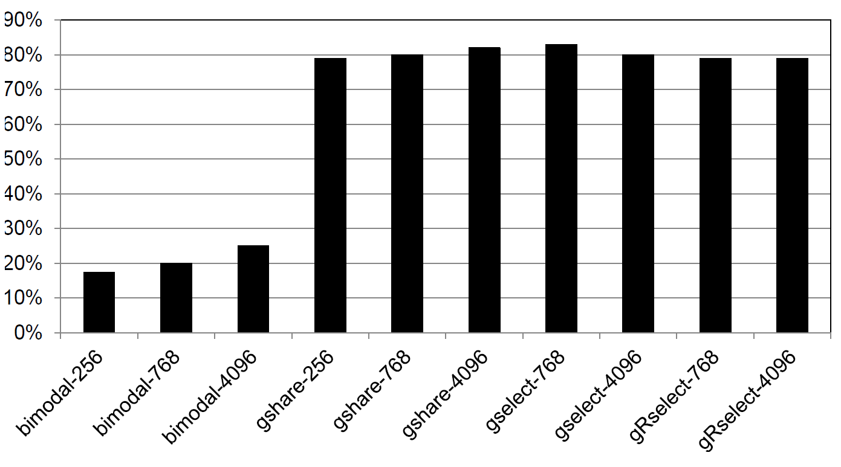
Direction Predictors: MPKI improvement over Base

Slide 42
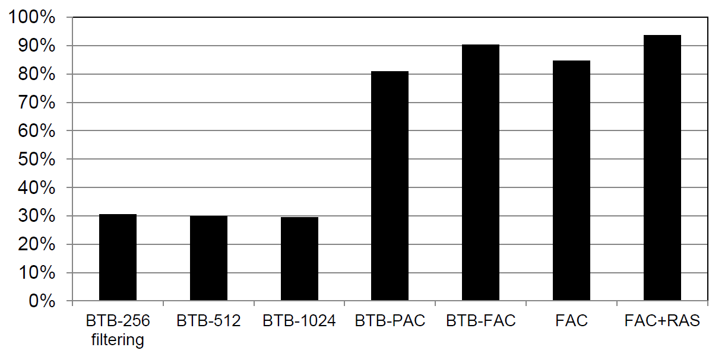
Reduction in target address mis-prediction over BASE

Slide 43
List of Benchmarks
bzip2
gobmk
hmmer
sjeng
libquantum
h264
astar
xalanc

