Slide 1
High-performance Branch Predictors For Soft Processors
Di Wu
M.A.Sc Defense
September 8, 2014

Slide 2
Why Branch Prediction
Time
Without a Branch Predictor
Branch
stall
Branch Predictor: Correct prediction
Guess Next PC
Fetch and execute speculatively
Branch Predictor: Incorrect prediction
Guess Next PC
Fetch and execute speculatively
Squash
Branch resolved

Slide 3
Branch Predictors on FPGAs
Fetch Stage
Decode Stage
Slower relative to ASIC
iCache
(BRAM)
Branch Prediction Logic
Branch Prediction Table
(BRAM)
Faster relative to ASIC
Next PC

Slide 4
Proposed Branch Predictor
Frequency | 259 MHz
Instruction per cycle (IPC) | 0.3266
Million instructions per second (MIPS) | 84.92
Area (# ALUTs) | 147
# M9K BRAM | 1

Slide 5
Road Map
Introduction
Goals
Branch Prediction Overview
FPGA implementation
Evaluation
Conclusion

Slide 6
Goals
A branch predictor for soft-processors that:
Balance operating frequency and accuracy
Uses as few on-chip resources as possible

Slide 7

Branch Prediction
Fetch Stage
Decode Stage
iCache
Branch Prediction Logic
REQ1: Guess the direction of a branch
REQ2: Guess its target (Next PC)
Fetch instructions from there
Execute Speculatively
Verify if the prediction was correct
Branch Prediction
Table
Next PC

Slide 8
REQ #1. Direction Predictor
bimodal
gshare
gselect
PC
PC
PC
XOR
Concatenate
…
…
…
DIR table
DIR table
DIR table
GHR
GHR

Slide 9
REQ #2. Target Predictor
Branch Target Buffer (BTB)
Can be used for all branches
Return Address Stack (RAS)
Uses calls to predict targets of returns
Target Address Pre-calculation

Slide 10
Canonical Branch Predictor
PC
DIR
Selection Logic
BTB
Next PC
RAS
PC + 4
+4

Slide 11
Target Address Pre-calculation
Fetch Stage
Branch Type
Branch Target
insn
Target Address Pre-calculation
iCache
Pre-decode
IMM16/26
Other possible targets
Next PC
Target Selection
Impractical on ASIC

Slide 12
Target Address Pre-calculation
Branch Type
insn
Pre-decode
IMM16/26
I-Type
J-Type
Full Address Calculation (FAC): IMM26/IMM16
Partial Address Calculation (PAC): IMM16 only

Slide 13
Fused BTB and bimodal
Index
Branch Targets
Directions
256
……
……
……
……
30
2
2
2
Stratix IV M9K BRAM

Slide 14

BRAM configurations
BTB + bimodal-256
BTB + bimodal-768
PC[9:2]
PC[9:2]
256
256
PC[11:10]
BTB + gselect-768
BTB + gshare
PC[9:2]
Cannot access both in the same cycle
PC
256
256
PC $⊕$ GHR
GHR[1:0]

Slide 15
Eliminating the BTB
93% of all branches are direct branches
97% of indirect branches are returns

Slide 16
Eliminating the BTB
Target Predictor
Branch Type
IMM16/26
FAC
RAS
Index
BTB
BRAM
The BRAM can be dedicated to direction prediction

Slide 17
Timing details of gshare/gselect
f
Selection Logic
…
Target
Predictor/
Calculator
Predicted PC
GHR
…
DIR table

Slide 18
gRselect
2
gRselect
PC
32
GHR
16 DIR entries
…
Selection Logic
Target
Predictor/
Calculator
Predicted PC
…

Slide 19
Relaxing Storage Constraint
Accuracy saturates with increasing predictor sizes
Consider more advanced branch prediction schemes

Slide 20
Perceptron
Weight Table
weight vector
w₀
w_{h}
……
X
G₀
X
G_{h}
+

Slide 21
“Multiplication”
Weight Table
negate
……
negate
w₁
-w₁
w_{n}
-w_{n}
h₁
h_{n}
(a)
Weight Table
Complement Weight Table
……
w₁
-w₁
w_{n}
-w_{n}
h₁
h_{n}
(b)

Slide 22
Low Order Bit Elimination
Using 3 bits at prediction time improves maximum frequency by 14.6% with negligible accuracy reduction

Slide 23












Perceptron Predictor Structure on FPGA
Weight Table
Complement Weight Table
$${\tilde{w}}_{1}$$
$${\tilde{w}}_{2}$$
$${−\tilde{w}}_{1}$$
$${−\tilde{w}}_{2}$$
$${\tilde{w}}_{h−1}$$
$${\tilde{w}}_{h}$$
$${−\tilde{w}}_{h−1}$$
$${−\tilde{w}}_{h}$$
Replace a layer of adders with muxes
……
$${(h}_{1}⊕h_{2})$$
$${(h}_{h−1}⊕h_{h})$$
$$h_{1}$$
$$h_{h−1}$$
Wallace Tree

Slide 24












Perceptron Predictor Structure on FPGA
Weight Table
Complement Weight Table
$${\tilde{w}}_{1}$$
$${\tilde{w}}_{2}$$
$${−\tilde{w}}_{1}$$
$${−\tilde{w}}_{2}$$
$${\tilde{w}}_{h−1}$$
$${\tilde{w}}_{h}$$
$${−\tilde{w}}_{h−1}$$
$${−\tilde{w}}_{h}$$
$${(h}_{1}⊕h_{2})$$
……
$${(h}_{h−1}⊕h_{h})$$
$$h_{1}$$
$$h_{h}$$
6-LUT
6-LUT
Wallace Tree
Reduces one layer of logic

Slide 25
TAGE
PC
h[0:L(1)]
PC
h[0:L(2)]
PC
h[0:L(3)]
PC
h[0:L(4)]
PC
hash
hash
hash
hash
hash
hash
hash
hash
T₀
T₁
T₂
T₃
T₄
base
ctr
tag
u
ctr
tag
u
ctr
tag
u
ctr
tag
u
=?
=?
=?
=?
Prediction

Slide 26
Overriding TAGE
Fetch
Decode
Override
Statistical Corrector
!=
Base Prediction
TAGE
The Statistical Corrector Improves Accuracy by ~2.4x

Slide 27
Evaluation – Minimalistic Predictor
Baseline predictor
256-entry fused BTB and bimodal
Does not decode instructions, uses the BTB and the bimodal for all instructions
Data gathered from SPECCPU2006 benchmarks
Metrics | Description
Misses Per Kilo Instructions (MPKI) | Predictor accuracy
Target prediction rate | Target predictor accuracy
Instruction Per Cycle (IPC) | Overall branch predictor performance without considering maximum frequency
Million Instruction Per Second (MIPS) | Overall branch predictor performance

Slide 28
Direction Prediction Schemes
gshare is the most accurate, followed by gselect and gRselect

Slide 29
Target Address Prediction Schemes
FAC+RAS is the most accurate

Slide 30
Maximum Frequency and Area
FAC+RAS with gRselect+PD is faster than FAC+RAS with bimodal

Slide 31
IPC and MIPS
The overall best performing prediction scheme is FAC+RAS w/ gRselect

Slide 32
Evaluation – Perceptron and TAGE
Bimodal, gshare and gRselect are scaled from 1KB to 32KB
All the schemes use FAC+RAS as target predictor
Four TAGE variations:
single-cycle TAGE, single-cycle TAGE-SC, O-TAGE, O-TAGE-SC
Same methodology

Slide 33
Accuracy
TAGE-SC variations are ~2.3x more accurate than the best gRselect and gshare

Slide 34
Maximum Frequency
O-TAGE variations are capped at 270 MHz

Slide 35
IPC

Slide 36
Conclusion
The best performing branch predictor is FAC+RAS with gRselect
Operates at 259 MHz
Uses 147 ALUTs and 1 M9K BRAM
Delivers 84.9 Million instructions per second over SPECCPU2006 benchmarks

Slide 37
Thank you!
Questions?

Slide 38
Backup Slides

Slide 39
FAC+RAS with gRselect
2
gRselect
32
GHR
16, 2-bit sat. counters
…
Selection Logic
Target Predictor/
Calculator
iCache
PC
+4
Predicted PC

Slide 40
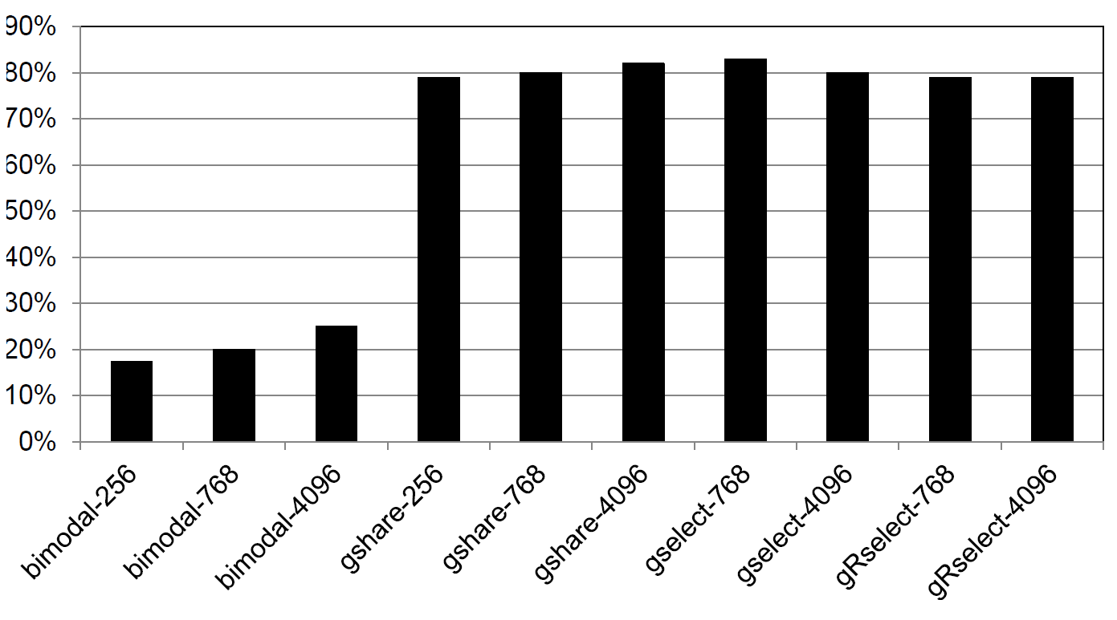
Direction Predictors: MPKI improvement over Base

Slide 41
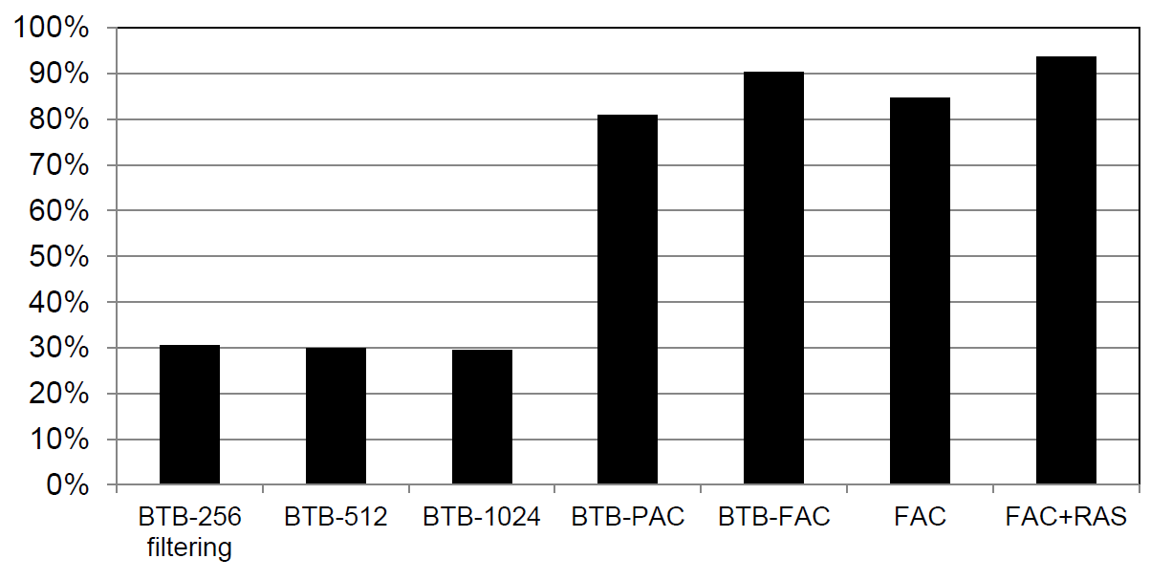
Reduction in target address mis-prediction over BASE

Slide 42
List of Benchmarks
bzip2
gobmk
hmmer
sjeng
libquantum
h264
astar
xalanc

