Slide 1
Supply Chain Optimization: Blockchain Applications in Inventory Management
With Ashish Jagmohan, Pavithra Harsha, Yichong Yu

Slide 2
Summary of Work
IBM Food Trust
Analytics
Visibility
Improving operational values
Reducing waste
Improving freshness
Academic contribution
Perishability, and coordination in multi-echelon supply chain
Notes:
What IFT provides, or is aiming to provide
Analytics: travel times, temperature, inventory levels, shelf life distributions as certain places
These things alone is valuable but not unimaginable for individual firms
IFT creates a *platform* by elevating trust levels, and consequently improving visibility of (a subset of) the analytics
With these things, we want to do good things.
1/3 of the products are wasted, due to spoilage, expiration, etc.
On the customer side, we also care about freshness
Academic:
We show precisely where these analytics and visibility play a role
And in fact we want to show that even limited visibility can provide a lot of benefit (which relates to the practical issue of having limited data for IFT at the moment)
We start by setting up the basic framework,
reviewing some academic literature to set up the baseline,
focus on where our setting differs, how that constitutes as an interesting academic problem, and our approach

Slide 3
Summary of Work
Literature survey
Problem formulation
Problem approach
Heuristic solutions
Notes:
What IFT provides, or is aiming to provide
Analytics: travel times, temperature, inventory levels, shelf life distributions as certain places
These things alone is valuable but not unimaginable for individual firms
IFT creates a *platform* by elevating trust levels, and consequently improving visibility of (a subset of) the analytics
With these things, we want to do good things.
1/3 of the products are wasted, due to spoilage, expiration, etc.
On the customer side, we also care about freshness
Academic:
We show precisely where these analytics and visibility play a role
And in fact we want to show that even limited visibility can provide a lot of benefit (which relates to the practical issue of having limited data for IFT at the moment)
We start by setting up the basic framework,
reviewing some academic literature to set up the baseline,
focus on where our setting differs, how that constitutes as an interesting academic problem, and our approach

Slide 4
Inventory Management Literature
The central decisions:
Ordering, replenishment, fulfillment, and pricing
Solution approach: dynamic programming
Current period: inventory holding/ordering, demand satisfaction/lost
Future: inventory affected by current period decision
Challenge: difficult to solve the general problem
Optimal policies for special classes of the problem
Industry practice
Base stock policies
Notes:
Most of the literature focus on single echelon problems, because the field favors analytical results when solving the dynamic program
The dynamic part comes from the fact today’s decision (e.g., ordering quantity) will not only affect immediate reward, but also have impact on the future (via inventory levels)
Our taxonomy of problems.
Show structure and thoughts flow and sequence
Ordering and replenish
Fulfillment (issuing)
Routing
Pricing (B2C)
Secondary channels
Contracts (B2B)

Slide 5
Inventory Management Literature
Seminal papers:
Single warehouse: Arrow, Harris, and Marschak (1951), Scarf (1960), Iglehart (1963), Veinott and Wagner (1965)
Multi-echelon: Clark and Scarf (1960)
Distribution systems: Eppen and Schrage (1981), Federgruen and Zipkin (1984)
Assembly systems: Rosling (1989)
Structure of optimal policies
Finite horizon: Iglehart (1963), Veinott and Wagner (1965), Zheng (1991): (s, S) policy
Infinite horizon: Zheng (1991), Zheng and Federgruen (1991), (s, S) policy
Positive lead time: Huh, Janakiraman, Muckstadt, Rusmevichientong (2008) (base stock), Xin and Goldberg (2016)
Perishable products: Nahmias (1975), Chen, Pang, and Pan (2014)

Slide 6
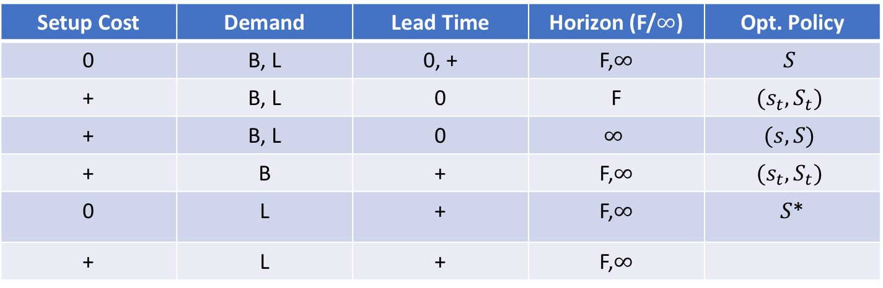
Inventory Management Literautre
Sequence of events: pipeline inventory arriving, observing inventory state, ordering, demand realization, demand fulfillment
Setup Cost | Demand | Lead Time | Horizon (F/$∞$) | Opt. Policy
0 | B, L | 0, + | F,$∞$ | $$S$$
+ | B, L | 0 | F | $$(s_{t}, S_{t})$$
+ | B, L | 0 | $$∞$$ | $$(s,S)$$
+ | B | + | F,$∞$ | $$(s_{t}, S_{t})$$
0 | L | + | F,$∞$ | $S$*
+ | L | + | F,$∞$
B: backlogged demand
L: lost sales
* Approximate
Notes:
Main body of the literature deals with single echelon (single node)
This table we present only the inventory decisions (no pricing, shipment etc.)
Explain (s, S)-type policies

Slide 7
Inventory Management
(s, S)-type policy
Ordering quantity
S
0
s
Inventory at beginning of period

Slide 8
Inventory Management
With no setup cost, these policies reduce to base stock type policies
Ordering quantity
S
0
S
Inventory at beginning of period

Slide 9
Perishable Inventory
Main modeling difference:
Not all inventories are treated equally: due to difference time to expiration
Two intuitions of optimal control policy
The more perishable the product is, the less we order
1 unit of fresh inventory + 9 units of old inventory vs. 9 unites of fresh inventory and 1 unit of old inventory -> order more in the first case

Slide 10
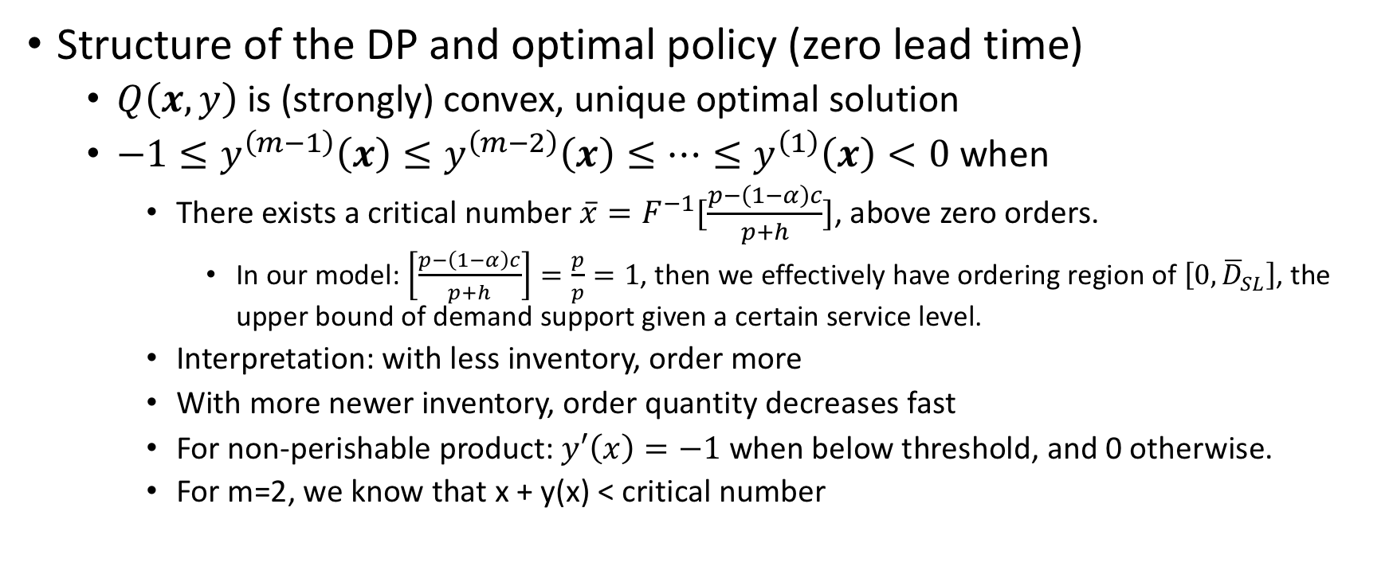
Perishable Inventory (technical details)
Structure of the DP and optimal policy (zero lead time)
$Q\left(x,y\right)$ is (strongly) convex, unique optimal solution
$−1≤y^{\left(m−1\right)}\left(x\right)≤y^{\left(m−2\right)}\left(x\right)≤⋯≤y^{\left(1\right)}\left(x\right)<0$ when
There exists a critical number $\overline{x}=F^{−1}[\frac{p−\left(1−α\right)c}{p+h}]$, above zero orders.
In our model: $\left[\frac{p−\left(1−α\right)c}{p+h}\right]=\frac{p}{p}=1$, then we effectively have ordering region of $\left[0,{\overline{D}}_{SL}\right]$, the upper bound of demand support given a certain service level.
Interpretation: with less inventory, order more
With more newer inventory, order quantity decreases fast
For non-perishable product: $y′\left(x\right)=−1$ when below threshold, and 0 otherwise.
For m=2, we know that x + y(x) < critical number
Notes:
Nahmias review paper 1982
Inv: x
Order quantity: y
Ordering cost: c
Demand loss/backlog cost (profit): p
Alpha: discount factor
Holding cost: h

Slide 11
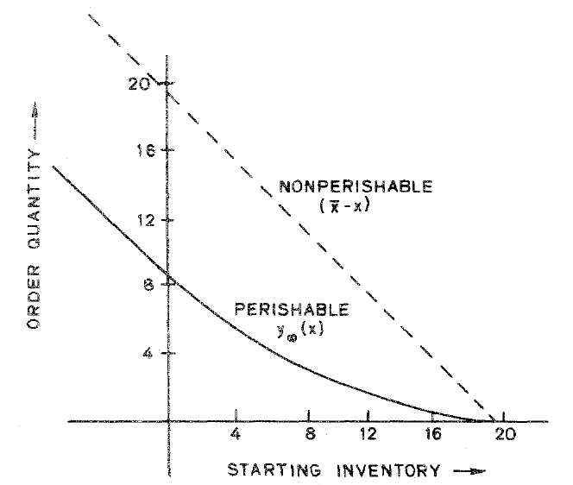
Notes:
How about lead time?
Heuristic policies that we can :
Critical number: single dimensional action space: finding the critical number to order up to
For m=2, Nahmias (1976) observed in numerical studies that the critical number policy is no more than 1% away from the optimal
Further improvement can be done when tuning the weights of when calculating total effective inventory: Nahmias (1977b) parameterized this by k, where any weight w_m to w_k = 1, and w_k-1 = … = w_1 = 0
Actually the previous point indicates that we do not need too much of a visibility downstream – a couple of nodes would be nice. Actually sometimes it would be nice to ignore the further downstream nodes.
Linear: single dimensional action space: finding the best y(0), or \beta, where \beta = y(0) / basestock. (As a function of SL)
This is good in the sense that we can collapse the state space and yield strong solutions.

Slide 12
Critical Number Policy
Linear Policy
Notes:
How about lead time?
Heuristic policies that we can :
Critical number: single dimensional action space: finding the critical number to order up to
For m=2, Nahmias (1976) observed in numerical studies that the critical number policy is no more than 1% away from the optimal
Further improvement can be done when tuning the weights of when calculating total effective inventory: Nahmias (1977b) parameterized this by k, where any weight w_m to w_k = 1, and w_k-1 = … = w_1 = 0
Actually the previous point indicates that we do not need too much of a visibility downstream – a couple of nodes would be nice. Actually sometimes it would be nice to ignore the further downstream nodes.
Linear: single dimensional action space: finding the best y(0), or \beta, where \beta = y(0) / basestock. (As a function of SL)
This is good in the sense that we can collapse the state space and yield strong solutions.

Slide 13
Our Setup
Extensions: multi-echelon, with positive lead times
Challenging even when non-perishable, and centralized decision
Challenge 1: structure of optimal policy for multi-echelon
Challenge 2: dimensionality

Slide 14
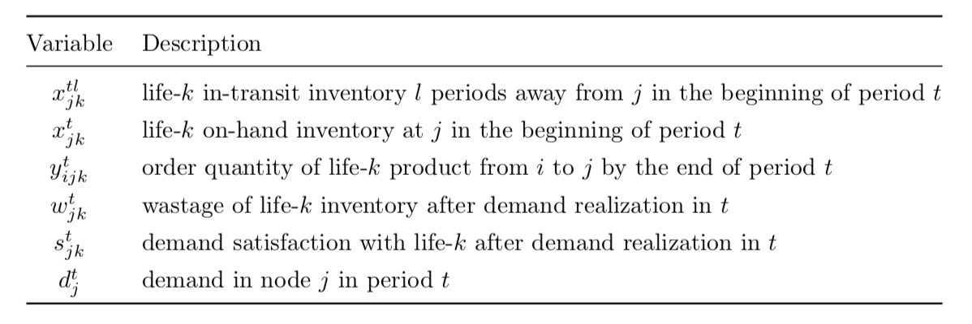
Our Setup
Problem definition
Decision: how much to order and where
Maximize: (current reward + expected future reward)
Current reward: freshness, -spoilage, -demand loss
State update: inventory change due to sales and spoilage
Notes:
Centralization

Slide 15
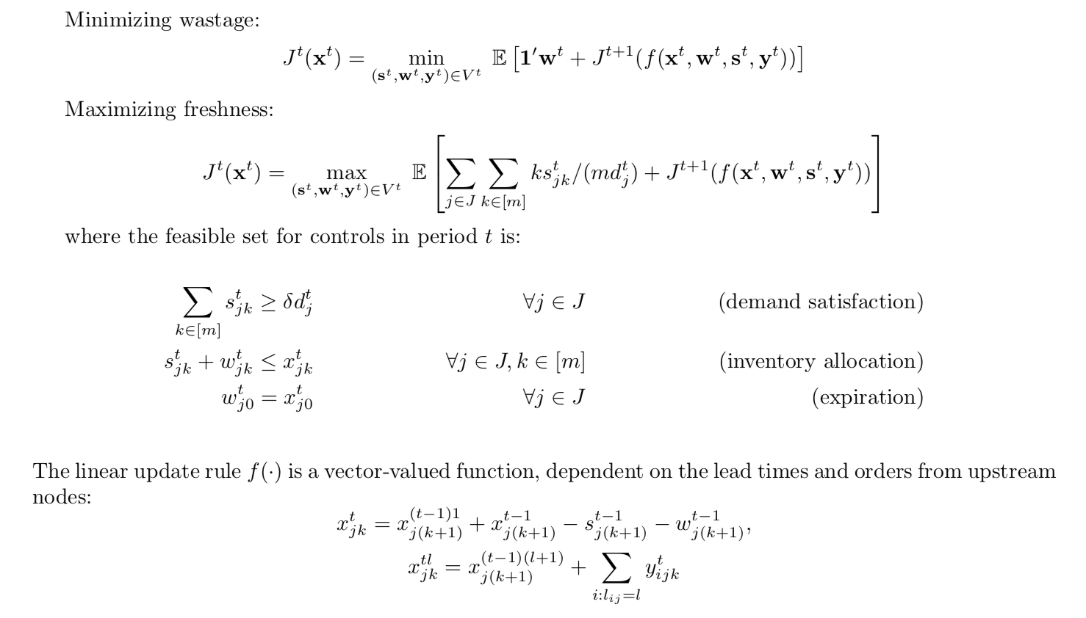

Slide 16
Simulator
Python-based simulation testbed for understanding the performance of different ordering policies
Simulation input
Supply chain network topology: adjacency, and lead time on arcs (directed, acyclic)
Demand random variables and production
Ordering policy: how much to order given the state of inventory and demand information
Time horizon
Sequence of events (per period update function):
﻿Pipeline inventory updating, expiring, arriving on hand,
Order placement, propagation from downstream to upstream, initiating flows from a supply node to the pipeline of downstream
Demand realization and fulfillment (by source nodes), production arrival
Oldest inventory expire, and on-hand inventory aging
Notes:
Setup:
Network
Lead time
The

Slide 17
Simulator
Each simulation run traces a trajectory of inventory state over T time periods,
controlled by the ordering at each period
perturbed by the demand realization and production quantity at each period
A network of 3 nodes, 1000-period test run takes a few seconds
To test different policies, select different order-up-to levels, and smoothing coefficient

Slide 18
Baseline Performance
Notes:
Tests assume lead time visibility – upstream nodes know about the downstream performance and sends fresh enough inventory. Performance could be worse if we do not have this visibility, which demonstrates the value of visibility

Slide 19
Local Improvement
Notes:
Local = changing the ordering policy to be not naïve base-stock, but trying to smooth the ordering over time, and disregard the quantity of old inventory when making the ordering decisions

Slide 20
Ongoing
Lisa and Janice: computationally explore the policy space with dynamic programming and reinforcement learning approaches
Peter:
Coordinating the computational search
Designing and prototyping strong policies, analytical approaches (for stylized settings)
Demonstrating the benefit of visibility and coordination

Slide 21
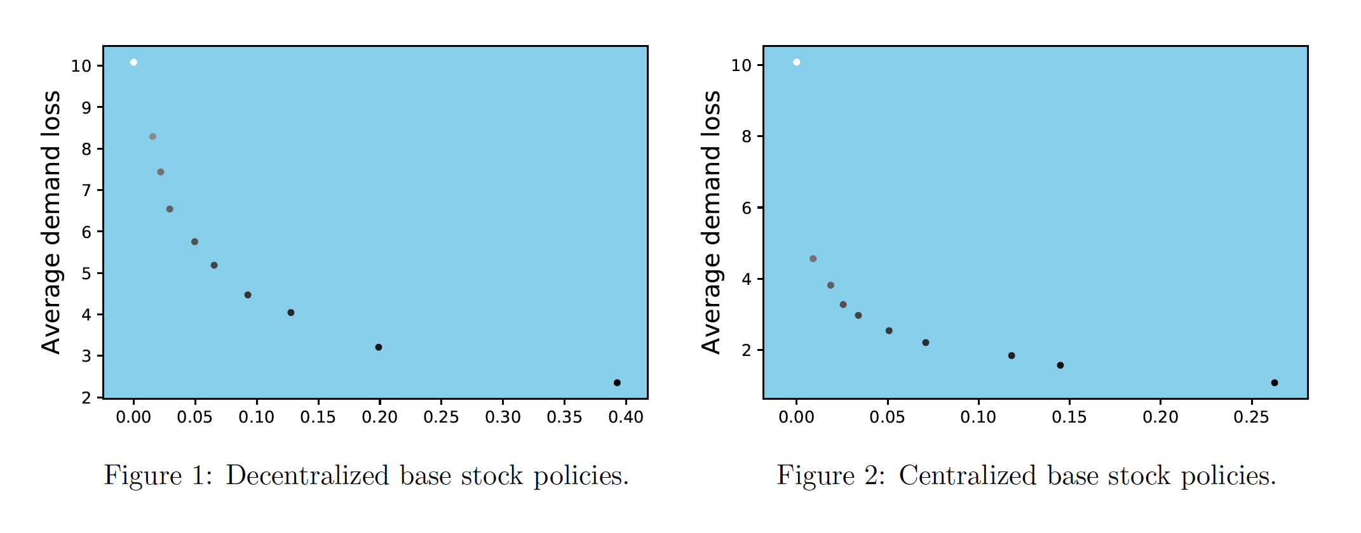
Value of Supply Chain Information Sharing

Slide 22
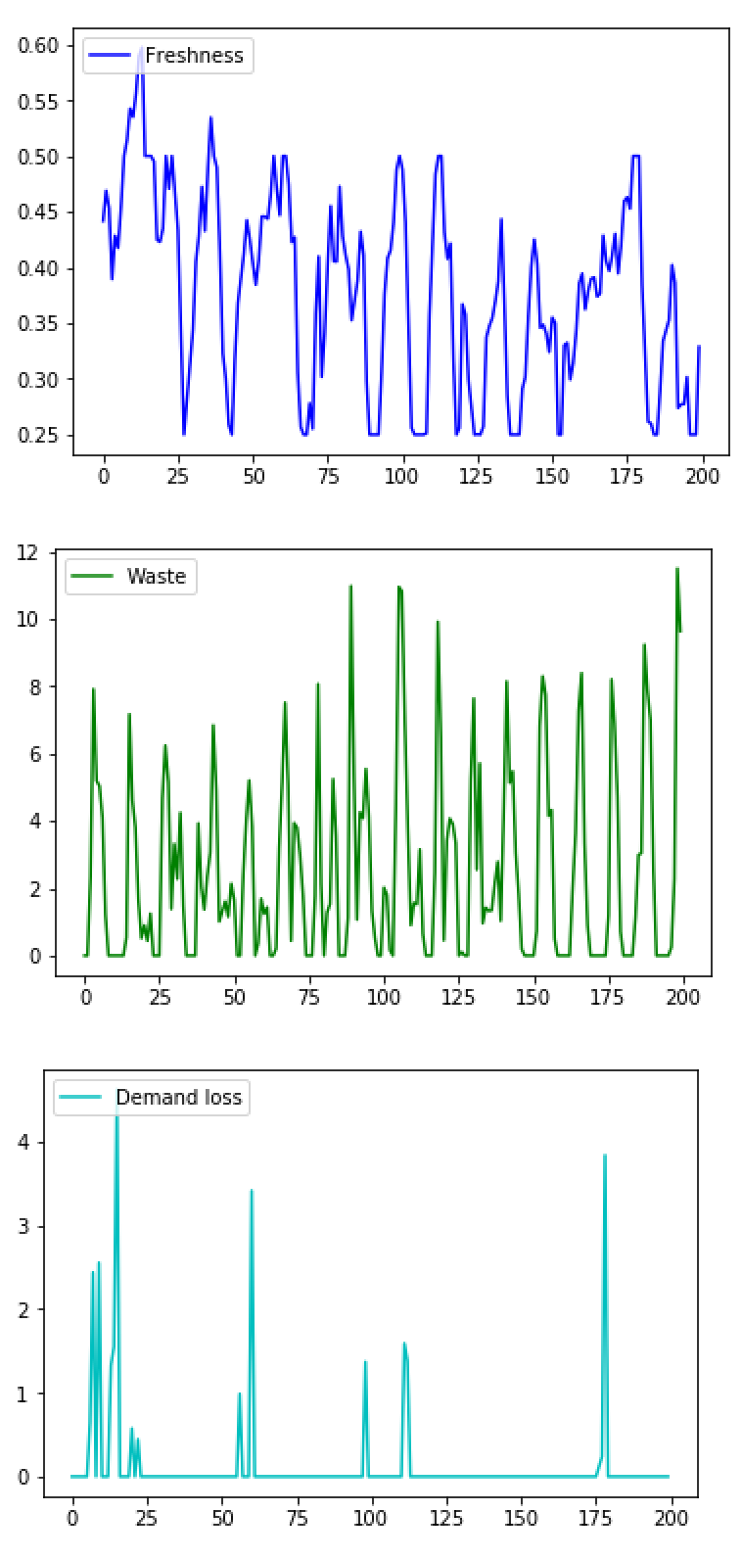
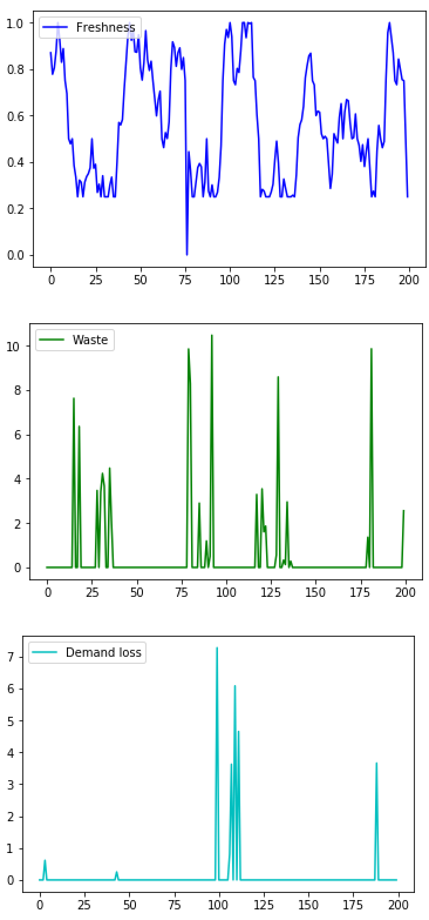
Decentralized scenario averages:
Freshness 0.37
Waste 27%
Demand loss 1%
Centralized scenario averages:
Freshness 0.55
Waste 6%
Demand loss 1%

