Slide 1
Spatial Architecture of
Pediatric Brain Tumors
Peter Youyun Zheng
Beroukhim Lab · Dana-Farber Cancer Institute / Broad Institute
September 2026

Slide 2
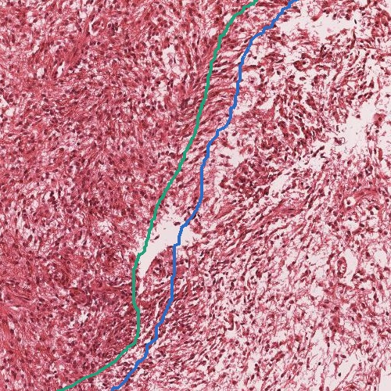
Pediatric brain tumors are spatially structured
Pilocytic astrocytoma is biphasic — dense compact-fibrillary tissue abuts loose myxoid tissue (H&E, right).
Across these tumors cells are arranged, not mixed — glia, neurons, and immune cells hold distinct neighborhoods.
Bulk and dissociated single-cell assays discard that arrangement; in-situ transcriptomics preserves it.
Pilocytic astrocytoma H&E — green = compact fibrillary, blue = loose myxoid (pathologist-annotated).

Slide 3
The cohort
11
4
266
tumors
tumor histologies
gene brain panel
Histology | n | Driver alteration(s) | Location
Pilocytic astrocytoma | 4 | KIAA1549::BRAF, FAM131B::BRAF, RAF1::TOP2B, FGFR1-ITD | Cerebellum / temporal
Ganglioglioma | 2 | BRAF-V600E, FGFR1-ITD | Cortical
Central neurocytoma | 2 | Unknown | Intraventricular
Cerebellar liponeurocytoma | 3 | Unknown | Cerebellum
Panel: 10x Xenium Human Brain panel (266 genes).

Slide 4
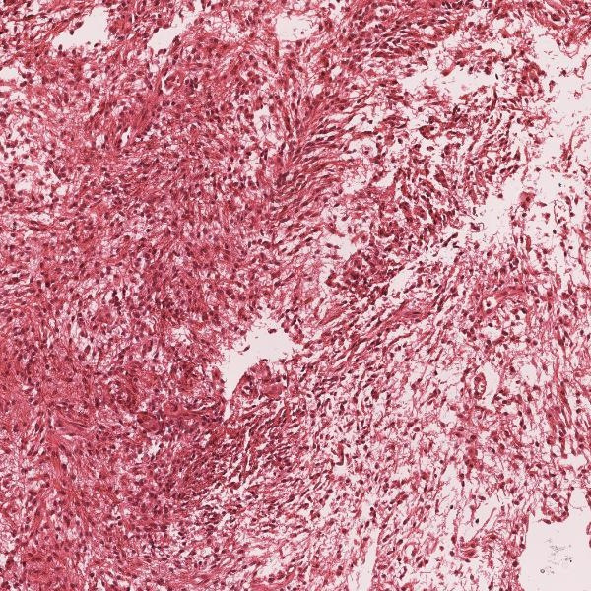
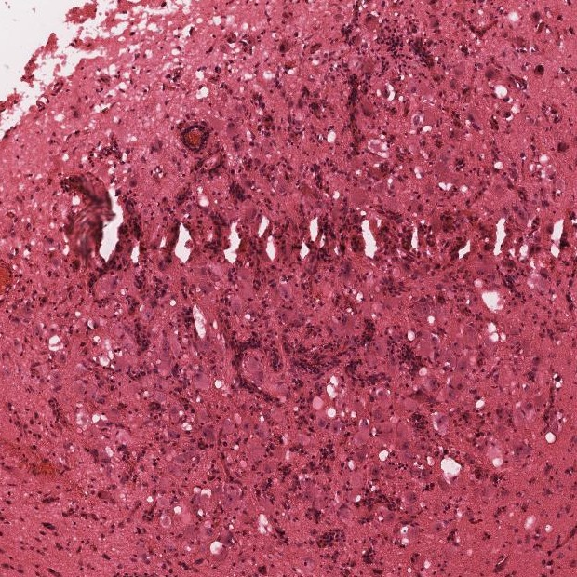
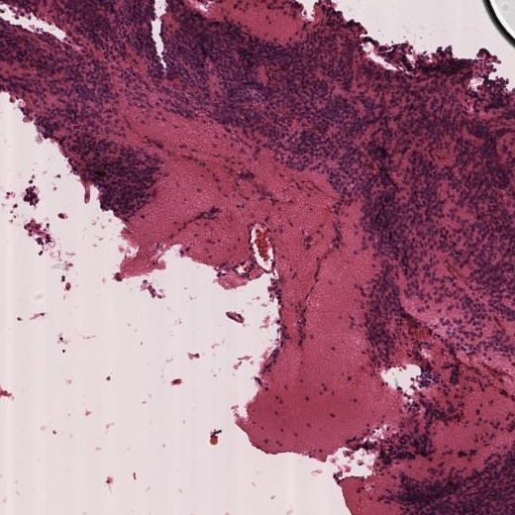
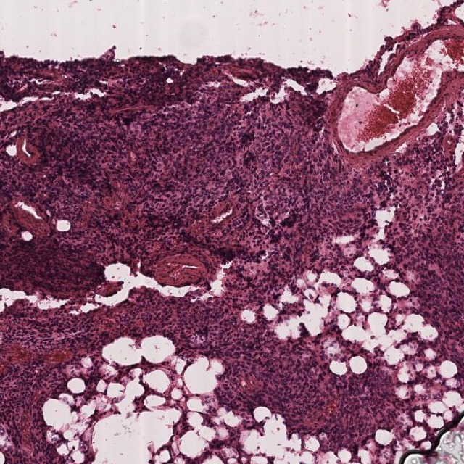
Four tumor histologies
Pilocytic astrocytoma
Ganglioglioma
Central neurocytoma
Cerebellar liponeurocytoma
WHO 1 · biphasic · BRAF
WHO 1 · neurons + glia · BRAF-V600E
WHO 2 · intraventricular
WHO 2 · lipidized

Slide 5
Questions
01
What cell types and spatial niches build each tumor?
02
Do those spatial niches match what a pathologist sees?
03
In PA, how does MAPK activation shape glial–immune interaction?

Slide 6
One resegmentation, feeding three analyses
Xenium segmentation
BANKSY
find spatial niches — recurrent local neighborhoods
ProSeg — resegment cells
ENVI
impute the whole transcriptome from paired single-cell data
STalign
overlay pathologist annotations onto the data
default segmentation was poor → shape cells to their transcripts

Slide 7
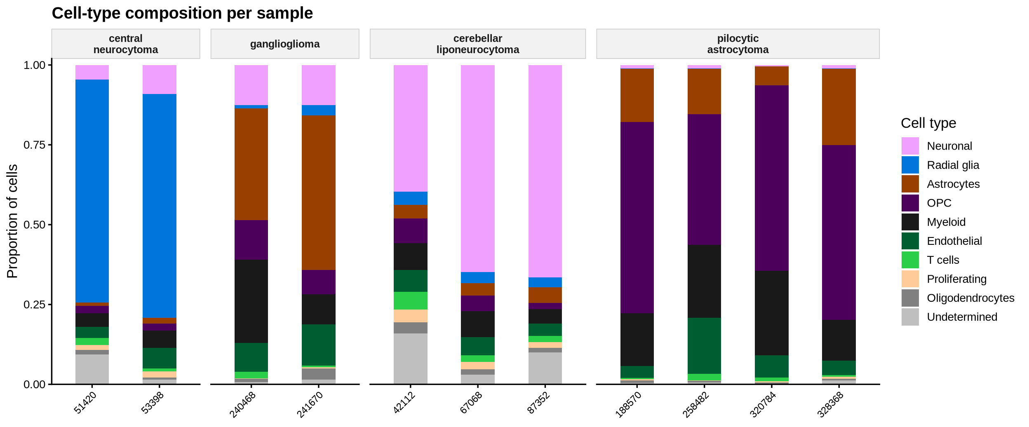
CELL TYPING
Cell types across the cohort

Slide 8
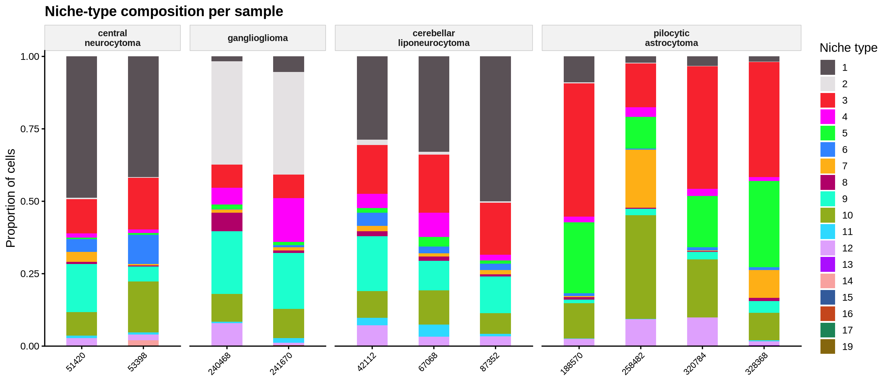
SPATIAL MOTIFS
Recurrent spatial niches

Slide 9
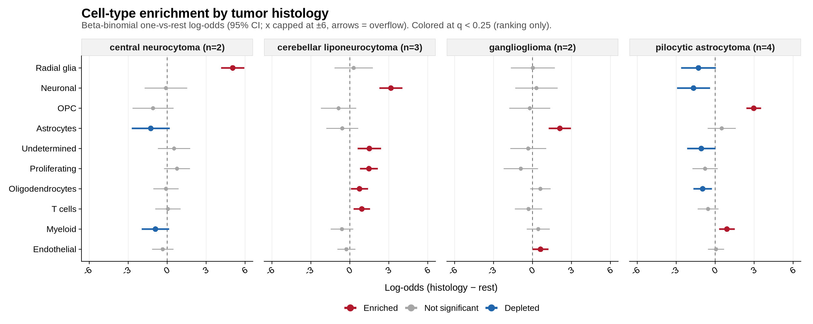
SPATIAL ATLAS
Each histology has its own cell-type makeup

Slide 10
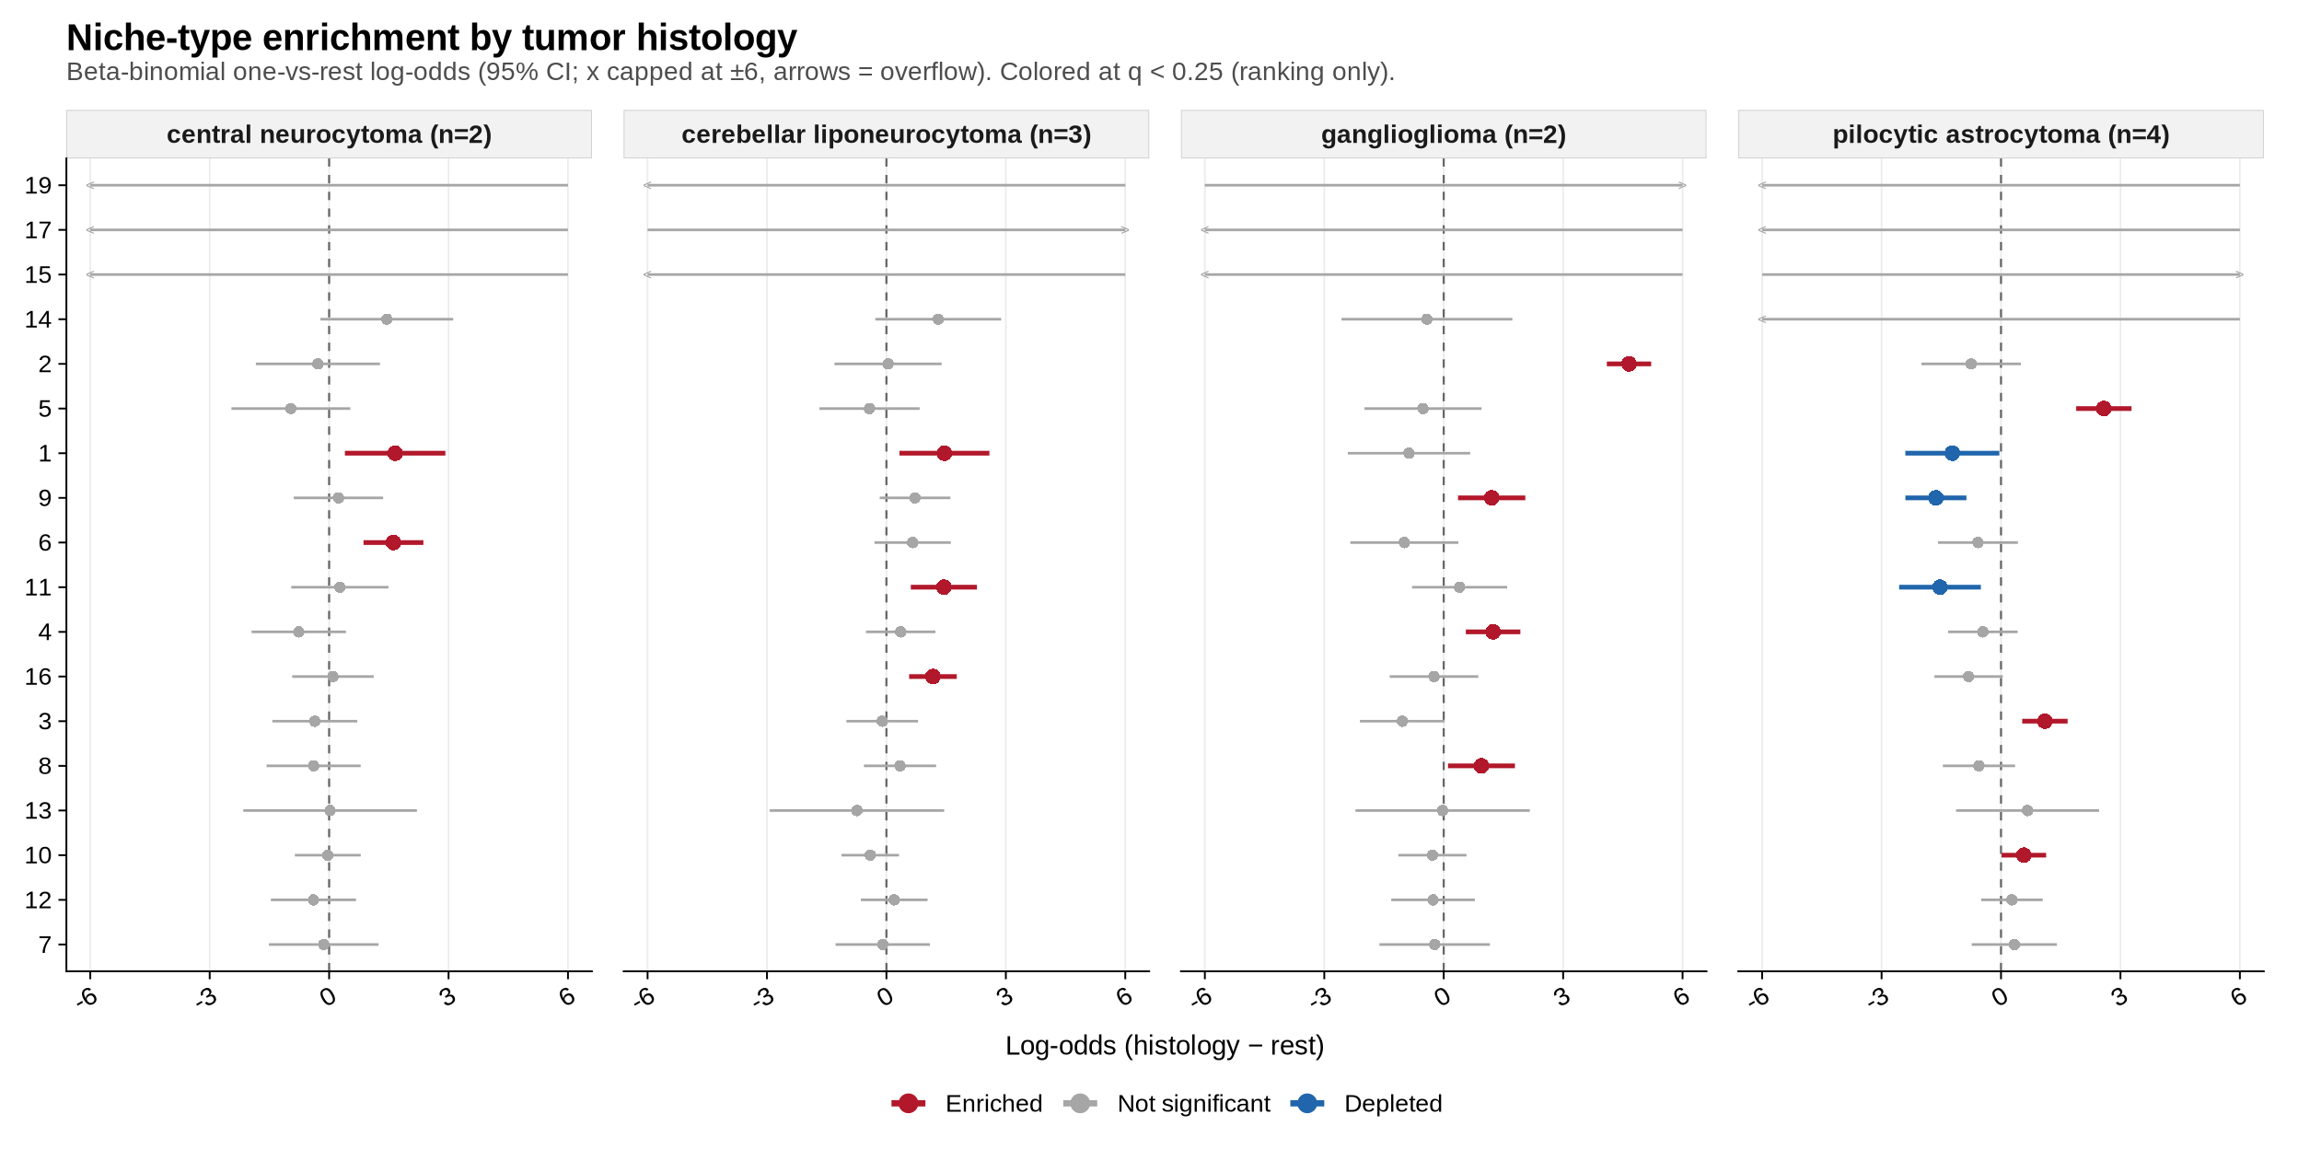
SPATIAL ATLAS
…and its own spatial niches

Slide 11
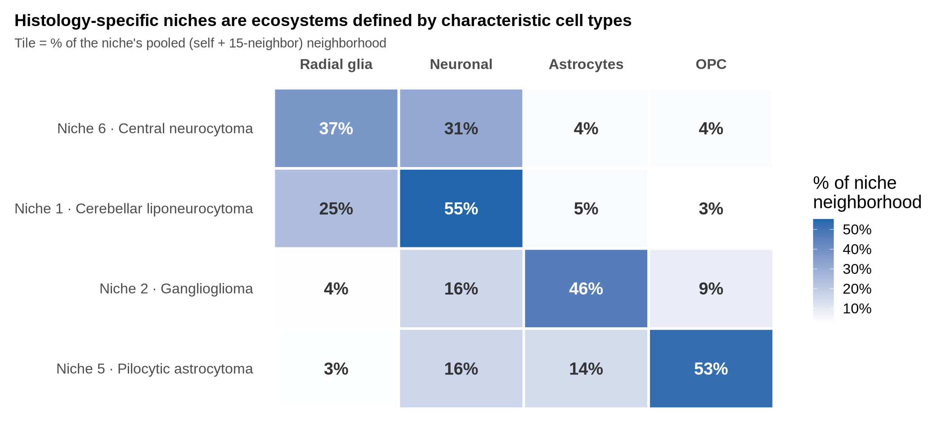
SPATIAL ATLAS
Signature niches are ecosystems of signature cell types

Slide 12
Pilocytic astrocytoma:
the MAPK driver organizes the microenvironment

Slide 13
Imputing a whole transcriptome in situ with ENVI
Xenium measures ~266 genes; ENVI co-embeds matched single-nucleus whole-transcriptome PA data.
It imputes genome-wide expression onto each spatial cell, so we can score pathway activity (e.g. MAPK) in place.
Four PA patients, four driver alterations.
▸ paste figure ENVI co-embedding schematic sc_integration/ENVI

Slide 14
MAPK activity is concentrated in the tumor glial lineage
Imputed MAPK activity concentrates in OPCs and astrocytes across all four drivers.
Myeloid, lymphoid, and stromal cells are consistently MAPK-low.
▸ paste figure MAPK activity: patient × cell type (heatmap) 2_MAPK_adj.qmd · mapk_patient_cell_type_significance.tsv

Slide 15
MAPK-high glia sit among more myeloid cells
As a glial cell's MAPK score rises, its neighborhood gains more myeloid cells (Astro→Myeloid +0.030, z≈19).
Modest but highly consistent across cells and patients.
Echoes the PA axis where microglia/myeloid recruitment enables bypass of BRAF-fusion senescence.
▸ paste figure Neighbor composition vs. MAPK (volcano) 2_MAPK_adj.qmd · mapk_adj_results.tsv

Slide 16
Proximity to MAPK-high glia reprograms myeloid programs
Myeloid cells near MAPK-high glia show a shifted immunoactivation ↔ immunosuppression balance.
Signatures span Hallmark IFN / inflammatory, TIM3± microglia, complement / scavenger, FOSL2 regulon.
Consistent within patients; small effect (R²≈1%). Emerging.
▸ paste figure Glial-exposure effect on myeloid signatures (heatmap) 2_MAPK_adj.qmd · myeloid_glial_exposure_part[A/B]_results.tsv

Slide 17
Spatial niches are molecular, not morphological
▸ paste figure STalign registration + niche × region (forest) annotations/STalign · linear_models_niches.qmd
Pathologist H&E regions registered to Xenium via STalign.
Only the vascular Blood region robustly marks niches (PA niches 9 & 12).
Diagnostic architecture regions do not — so niches add information beyond the H&E.

Slide 18
The driver shapes the spatial immune architecture
MAPK driver
activation
Glial lineage
OPC / astrocyte state
Immune organization
myeloid recruitment + reprogramming
Every histology's dominant spatial signature matches its expected cell-of-origin.
In PA, the driver is glial-restricted and organizes the myeloid compartment.
Molecular niches carry information beyond histopathology.

Slide 19
Where this leaves us
What we show
Limitations & next steps
An integrated in-situ pipeline across four rare tumors.
Histology-specific cellular & niche architecture matching known biology.
In PA, MAPK-driven glial–immune crosstalk, seen spatially.
n = 11, confounded and underpowered — read direction, not p-values.
Sample-private niches unconfirmed (inferCNV).
Niche ↔ pathology correspondence weak beyond vasculature.
ENVI / MAPK deep dive is PA-only so far.
Next: inferCNV, cohort expansion, extend to GG / CN / CLN.

Slide 20
Acknowledgements
Collaborators [names / labs]
Neuropathology [pathologist(s)]
Single-nucleus data [contributors]
Funding [grants]
Thank you

