Slide 1
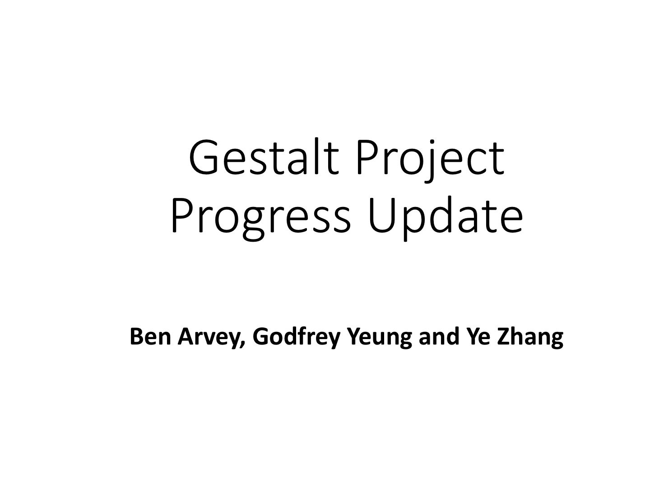

Slide 2
Overview
Development
R200
F200
Kinect
Testing
Range/FOV
Feature Analysis
User Testing
Future Research

Slide 3
Overview
Development
R200
F200
Kinect
Testing
Range/FOV
Feature Analysis
User Testing
Future Research

Slide 4
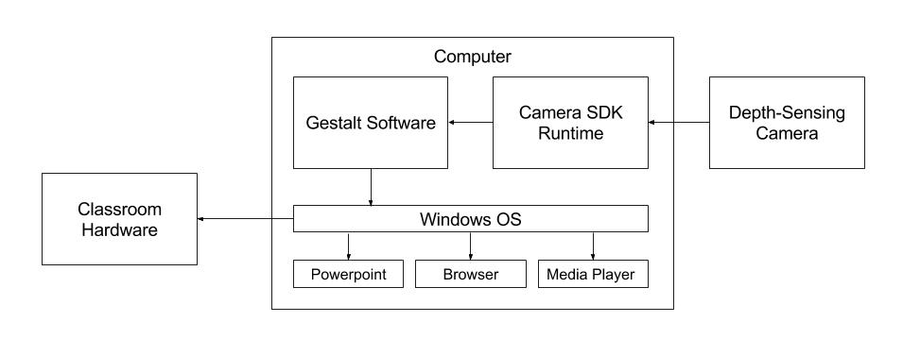

Slide 5
Milestone Progress
Setup SDK
Setup development environment
Generate operating system input
Detect simple gesture
Test accuracy and range
Prototype Powerpoint control
Research pointing control
Prototype web browser control
Prototype application switching
Determine included features
Test performance
Develop demonstration system
Run user testing
Create report

Slide 6
Overview
Development
R200
F200
Kinect
Testing
Range/FOV
Feature Analysis
User Testing
Future Research

Slide 7
Overview
Development
R200
F200
Kinect
Testing
Range/FOV
Feature Analysis
User Testing
Future Research

Slide 8
Overview
Development
R200
F200
Kinect
Testing
Range/FOV
Feature Analysis
User Testing
Future Research

Slide 9
Code Samples

Slide 10
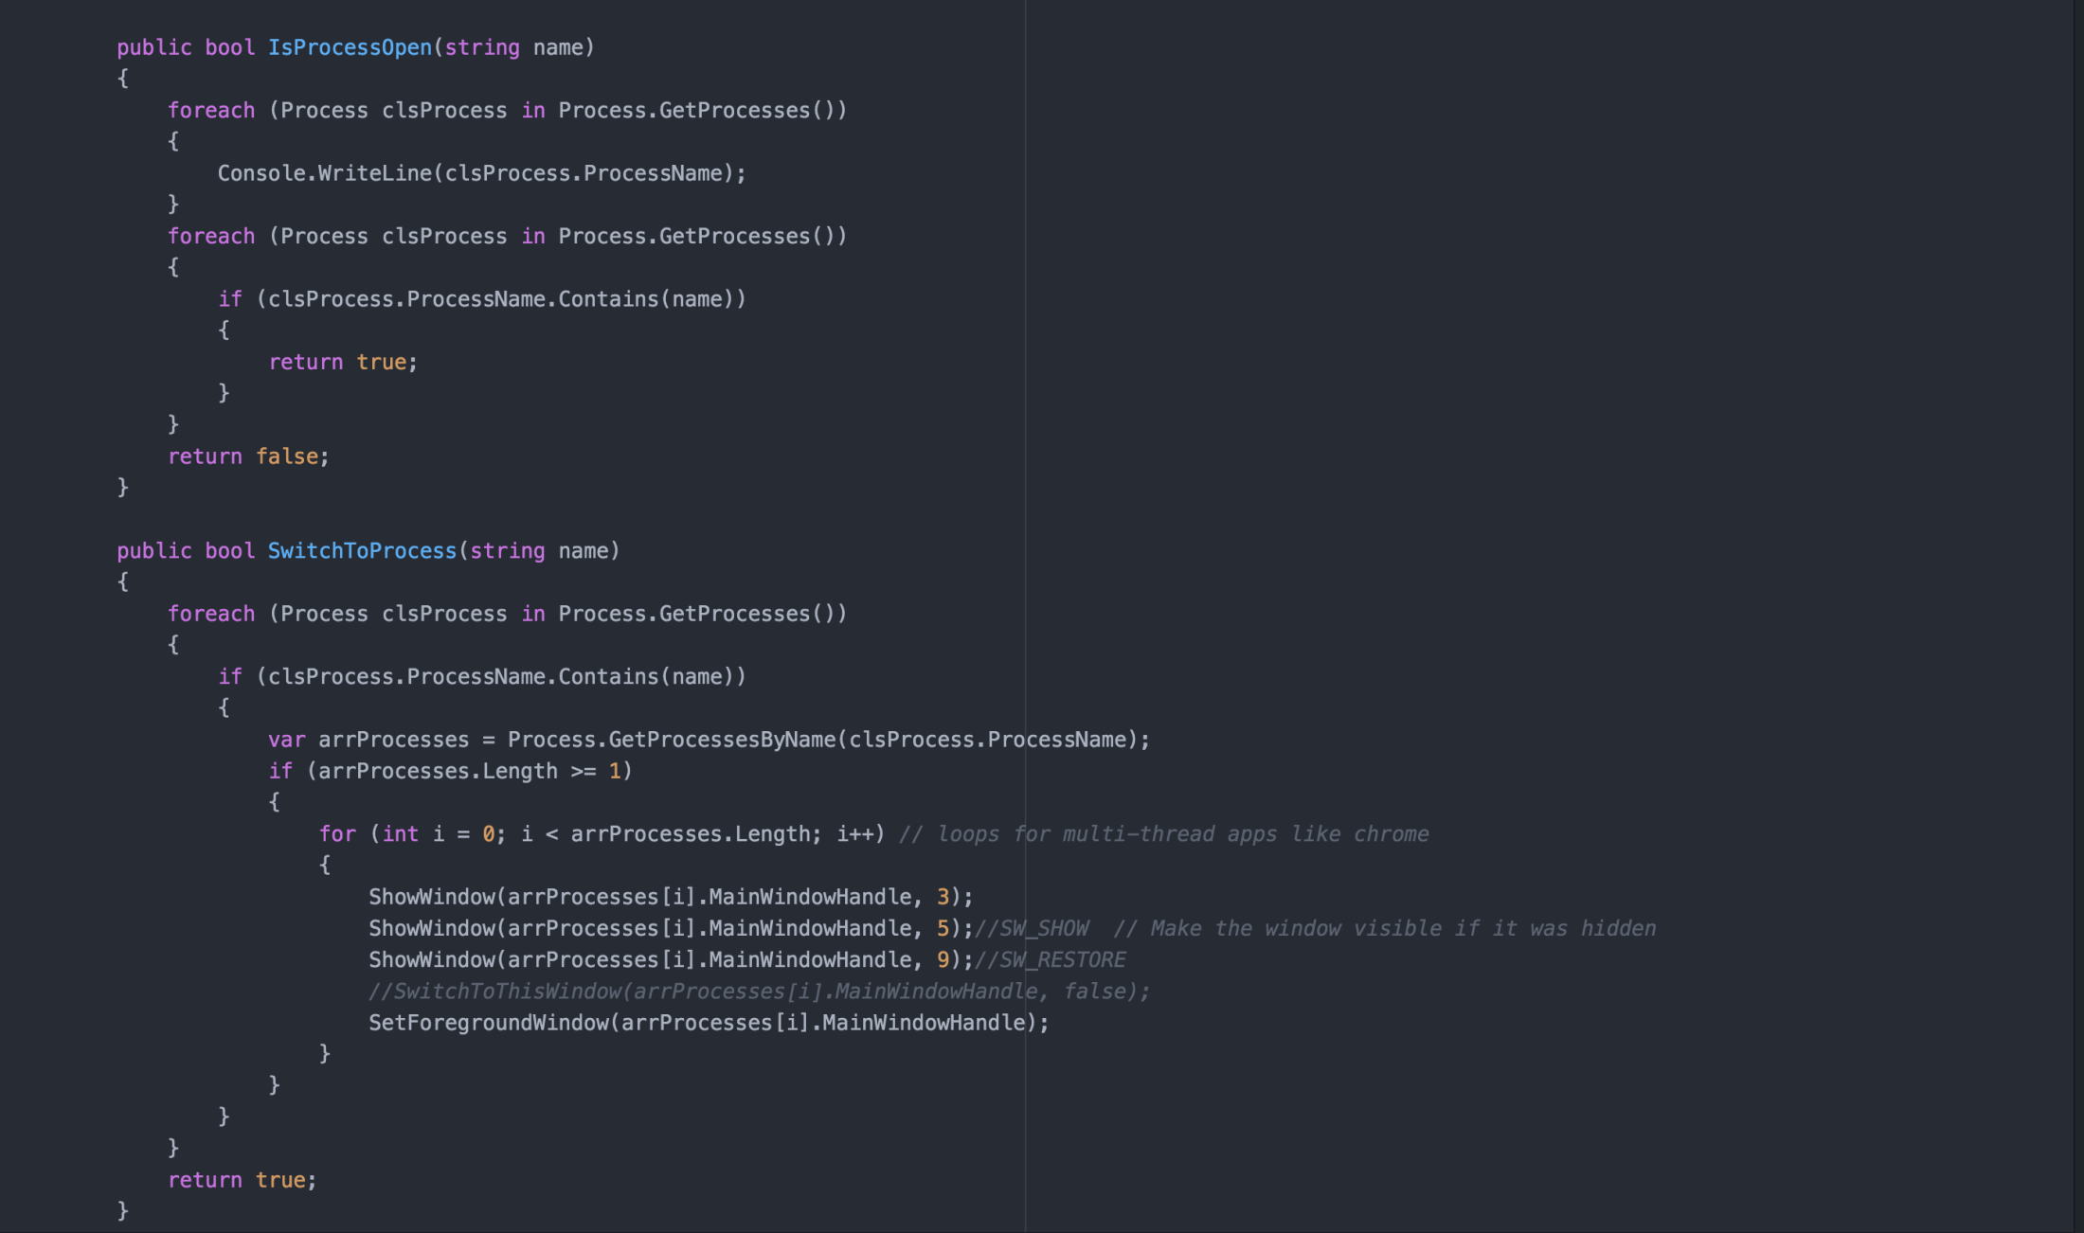
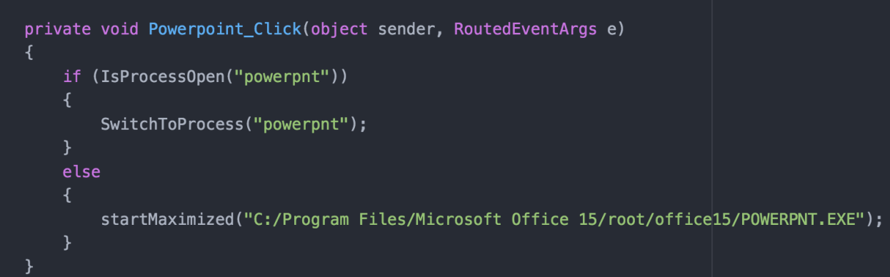
Application Switching

Slide 11
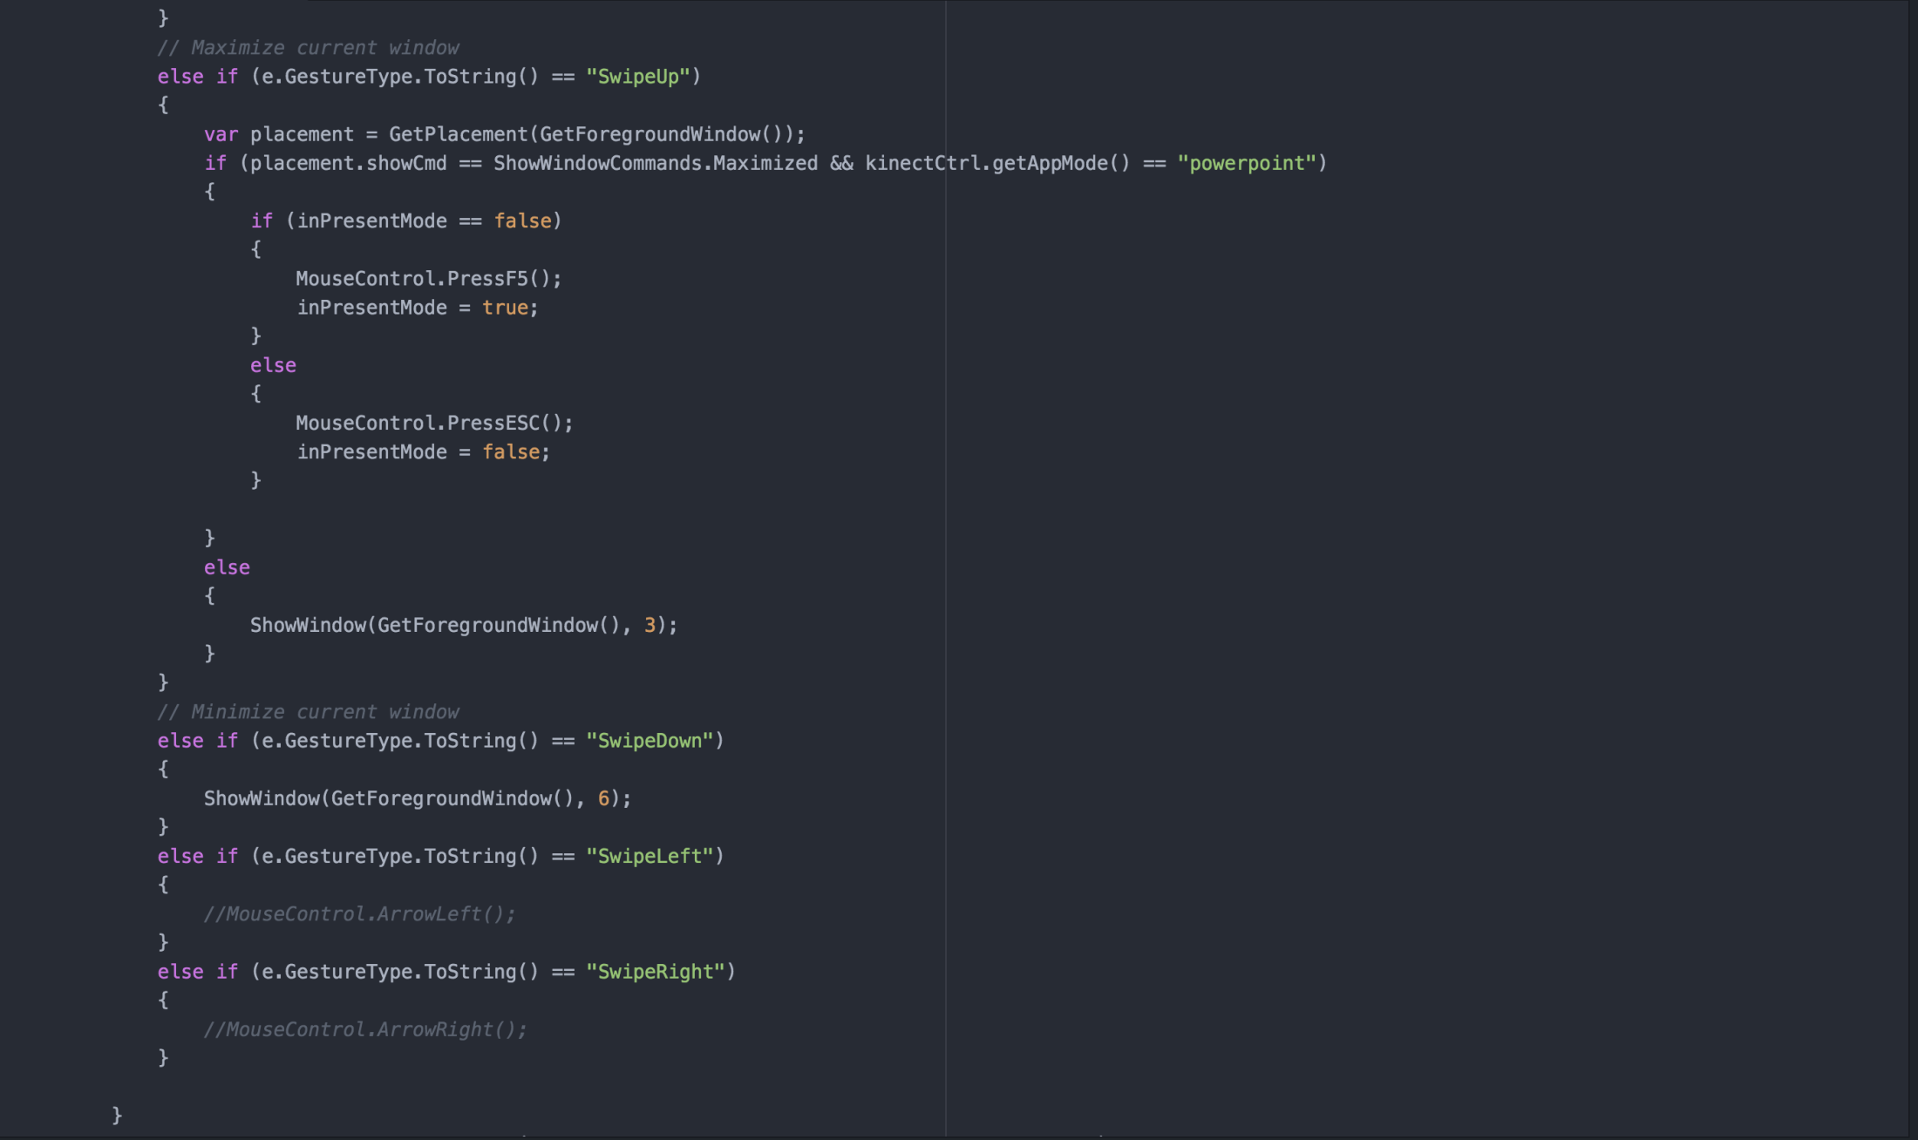
Maximize/Presentation Mode

Slide 12
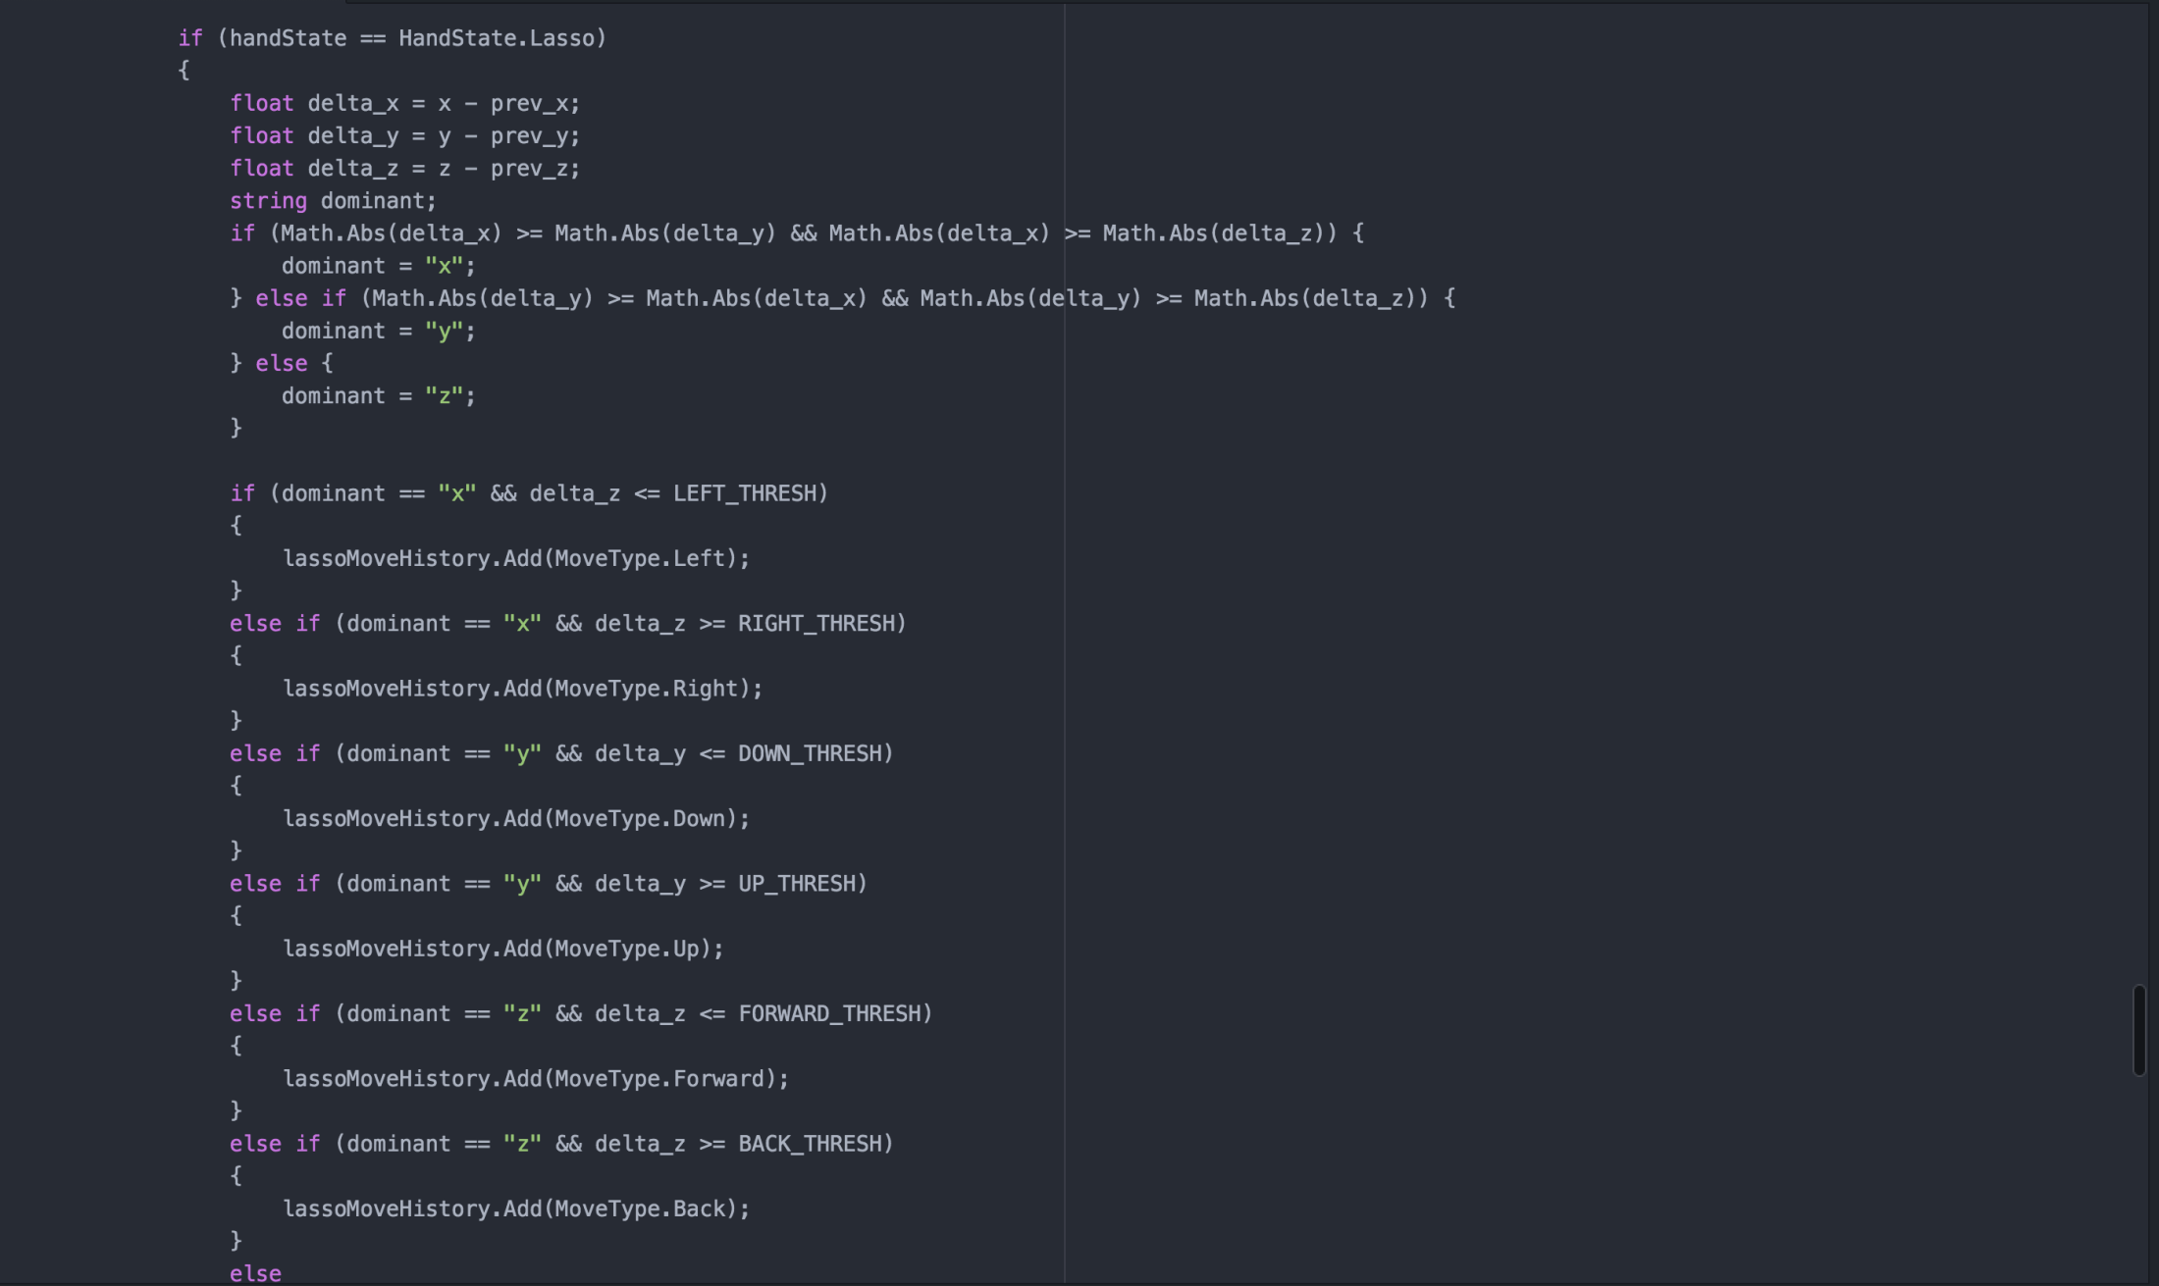
Better Gesture Detection

Slide 13
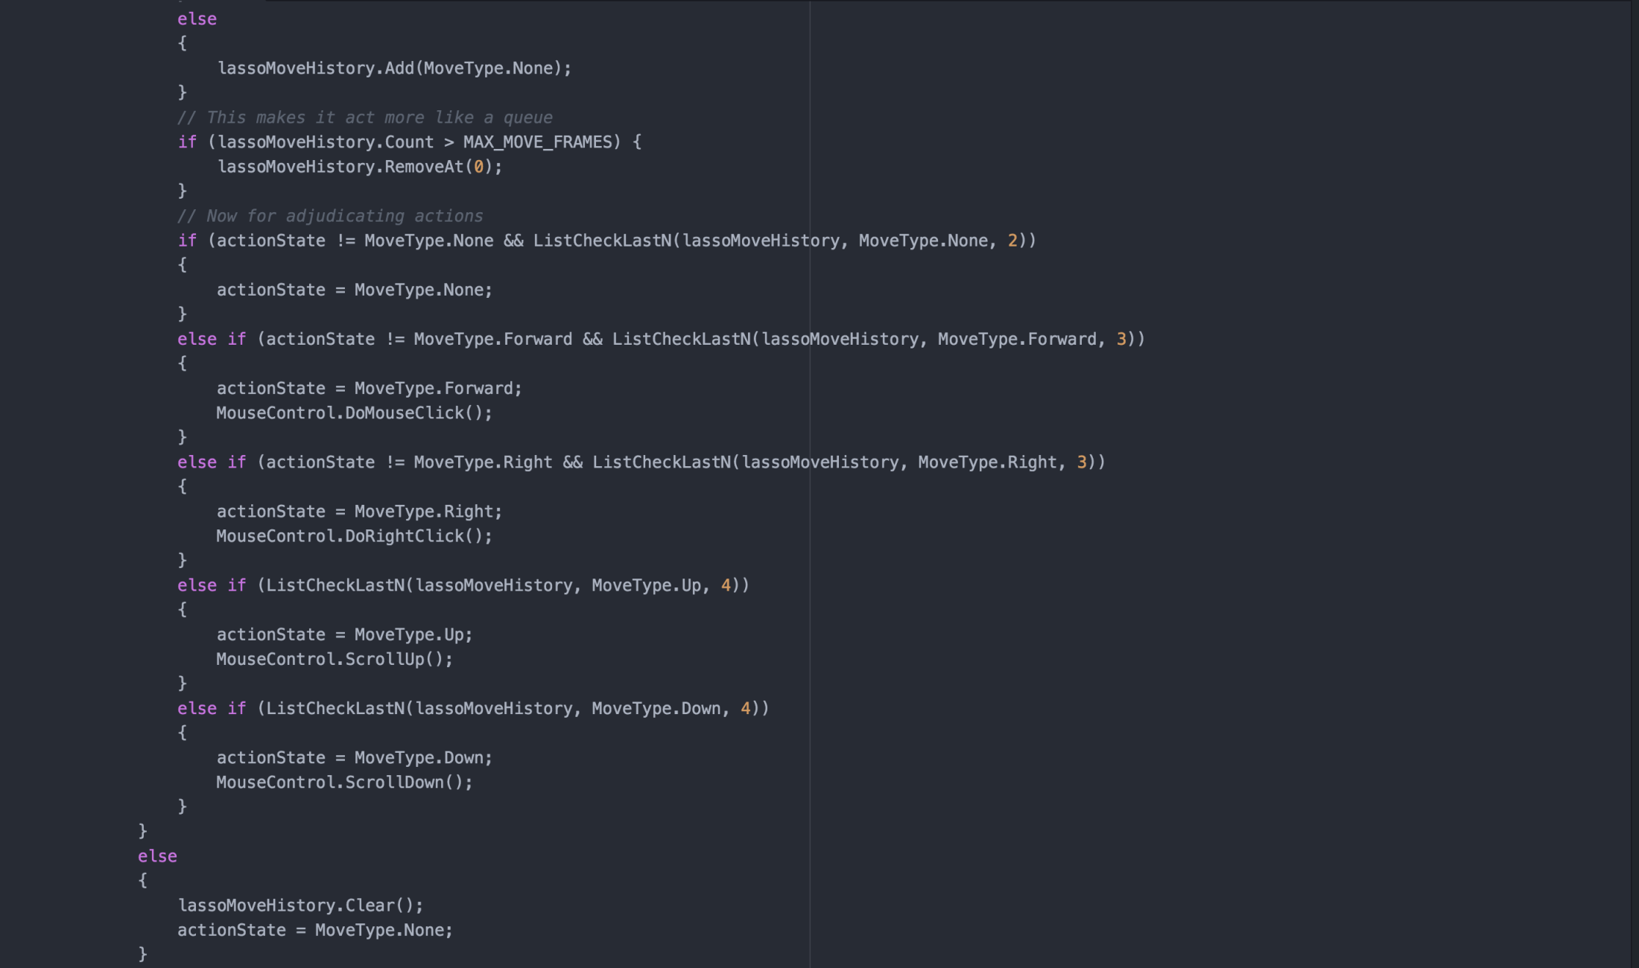
Better Gesture Detection (Cont.)

Slide 14
Overview
Development
R200
F200
Kinect
Testing
Range/FOV
Feature Analysis
User Testing
Future Research

Slide 15
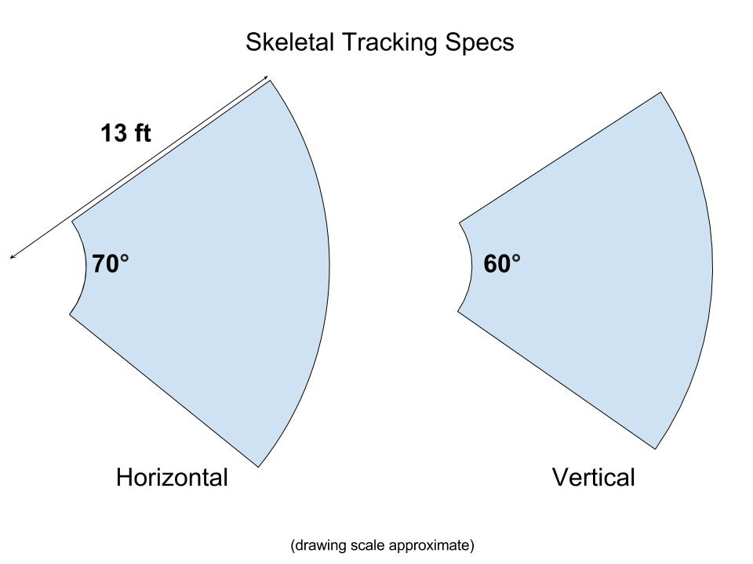

Slide 16
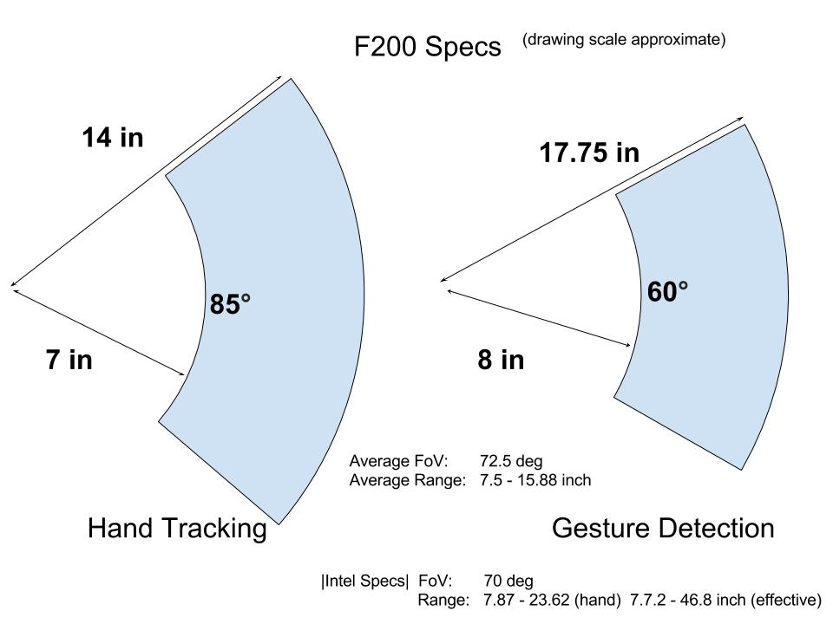

Slide 17
Overview
Development
R200
F200
Kinect
Testing
Range/FOV
Feature Analysis
User Testing
Future Research

Slide 18
Overview
Development
R200
F200
Kinect
Testing
Range/FOV
Feature Analysis
User Testing
Future Research

Slide 19
Questions we had for Intel
Longer-range gesture sensing?
What about the SR300?
Mouse control?
What’s the deal with RealSense Navigator?
Source code maybe please?

Slide 20
Overview
Development
R200
F200
Kinect
Testing
Range/FOV
Feature Analysis
User Testing
Future Research

Slide 21
Ideas for Future Research
Expanded range
Multi-sensor systems
Swiveling sensor mount
Multiple users
“Switch control” gesture
Optical marker
Intelligent Standby
Power down when no activity
Power up when user detected?

