Slide 1
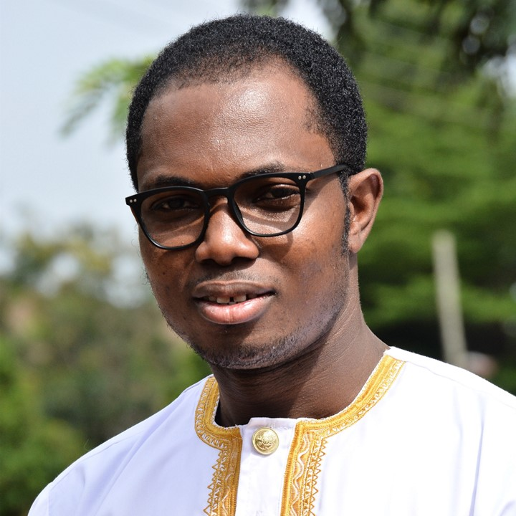




Peter Zorve
Data Scientist / Computational Chemist

Slide 2


Slide 3






Slide 4
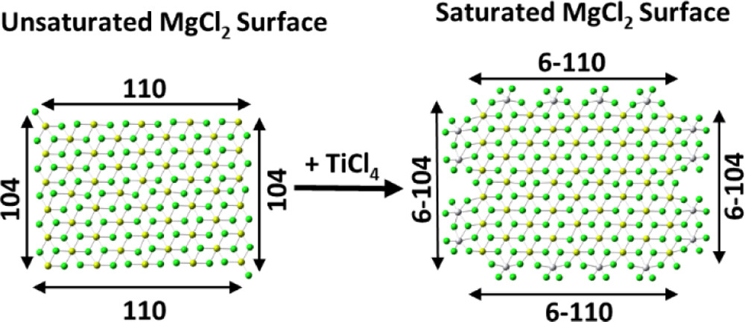
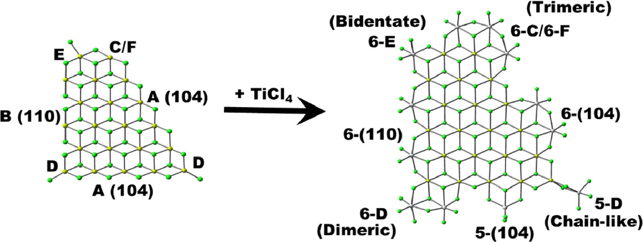

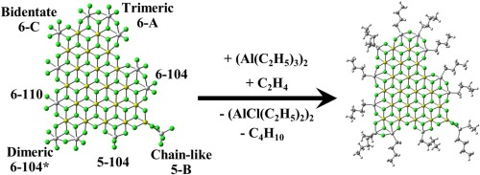

Slide 5

Peter Zorve

Slide 7
G
L
M
P
T
C
C
D
T
S

Slide 8
Peter Zorve

