Slide 1
NYC Airbnb data clustering analysis and recommendation
Applied Data Science Capstone by IBM/Coursera

Slide 2
Table of contents
Introduction
Data Description
Modeling and analysis
Conclusion

Slide 3
Introduction
The prices of the hotels in the NYC is notoriusly high and as a result, most people prefer to find alternative residences as Airbnb.
It is always hard to find a good Airbnb for travelers new to the New York City.
Need a recommendation that matches their interest and save their time
Used Clustering based recommendation

Slide 4
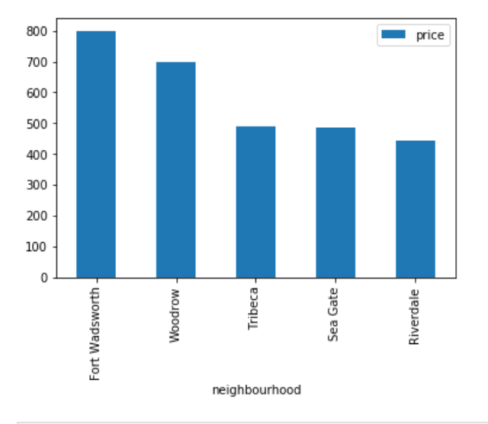
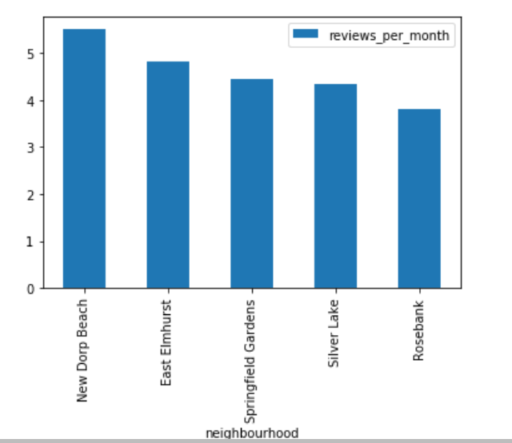
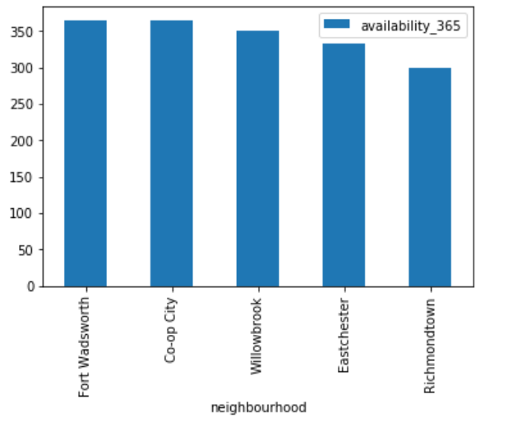
Data Descriptions
Data comes from Kaggle.com about 2017 Airbnb housing data
Cleaned the data with pandas and sklearn
EDA founds distributions of variables

Slide 5
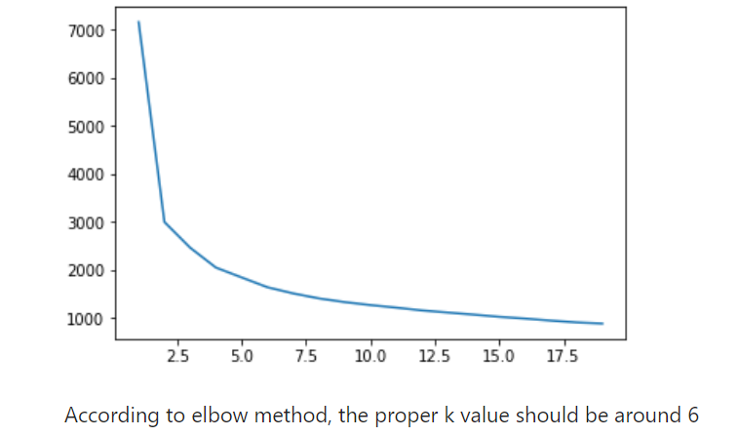
Modeling and Analysis
Applied Kmeans to cluster the housing data
Applied elbow method to find that the best k value is 6

Slide 6
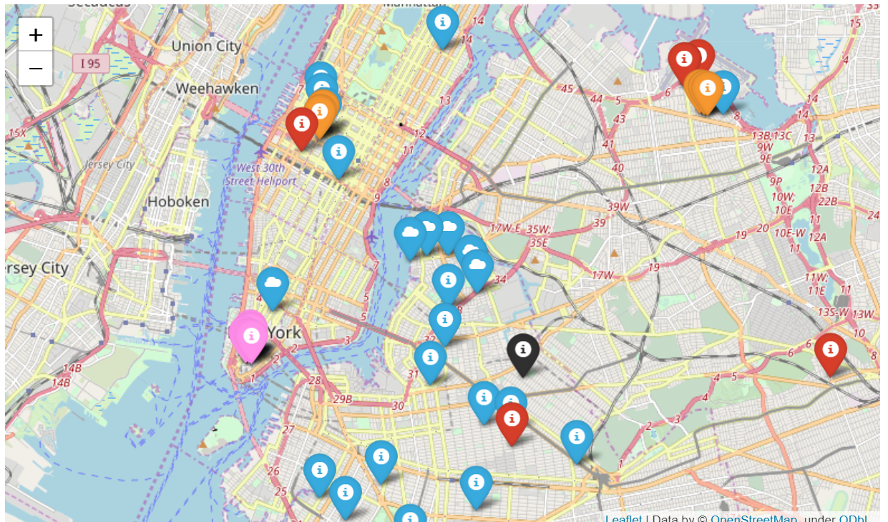
Modeling and Analysis
Visualize the data on the map with folium

Slide 7
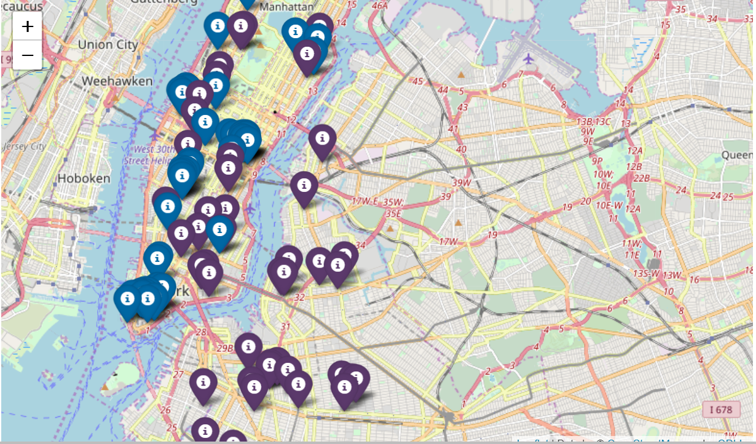
Modeling and Analysis
Test with case study: a customer who cares only about price and review per month
Founded 2 clusters to recommend and the location seems reasonable

Slide 8
Conclusion
The recommendation system doesn’t require consumer data which is hard to get
It provides an initial start point for customers but still needs further consideration
Could be improved with more data about attributes of the houses

