Slide 1



Control & Teleoperation for a DARPA Robotics Challenge Humanoid Robot
Debris removal
Wall breaking
Door opening
Core Team: 5 people

Slide 2
Today's Presentation
Start to Critical Design Review (CDR)
HUBO2+
Low-level Software
Control and Teleoperation
Walking
Results
CDR to Semi-Finals
DRC-HUBO
Walking
Operation Scheme
Lessons Learned
What Went Well

Slide 3
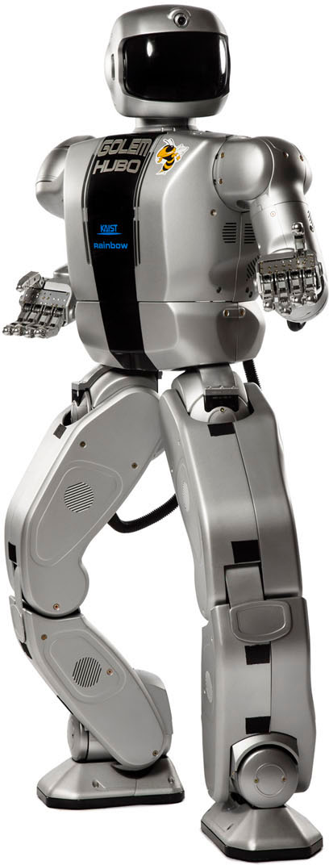
HUBO2+
37 DoFs
CAN
Position Control
3-axis IMU
3-axis F/T sensors

Slide 4
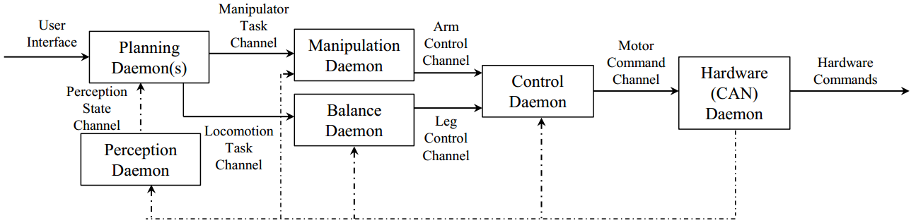
Real-time Architecture
Ach: IPC for Real-time control of robots^{[1]}
Achd: TCP/UDP communication
Daemons: Background processes
Major Contributions: Joint info parsing, balancing, walking daemon, UI
[1] N. Dantam and M.Stilman. Robust and efficient Communication for real-time multi-process robot software. International Conference on Humanoid Robotics (Humanoids). 2012.
Notes:
Maybe add ach push pull diagram

Slide 5
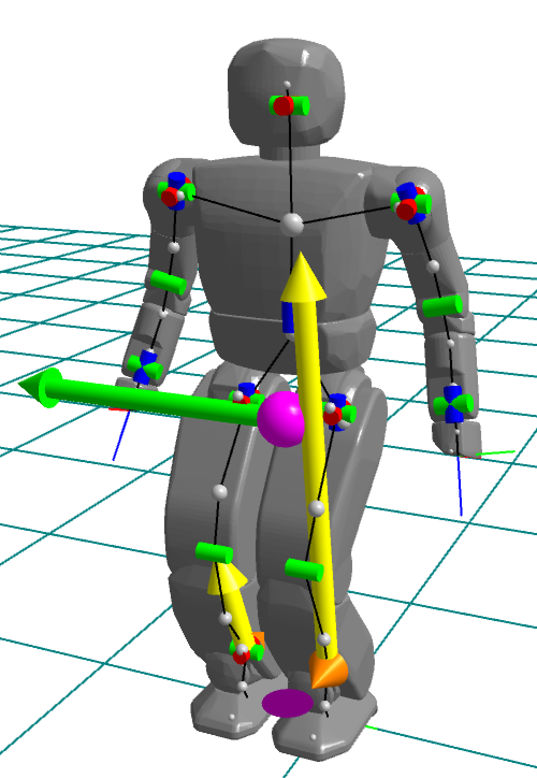
Balancing
Φx
Resist IMU
Φy
Y
X
Comply with Moments
Mx
My
Y
X
Notes:
Internal forces, human-like compliance, PD control, torso reference

Slide 6
Balancing

Slide 7
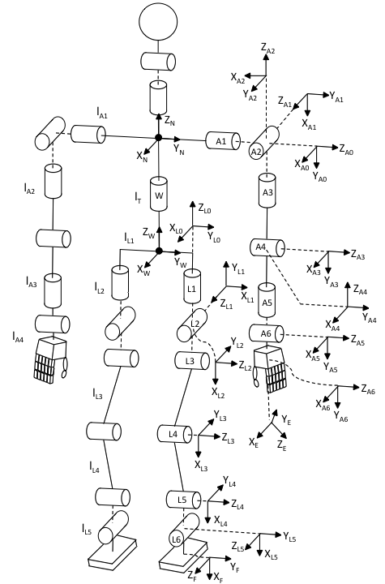
Kinematics
Forward Kinematics:
Denavit-Hartenberg TFs
Inverse Kinematics:
Peiper [2] technique
Ali et. al. [3]
[2] D. L. Peiper, “The Kinematics of Manipulators Under Computer Control,” Oct. 1968.
[3] M. A. Ali, H. A. Park, and C. S. G. Lee, “Closed-form Inverse Kinematic Joint Solution for Humanoid Robots,” pp. 704– 709, 2010.

Slide 8
IK Solution Selection
Difficulties
Arm has 3 different types of singularity conditions
Arm and Leg IK have 8 solutions each
Limited workspace due to joint limits
Selection
Goal inside workspace:
Select solution that minimizes squared joint values
Goal outside workspace
Select solution with position closest to desired position
[4] Rowland O'Flaherty, Peter Vieira, M.X. Grey, Paul Oh, Aaron Bobick, Magnus Egerstedt, and Mike Stilman. Kinematics and Inverse Kinematics for the Humanoid Robot HUBO2+. no. GT-GOLEM-2013-001. Georgia Institute of Technology, Atlanta, GA. 2013.

Slide 9
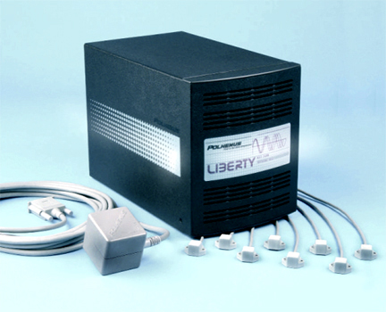
Teleoperation
Polhemus Motion Tracker
6 DOF
240 Hz
3.5 ms latency

Slide 10
Teleoperation

Slide 11
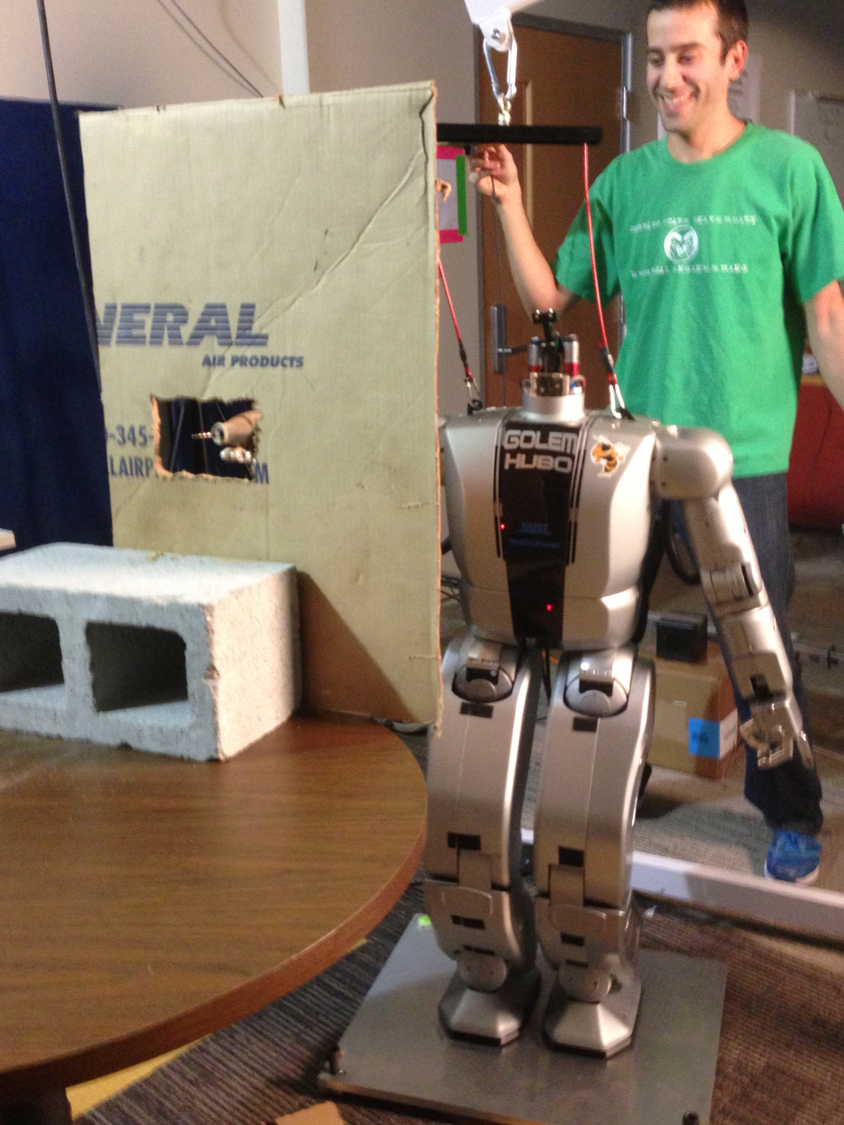
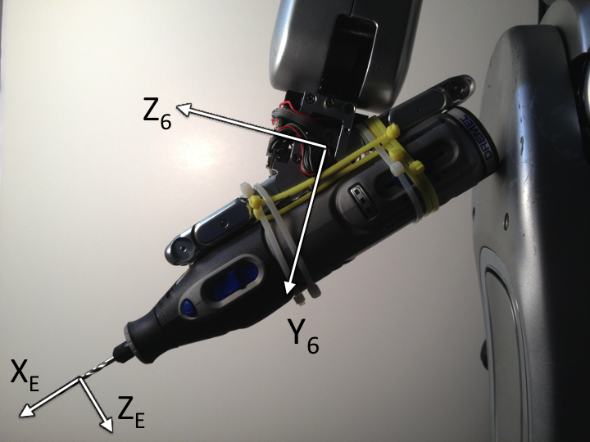
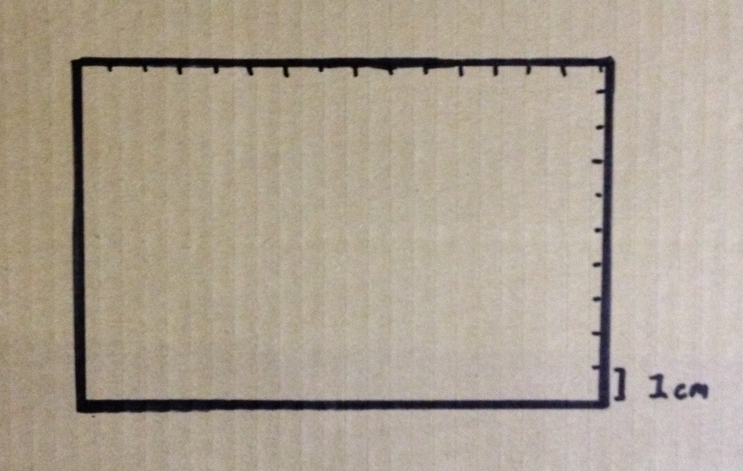
Putting it all together
Setup
Hand & Drill Frames
Rectangle to cut out
(15 x 10 cm)
[5] Rowland O’Flaherty, Peter Vieira, M.X. Grey, Paul Oh, Aaron Bobick, Magnus Egerstedt, and Mike Stilman. Proc. 5th IEEE International Conference on Technologies for Practical Robot Applications, 2013.

Slide 12
Wall Breaking for TEPRA
10x

Slide 13
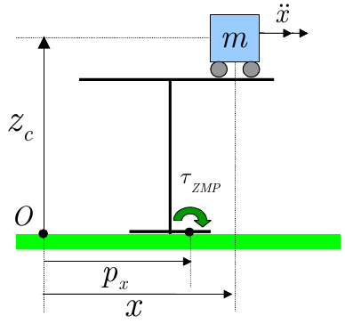
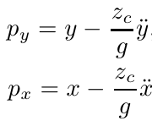
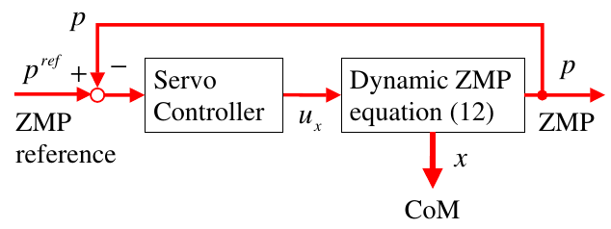
ZMP Walking
[6] Kajita, Shuuji, et al. "Biped walking pattern generation by using preview control of zero-moment point." Robotics and Automation, 2003. Proceedings. ICRA'03. IEEE International Conference on. Vol. 2. IEEE, 2003.

Slide 14
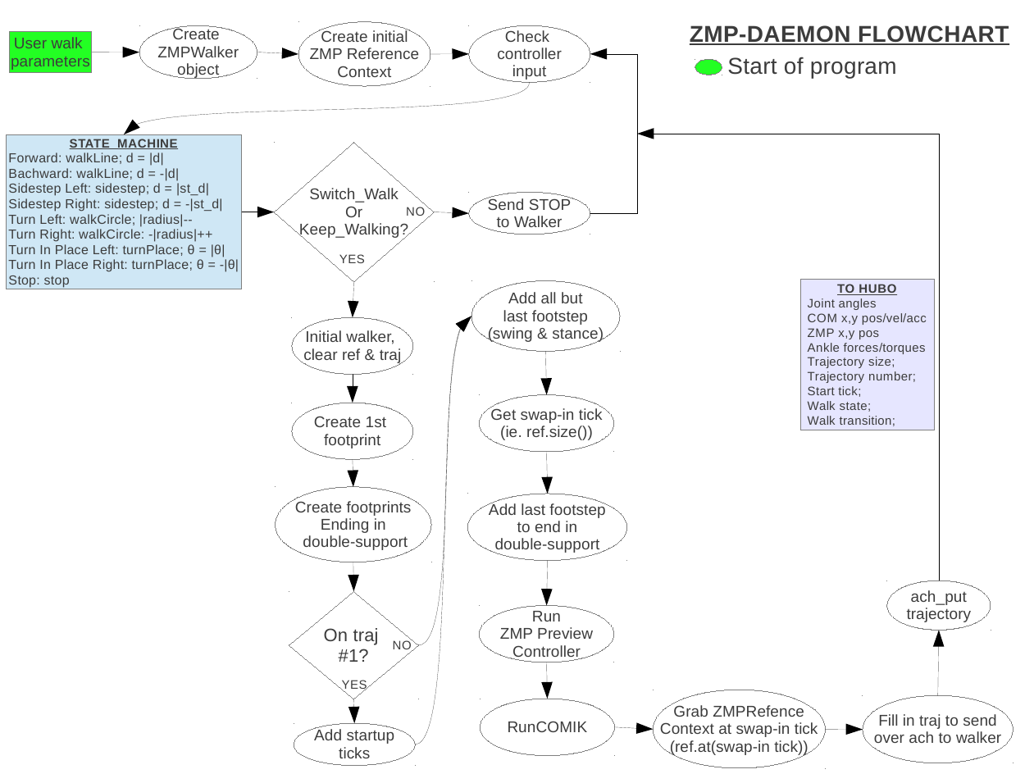
ZMP Daemon

Slide 15
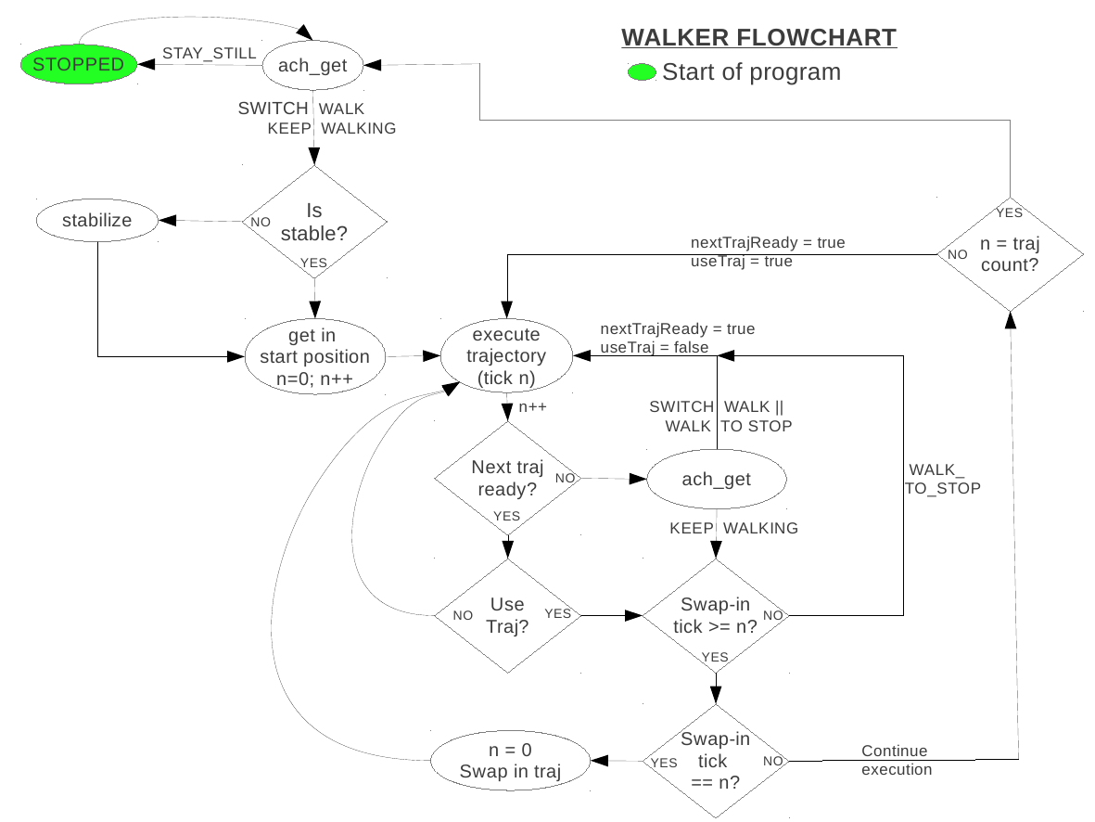
Real-time Continuous Walking

Slide 16
Walking - Simulation

Slide 17
Walking – The real thing

Slide 18
Critical Design Review
4x speed

Slide 19
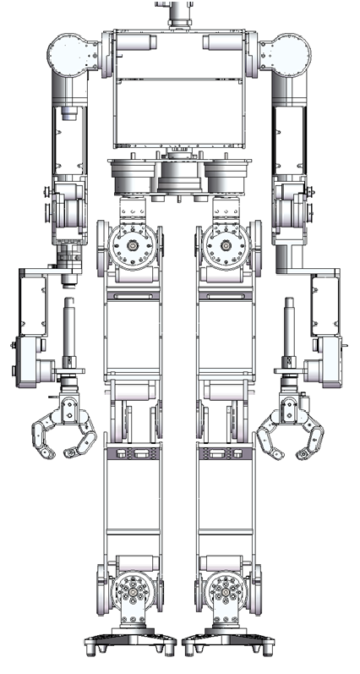
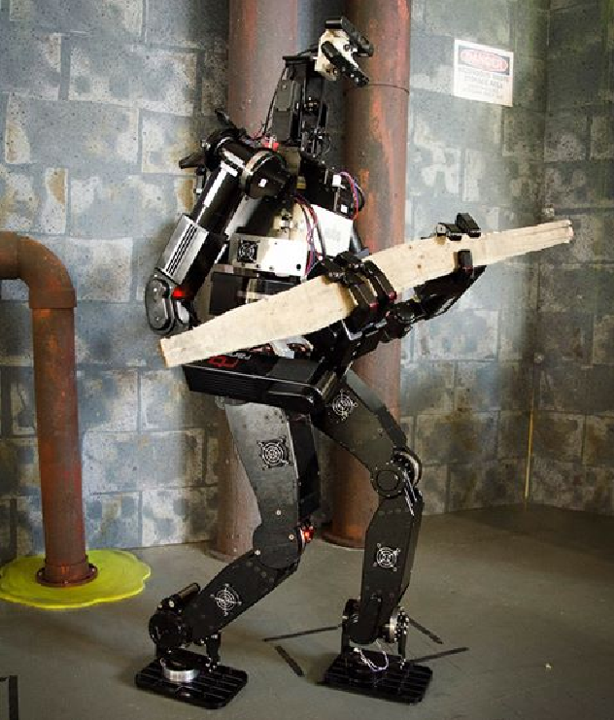
DRC-HUBO

Slide 20
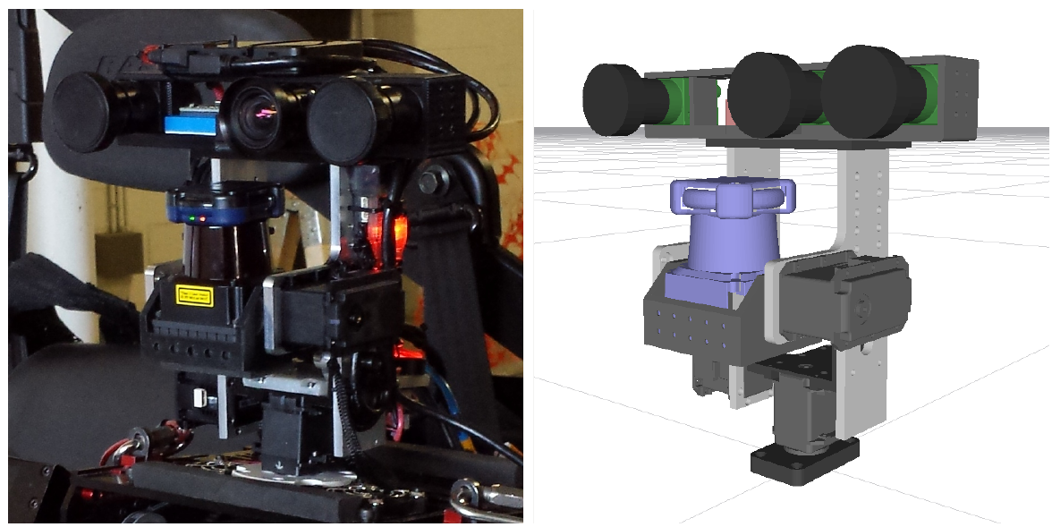
Perception Suite
3 x Pt. Grey Flea3 cameras
Hokuyo UTM-30LX-EW laser range-finder

Slide 21
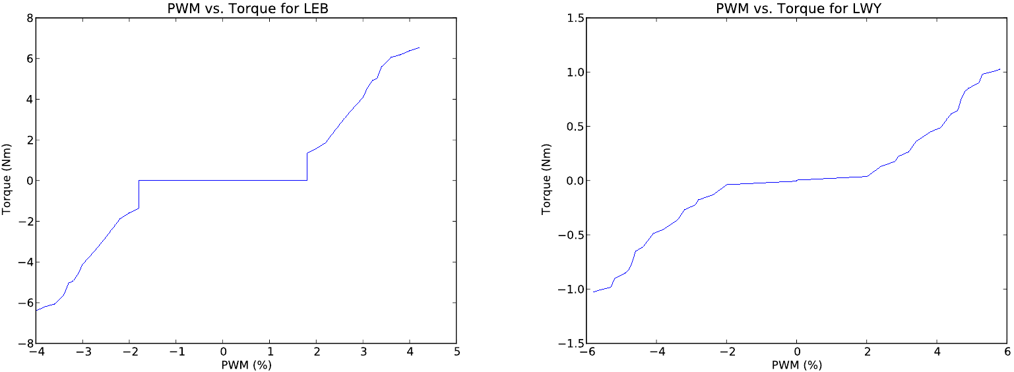
Joint Compliance
Non-complimentary switching mode - PWM
Gravity compensation

Slide 22
Walking Controllers
Workspace Balance Controller: Hips
Workspace Landing Controller

Slide 23
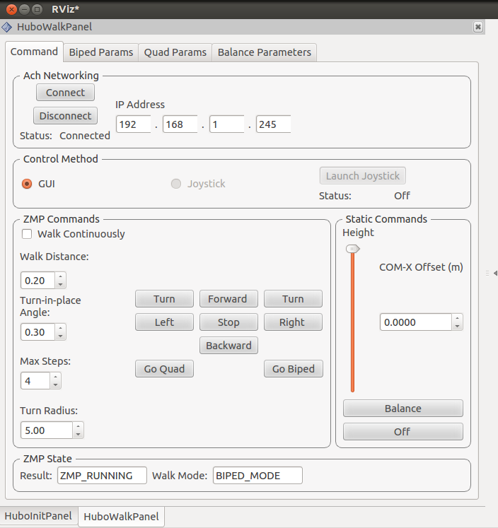
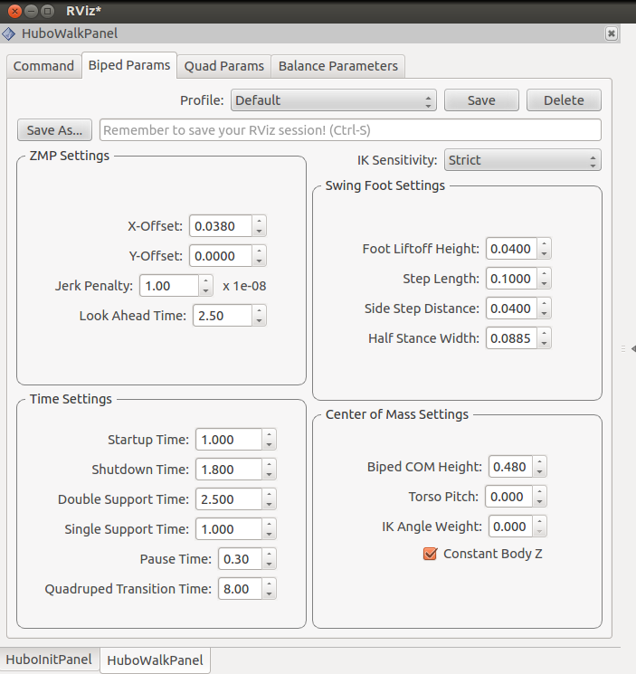
Biped/Quadruped Walking

Slide 24
Biped/Quadruped Transition
5x

Slide 25
Some Other Features
Numerical inverse kinematics
Interpolation
Collision Detection
Perception
Trajectory Management
Notes:
Constructs waypoint configs using interactive markers
Joint space vs. Workspace
Null space
Target offset
Passes traj to exection manager

Slide 26
Teleoperation in RViz
Notes:
Constructs waypoint configs using interactive markers
Joint space vs. Workspace
Null space
Target offset
Passes traj to exection manager

Slide 27
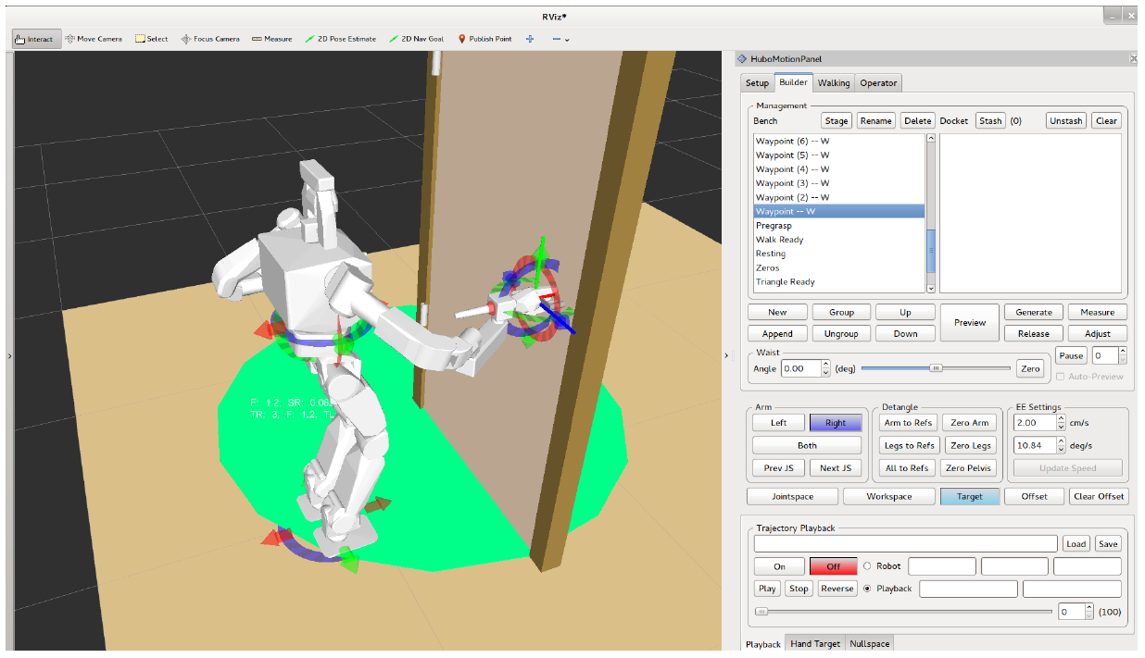
Trajectory Designer
Notes:
Constructs waypoint configs using interactive markers
Joint space vs. Workspace
Null space
Target offset
Passes traj to exection manager

Slide 28
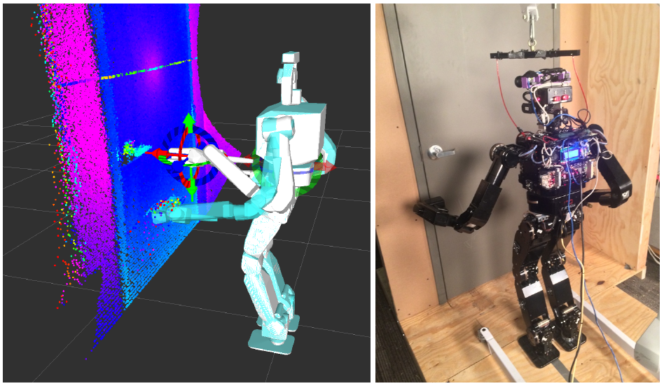
Execution Manager
Notes:
Sends trajs to robot
Monitors execution
Pauses trajs in event of collision and adjusts
Manages grasping
Small footsteps for correction
Decides which controllers should be active
Compliance, balance
Compliance in door and wall
Stiff PD for debris, light wood

Slide 29
Debris Removal
Practice - 1/3 points, DRC – 0/3 points

Slide 30
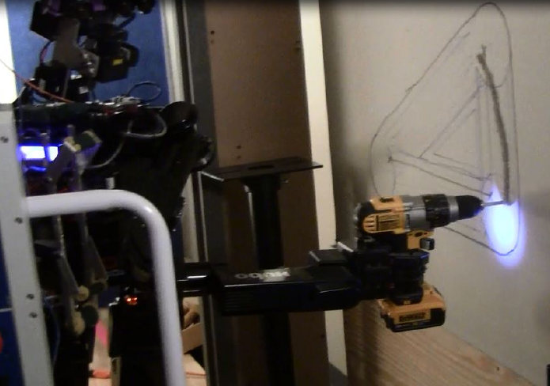
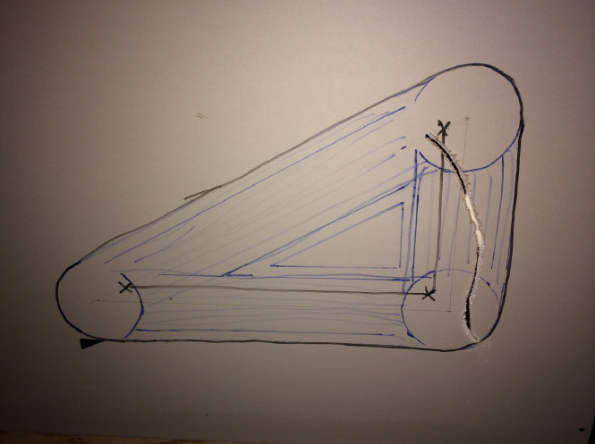
Wall Breaking
Practice - 2/3 points
DRC – 0/3 points

Slide 31
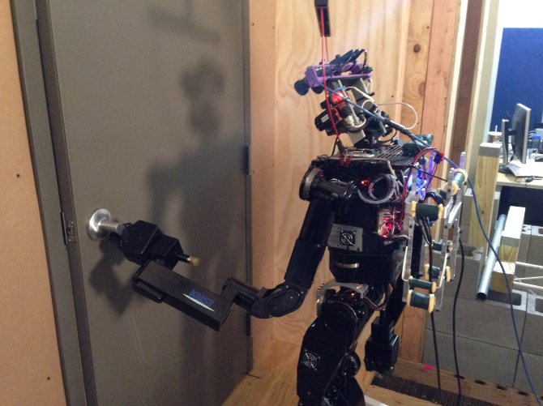
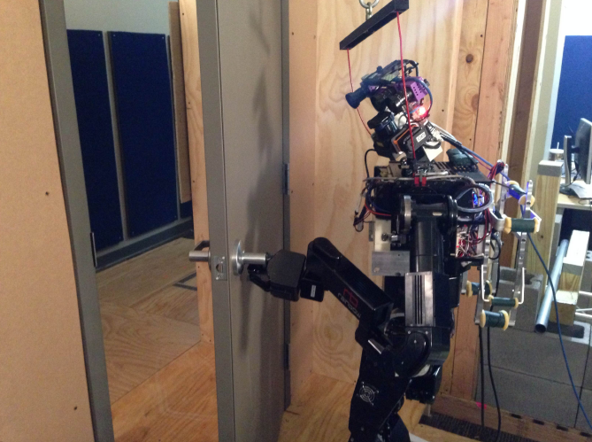
Door Opening
Practice - 2/3 points
DRC – 0/3 points

Slide 32
Lessons Learned
Event-based task allocation
Managing complexity
sporadic walking failures -> low-level-software
Walking and dynamic stability
Several algorithms, but no responsibility
ROS
TF tree
Communications
packet buffering, out-of-order packets
Hardware issues
burnt motors and boards. Need safety systems
Notes:
Sends trajs to robot
Monitors execution
Pauses trajs in event of collision and adjusts
Manages grasping
Small footsteps for correction
Decides which controllers should be active
Compliance, balance
Compliance in door and wall
Stiff PD for debris, light wood

Slide 33
Successes
DRC Practice
5/9 points
General-purpose, usable operator software
Same SW for all three events
Simple implementations
Limit complete planners and feedback controllers.
Agile development
Whiteboard of prioritized tasks
ROS
Point clouds, Dynamixels, GUI
Ach
Stable, low latency, configurable
Notes:
Sends trajs to robot
Monitors execution
Pauses trajs in event of collision and adjusts
Manages grasping
Small footsteps for correction
Decides which controllers should be active
Compliance, balance
Compliance in door and wall
Stiff PD for debris, light wood

