Slide 1
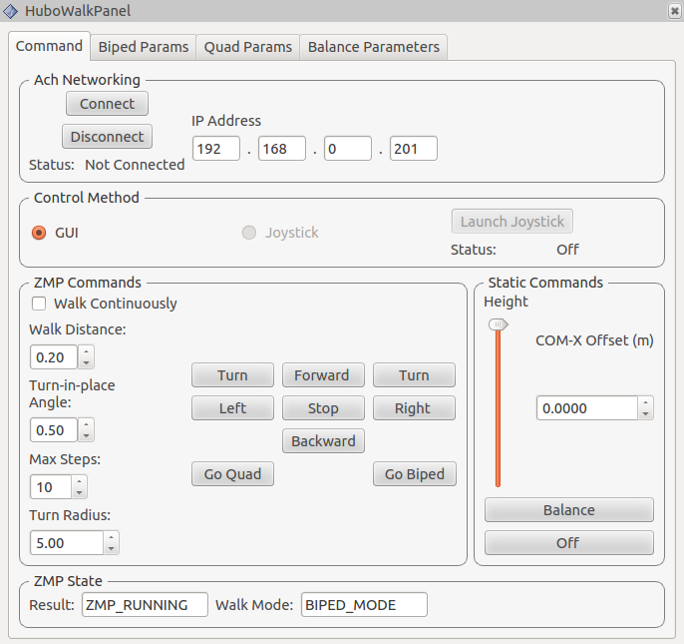
Connection
To Hubo
Walk Commands
Balance Commands

Slide 2
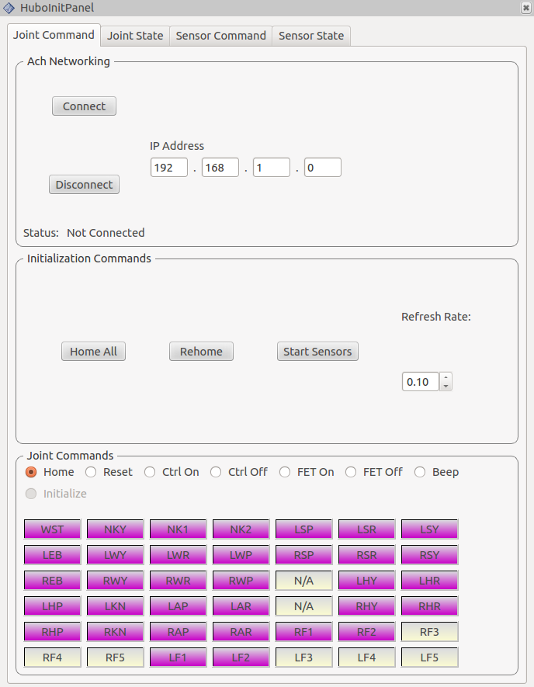
Connection
To Hubo
Homing
&
Sensor Initialization Commands
Joint States

