Slide 1
BlockChain, SupplyChain, Big Data
Demonstration Application
Pete Zybrick
pzybrick@gmail.com
pzybrick@mdsol.com
https://github.com/petezybrick

Slide 2
Pete Zybrick
Bell Labs to BMW to Big Data
Bridging Business and Technology
Solving Business Challenges by Intelligently Combining Reasonable Advanced Technology Solutions
Design and Deliver Full Life Cycle Architectures
Lifelong Learner
Sr. Lead Architect, Big Data Engineering, Medidata

Slide 3
My Objectives
Demonstrate Real World Use Cases for Blockchain in Supply Chain via Pet Nutrition
Apply Big Data and Relational to Blockchain
Learn about Blockchain (but not Bitcoin)
Complex, Configurable Simulation Generation
Maximize Developer Efficiency
Data Science Ready
Utilize Open Source, Industry Standard Approaches

Slide 4
Participant Objectives
Customer
Where Is My Pet Food From?
My Dog Is Getting Sick – Is It The Food?
Proactive Notification from the Company
Company
Let Customers Know Where The Food Is From
Immutable Tracking Of Ingredient Supply Chains
Customers Complaining – What Is Root Cause?
Data Available for Analytics and Data Science
Maximize Supplier Quality
Reduce Costs
Earlier Detection of Potential Issues
Future Predictive Analytics

Slide 5
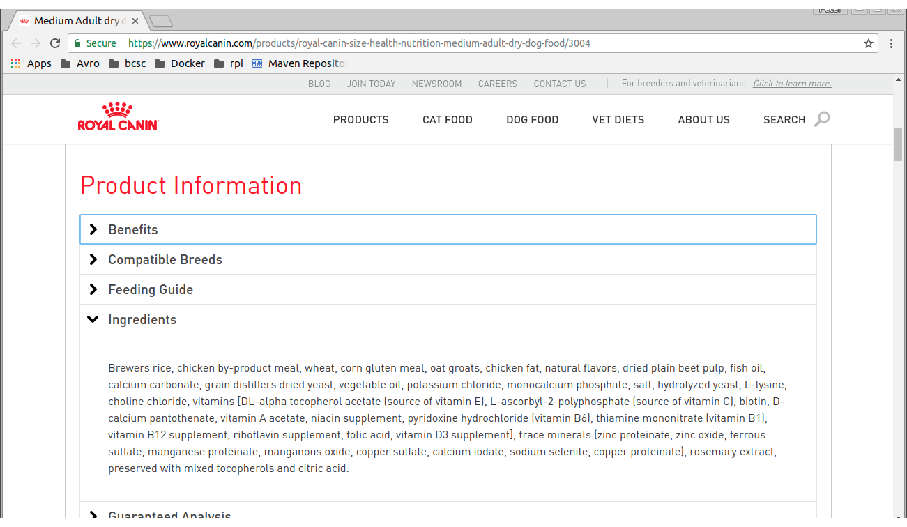
Canine Nutrition Ingredients

Slide 6
Where is My Pet Food From?
Fixed Set of Ingredients
Based on Lot Number, show Ingredient Supply Chains
Each Ingredient has 4 Supply Chain Components
Source (aka Farm)
Supplier (i.e. Seeds)
Growth Enhancer (i.e. Fertilizer)
Distributor
Configurable Simulation Data Generator
Demo

Slide 7
What is Making My Pet Sick?
Customer Loyalty DB – Track Complaints
Complaints Regarding Canine Nutrition Across Many Lots
Complaint Injection - Culprit Will Be The 7th Brewers Rice - Fertilizer Supplier (configurable)
Analyze Root Cause
Counts Of Supplier Chain Components Across All Lots In The Complaints
Scale - SparkSQL Cluster, ORC files
Demo
Query, Graph – Customer Complaints, Customer Supplier Complaints

Slide 8
Blockchain in this Application
Manufacturer has Fixed Private and Public Keys
Each Simulated Supplier has a Generated Public Key
Hash based on:
Distinct Supplier and Ingredient Information: DUNS Number, Lot Number, Fill Date, Qty, etc.
Block Sequence Number
Previous Hash
Future Goal Is To Externalize To Distributed Blockchain Virtual Machine, Externalize The Supplier Simulation

Slide 9
Demo Environment: 21 Containers
4x Cassandra
1x MySQL
Hive/HDFS
1x MySQL Hive Catalog Store
1x NameNode, 1x SecondaryNameNode
2x DataNodes
Presto
1x Coordinator
2x Worker's
Spark
1x Master
4x Workers
Jetty
1x WebAPI – handles the Swagger/OAS API to bcsc-service
1x WebUI – hosts the web site, specifically nutritionLineage.jsp
1x Zeppelin

Slide 10

Flow: Landscape
Zeppelin
Cassandra
webui - Jetty
nutritionLineage.jsp
bcsc-apiclient.jar
MySQL
HadoopHive
webapi - Jetty
bcsc-api.jar
Presto
Spark
bcsc-sim
GenSimSuppliers
GenSimComplaints

Slide 11
Flow: Initialization
Zeppelin
Cassandra
webui - Jetty
nutritionLineage.jsp
bcsc-apiclient.war
SupplyBlockchainConfig
MySQL
HadoopHive
webapi - Jetty
bcsc-api.jar
Presto
Spark
bcsc-sim
GenSimSuppliers
GenSimComplaints

Slide 12
Flow: Suppliers, Lots
Zeppelin
Cassandra
webui - Jetty
nutritionLineage.jsp
bcsc-apiclient.war
SupplyBlockchainConfig
MySQL
HadoopHive
webapi - Jetty
bcsc-api.jar
Presto
Spark
bcsc-sim
GenSimSuppliers
GenSimComplaints

Slide 13
Flow: Suppliers, Lots
Zeppelin
Cassandra
webui - Jetty
nutritionLineage.jsp
bcsc-apiclient.war
MySQL
HadoopHive
webapi - Jetty
bcsc-api.jar
Presto
Spark
bcsc-sim
SimBlockchainSequenceItems.json
GenSimSuppliers
GenSimComplaints

Slide 14
Flow: Suppliers, Lots
Zeppelin
Cassandra
webui - Jetty
nutritionLineage.jsp
bcsc-apiclient.war
MySQL
HadoopHive
webapi - Jetty
bcsc-api.jar
Presto
Spark
bcsc-sim
GenSimSuppliers
GenSimComplaints

Slide 15
Flow: Nutrition Lineage
Zeppelin
Cassandra
webui - Jetty
nutritionLineage.jsp
Bcsc-apiclient.jar
MySQL
HadoopHive
webapi - Jetty
bcsc-api.jar
Presto
Spark
bcsc-sim
GenSimSuppliers
GenSimComplaints

Slide 16
Flow: Nutrition Lineage
Zeppelin
Cassandra
webui - Jetty
nutritionLineage.jsp
bcsc-apiclient.war
bcsc-api: CanineApiService.findLotTree()
MySQL
HadoopHive
webapi - Jetty
bcsc-api.jar
Presto
Spark
bcsc-sim
GenSimSuppliers
GenSimComplaints

Slide 17
Flow: Nutrition Lineage
Zeppelin
Cassandra
webui - Jetty
nutritionLineage.jsp
bcsc-apiclient.war
MySQL
HadoopHive
webapi - Jetty
bcsc-api.jar
bcsc-service: LotCanineDao.findLotTree()
Presto
Spark
bcsc-sim
GenSimSuppliers
GenSimComplaints

Slide 18
Flow: Nutrition Lineage
Zeppelin
Cassandra
webui - Jetty
nutritionLineage.jsp
bcsc-apiclient.war
MySQL
HadoopHive
webapi - Jetty
bcsc-api.jar
Presto
Spark
bcsc-sim
GenSimSuppliers
GenSimComplaints

Slide 19
Flow: Nutrition Lineage
Zeppelin
Cassandra
webui - Jetty
nutritionLineage.jsp
bcsc-apiclient.war
MySQL
HadoopHive
webapi - Jetty
bcsc-api.jar
Presto
Spark
bcsc-sim
GenSimSuppliers
GenSimComplaints

Slide 20
Flow: Nutrition Lineage
Zeppelin
Cassandra
webui - Jetty
nutritionLineage.jsp
bcsc-apiclient.war
HTML5 <details
MySQL
HadoopHive
webapi - Jetty
bcsc-api.jar
Presto
Spark
bcsc-sim
GenSimSuppliers
GenSimComplaints

Slide 21
Flow: Generate Complaints
Zeppelin
Cassandra
webui - Jetty
nutritionLineage.jsp
bcsc-apiclient.war
SupplyBlockchainConfig
MySQL
HadoopHive
webapi - Jetty
bcsc-api.jar
Presto
Spark
bcsc-sim
GenSimSuppliers
GenSimComplaints

Slide 22
Flow: Generate Complaints
Zeppelin
Cassandra
webui - Jetty
nutritionLineage.jsp
bcsc-apiclient.war
MySQL
HadoopHive
webapi - Jetty
bcsc-api.jar
Presto
Spark
bcsc-sim
GenSimSuppliers
simUsers.csv
GenSimComplaints

Slide 23
Flow: Generate Complaints
Zeppelin
Cassandra
webui - Jetty
nutritionLineage.jsp
bcsc-apiclient.war
MySQL
HadoopHive
webapi - Jetty
bcsc-api.jar
Presto
Spark
bcsc-sim
GenSimSuppliers
GenSimComplaints

Slide 24
Flow: Analyze Complaints
Zeppelin
Cassandra
webui - Jetty
nutritionLineage.jsp
bcsc-apiclient.war
MySQL
HadoopHive
webapi - Jetty
bcsc-api.jar
Presto
Spark
spark-submit:
CustomerComplaintService
bcsc-sim
GenSimSuppliers
GenSimComplaints

Slide 25
Flow: Analyze Complaints
Zeppelin
Cassandra
webui - Jetty
nutritionLineage.jsp
bcsc-apiclient.war
MySQL
HadoopHive
webapi - Jetty
bcsc-api.jar
Query Complaints
Presto
Spark
bcsc-sim
GenSimSuppliers
GenSimComplaints

Slide 26
Flow: Analyze Complaints
Zeppelin
Cassandra
webui - Jetty
nutritionLineage.jsp
bcsc-apiclient.war
MySQL
HadoopHive
webapi - Jetty
bcsc-api.jar
Write SupplierComplaint
ORC Tables as Files
Presto
Spark
bcsc-sim
GenSimSuppliers
GenSimComplaints

Slide 27
Flow: Analyze Complaints
Zeppelin
Cassandra
webui - Jetty
nutritionLineage.jsp
bcsc-apiclient.war
MySQL
HadoopHive
webapi - Jetty
bcsc-api.jar
Distributed
Query
Presto
Spark
bcsc-sim
GenSimSuppliers
GenSimComplaints

Slide 28
Distributed Join using Presto
Combine Data from Multiple Physical Sources into One Logical Data View
Developed by Facebook, Enhanced by Netflix, Uber
Active Community,
Business Value
Speed To Market – No Changes To Source Databases
Scalable Analytics Across Databases
Data Warehouse Population

Slide 29
Distributed Join Flow
Zeppelin
select ...
Presto
Hive
Catalog
Coordinator
Worker1
Worker2
Worker3
Hadoop
NameNode
MySQL
DataNode1
DataNode2
DataNode3

Slide 30
Distributed Join Flow
Zeppelin
Presto
Hive
Catalog
fetch ORC/HDFS
metadata
Coordinator
Worker1
Worker2
Worker3
Hadoop
NameNode
MySQL
DataNode1
DataNode2
DataNode3

Slide 31
Distributed Join Flow
Zeppelin
Presto
Hive
Catalog
Coordinator
Worker1
Worker2
Worker3
Hadoop
NameNode
MySQL
DataNode1
DataNode2
DataNode3

Slide 32
Distributed Join Flow
Zeppelin
Presto
Hive
Catalog
Coordinator
Worker1
Worker2
Worker3
Hadoop
NameNode
MySQL
DataNode1
DataNode2
DataNode3

Slide 33
Distributed Join Flow
Zeppelin
Presto
Hive
Catalog
Coordinator
Worker1
Worker2
Worker3
dn2
dn3
dn1
Hadoop
NameNode
MySQL
DataNode1
DataNode2
DataNode3

Slide 34
Distributed Join Flow
Zeppelin
Presto
Hive
Catalog
Coordinator
Worker1
Worker2
Worker3
Hadoop
NameNode
MySQL
DataNode1
DataNode2
DataNode3

Slide 35
Distributed Join Flow
Zeppelin
Presto
Hive
Catalog
Coordinator
Worker1
Worker2
Worker3
Hadoop
NameNode
MySQL
DataNode1
DataNode2
DataNode3

Slide 36
Distributed Join Flow
Zeppelin
Presto
Hive
Catalog
Coordinator
Worker1
Worker2
Worker3
fetch MySQL
metadata
Hadoop
NameNode
MySQL
DataNode1
DataNode2
DataNode3

Slide 37
Distributed Join Flow
Zeppelin
Presto
Hive
Catalog
Coordinator
Worker1
Worker2
Worker3
fetch ResultSet
Hadoop
NameNode
MySQL
DataNode1
DataNode2
DataNode3

Slide 38
Distributed Join Flow
Zeppelin
Return Combined ResultSet
Presto
Hive
Catalog
Coordinator
Worker1
Worker2
Worker3
Hadoop
NameNode
MySQL
DataNode1
DataNode2
DataNode3

Slide 39
Whats Next?
Gain Deeper Understanding Of Blockchain
Install Virtual Machine, I.E. Evm
Learn Structure And Api
Integrate Blockchain Virtual Machine
Pump The Simulation Data Into VM/Distributed Ledger
Consensus
Digital Signatures
Ingest The Block Chains

Slide 40
Questions and Answers Feedback

Slide 41
Management and Engineering

Slide 42
Objectives
Develop on Workstation
Generate Realistic Simulation at Varying Scale
Scalable Deployments from Development to Big Data
Ensure Graduated Approach
Developer Workstation to RDB to Big Data
Complex, Configurable Simulation Generation
Apply Containerized Approach
Utilize Open Source, Industry Standard Methods: Spark, Presto, ORC, OAS/Swagger, Cassandra, Zeppelin, Docker

Slide 43
Data Model Overview

Slide 44
Lot Simulations
Configurable Number of Component Suppliers
Fixed Set of
Each Ingredient has 4 Supply Chain Components, aka Suppliers ()
Suppliers Generated
Configurable, currently 30 per Cat/SubCat
Prefix A1, B2, C3, …, D30 (query)
Each Lot Has Fixed Set Of Ingredients, Random Set Of Suppliers (query)
Data Written To Both MySQL and ORC in HDFS
Demo

Slide 45
Complaint Data Generation
The Culprit will be the 7th Brewers Rice - Fertilizer Supplier
Configurable
During GenSimSuppliers
60% of the time, override the Brewers Rice – Fertilizer supplier to the Culprit
Insert the Affected Lot Numbers to Adverse Effects staging table
During GenSimComplaints
Create Complaints in Customer Loyalty Table
Each Complaint has a Random Affected Lot Number from Adverse Effects Staging Table

Slide 46
Complaint Analysis
Customer Loyalty DB – Track Complaints
Complaints Regarding Canine Nutrition Across Many Lots
Root Cause Determination - What Are The Counts Of Supplier Chain Components Across All Lots In The Complaints?
Query Customer_Loyalty
Large Amount Of Data To Sift Through – How To Scale?
SparkSQL Cluster, ORC files
Demo
Review SparkSQL query
Review file structures in HDFS
Run Spark job

Slide 47
Demo Environment: 21 Containers
Review the Docker Compose files
Common Shared Directory
Demo
Docker Exec into Hadoop NameNode
List HDFS folders
Exec into Any Other Containers Of Interest

Slide 48
Projects
Java using Maven
Swagger for OAS Server and Client API's
Parent: blockchain-supplychain
Children
bcsc-common: Common Utilities, Constants, etc.
bcsc-service: Centralized Services – Database, Hive, ORC, SparkSQL
bcsc-sim: Generate The Simulated Data
bcsc-test: Unit Tests
bcsc-api: Server OAS Code – Connects To bcsc-service
bcsc-apiclient: Client OAS Code, Connects to bcsc-api
bcsc-webapi: Generates the WAR including the apiclient
bcsc-webui: Web Site, Deploys the WAR

Slide 49
Distributed Join using Presto
Each Database is Catalog
Connectors connect Presto to each DBM
Statements are <Catalog>.<Schema>.<Table>
Review /conf folder Structure and Contents
Example: What State are the SupplierComplaints from?
Show SupplierComplaints in Hive/HDFS
Show Supplier in MySQL
Query

Slide 50
Questions and Answers Feedback

