Slide 1

Scanning Tunneling Microscopy
Gregorio Jaca
October 9, 2025

Slide 2
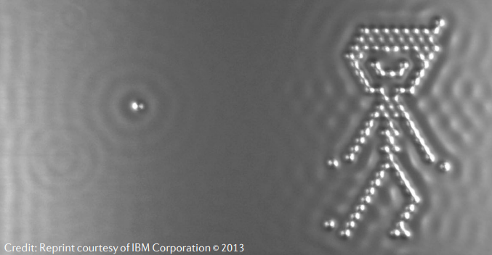
“I couldn’t stop looking at the images, it was entering a new world” Gerd Binnig

Slide 3
Table of Contents
- Introduction and Motivation
Theoretical Minimum
Principle of operation
Measurement
Study of Highly Oriented Pyrolytic Graphite (HOPG)
Atomic Steps
Atomic Resolution
Moiré effect
Conclusions and Discussion

Slide 4
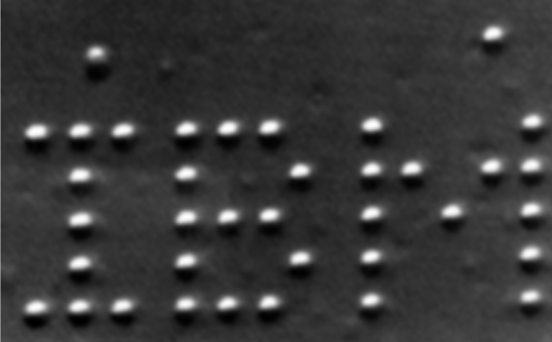
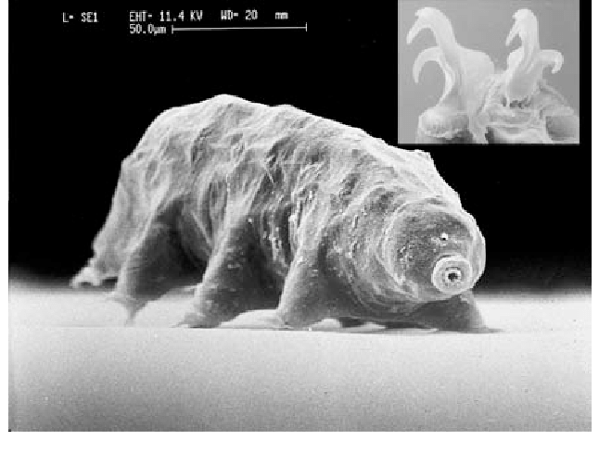
STM imaging
IBM Corporation
Scanning electron micrograph of the tardigrade Macrobiotus furciger with inset showing details of claw structure (Photography by S. McInnes)

Slide 5
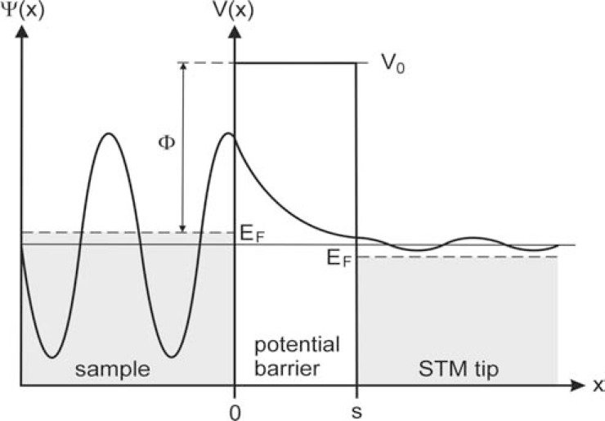


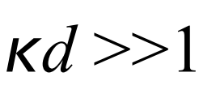
Tunneling
Trixler, Frank. (2013). Quantum Tunnelling to the Origin and Evolution of Life. Current organic chemistry. 17.

Slide 6
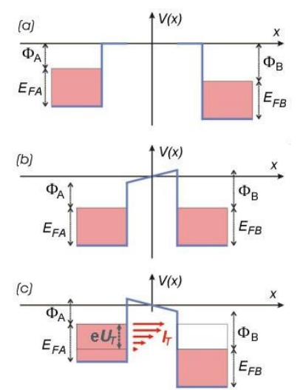
Electrodes A and B are far apart.
Fermi level: A > B
The electrodes are brought into sub-nm proximity,
The Fermi levels are equalized
A contact potential is formed.
A bias Ut is applied.
The tunneling current flows
(filled states A) -> (empty states B)

Slide 7
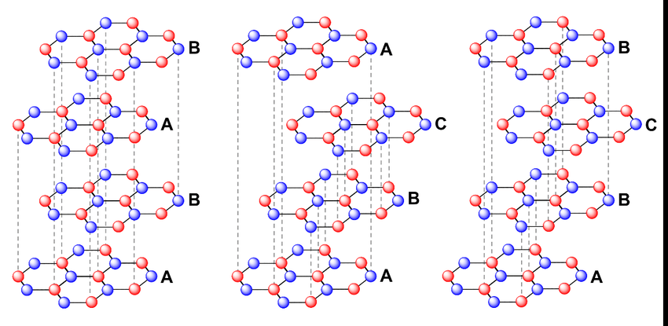
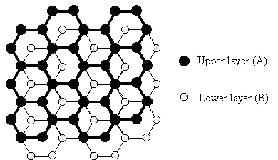
Study of Highly Oriented Pyrolytic Graphite (HOPG)

Slide 8
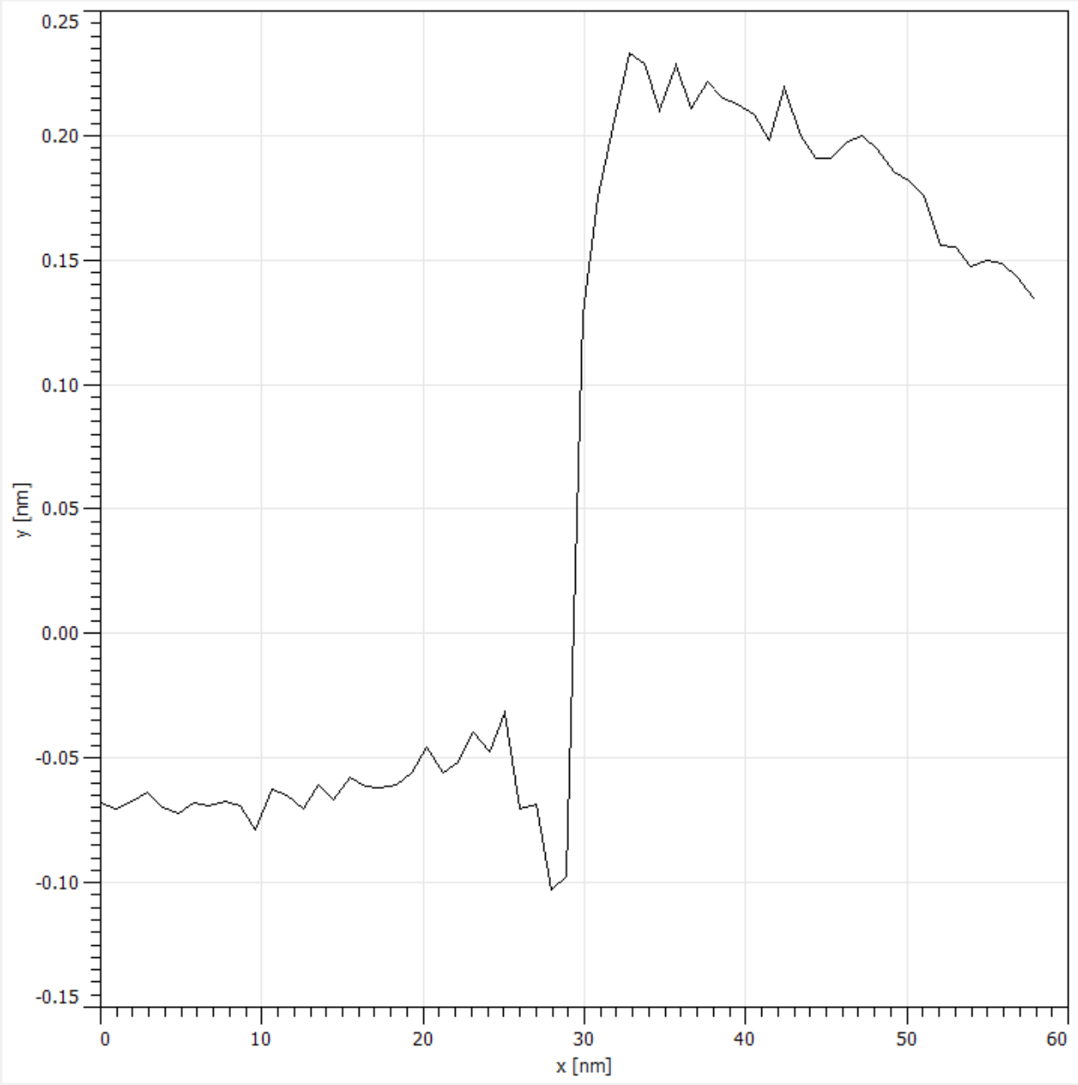
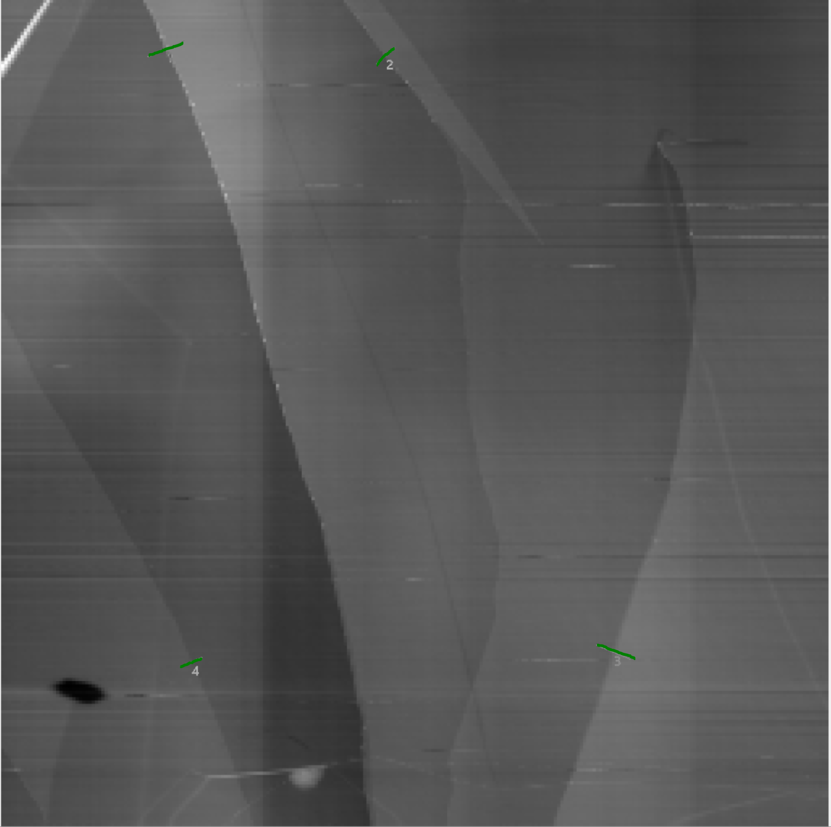
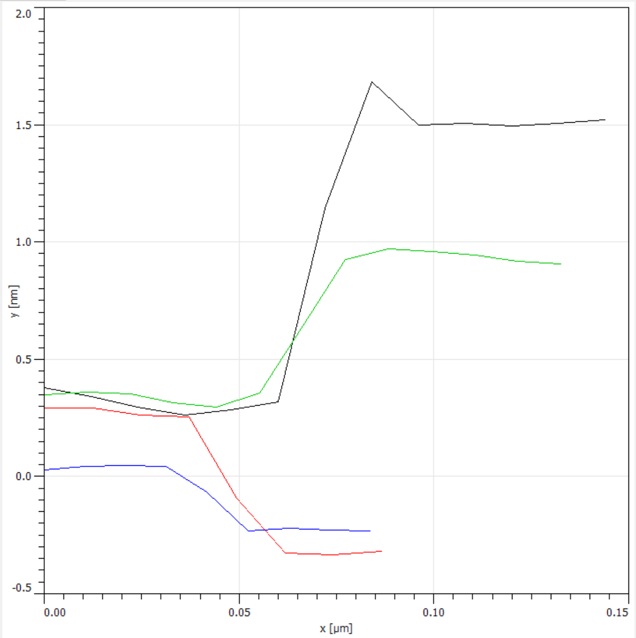
Atomic Steps
Step height of around 3.3 ± 0.1 A
The interlayer spacing for graphite is approximately 34 A
Image of the graphite surface showing terraces
Altitude profiles at several terrace boundaries

Slide 9
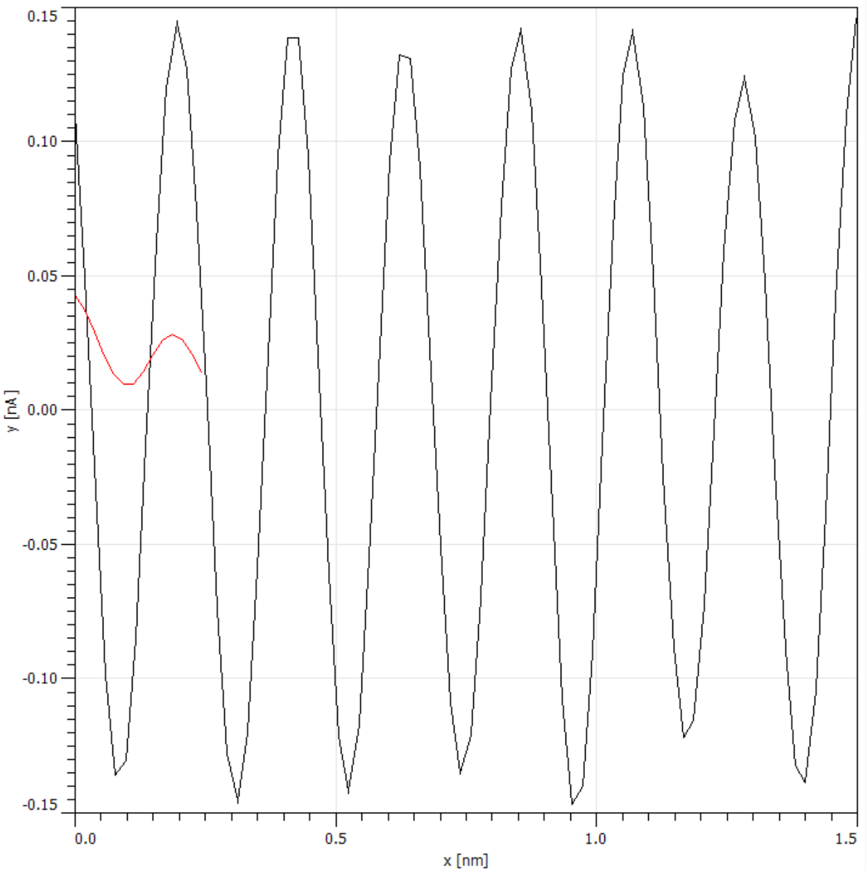
Atomic Resolution
Image an area with NO atomic terraces
Reduce surface-tip distance
Increase current set-point
Decrease bias voltage
Use 2D FFT filtering (noise reduction)
Triangular (not Hexagonal) patter emerges
The periodicity corresponds to the lattice constant.
Measured value: 2.5 ± 0.1 A
Theoretical value: 2.46 A
Plot with the peaks corresponding to the positions of the imaged carbon atoms.

Slide 10
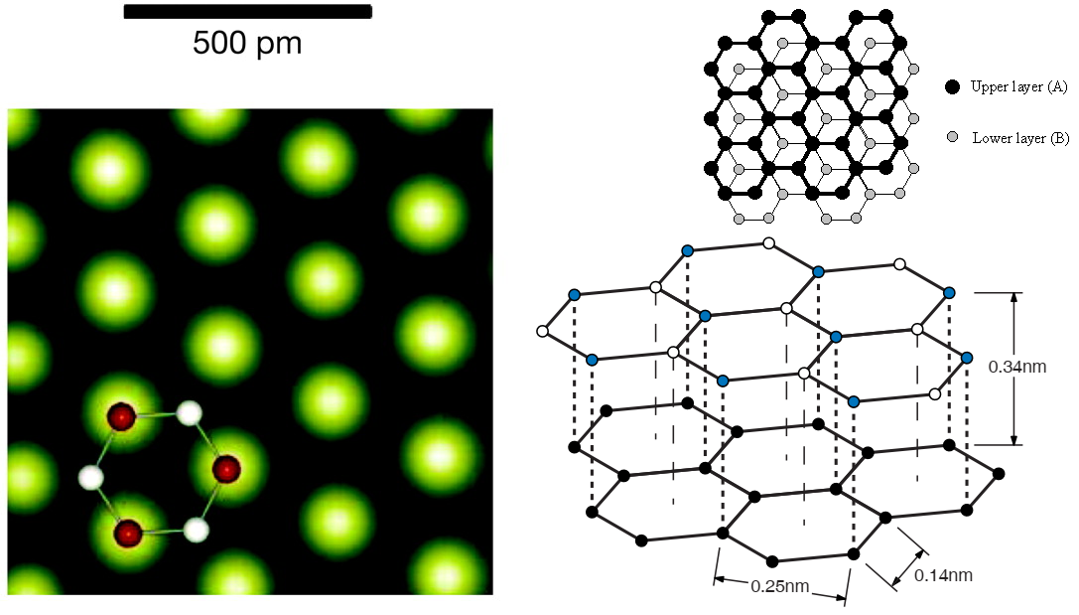
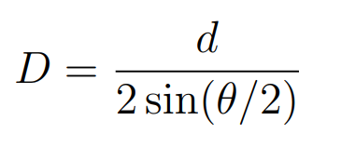
Moiré effect

Slide 11
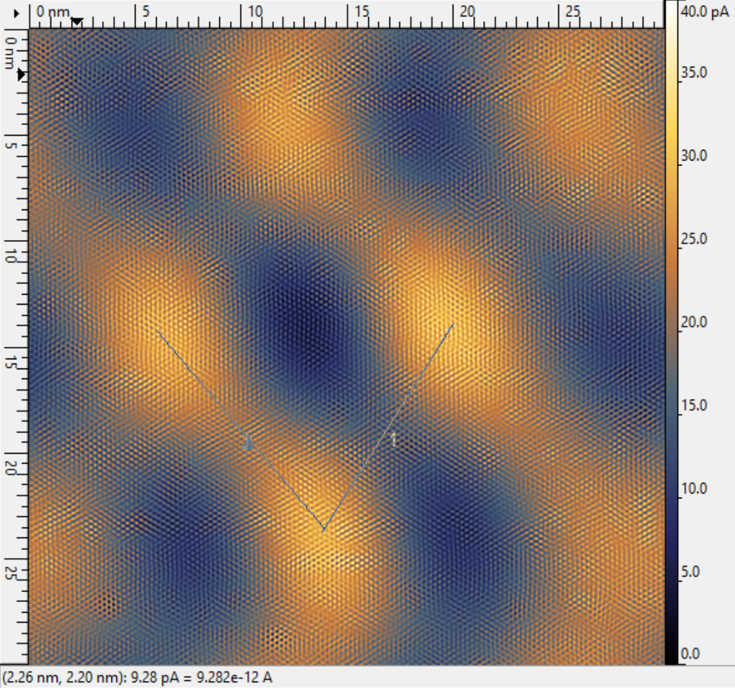
Moiré effect
Image two slightly rotated periodic gratings
Measured period of Moiré pattern:
D = 128.9 ± 1 A
Twist angle = 1.09 ± 0.03 °

Slide 12
Conclusions and Discussion
- We measured Atomic Steps in Highly Oriented Pyrolytic Graphite
We measured the lattice constant of the sample with atomic resolution
We observed the Moiré pattern, measured its period and the rotation angle
We employed data cleaning and noise reduction techniques to ensure accuracy and precision in our measurements

Slide 13
Thank you for the attention!
Please ask any questions you had during the presentation

Slide 14
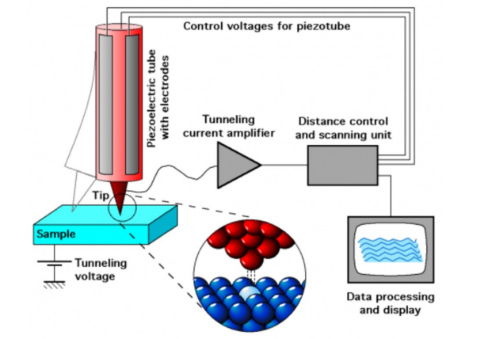
STM measurement device

