Slide 1
Code-Red: a case study on the spread and victims of an Internet worm
By David Moore, Colleen Shannon, Jeffery Brown
Vijayshankar Venugopal

Slide 2
Virulent worm calls in doubt our ability to protect the Internet
The spread of the virus was possible because of the Index Server ISAPI vulnerability.
There exists a remote buffer overflow vulnerability in all version of Microsoft IIS web server.
This is the loop-hole which was used by Code-Red worm.
It started to spread on July 12th 2001.
On July 19th 2001, more that 350,000 servers where infected with so-called Code-Red worm.

Slide 3
Path taken by the Code-Red worm
July 12: The first Net address from which attacks emanate is later determined to apparently be from Foshan University in China.
July 13: Senior security engineer Ken Eichman notices strange traffic coming in on a port normally used by Web servers.
July 14: Eichman reports the traffic to incident-handling community DShield.org.
July 15: DShield.org's Johannes Ullrich gets confirmation that some computers are indeed infected by a worm.
July 16: eEye Digital Security obtains a copy of the worm and begins decoding.
July 17: After spending all night reverse-engineering the binary code, eEye releases a partial analysis of the worm it dubbed Code Red. Growth of the worm slows.

Slide 4
…continued
July 18: eEye discovers that at 5 p.m. PDT July 19, the worm will direct infected servers to flood the White House Web site with data.
July 19: Someone modifies the worm, fixing a problem with its random-number generator. Code Red I version II is created. Spreads faster.
July 19: System administrators for the White House place their Web site on a different IP address: from 198.137.240.91 to 198.137.240.92.
July 19: The worm continues its unsuccessful attack, but it stops infecting other machines, as designed. However, a few infected servers continue to scan the Net, apparently because the administrators had set the time wrong.
July 22: Eichman still detects some active Code Red worms, but their numbers continue to decline.

Slide 5
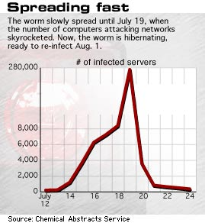
By July 19th 2001, the worm had almost infected 280,000 computers

Slide 6
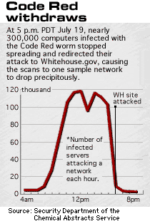
On July 19th 2001, the virus stops spreading and redirects its attacks on Whitehouse website (http://www.whitehouse.gov)

Slide 7
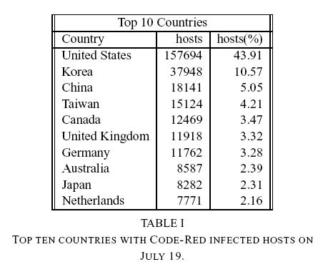
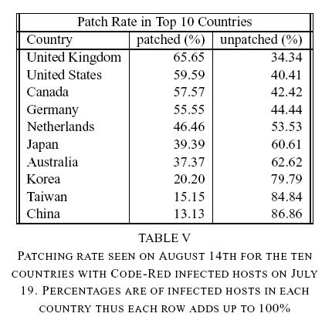
Countries affected and Patched…

Slide 8
Code-Red II
This is more powerful than Code-Red I, based on Code-Red I, modified and many of the flaws which existed were removed.
Since it is not a memory resident virus, it cannot be easily stopped.
It infects a server and opens a backdoor for administrative access to the server, so it can be used for attacks of Denial of Service in future.
It uses 6 times more threads to spread as compared to Code-Red I.

Slide 9
Conclusion
System Software must be patched regularly.
If you were vulnerable, you were nailed.
Many comments and fingers pointed to eEye for releasing too much information about IIS vulnerability.

