Slide 1
From AntiVirus to AntiWorm:
A New Strategy for A New Threat Landscape
Carey Nachenberg
Symantec Research Labs

Slide 2
Symantec Research Labs
Symantec Research Labs is an organization dedicated to short, medium and long-term research in the computer security and information assurance space.
“Our mission is to ensure Symantec’s long-term leadership by fostering innovation, generating new ideas, and developing next-generation technologies across the security space.”

Slide 3
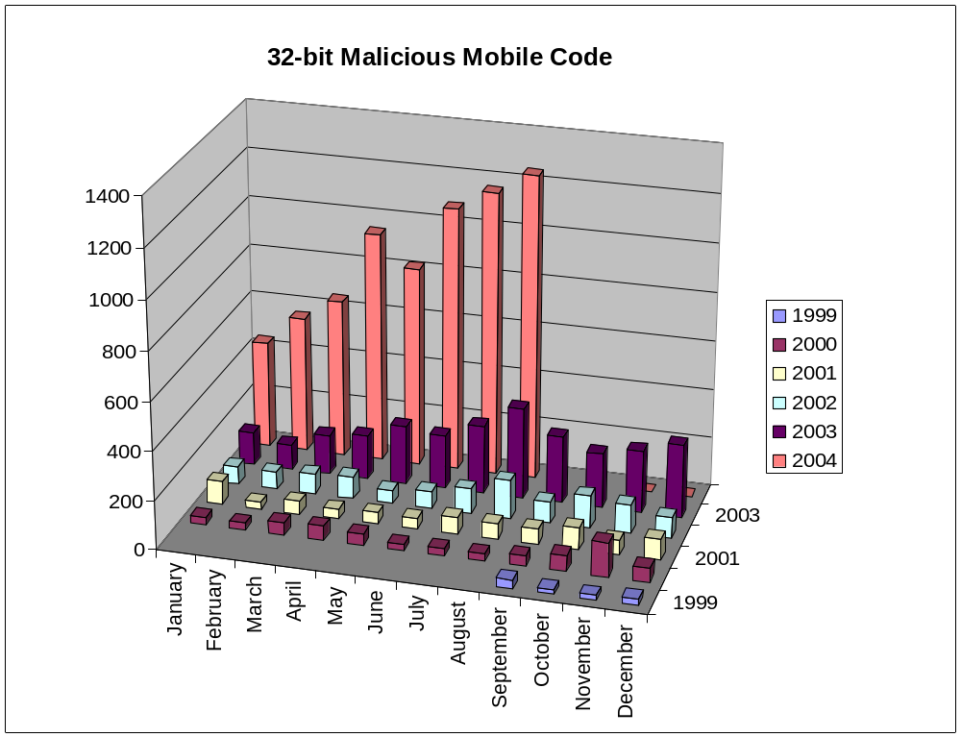
What We’re Up Against
Source: Symantec Internet Security Threat Report

Slide 4
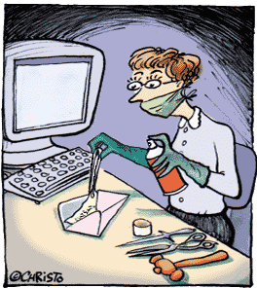

Current State of AV Technology
AV today is still largely file-centric
  When Code Red came out, several AV vendors said: “Code Red is not a virus, so we won’t detect it.”
AV today is still largely signature-centric
  “I can write a sig for that threat.”
AV today is still largely reactive
  “We’ll send out a new fingerprint as soon
  as there’s a threat.”
AV analysis today is largely a manual process
  Automated analysis is used for simple threats

Slide 5
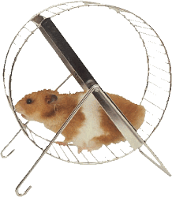
Current State of AV Technology
Process
  Capture, Analyze, Create signature, Test, Roll-out
Detection technology – not just grep!
  These technologies are used in client AV software; these are not back-end server technologies!
  Multi-String search
  Scalpel scanning (precision scanning at the entrypoint)
  X-Ray (plaintext crypto attack on virus/worm)
  CPU emulation
  P-CODE-driven detection
    Decide where and when to scan/emulate
    Hand-code detections in P-CODE
Timeframe
  5 minutes to several weeks (!) to write a signature
  Several hours or more for FP/FN testing

Slide 6
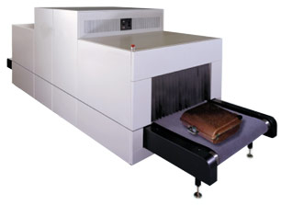
Current State of AV Technology
What’s Running on the Typical Desktop in AV
Heuristics
  Dynamic heuristics
    Leverage CPU emulator to coax file-based threat into displaying bad behaviors
  Static heuristics
    Use signatures to detect known-bad sequences of code
  Applied to macro, script, and binary threats
Behavior blocking
  1st generation systems today
  Stop threats by intercepting and blocking system calls
  Policy-based blocking prevalent
  Simple buffer-overflow protection (software/NX)

Slide 7
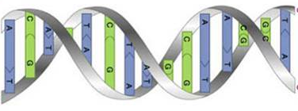
Current State of AV Technology
Signature Updates
  Volume
    We push up to 1.4B (virus definition) updates every day
    Up to 60 terabytes of data sent down every day!
    That’s up to 6 times the total amount of printed material in the Library of Congress per day
  Scalability
    Leverage Akamai’s 14,000 servers in 1,100 networks
  Compression
    Employ incremental update technologies and compression (~85-90% percent reduction)
    Some vendors ship “single definition packages”

Slide 8

Current State of AV Technology
Automation
  Submission filtering
    Automatic filtering of customer submissions (95%)
    Application of super-sensitive heuristics for triage purposes
  Analysis
    Auto-replication of threats in VMs
      Macro-based threats, binary threats
    Auto-fingerprint generation with provably-low FP rates
      Leverages Markov chaining approach
  Quality Assurance
    Automated, parallel testing
    Huge corpora of files for FP testing

Slide 9
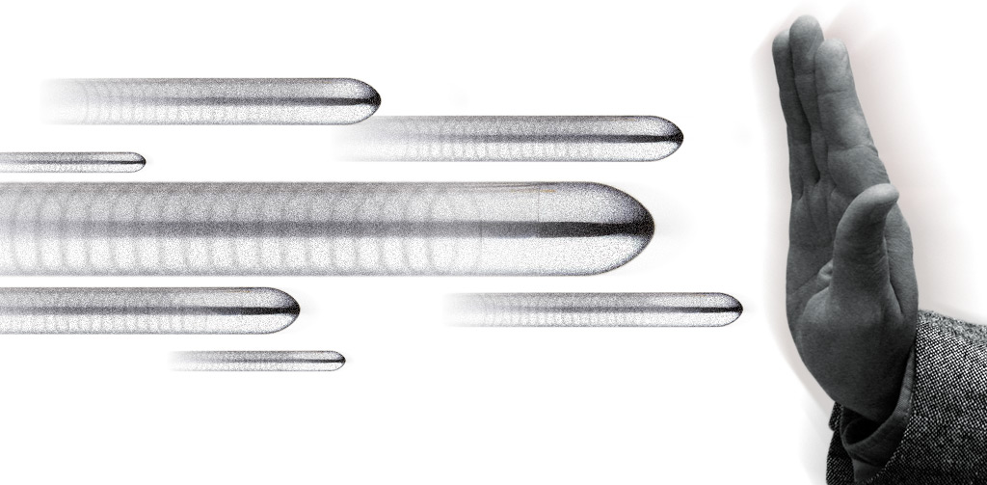
Stopping the Bullet
Question:
How do you stop a bullet that has already been fired?

Slide 10


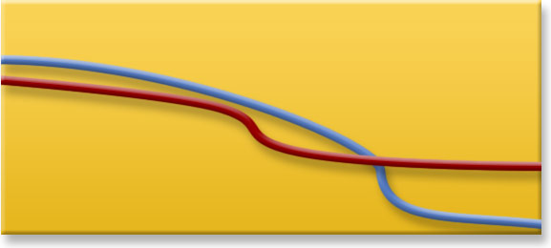

Stopping the Bullet
We’ve reached an inflection point where the latest threats now spread orders of magnitude faster than our ability to respond
The existing signature based capture/analyze/signature/rollout model fails to address these threats on its own
Program
Viruses
months
Macro
Viruses
E-mail
Worms
Network
Worms
days
Pre-
automation
Post-
automation
Signature
Response Period
Contagion Period
hrs
Flash
Worms
mins
Contagion Period
secs
Signature Response Period
1990
Time
2005

Slide 11
Attributes of an AntiWorm solution
Multi-platform support
  Windows, Linux, Solaris, Handhelds, etc…
Protection at all tiers of the network
  Clients, Servers, Gateways and the Fabric
Proactive and reactive technologies
  Proactive is key, but no solution is perfect!
Technology and Information

Slide 12

AntiWorm: A five-tier approach*
Vulnerability information and patching
Real-time backup
Early warning and monitoring systems
Proactive host and network blocking technologies
Classical reactive technologies
* According to Symantec Research Labs

Slide 13
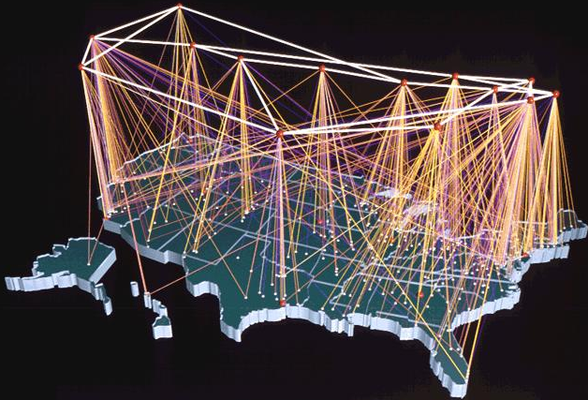
AntiWorm: Early Warning and Monitoring
Sensor Network (today)
  Gather security events from partner devices around the world (20,000+ sensors monitored in 180 countries)
  Statistical analysis used to correlate and detect attacks
  Often detect early recon for later attacks
Machine Honeypot Network (today)
  Detect new worms and recon attempts on new vulnerabilities
  Forward attacker data to automated workflow systems
  40 honeypot virtual machines deployed, covering 2000 IPs
Email Honeypot Network (tomorrow)
  Identify new email worms by looking for executable attachments to existing Brightmail honey accounts (2 million+ accounts!)
Inform corporations about recon to preempt threats

Slide 14
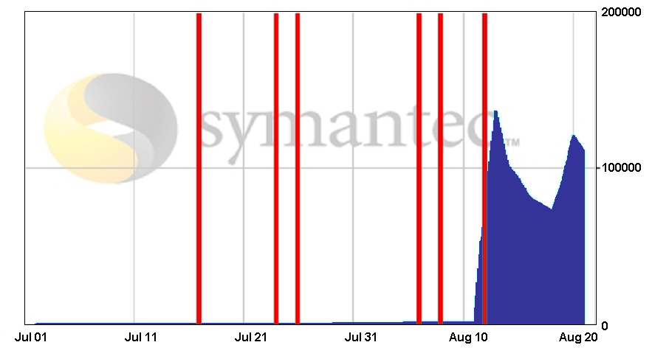
Early Warning in Action: Blaster Worm
7/16 - DeepSight Alerts & TMS initial alerts on the RPC DCOM attack
8/11 - Blaster worm breaks out. ThreatCon is raised to level 3
8/5 -DeepSight TMS Weekly Summary, warns of impending worm.
7/23 - DeepSight TMS warns of suspected exploit code in the wild. Advises to expedite patching.
8/7 TMS alerts stating activity is being seen in the wild.
7/25 - DeepSight TMS & Alerts update with a confirmation of exploit code in the wild. Clear text IDS signatures released.
DeepSight Notification
IP Addresses Infected With The Blaster Worm

Slide 15

AntiWorm: Proactive Host and Network Protection
Symantec is doing R&D in two key areas:
  Proactive prevention of initial infection
    Network Protocol Anomaly Protection
    Network Generic Exploit Blocking
  Generic blocking of threats after infection
    Host buffer-overflow protection
    Host behavior blocking/limiting approaches
Other interesting areas:
  Statistical blocking/limiting of threats on the network
  Interesting but not ready for commercialization
packets/sec

Slide 16
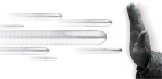
Generic Exploit Blocking (Today)
Idea
  Write a network IPS signature to generically detect and block all future attacks on a vulnerability
  Different from writing a signature for a specific exploit!
Step #1: Characterize the vulnerability “shape”
  Identify fields, services or protocol states that must be present in attack traffic to exploit the vulnerability
  Identify data footprint size required to exploit the vulnerability
  Identify locality of data footprint; will it be localized or spread across the flow?
Step #2: Write a generic signature that can detect data that “mates” with the vulnerability shape
Similar to Shield research from Microsoft

Slide 17



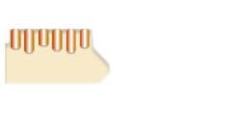




Generic Exploit Blocking (Today)
Idea:
Just as only properly shaped keys can open a lock, only properly “shaped” worms can exploit a vulnerability
Step 1: Characterize the “shape” of a new vulnerability
Entirely new worms can be blocked immediately, without specific fingerprints.
Step 2: Use this shape as a signature, scan network traffic and block anything that matches it

Slide 18
Generic Exploit Blocking Example #1
Consider MS02-039 Vulnerability (SQL Buffer Overflow):
Field/service/protocol
UDP port 1434
Packet type: 4
BEGIN
DESCRIPTION: MS02-039
NAME: MS SQL Vuln
TRANSIT-TYPE: UDP
TRIGGER: ANY:ANY->ANY:1434
OFFSET: 0, PACKET
SIG-BEGIN
"\x04<getpacketsize(r0)>
<inrange(r0,61,1000000)>
<reportid()>"
SIG-END
END
Pseudo-signature:
if (packet.port() == 1434 &&
packet[0] == 4 &&
packet.size() > 60)
{
report_exploit(MS02-039);
}
Minimum data footprint
Packet size > 60 bytes
Data Localization
Limited to a single packet

Slide 19
Generic Exploit Blocking Example #2
Consider MS03-026 Vulnerability (RPC Buffer Overflow):
Field/service/protocol
RPC request on TCP/UDP 135
szName field in
CoGetInstanceFromFile func.
BEGIN
DESCRIPTION: MS03-026
NAME: RPC Vulnerability
TRANSIT-TYPE: TCP, UDP
TRIGGER: ANY:ANY->ANY:135
SIG-BEGIN
"\x05\x00\x0B\x03\x10\x00\x00
(about 50 more bytes...)
\x00\x00.*\x05\x00
<forward(5)><getbeword(r0)>
<inrange(r0,63,20000)>
<reportid()>"
SIG-END
END
Sample signature:
if (port == 135 &&
type == request &&
func == CoGetInstanceFromFile &&
parameters.length() > 62)
{
report_exploit(MS03-026);
}
Minimum data footprint
Arguments > 62 bytes
Data Localization
Limited to 256 bytes from
start of RPC bind command

Slide 20
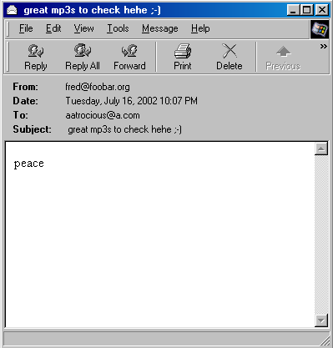
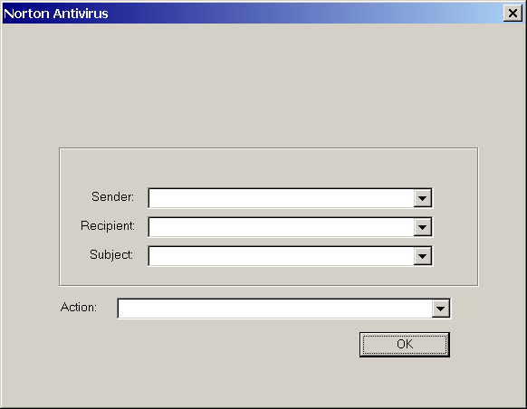



Email Worm Blocking (Today)
Works on desktop computers
Intercepts all outgoing mail
sent from the computer
Prevents programs from
sending themselves (as
worms do)
Proven 95+% effectiveness
against email worms
fred@corporation.org
Alert: Malicious worm detected
Tuesday, March 2, 2004 10:07 PM
rob@symantec.com
great mp3s to check hehe ;-)
Transmission of this email is stopped because it
contains this worm:
Hey Rob,
Check out this cool calendar program.
Email Information
rob@symantec.com
user@company.net
Fw: some stuff here
Same?
Quarantine this worm (Recommended)
cool.exe

Slide 21
DEFCON Research (Tomorrow)
DEFCON is a host-based, temporal behavior blocking system
  Blocking rules take into account when and where software comes from
  Who do you trust more - long-time friends or new acquaintances?
During normal operations, DEFCON
  passively tracks when new software arrives and where it came from
  performs no blocking
During a heightened alert period
  Administrator or alerting service pushes granular blocking policy to hosts
  DEFCON blocks software based on its source, arrival time, etc.
  Blocking is granular; i.e. block all new programs, or allow new programs to run but limit access to the network or file-system
No blocking performed on known, trusted applications
  Existing email, word processors and other business apps run normally
  Supports business continuity

Slide 22


Conclusion
AntiWorm requires a paradigmatic shift from AV
Given potential ultra-fast replication rates, the basis of the AW approach must be proactive
  Best
    Technologies that block infection in the first place
    Sensors to identify likely upcoming attacks to enable preparation and prioritization
  Good
    Technologies that can’t block the initial infection but limit propagation/damage
  Needed
    Technologies to clean up the mess if and when Best and Good fail
No one technology or approach will be sufficient; we need to attack the problem from every angle!

