Slide 1
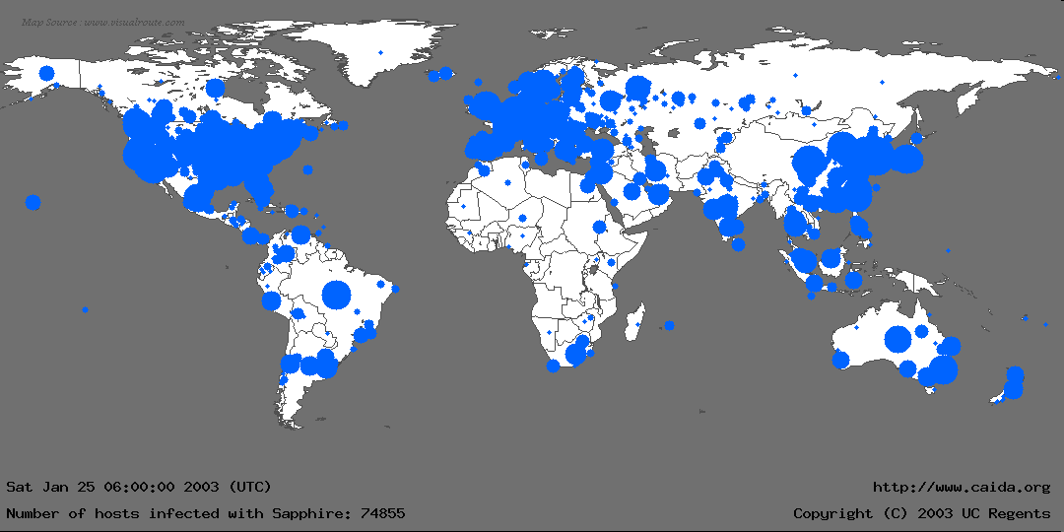
How Many Ways to 0wn the Internet?
Towards Viable Worm Defenses

Slide 2
How Many Ways to 0wn the Internet?
Towards Viable Worm Defenses
Nicholas Weaver
UC Berkeley
Ph D Candidate, EECS, UC Berkeley
International Computer Science Institute
nweaver@cs.berkeley.edu
Notes:
Abstract: Computer worms, autonomous programs which can spread through a computer network, represent a substantial threat to our computing infrastructure. With the release of Sapphire/Slammer, very fast computer worms are now a real, not theoretical threat. Such worms easily outpace human defenses. Any robust defense will require automatic detection, analysis, and response mechanisms.
To create these defenses, we first must understand the strategies attackers could employ. Fortunately, there seem to be only a few mechanisms which worms can use to find new targets: random selection, external, pregenerated, and internal target lists, and passive techniques. Some of these techniques have been used before, while others represent novel strategies. Understanding these techniques, it becomes possible to construct detectors, analysis tools, and response mechanisms. We then discuss in detail one of our proposed detector/analysis system, wormholes and a honeyfarm. This detector would be highly sensitive to worm activity.

Slide 3
Acknowledgements
Work performed in association with
  Stuart Staniford, Silicon Defense
  Vern Paxson, ICSI Center for Internet Research
  Robert Cunningham, MIT Lincoln Laboratory
Sapphire Analysis with:
  David Moore (CAIDA & UCSD), Vern Paxson (ICIR & LBNL) Stefan Savage (UCSD), Colleen Shannon (CAIDA), and Stuart Staniford (Silicon Defense)
Work sponsored in part by DARPA
  Performed at Silicon Defense, Contract N66001-00-C-8045
More information:
  “How to 0wn the Internet...” http://www.cs.berkeley.edu/~nweaver/cdc.web/
  Sapphire Analysis
  http://www.cs.berkeley.edu/~nweaver/sapphire/
Notes:
This work has been sponsored by DARPA, under Contract N66001-00-C-8045. The general worm work has been performed in association with Stuart Staniford of Silicon Defense, Vern Paxson of ICIR, and Robert Cunningham of MIT Lincoln Laboratory.
The Sapphire analysis was conduced with David Moore (CAIDA & UCSD), Vern Paxson (ICIR & LBNL) Stefan Savage (UCSD), Colleen Shannon (CAIDA), and Stuart Staniford (Silicon Defense).

Slide 4
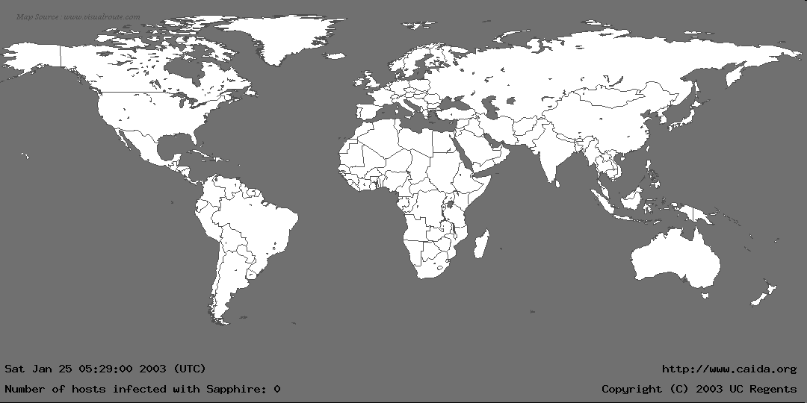
The Spread of the Sapphire/Slammer SQL Worm
Notes:
Before January 25th, this talk contains a considerable amount of motivation as to why fast Internet worms are a potential threat. They are now a real threat.
In the first 30 minutes of Sapphire’s spread, we recorded nearly 75,000 unique infections. Most of these infections actually occurred within 10 minutes.
This graphic is more for effect rather than technical detail: We couldn’t determine a detailed location for all infections, and the diameter of each circle is proportional to the lg() of the number of infections, underrepresenting larger infections. Nevertheless, it gives a good feel for where Sapphire spread.
We monitored the spread using several “Network Telescopes”, address ranges where we had sampled or complete packet traces at single sources. We also used the D-shield distributed intrusion detection system to determine IPs of infected machines, but we couldn’t use this data for calculating the scanning rate.

Slide 5
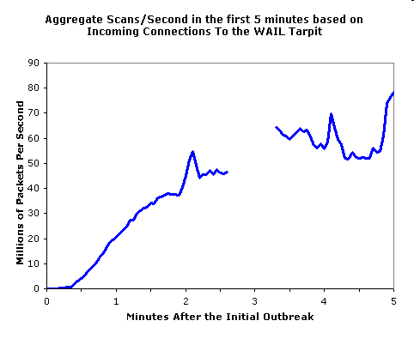
How Fast was Slammer?
Infected ~75,000 machines
in 10 minutes
Full scanning rate in ~3 minutes
  >55 Million IPs/s
Initial doubling rate was about every 8.5 seconds
  Local saturations
  occur in <1 minute
Notes:
The somewhat surprising part is just how fast. We start to see local links saturating in less than a minute (where Sapphire stops following the RCS model), and general internet scanning saturates at 3 minutes.
Based on the size of our windows and the number of packets received, Sapphire's peak was over 55 million IPs/second, randomly chosen from the 2³² bit IP address space.
At a rate of 55 million packets per second, this easily saturates the bulk of the Internet in less than 10 minutes. The most significant exceptions are large addresses connected by low-bandwidth links, as these connections will not receive all intended scans.

Slide 6
What Are Computer Worms?
Self replicating network programs
  Exploit vulnerabilities to infect remote machines
  Victim machines continue to propagate the infection
Three main stages
  Detect new targets
  Attempt to infect new targets
  Activate the code on the victim
  machine
This talk focuses on
autonomous worms
  No human intervention required
Network
Notes:
Computer worms are self-propagating network programs, and usually considered extremely hostile. They exploit vulnerabilities in order to spread to other machines, which propagate the infection further. Vulnerabilities can exist in policies, not just as bugs in the code.
It is the self-propagation which distinguishes worms from conventional attacker tools, and which lends a very fast growth.
This talk, and the work on defenses, focuses on autonomous worms. Mail-Worms such as Klez require human intervention, and therefore propagate much more slowly. However, mailworm techniques can be effective to cross firewalls as part of a larger autonomous worm.

Slide 7
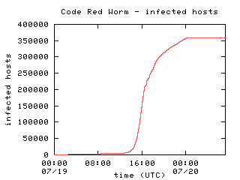
Why Worry About Worms?
Worms can be fast
  Code Red required ~13 hours to spread worldwide
    See Moore’s analysis and “How to 0wn the Internet...”
  Other techniques can be even faster
    Eg, “Warhol Worm” → 15 minutes
    Sapphire → 10 minutes
  Faster than human reaction
Worms can have highly
malicious payloads
  Distributed Denial of Service Attacks
  Internet scale espionage
  Data corruption, manipulation
  BIOS reflashing
Graph from David Moore's analysis (caida.org)
Notes:
“How to 0wn the Internet in your Spare Time” is available at http://www.cs.berkeley.edu/~nweaver/cdc.web/
David Moore’s analysis is at
http://www.caida.org/analysis/security/code-red/
A fuller paper at
http://www.caida.org/outreach/papers/2002/codered/codered.pdf
Payload: The additional code carried in the worm. Although propagation can be disruptive, it is the payload which will cause the most damage. We have seen most of these payloads in various forms.

Slide 8
Some Major Worms
Worm | Year | Strategy | Victims | Other Notes
Morris | 1988 | Topological | 6000 | First major autonomous worm. Attacked multiple vulnerabilities.
Code Red | 2001 | Scanning | ~300,000 | First recent "fast" worm
CRClean | 2001 | Passive | none | Unreleased Anti-Code-Red worm.
Nimda | 2001 | Scanning Others | ~200,000 | Local subnet scanning. Effective mix of techniques
Scalper | 2002 | Scanning | <10,000 | Released 10 days after vulnerability revealed
Slapper | 2002 | Scanning | 13,000 | Reused Scalper Code
Slammer | 2003 | Scanning | >75,000 | Spread worldwide in 10 minutes
Notes:
Strategy is the target selection strategy, which will be discussed in detail later.
There have been numerous other worms, but these are a good representative sample of major incidents. I’ll refer to these elsewhere in the talk, you don’t need to memorize this list.

Slide 9
Why Do Attackers Like Worms?
Worms are useful attacker tools
  Can attack an entire vulnerable population at once
  Can be harder to trace than conventional attacks
Worms are easy to write
  Propagation routines can be generic, enabling code reuse (Slapper)
    Drop in an exploit and release
  Payload is independent of propagation
Current record: 10 days from disclosure to worm (Scalper)
  Can easily be reduced to 1 day
  Smart attacker can produce a “0 day” worm
    A worm which attacks an otherwise unknown vulnerability
Notes:
Slapper reused scalper's source code, but used a new exploit (OpenSSL vulnerability in apache Linux). Scanning worms in particular are potentially very generic, allowing code reuse and therefore quick release.
Scalper was 10 days from exploit post (on bugtraq) to release of the worm. Scalper was limited in scope because of the exploit script posed (only freebsd apache, apache chunk vulnerability), which limited the targets it could find, but represents a disturbing trend
A “0-day” worm requires the attacker to discover the exploit first, but enables the worm to attack most or all computers running the vulnerable service.

Slide 10
What Are Some Worm Ecologies
Firewall
Corporate
Intranet
Home
Machines
The Internet
Game Servers, Halflife: 20,000
Web Servers, IIS/Apache: 3,000,000
P2P, KaZaA: >5,000,000
Windows CIFS and RPC: 50,000,000?
Webservers
Notes:
Worms target monocultures, as monocultures are generally all vulnerable to an identical attack.
So what can support worms?
Game servers. Minority population, but not considered high risk. Yet 20,000 is enough to launch meaningful Denial of Service attacks, so they deserve more scrutiny. Also, many are vulnerable to "Metaserver" worms, and very fast worms like Sapphire can still be successful with vulnerable populations of 20,000 or more.
Web servers. IIS, apache as well. Some home machines, some corporate, dedicated webservers. Attractive targets.
P2P programs, eg KaZaA, support potentially very fast worms. KaZaA etc is widespread in home and university use, some corporate policy violators will put it in the corporate network, and it is very vulnerable to topological worms.
File sharing (windows CIFS), is nearly ubiquitous (and the basic service is on by default on Windows). It is usually blocked at the firewall, however. But it is a big target. Getting 50,000,000 machines can produce an economically significant attack. The same observation applies to the windows RPC (Remote Procedure Call) services

Slide 11
What is Necessary to
Stop Worms?
"Write Better Code" is insufficient
  Bugs Happen (including stack overflows)
  Patches aren’t deployed
Firewalls don’t work
  Code Red II and Nimda could exploit a single breach
Automatic responses are critical to stop worms
  Sapphire could not be slowed by human response
  See “How to 0wn ...” and
  Moore et al, “Internet Quarantine”
Also needed:
  Better human analysis tools
  Better recovery mechanisms
  Protocol-level prevention
Notes:
Bugs will happen. If we only rely on writing code without vulnerabilities, there will still be opportunities for worms. Thus we need other defenses as well.
Firewalls don't work, as a single successful penetration is sufficient for a worm to spread through the entire "protected" network. There are too many ways for worms to walk through a firewall and once they penetrate, they can scan everything quickly.
We need automatic responses because of the speed of worms, which act as additional layers of defense.
Moore, Shannon, Voelker, and Savage, “Internet Quarantine, Requirements for Containing Self-Propagating Code”, Proceedings of the 2003 IEEE Infocom Conference, San Francisco, CA, April 2003, http://www.cs.ucsd.edu/~savage/papers/Infocom03.pdf
Based on simulation, analyzes the necessary response time to stop worms.

Slide 12
3 Key Problems: Detection,
Analysis, and Response
Automated Detection: Determine that a worm is operating on the Internet
  What strategies does a worm use, what services are targeted, and what systems are vulnerable (a vulnerability signature)?
    If possible, an attack signature
  “What machines are infected” is insufficient,
    see Moore et al.
Automated Analysis: Given numerous sensors and other devices, create an understanding of the worm
  How virulent?
  Are current defenses effective?
    Use to scale responses
Automated Response: Change the network in order to resist further infection
Notes:
In order to automatically defend against worms, we need automated detection, analysis, and response. These systems also need to resist deliberate false positives and negatives.
One desired piece of information from detection/analysis is a "Vulnerability signature", what the worm can infect, as this can define a response: block traffic to vulnerable machines. An attack signature is even more useful, as one can then just block the infecting traffic.
Included in Moore et al’s analysis was a comparison between blocking based on signatures and based on knowing that a machine is infected. They concluded that blocking based on infected machines is unfeasible for internet level blocking.
We need to know whether current defenses are effective, because this enables us to determine if we need to increase the severity of response, so there is a feedback mechanism which can make a more graceful defense.
Finally, automated detection/analysis needs to drive automated response, to prevent infections and to contain infections into sections of the net. Response is probably easier, given vulnerability signatures and attack signatures.

Slide 13
The Rest of This Talk
Worm target selection strategies
  Techniques which worms can use
    Understand the offense before building detectors and response mechanisms
A potential detection and analysis technique:
Wormholes and a Honeyfarm
  Illusion of hundreds or thousands of distributed honeypots
  A widespread, reliable sensor network
  Capable of being fully automatic
    Single point of trust
Notes:
The remaining talk, in two sections, are on the different worm spreading techniques and a possible detector.
We have observed previous spreading strategies and optimizations, and discovered new techniques not yet seen. We need to understand how worms can find new targets in order to build defenses.
Then we cover one detector which we have proposed and analyzed on paper (but not constructed) which looks like it has very good potential to automatically detect and classify worms. this creates the illusion of a massively distributed system, while maintaining a single point of trust.
Since automatic detectors need to trigger automatic responses, we must be very careful about what interlocking trust is required, and how attackers could trigger false alarms and false negatives.

Slide 14
Worms Must
Discover New Targets
A spreading worm must discover new targets
  First understand all possible strategies
  Only a few target selection strategies seem possible
Don't detect the worm, detect the act of spreading
  Allows detection of previously unknown
  worms
Stop the spreading
  Prevent further targets from being
  discovered and infected
  Use knowledge from detection and analysis
Step 1: Understand the strategies
Network
Notes:
All worms, new or old, must somehow discover new targets to infect. If we can detect the act of spreading, that allows us to detect the worm, whether or not its been seen before.
Similarly, if we can block this process, we will block the worm. So we first must understand the target selection/target discovery strategies worms can employ. Fortunately, there appear to be a very limited number of possible target selection strategies a worm can use.

Slide 15
Limited Spreading Strategies
Random Target Selection (scanning)
  "slower", generic
External target list (metaserver)
  fast, application specific
Pregenerated target lists (hitlist & flash)
  fast, requires preparation
Internal target list (topological)
  fast, application specific
Passive (contagion)
  "slow" and stealthy
  Propagate in response to external events
Attacker can mix and match strategies
Metaserver
Topological
Flash
Scanning
Speed
Contagion
Target Selection
Network Stealth
Notes:
Graph is to somewhat visualize the strategies as we go into them in more detail.
An important observation is that an attacker can mix and match strategies, as well as vulnerabilities. EG, use a hitlist to speed a scanning worm. Use a passive attack to try to cross firewalls (which Nimda did). Etc.
Also, scanning speed varies considerably whether or not a bandwidth-limited scanner is employed. Scanners are slow if latency bound, very fast if bandwidth-bound.

Slide 16
Techniques Used to Understand Worm Strategies:
Previous Worms:
  Use to calibrate simulation and mathematical models
Mathematical modeling:
  Can model scanning and some other strategies
Simulation: Model the worms in a fully connected, 32 bit address space
  Use a block cipher to construct a pseudo-random permutation
    E(addr) -> table ID. D(table ID)-> addr
  Heavily used to model enhanced strategies
Notes:
There are three major techniques used to understand worms.
Previous worms offer good examples of what has been done, and can be used to calibrate simulations and modeling.
Mathematical modeling works well for scanning, hitlists (pregenerated target-lists), and some topological worms. It doesn't work well for evaluating other strategies.
Simulations are highly useful. I built my simulator a couple weeks after Code Red to explore some techniques. I needed to use a block cipher because I want a pseudo-random permutation, not a pseudo-random number, in order to efficiently map between the address space and the table to store the worms.

Slide 17
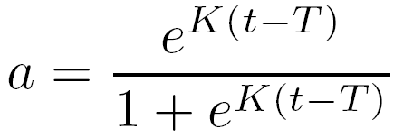
Random Target Selection:
Scanning Worms
Repeat Forever:
  Pick a "random" address,
  if vulnerable, infect it
Simple to implement
  Most code is generic
Speed (K) depends on:
  Rate of scanning
  Number of vulnerable machines
  Size of address space
    Scanning unproductive in an IPv6 internet
Early stages are exponential
  Equation from epidemiology
K =
Scan Rate * Vuln Machines
Address Space Size
Notes:
Scanning is probably the most ubiquitous: it is easy to implement and generic. It's simply repeating forever and trying to infect the machines.
K is simply the expected number of new targets found per unit time, which depends on the address space size, the number of vulnerable machines, and the scanning rate. Increase the scan rate, OR the number of vulnerable machines, and the worm speeds up.
a is the fraction of the vulnerable population infected
T is simply an offset from the integration process.
Finally, generic IPv6 scanning is unproductive (the address space is too large) but may still be productive in internal networks (which probably will clump) and possibly within high-density clumps on the general internet.

Slide 18
Scanning Worm Optimizations
Local subnet scanning: Preferentially scan the local network
(Code Red II, Nimda)
  Exploit a single breach to attack the local Intranet
Preferentially scan more populated addresses: (scalper & slapper)
Comprehensive scan random /24s: (scalper & slapper)
  Actually not needed
Permutation Scanning (original)
  Guarantees distributed scanning without explicit cooperation
Bandwidth-limited scanner (sapphire)
aa.bb.cc.00 – aa.bb.cc.FF
Notes:
Local subnet scanning proved incredibly effective with Code Red II and Nimda, as it converted a single penetration into a company wide epidemic. This is highly effective, and one of the main reasons why firewalls offer very little worm protection.
The selection of /24s in scalper and slapper improve scanning and reduce the routing-related costs of each scan. Looking at Sapphire, its a needless "optimization". But preferentially (rather than scalper/slapper's exclusive selection) scanning more populated addresses is helpful.
Permutation scanning is original and not seen yet, it is detailed in the “0wn” paper. IT creates a distributed scanner without full cooperation, just self-coordination.
Bandwidth limited scanners is an obvious optimization, as opposed to using Connect(). Also discussed somewhat in the “0wn” paper, but really is demonstrated by Sapphire.

Slide 19
Why Was Sapphire Fast: A Bandwidth-Limited Scanner
Code Red's scanner is latency-limited
  In many threads: send SYN to random address,
  wait for response or timeout
  Code Red → ~6 scans/second,
    population doubles about every 40 minutes
Every Sapphire copy sent infectious packets at maximum rate
  1 Mb upload bandwidth →
  280 scans/second
  100 Mb upload bandwidth →
  28,000 scans/second
Any reasonably small TCP worm can spread like Sapphire
  Needs to construct SYNs at line rate, receive ACKs in a separate thread
Notes:
Sapphire didn't infect significantly more machines than Code Red, if anything it infected substantially less. Nevertheless, code red was nearly two orders of magnitude slower than Sapphire, with the population doubling approximately every 40 minutes (37 minutes is our best estimate).
Code Red and previous TCP worms have always used one or more threads, with each thread trying to connect() to individual machines, and, if successful, infecting it. Thus any given thread is limited by the network latency: the time to receive a response (positive or negative) or for the connect call to timeout. Even with several hundred threads, the worm is still limited by the latency.
Sapphire, on the other hand, since its scan also infects, never waits for a response. It simply sends out packets at line rate. So obviously it scans the net, especially before saturation effects occur, much faster than Code Red.
Note that bandwidth-limited scanners change scanning from being just "fast" to "very fast", enabling <15 minute spread times.

Slide 20
External Target Lists:
Metaserver Worms
Many systems use a "metaserver", a server for information about other servers
  Games: Use as a matchmaker for local servers
  Google: Query google to find web servers
  Windows Active Directory: Maintains the "Network Neighborhood"
Worm can leverage these services
  Construct a query to find new targets
  Each new victim also constructs queries
    Creates a divide-and-conquer infection strategy
Original strategy, not yet seen
Metaserver
Server
Server
Server
Server
Server
Server
Server
Server
Notes:
Simple animation of metaserver protocol. Metaserver term first used/created by ERic Mehlhaff for Netrek, for a server which acts as a guide to other servers.
A worm can use a metaserver to get one or more vulnerable servers to infect. This is an original strategy, we haven’t seen it in practice. But we need to understand this strategy to build defenses in advance, as it does present a potential anomaly at the metaserver. Metaservers are quite common in practice, as many multiplayer games, google, and Windows uses metaservers

Slide 21
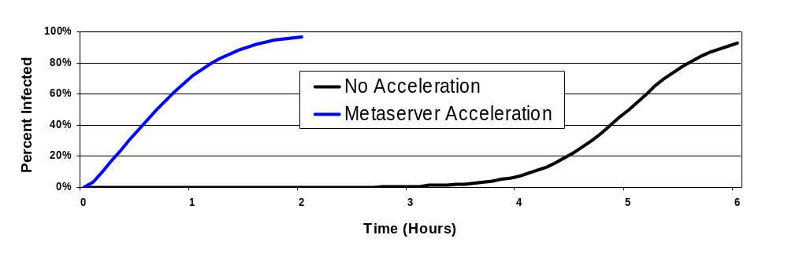
How Fast Are
Metaserver Worms?
Game Metaserver: Use to attack a small population (eg, all Half-Life servers)
  ~1 minute to infect all targets
Google: Use to enhance a scanning web worm
  Each worm conducts initial queries to find URLs
Windows Active Directory: Nearly essential for CIFS worm
  Needed for the login process, only works in the corporate Intranet
Notes:
This metaserver acceleration simulation: Each new worm queries a metaserver to find ONE potential victim, and then scans normally. This victim is randomly chosen from only 1/3 of the vulnerable population. 300,000 vulnerable machines.
This would be a “code red” style worm (10 scans/second) which can do a google query at the start, to find ONE vulnerable machine. That alone drastically changes the spread rate of the worm. If it discovers 2 vulnerable machines in the process, the speed is increased even more, as now the metaserver portion grows on the exponential/logistic graph instead of linear.
The game observation is critical, as these systems are not generally written with high security in mind, as they would seem to be too small to worry about. But a metaserver attack enables a large, fast compromise of all game servers listed in the matchmaking/metaserver.

Slide 22
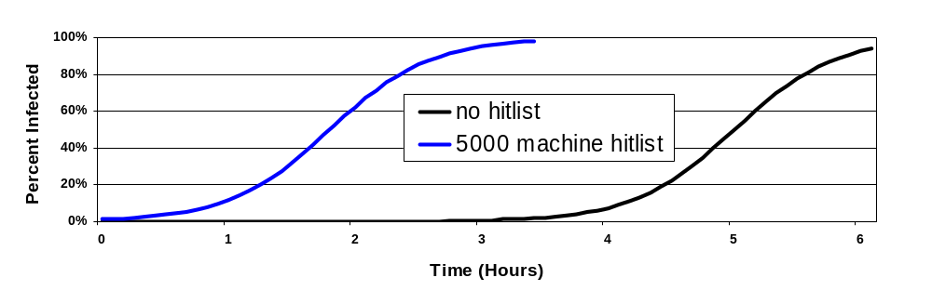
Pregenerated Target Lists:
Hitlisting & Flash Worms
Worm starts with a list of vulnerable machines
  Infects using a divide-and-conquer strategy, O(lg(n)) time
    Small hitlist (eg 5000 machines) accelerates a scanning worm
    Complete hitlist of all machines ("Flash" worm) takes <1 minute
  Hitlist doesn't need to be perfectly precise
Original Strategy, not yet seen
  Biggest problem is acquiring the hitlist, see “How to 0wn”
Notes:
Another strategy which we haven’t seen yet is using a pregenerated list, namely generating (or stealing) a list of probably vulnerable machines in advance and using it to seed the initial spread by having the worm either "divide and conquer" through the list (faster) or linearly attacking the list in order (easier). This was part of my initial "Warhol" proposal to accelerate a scanning worm to get <15 minute infection times. Stuart extended the observation that a complete hitlist of the internet can infect all machines in <1 minute.
The most useful use is a small hitlist to skip the initial stages of the worm's growth. This graph is for a scanning worm with the addition of a hitlist, 300,000 victim machines, 10 scans/second, based on the math. A hitlist effectively shifts the graph to the left when accelerating a scanning worm. It doesn't change the curve of the graph, but acts to shift it to the left, offering a substantial speedup in total. This offers substantial gains without needing a nearly complete hitlist.
We discuss in the "0wn" paper many ways an attacker can generate the hitlist with fairly low risk.
We have not seen a hitlist used in practice. As far as I know, all previous "Someone is scanning for a hitlist" alarms have been related to conventional human intruder activity.

Slide 23
Internal Target Lists:
Topological Information
Look for local information to find new targets
  URLs on disk and in caches
  Mail addresses
  .ssh/known_hosts
Ubiquitous in mail worms
  More recent mail worms are more aggressive at finding new addresses
Basis of the Morris worm
  Address space was too sparse for scanning to work
Notes:
Topological worms are particularly fast, originally used in the Morris worm. In a topological worm, the worm simply uses local information to find new targets.
As a result, they can be very fast, depending on what the topology involved looks like. The Morris worm was a topological worm, as the Internet was too sparse and slow for scanning to work

Slide 24
How Fast are
Topological Worms?
Depends on the topology G = (V, E)
  Vulnerable machines are vertices,
  edges are local information
  Time to infect is a function of the shortest paths from the initial point of infection
Power law or similar graph (KaZaA)
  Depends greatly on the parameters,
  but generally very, VERY fast
Chord-style network (ring with fingers)
  O(lg(n)) time, using the fingers
Notes:
The speed of a topological worm depends on the connectivity in the network, the longest shortest-path from the initial point of infection. Thus it can be very fast.
EG, for a power-law or similar enough graph (where there are numerous supernodes, which we believe KaZaA to be like) are very fast: hundreds or even tens of timesteps. If ~1 second/step, such worms can be incredibly fast.
Similarly, Chord (Robert Morris's "ring with fingers" structure) has lg(n) time to infect all nodes, as the worm follows the finger pointers.
This graph is a "vaguely Chord-ish" network, using one forward pointer and one finger. Its very fast.
Hypothesis: If, in a peer-to-peer network, one can find or reach an arbitrary datum in expected lg(n) time and there is a fixed (constant) maximum amount of replication, then one can create a worm which would infect the P2P network in O(lg(n)) time. No proof yet, this is just a hunch.

Slide 25
Passive Worms &
Contagion Strategies
Wait for information about other targets
  CRclean, an anti-CodeRed II worm
    Wait for Code Red, respond with counterattack
  Nimda: Infect vulnerable IE versions with Trojan web-page
  Contagion strategies (not yet seen, see “How to 0wn”...)
    Piggyback infection on normal traffic
Speed is highly variable
  Depends on normal communication traffic
Very high stealth
  Have to detect the act of infection, not target selection
Notes:
Passive worms DON'T actively look for targets, instead they wait for targets to come.
CRclean was written and posted (with deliberate flaws) to bugtraq, but not released in the wild. It was a passive anti-worm to code red.
Nimda used a passive attack (to an IE exploit) to try to cross firewalls.
Finally, the contagion strategy (which KaZaA may be vulnerable to) is a passive strategy.
The speed of passive worms is highly variable, it depends on the traffic they are using to spread. But they are very stealthy as they don't do active, only reactive communication.

Slide 26
So What Does This Mean?
We think we understand the worm target selection strategies
  Only appear to be a few ways to discover potential victims
Some strategies will produce obvious anomalies
  Scanning worms:
    Negative/no response connections
    Probes to random addresses around the Internet
So lets start working on detectors, analysis tools, and response mechanisms
Notes:
Having understood the offense, can we build a defense? Some strategies will produce obvious side effects, and others may have effects we don't yet understand. But at least by understanding the strategies, we can start to think about/detect side effects, and start working on detectors, analysis tools, and response mechanisms.

Slide 27

Honeypots as Worm Detectors
Honeypot: a machine who's sole purpose is to be compromised by an attack
  Most of the technology by the Honeynet project
  Also Niels Provos’s honeyd & Fred Cohen deception
A network of k vulnerable honeypots is a
highly sensitive worm detector
  For random worm, Infection is detected after
  approximately 1/k of the Internet is infected
    P(detect) = 1 – ((V-k)/V)^{M} after M machines infected
  Works best to detect scanning and human attackers
Major limitations:
  Cost: both in machines and administration
  Trust: need to trust most or all honeypot deployers
Notes:
Its now time to consider possible detectors. One possible detector is a "honeypot", a machine who's purpose is to be corrupted.
Honeypots are machines which are deliberately designed to be compromised. There is a considerable amount of information and work done on Honeypots available from the Honeynet project (www.honeynet.org). Also, Niels Provos has honeyd, a nice little daemon for creating the illusion of a large number of honeypots on a single machine.
Probability after M machines are infected, V vulnerable population, NONdetect is V-k/v^M. So probability of detection is simply 1-that.
Thus with even a few hundred vulnerable honeypots, this ends up being highly sensitive. Since scanning worms “start slow” you want such sensitivity.
This is easier than host-based IDS for two reasons: First, there is only generated background. All activity is, by definition, either synthetic or abnormal. Secondly, scanning worms and similar traffic produce really significant anomalies in a honeypot.
A honeypot detected the scalper worm
The trust issues prevent us from just using a network of honeypots as a detector, as worm detectors need to drive automated response mechanisms

Slide 28
So what do we desire?
We want the illusion of distributed honeypots
  Needed for sensitivity
  Creates a distributed obscured secret
We want the advantages of a central collection of honeypots
  Centralized trust and administration
  Lower cost
Idea:
  Separate the network endpoints from the honeypots
  Central system raises the alarm
    Alarm is used by automatic response systems
Notes:
We desire hundreds or thousands of "obscured location" honeypots. A single location is a known/knowable entity, so a worm author could walk around it and to increase sensitivity.
At the same notion, we don't want thousands of honeypots, as for detection purposes, each honeypot has to be able to raise an alarm. Also, there is a lot of intelligence/administration cost when creating/using honeypots, so we want to gain the advantage of centralized administration.
So can we separate honeypots from the endpoints, in order to gain what we desire?

Slide 29
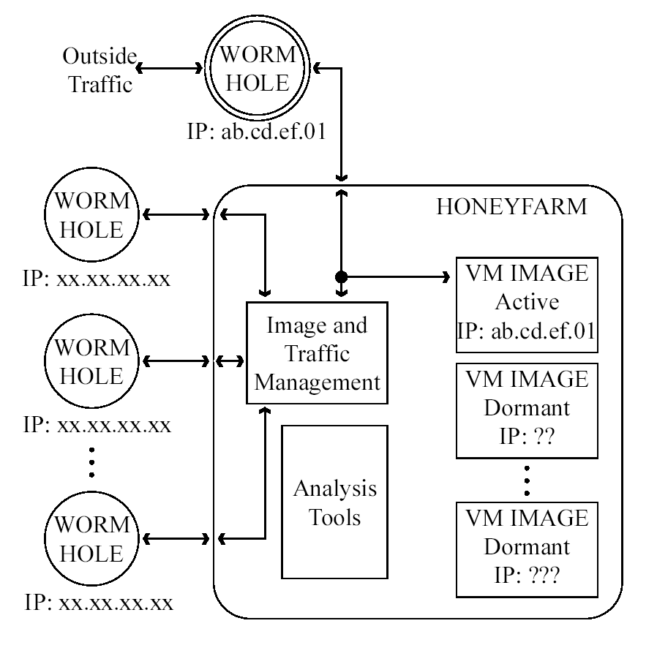
A Proposed Detector/Analysis:
Wormholes and a Honeyfarm
Wormholes are traffic tunnels
  Routes connections to
  a remote system
  Untrusted endpoints
Honeyfarm consists of
Virtual Machine honeypots
  Create virtual honeypots
  on demand
    See honeynet.org
  Route internally generated
  traffic to other images
    Classify based on what
    can be infected
Notes:
This is the resulting split. The endpoints, “Wormholes”, are traffic tunnels. The honeyfarm itself uses virtual machine techniques so it doesn’t need to create a honeypot for each endpoint. The honeyfarm needs to use VM techniques simply because of the number of wormholes and you need to create images on demand.
For more information on virtual honeypots, see the honeynet project.

Slide 30
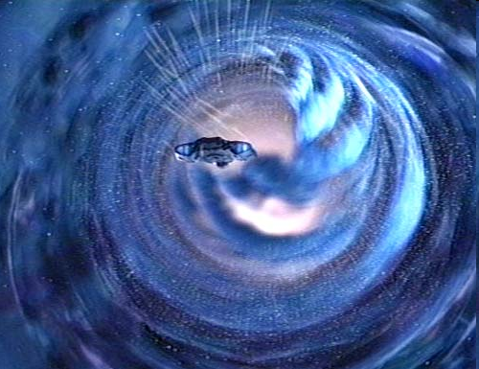
How Wormholes Work
Low cost, low administration “appliance”:
  Plugs into network, obtains
  address through DHCP
  Contacts the Honeyfarm
  Reconfigures local network stack
    fool nmap style detection
  Forwards all traffic to/from the Honeyfarm
Clear Box:
  Deployers have source code
    Restrictions built into the wormhole code
Could also forward/route entire address ranges (/24s or larger) to the honeyfarm
  Still want many single IP endpoints for obscurity
Notes:
The goal of the wormholes is to design traffic tunnels that people will deploy.
Exception: DNS requests can be generated to local DNS server.
Wormhole CAN forward requests from the honeyfarm out, to prevent “phone home” based detection strategies. But it can’t forward requests to the local network, allowing it to be deployed more safely. The goal is to build devices which the deployers can trust, but the Honeyfarm does not have to
Since the functionality is simple, we can run on low cost, commodity hardware
We might want to also route entire address ranges, although such address ranges, although sensitive, represent more valuable “secrets” from an attacker’s viewpoint, so they can't be relied on as heavily.
Image is random DS9 screen capture, found on the net.

Slide 31
How a Honeyfarm Works
Creates Virtual Machine images to implement Honeypots
  Using VMware or similar
    Or a bunch of net-booting
    physical machines
  Images exist "in potential" until traffic received
  Completes the illusion that a honeypot
  exists at every wormhole location
Any traffic received from wormhole
  Activate and configure a VM image
  Forward traffic to VM image
Honeypot image generated traffic is monitored and redirected
Wormhole
IP: aa.bb.cc.dd
Honeyfarm
VM Image
IP: xx.xx.xx.xx
VM Image
IP: aa.bb.cc.dd
VM Image
IP: xx.xx.xx.xx
VM Image
IP: aa.bb.cc.ee
Notes:
The honeyfarm needs to use virtual machine honeypots, as otherwise it would require too many resources. The goal is to detect behaviors in the system.
Thus we need to have images almost ready to go, they need to be reconfigured and connected when traffic is received.
We monitor the traffic to serve as the detector.

Slide 32
What Could We Automatically Learn From a Honeyfarm?
A new worm is operating on the Internet
  Triggered based on ability to infect VM images
What the worm is capable of
  Types of configurations which can be infected
    Including patch level
    Creates a “Vulnerability Signature”
  Any overtly and immediately malicious behavior
    Immediate file erasers or similar behavior
  Possible attack signatures
Works best for tracking:
  Human attackers
  Scanning worms
    Slow enough to react effectively
Notes:
Note the one limitation: Can only detect worms which can infect the VM images.
We note capabilities based on what other VM image the captured worm can succeed in infecting.
A “vulnerability signature” could be used by response mechanisms to block all traffic to vulnerable machines, without affecting immune machines.
Noticing overtly malicious behavior is useful secondary information, but not the primary objective

Slide 33

What Trust is Needed?
Wormhole deployers:
  Need to trust wormhole devices,
  not the honeyfarm operator
Honeyfarm operator:
  Attackers know of some wormholes,
  but most are generally unknown
    Wormhole locations are “open secrets”
  Does not trust wormhole deployers
    Dishonest wormholes are filtered out
Responding systems receiving the alert:
  Either the honeyfarm is honest
  OR rely on multiple, independent honeyfarms all raising an alarm
Notes:
When building distributed systems and systems which trigger automatic responses, we need to be very concerned about trust issues.
The wormhole deployers trust the wormholes, NOT the honeyfarm.
The honeyfarm doesn’t trust the wormhole deployers.
Responding systems either trust the honeyfarm, or trust 2 independent honeyfarms to both raise an alarm.
(Image is taken from http://www.sonypictures.com/movies/matilda/assets/car.jpg ), copyright sony.

Slide 34
Possible Attacks on the Honeyfarm System
False negatives:
  Attacking code can’t infect the honeypots
  Attacker knows most or all wormhole locations
    Wormhole locations are a distributed “worthless secret”
  Attacker can remotely distinguish between a wormhole and another machine
    Scan the net for all wormholes
  Attacking code can determine that it is running in the honeyfarm
    Without triggering an alarm
False positives:
  Compromise the honeyfarm system
    NOT a VM image or a wormhole
Notes:
The biggest limitation is the last of the false negatives: We can’t detect worms which can’t infect the honeyfarm’s VM images. This isn’t such a big deal, as we are worried about the large monocultures, as they are the most vulnerable.

Slide 35
Future Work
Implement the Honeyfarm system
  Offers extremely high sensitivity and significant information
Build network-level (wiring closet) detectors/responders
  “Smart” switches with additional functionality (FPGA based)
    Have to be flexible (reprogrammable),
    fast (Gb links), and reasonably low cost
    New algorithms and techniques are required
  Replace “Hard on the outside” with “Hard everywhere”
Design a distributed analysis system
  Use various detectors to determine presence, speed, and behavior of a worm
Corporate
Intranet
Corporate
Intranet
Notes:
The Network Level detector/responders play very well to my other interest, FPGA, Field Programmable Gate Arrays, architectures and applications. FPGAs are effectively reprogrammable custom circuits, with current ones (Xilinx Virtex 2 pro) including multiple Gb serial links, the FPGA itself, and a microprocessor.
The only way to build something which is flexible, operates on Gb links, and doesn’t cost a fortune in large quantity, is to use such FPGAs. But FPGAs have vastly different programming models, and are good at very different tasks when compared to a microprocessor. Thus a system composed of FPGA “Smart” network switches requires new algorithms and techniques.
The main goal is to get away from the Firewall model of network security, for corporate networks. Instead, the entire network is hardened.
The distributed analysis system is necessary to combine multiple sensors (the Honeyfarm is just one possible sensor) to get a good picture of how a worm is operating and whether a given defense is successful.

Slide 36
The Overall Picture
Computer Worms are a substantial threat
  Able to quickly compromise millions of machines if a vulnerability exists
  Highly attractive technique for attackers
Limited number of worm strategies
  Evaluate the offense first
  Develop defenses to block these strategies
    Block the strategies and you stop the worms
Significant research required to build defenses
  But meaningful mechanisms seem available
    Example: Wormholes and a Honeyfarm as detector/analyzer

Slide 37
(Backup) Why Deploy a Wormhole?
Doesn’t cost much
  IP address and <50 watts
You can put it anywhere
  OK to place outside of the firewall
Only need to trust the device, not the honeyfarm
  Have full source code and control of the device
  Wormhole contains built-in protections against a “rogue” honeyfarm
You gain information about human attackers targeting your address space
  Honeyfarm tracks humans, not just worms
Notes:
One issue: Why would someone put a wormhole on their network?
Wormhole hardware probably needs to be subsidized by the Honeyfarm operator, but is still very low cost. Embedded processor/mb combinations (EG, Via Epia M motherboard) are a nice platform for such devices.

Slide 38
(Backup) How to Test a Honeyfarm System
Existing worms:
  Insure you are vulnerable and introduce a known worm
  Insure you are vulnerable and wait for attack
    Old worms are still endemic
Future worms:
  Create a daemon which behaves LIKE a worm
    Can’t create actual worms
Red Teaming:
  Try to develop new mechanisms to create false negatives or false positives
    In conjunction with worm-like daemon
Notes:
Need to understand/test the system as it is constructed.

Slide 39
(Backup) A Proposed Response: Quarantine/Containment
Goal:
  Locally detect a worm-compromised machine
  Limit further communication from infected machines
Relatively easy to implement for some classes of worms
  Scanning is easy to detect
    Williamson, "Throttling Viruses...“
Major Limitation: Only protects others
  Machines are still infected
Major Limitation: Requires widespread adoption
  Useful in a well constructed Intranet
  Difficult to deploy on the Internet
    See Moore et al, “Internet Quarantine”
Notes:
In addition to detection, we’ve also been considering response mechanisms. The easiest is “remove infected machines from the network”.
It is the combination of “only protects others” and “widespread adoption required” that prevent it from being useful on the Internet.
Without widespread, international legal mandates, such devices can never be deployed. EG, egress filtering, since it is not mandated and only really protects the rest of the internet, is only sparsely deployed.
Williamson paper/tech report is available at http://www.hpl.hp.com/techreports/2002/HPL-2002-172.pdf
This technique combines one scan detector with a quarantine mechanism running on the local machine

Slide 40
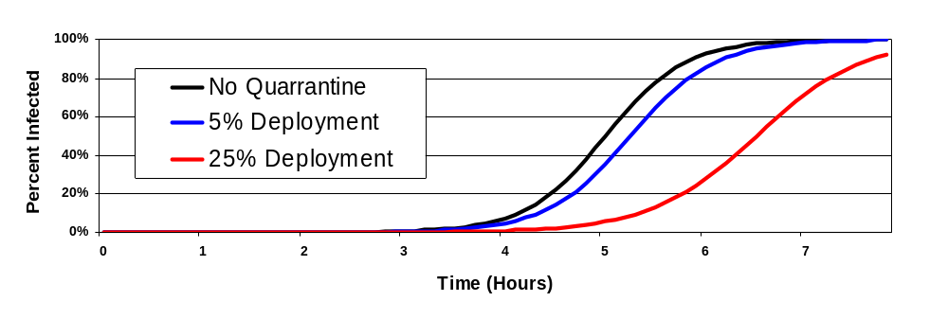
(Backup Slide) Why Quarantining Machines Fails
Assume perfect quarantine devices:
  Immediately detect that a machine is compromised
  Remove compromised machines from the net
Spread rate is reduced
  Any machine behind perfect quarantine devices can be considered uninfectable for calculating spread rate
Little or no benefit for individual deployers
Notes:
Same conclusion as Moore et al (they modeled a different quarantine/containment mechanism of universal removal of compromised machines, and noticed how quickly machines needed to be detected), different reasoning.
The basic observation: A machine behind a perfect quarantine device still ends up infected, but can’t spread the worm. Thus 25% coverage is equivalent to removing 25% of the vulnerable population from the net. Yet as it offers no benefit for the infected machines, you can’t get widespread deployment on the Internet

Slide 41
(Backup) A Proposed Response: Remote Detection & Response
Break the “to be protected” network into small pieces
  Gives fine grained response
  Monitor all pieces for worm activity
Use an analysis system with external and internal detectors
  Must trust the aggregate results of the external world
Block incoming connections to each small piece
  Based on port/vulnerability/signature information from external and internal analysis systems
  Scale response based on internal infections
Protects systems exposed to the Internet
  Doesn't require widespread adoption to protect participants
    Still requires widespread adoption to protect the Internet
Notes:
The big key is to exclude a worm from ENTERING an area of the network. And when the exclusion technique fails, you increase the severity of the exclusion technique as you only sacrifice a small part of the network in the process, which requires the small pieces.
This naturally drives the “Smarter Switches” model of detection/response

Slide 42
(Backup Slide) Some Potential Worm Anomalies
Scanning Worms:
  Negative or nonresponses to worm’s network queries
  Probes to (almost) arbitrary addresses
Metaserver Worms:
  Increase in query rate
  Unusual queries from servers
  Burst of outgoing connections
Hitlists:
  Burst of outgoing connections
Topological Worms:
  Burst of outgoing connections
Notes:
These are some network anomalies which the different strategies should create.
Metaserver worms are of particular note, as they should produce noticeably abnormal queries from the metaserver’s viewpoint (eg, how often do known http servers access Google?)

Slide 43
(Backup Slide)
Why Smart Switches?
The firewall model doesn’t work
  Many ways for a worm to initially
  penetrate a firewall
    Once inside, subnet scanning is very effective
  Need a finer granularity of protection
    Protect small groups or individual machines
    Each failure in protection only infects a small number of machines
Can’t effectively deploy software to all the machines
  Diversity of machines
  Once infected, software can’t be trusted
Idea: Maintain a switch’s functionality, add security features
  Replace “Crunchy on the Outside, Tasty on the Inside”
  with “Hard Everywhere”
Corporate
Intranet

Slide 44
(Backup Slide)
How to Build Smart Switches
Requirements:
  Reprogrammable (algorithms will change and evolve)
  Reasonable cost
  High performance (Gb/s line rates)
Solution: FPGAs or Network Processors
  Virtex 2 Pro FPGA (XC2VP7):
    8 2-Gb SERDESs
      Can support 1000base-SX Ethernet with external transceivers
    266-MHz Processor
    ~11,000 Logic Cells (4-lut + Flip Flop)
    99 KB RAM
    <$100 in ½ half of 2003!!!!
Needs new algorithms, tools, implementations, and techniques
Notes:
Fortunatly, FPGAs are my other area of research.

Slide 45
(Backup Slide) Why Talk
About this Work?
“You bury your head in the sand...
you will get more sand dumped on you”
–Jon Kuroda
Need to understand the techniques in order to build defenses
  Can’t just defend against previous attacks
The attackers can develop these techniques on their own
  The techniques aren’t particularly difficult
    Without public discussion, we’d be surprised
  Disclosing the risks puts everyone on equal footing
  Helps to understand what problems to avoid
Strategy does not equal implementation
  Lots of work for an attacker to turn a strategy into an attack

Slide 46
(Backup Slide)
What Was Sapphire/Slammer
Sapphire was a self replicating network program in a single UDP packet
  Cleanup from buffer overflow
  Get API pointers
  Create socket & packet
  Seed PRNG with getTickCount()
  While 1
    Increment PRNG
    Send packet to PRNG address
404 bytes total
Worldwide Spread in 10 minutes
Header
Oflow
API
Socket
Seed
PRNG
Sendto
Notes:
Sapphire was a single packet, UDP worm attacking Microsoft SQL 2000 and MSDE 2000 (Microsoft SQL Server Desktop Engine). It attacked a vulnerability in the section listening to UDP port 1434 as part of the protocol to negotiate further communication. The payload was 376 bytes, for a total packet size of 404 bytes.
The initial buffer overflow and portions of the API and recovery code were taken from a previously published exploit and the vulnerability itself was known for over six months.
Since there was no rate limiting on the inner loop, Sapphire will send packets as fast as the OS and network will allow. Thus it will quickly saturate the available bandwidth under many conditions.

Slide 47
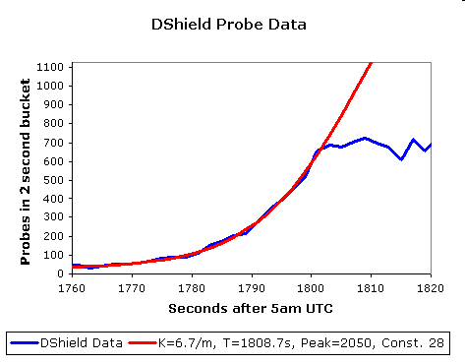
(Backup Slide)
Slammer is a Scanning Worm
First ~40 seconds behave like classic
scanning worm
  Doubling time
  of ~8.5 seconds
  Code Red’s doubling
  time: ~40 minutes
Matches Random
-Constant-Spread
(RCS) model
  No sign of hitlisting
  or other acceleration
Notes:
Sapphire, in the first 30-40 seconds after we first spotted it, behaves very much like a scanning worm, and similar fits can be applied to our other datasets. (The small amount above 0 is due to a separate, probably unrelated scan occurring at the same time)
Sapphire, at least for a few generations, matches the RCS model very well. The doubling time is about 8 seconds, and we probably failed to capture the first couple of generations in our data.
More importantly, our data shows that the author probably did not use a significant hitlist (a pregenerated list of targets) or other acceleration techniques which would distort the first few seconds of the curve.

Slide 48
(Backup Slide) Is Slammer’s Speed an Isolated Case?
Any single packet UDP scanner, unless deliberately limited or broken, will scan like Slammer
  Some vulnerabilities can be scanned with UDP packets, infected through a TCP connection (eg Bind 8)
Any reasonably small TCP worm can spread like Slammer
  Needs to construct SYNs at line rate, receive ACKs in a separate thread
Three Rhetorical Questions
  How hard is it to construct a bandwidth-limited TCP scanner?
  How to respond to upstream congestion when transmitting infection attempt and worm body?
  What happens when there is public sample code?
Notes:
An important consideration is whether Sapphire's speed is an isolated event. Although its speed may or may not have been an accidental property (and we will never know unless the author is found), any future single packet UDP worm, unless rate limited or broken, will demonstrate similar scanning rates and therefore similar propagation properties.
But any reasonably small (<100k) worm which uses TCP can spread this fast as well, if the worm can craft TCP SYNs or uses non-blocking connection routines capable of supporting many outstanding requests.

Slide 49
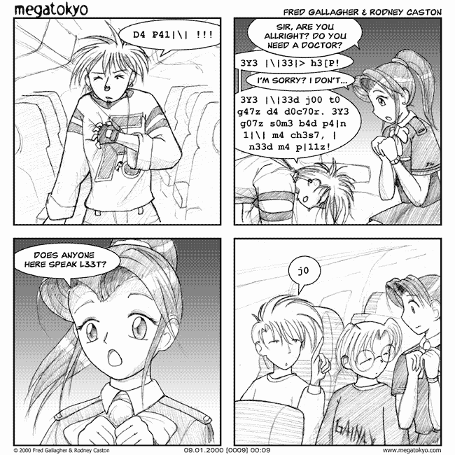
(Backup Slide)
Why the 0 in 0wn?
It is L33T
  Textual substitution “cipher” in the hacker community
  Adopted by early chat room/hacker community to avoid stupid keyword filters
Image Copyright 2000 by Fred Gallagher and Rodney Caston
  www.megatokyo.com
Notes:
Cartoon is from Megatokyo, by Fred Gallagher and Rodney Caston (www.megatokyo.com). Have query about copyright permission outstanding. If negative response, will remove this graphic.

