Slide 1
Fast Worm Propagation In IPv6 Networks
Malware Project Presentation
Jing Yang (jy8y@cs.virginia.edu)

Slide 2
Outline
Introduction
Performance Of Current Worms In IPv6
Speedup Of Worms’ Propagation In IPv6
Interim from IPv4 to IPv6
Conclusion

Slide 3
Fast-propagate Worms VS IPv6 (1)
Facts
  Almost all fast-propagate worms use some form of Internet scanning
  The larger address space is, the less efficient scanning is
  IPv6 has a huge address space
Optimistic vision
  Worms may experience significant barriers to propagate fast in IPv6

Slide 4
Fast-propagate Worms VS IPv6 (2)
Facts
  Some design features of IPv6 automatically decrease its huge address space
  A variety of techniques can be employed by a worm to improve its propagation efficiency
  Other progress of the future Internet can eliminate the current bottleneck of worms’ fast propagation
Pessimistic vision
  Fast-propagate worms will remain one of the main threats to the Internet in IPv6

Slide 5
Motivation
Importance
  Since IPv6 is the basement for next generation Internet, it is important to see whether its huge address space really makes it immune to fast-propagate worms
Usefulness
  There is still sometime for IPv6’s widely deployment, so design changes are still possible
Worthiness
  There still has not been comprehensively analysis of fast-propagate worms in IPv6

Slide 6
Goal
IPv6 design features analysis
  Identify the bad design choices and design tradeoffs that speed up worms’ propagation
  Figure out what modifications can prevent them from being taken advantage of
Possibility of fast-propagate worm in IPv6
  Based on a reasonable IPv6 design, can a worm still compromise all the vulnerable hosts even before human actions are ready to taken?
The achievement of both goals are interleaved in the project

Slide 7
Outline
Introduction
Performance Of Current Worms In IPv6
Speedup Of Worms’ Propagation In IPv6
Interim From IPv4 To IPv6
Conclusion

Slide 8
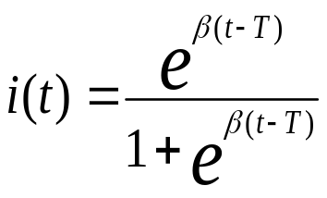
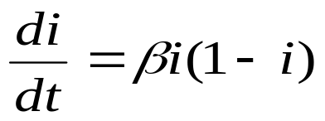
Model Used
Random constant spread (RCS) model
  Also called susceptible-infected (SI) model
  No treatment or removal
  Reasonable because fast worm propagation is usually beyond human time scale

Slide 9
Representative Of Current Worm
Quickest worm in the wild – Sapphire
  Doubled every 8.5 seconds
  Infected more than 90 percent of vulnerable hosts within 10 minutes
  Based on random scanning
  Attack via 404-byte UDP packet
  Size of total vulnerable population: 75,000
  Scan rate: 4,000 scans per second

Slide 10
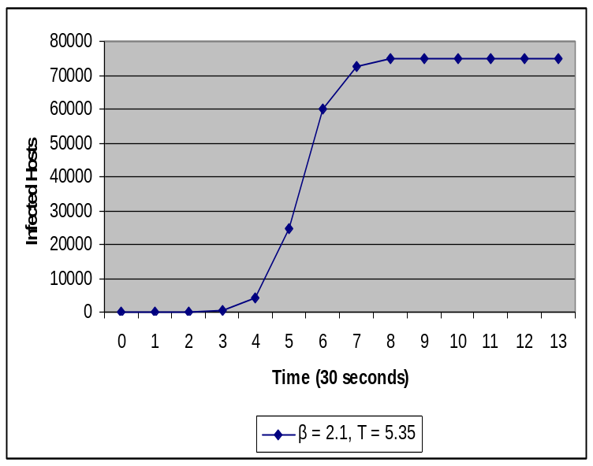
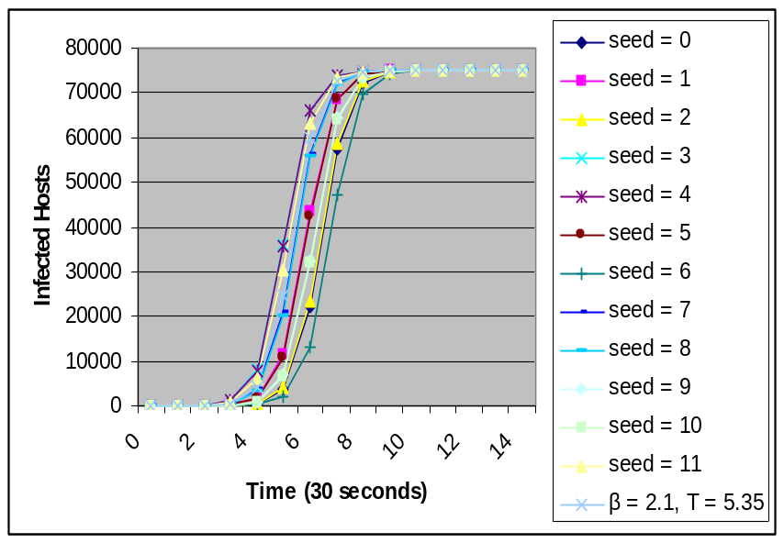
Sapphire in IPv4
Both the results from the formula and simulations match the real data collected during Sapphire’s spread – the infected population doubles in size every 8.5 (±1) seconds and scanning rate reaches its peak within 3 minutes

Slide 11
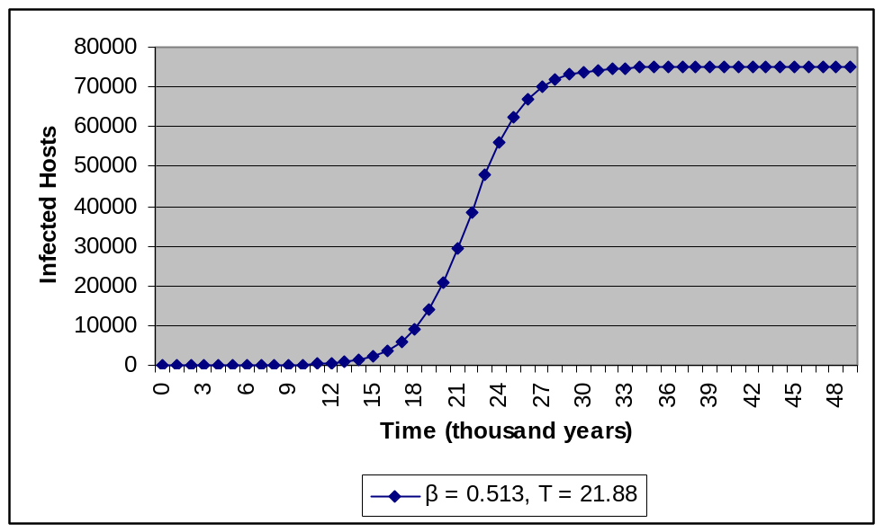
Sapphire in IPv6
We assume Sapphire spreads in a /64 IPv6 sub-network, which is the smallest sub-network in IPv6 – it will take 30 thousand years to compromise most of the vulnerable hosts

Slide 12
IPv6 Is Keeping Ahead
If IPv6 is perfectly designed
If no other techniques can speedup worms’ propagation
– Fast-propagate worm is impossible in IPv6

Slide 13
Outline
Introduction
Performance Of Current Worms In IPv6
Speedup Of Worms’ Propagation In IPv6
Interim From IPv4 To IPv6
Conclusion

Slide 14
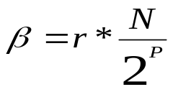
Analysis Of RCS Model
Original unknown parameters in RCS model: β and T
T is related to the initially infected hosts
Four real factors that affect worms’ performance based on RCS model
  Scan rate: r
  Size of total vulnerable population: N
  Real address space: P
  Initially infected hosts: I0

Slide 15
Taxonomy Based On RCS Model
A variety of IPv6 design features and scanning techniques can speedup worms’ propagation in IPv6
Most of their effects can be mapped to the four factors of RCS model
Some of them can not be fitted into RCS model – RCS model should be extended or simulations should be done

Slide 16
Features/mechanisms Fitted Into RCS Model (1)
Increase the scan rate: r
  High bandwidth network, such as Gigabit Ethernet
Increase the total vulnerable population: N
  Sophisticated hybrid worms that attack several vulnerabilities
  Target vulnerability in the core of widely deployed systems cased by monoculture

Slide 17
Features/mechanisms Fitted Into RCS Model (2)
Reduce the real address space: P
  Subnet scanning
  Routing worms
  The standard method of deriving the EUI field of IPv6 address from the 48-bit MAC address
  Densely allocated IPv6 addresses
Increase the initial infected hosts: I0
  Pre-generated hit list (Due to the annoying length of the 128-bit IPv6 address, every host in IPv6 networks may have a DNS name. So a DNS attack can reveal many host addresses)

Slide 18
Features/mechanisms Beyond RCS Model
Find host addresses during the spread besides scanning
  Topological scanning
  Passive worms
Minimize duplication of scanning efforts
  Permutation scanning

Slide 19
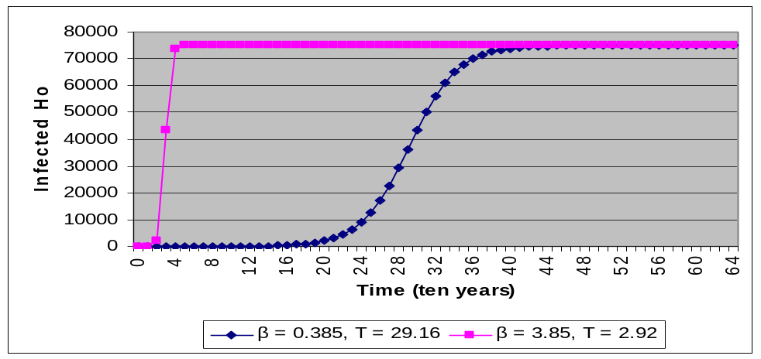
Increase The Scan Rate: r
UDP-based attack – bandwidth limited rather than latency limited
Gigabit Ethernet: scan rate can exceed 300,000 scans per second – reduce Sapphire’s spread time to 4 hundred years
10 Gigabit Ethernet: scan rate can exceed 3,000,000 scans per second – reduce Sapphire’s spread time to 40 years

Slide 20
Increase The Total Vulnerable Population: N
The effect of doubling N equals the effect of doubling r
Blaster targeted a vulnerability in core Windows components, creating a more widespread threat than the server software targeted by previous network-based worms, and resulting in a much higher density of vulnerable systems
According to IDC, Microsoft Windows represented 94 percent of the consumer client software sold in the United States in 2002

Slide 21
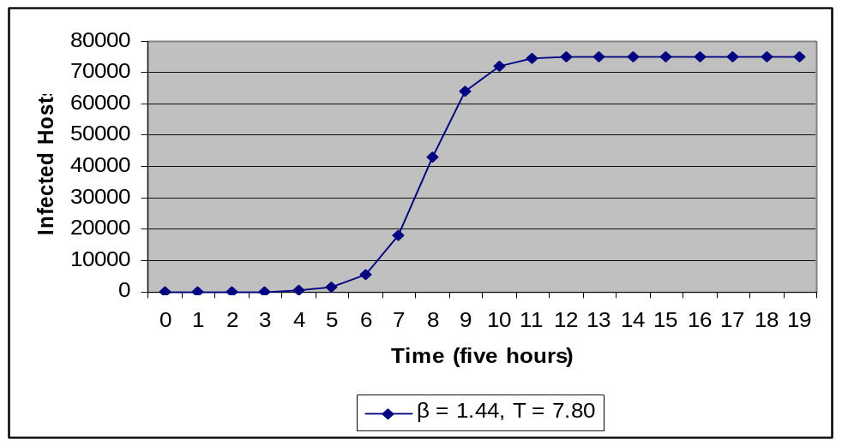
Reduce The Real Address Space: P (1)
Subnet scanning – focus on a /64 IPv6 sub-network
The standard method of deriving the EUI field of IPv6 address from the 48-bit MAC address – further reduce the address space to 48 bit
Assume a Gigabit Ethernet – 300,000 scans per second

Slide 22
Reduce The Real Address Space: P (2)
Densely allocated IPv6 Addresses – may reduce the real address space to 32 bit or even 16 bit, which means a few seconds are enough for the worm to compromise all the vulnerable hosts
Analysis of IPv6 design features
  The auto-configuration design feature of IPv6 scarifies 16 bit address space in the EUI field, which can dramatically speedup worms’ propagation – a new design choice which allows auto-configuration while maintaining the whole address space
  Addresses should never be allocated densely in IPv6 – a random distribution can take advantage of the whole address space

Slide 23
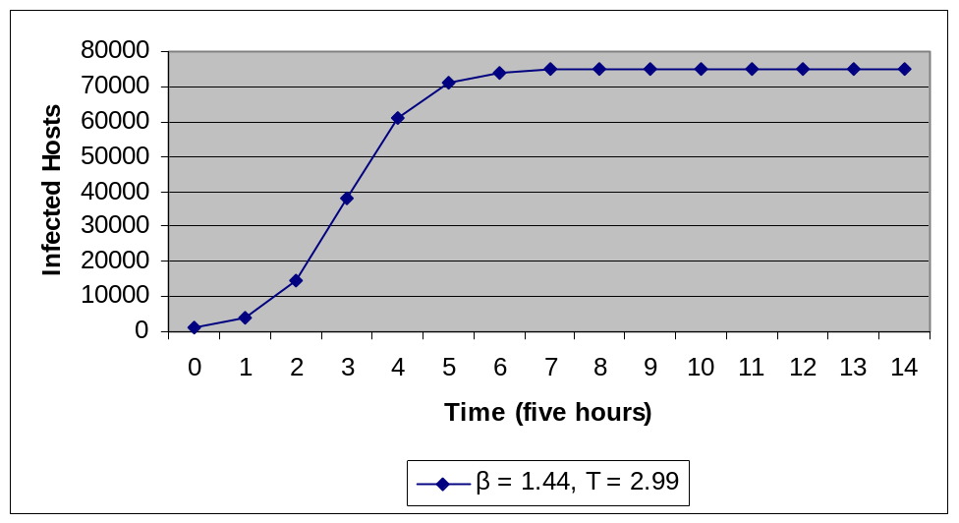
Increase The Initially Infected Hosts: I0 (1)
Due to the annoying length of the 128-bit IPv6 address, every host in IPv6 networks may have a DNS name. So a DNS attack can reveal many host addresses
Assume 1,000 initially infected hosts

Slide 24
Increase The Initially Infected Hosts: I0 (2)
Analysis of IPv6 design features
  Assignment of a DNS name to each host make the 128-bit IPv6 address tolerable, but it increases the harm of a DNS attack
  Not only public servers, addresses of normal hosts can also be revealed in a DNS attack
  Safe DNS servers are critical in IPv6 to prevent fast worm propagation

Slide 25
More Practical Scenario (1)
Scan rate r: 300,000 scans per second (assume Gigabit Ethernet)
Total population M: 20,000 (reasonable in a /64 IPv6 enterprise network)
Total vulnerable population N: 10,000 (due to monoculture)
Real address space P: 48 (due to auto-configuration requirement)
Initial infected hosts I0: 501 (assume a 1000-host address list, 500 of them are vulnerable)

Slide 26
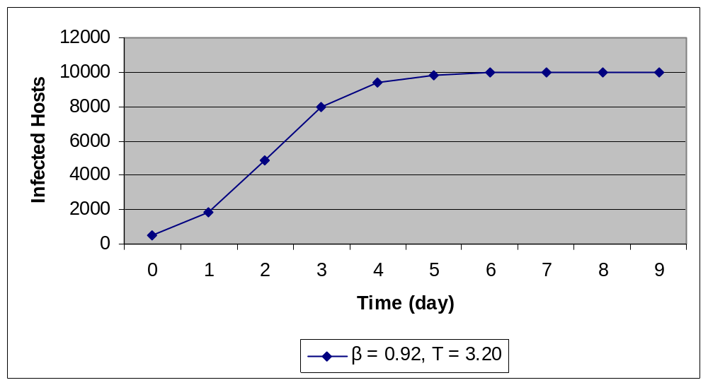
More Practical Scenario (2)
By taking advantage of the IPv6 design features and scanning mechanisms which can be fitted into RCS model, a couple of days are needed to infect the whole sub-network
Not fast enough – can only compromise 20% of vulnerable hosts within a day

Slide 27


Topological Scanning (1)
Every host in IPv6 has a DNS name
DNS cache in Windows XP
  CacheHashTableSize – Default: 0xD3 (211 decimal)
  CacheHashTableBucketSize – Default: 0xa (10 decimal)
  In a default case, the DNS cache in Windows XP has 211 * 10 = 2110 entries
Extension of RCS model – RCS_EX1 model
  Assume DNS cache remains the same during the whole worm spread process
  Parameter F: number of addresses can be found in a newly infected host

Slide 28
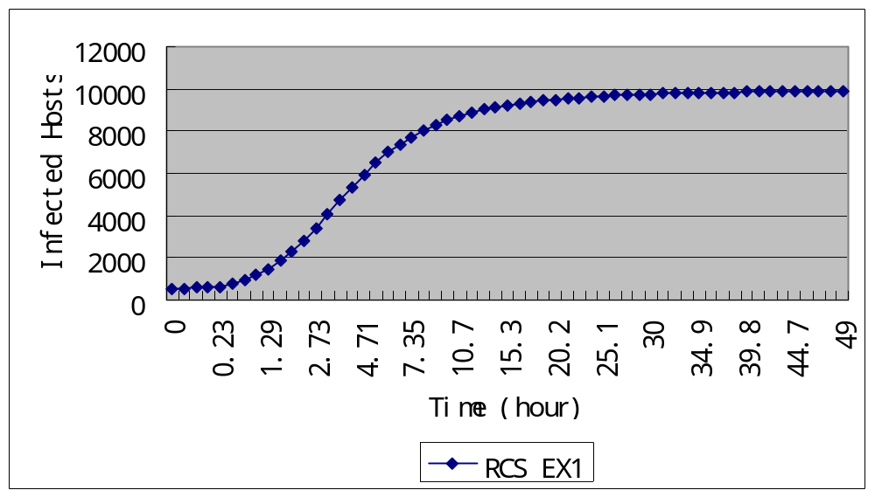
Topological Scanning (2)
Assume F = 50

Slide 29



Topological Scanning (3)
Extension of RCS_EX1 model
  Assume a hybrid worm, which can reveal host addresses from all machines it touches but only control a portion of them via another vulnerability – RCS_EX2_1 model
  DNS cache is updated when a host is touched more than once – RCS_EX2_2 model

Slide 30
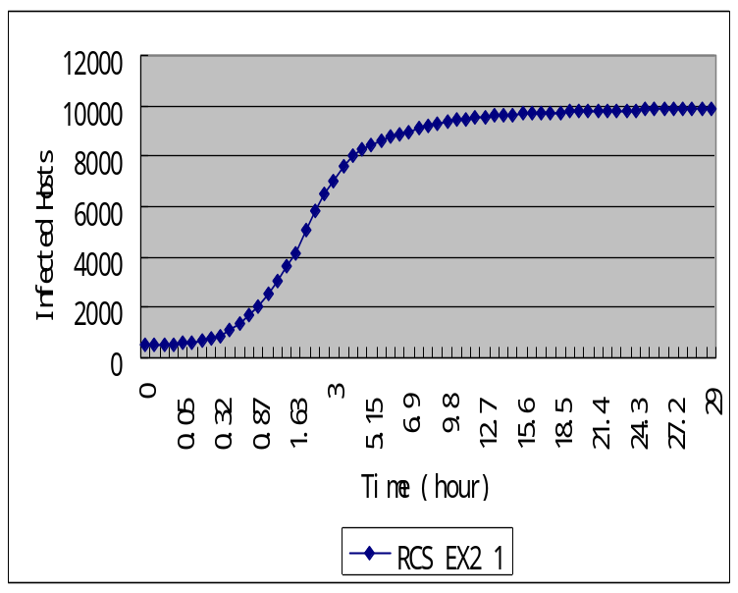
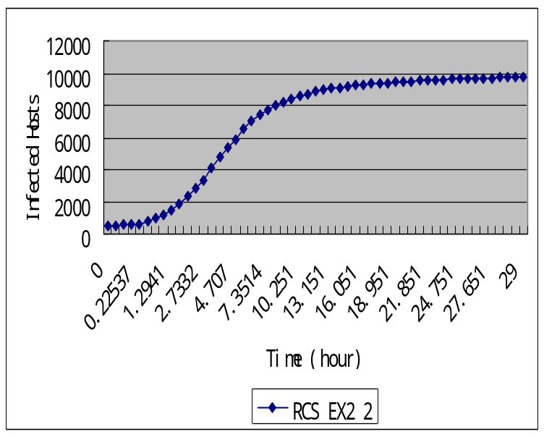
Topological Scanning (5)
F’ – Number of addresses updated when a host is touched again, assume it is 10

Slide 31
Topological Scanning (4)
Extension of RCS_EX2 model
  Combine RCS_EX2_1 model and RCS_EX2_2 model – RCS_EX3 model

Slide 32
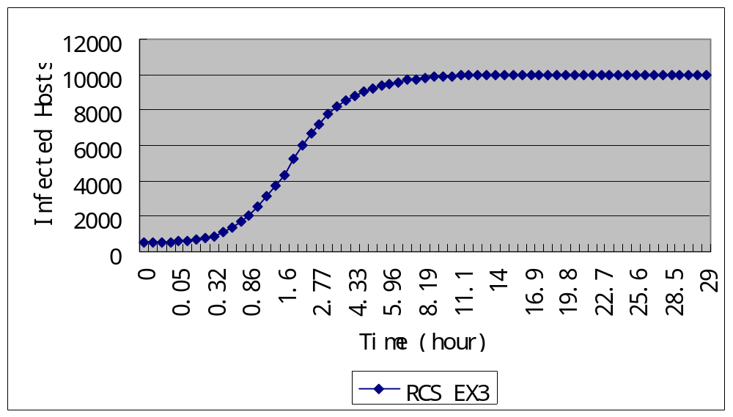
Topological Scanning (6)

Slide 33
Permutation Scanning
Permutation scanning can dramatically decrease the duplication of scanning efforts
Permutation scanning is somewhat controversial to topological scanning – duplicate touches can reveal new host addresses due to cache update
Combination of permutation scanning and topological scanning – worm maintains a thread on infected machines to wait for cache update
Simulation is on-going

Slide 34
Outline
Introduction
Performance Of Current Worms In IPv6
Speedup Of Worms’ Propagation In IPv6
Interim From IPv4 To IPv6
Conclusion

Slide 35
Things To Be Taken Care Of During Interim
Never use easy-to-remember IPv6 address
  It is common to derive IPv6 address directly from IPv4 address when a IPv4 network is newly updated to a IPv6 network
  This easy update limits real IPv6 address space to the original IPv4 address space
IPv6 networks are not isolated when most of the Internet is still IPv4
  6to4 automatic SIT tunnel (2002::/16 prefix) enables IPv4 hosts to connect to IPv6 networks (such as 6Bone) without external IPv6 support
  Gate ways are established for communication among three global prefixes (2002::/16 for 6to4, 2001::/16 for Internet6, 3fff::/16 for 6Bone)
  Many current operation systems support 6to4 SIT autotunnel

Slide 36
Outline
Introduction
Performance Of Current Worms In IPv6
Speedup Of Worms’ Propagation In IPv6
Interim From IPv4 To IPv6
Conclusion

Slide 37
Conclusion
Fast-propagate worm is definitely possible in IPv6, at least in /64 enterprise networks
Factors that speedup the propagation
  A variety of scanning techniques, some of them are theoretical and have not been found in the wild nowadays
  Bad design choices in IPv6 – can be eliminated easily
    Densely allocated IPv6 addresses
    Easy-to-remember IPv6 addresses
  Tradeoffs in IPv6 design – can hardly be eliminated unless innovative methods are developed to meet both requirements in a tradeoff
    Derivation of 64-bit EUI field from 48-bit MAC address
    Each host has a DNS name

