Slide 1

Social media Report
By Lucia Petillo
June 2023

Slide 2
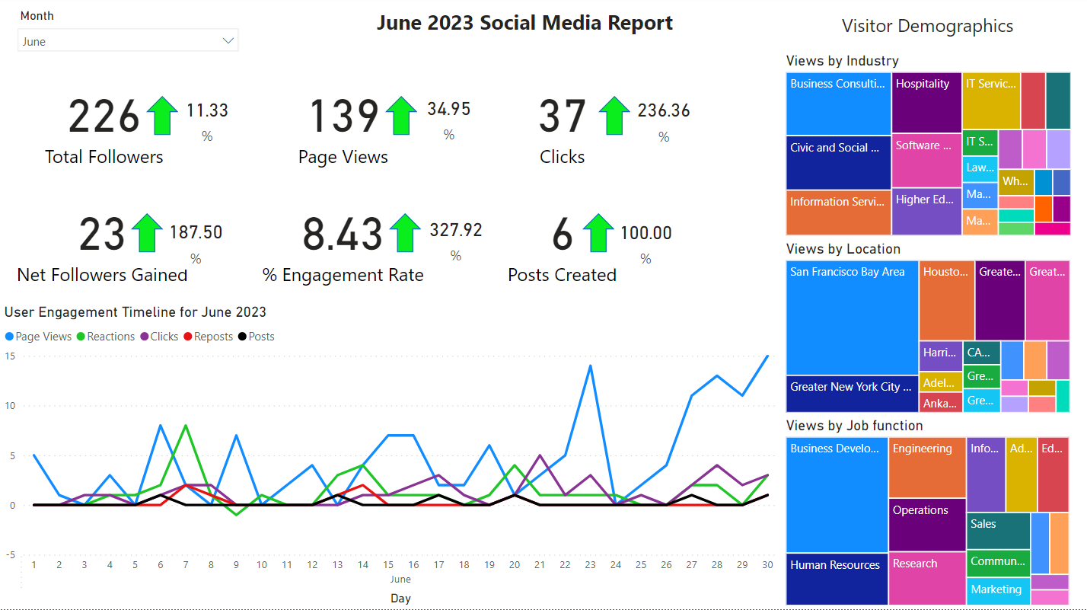
June 2023 dashboard

Slide 3
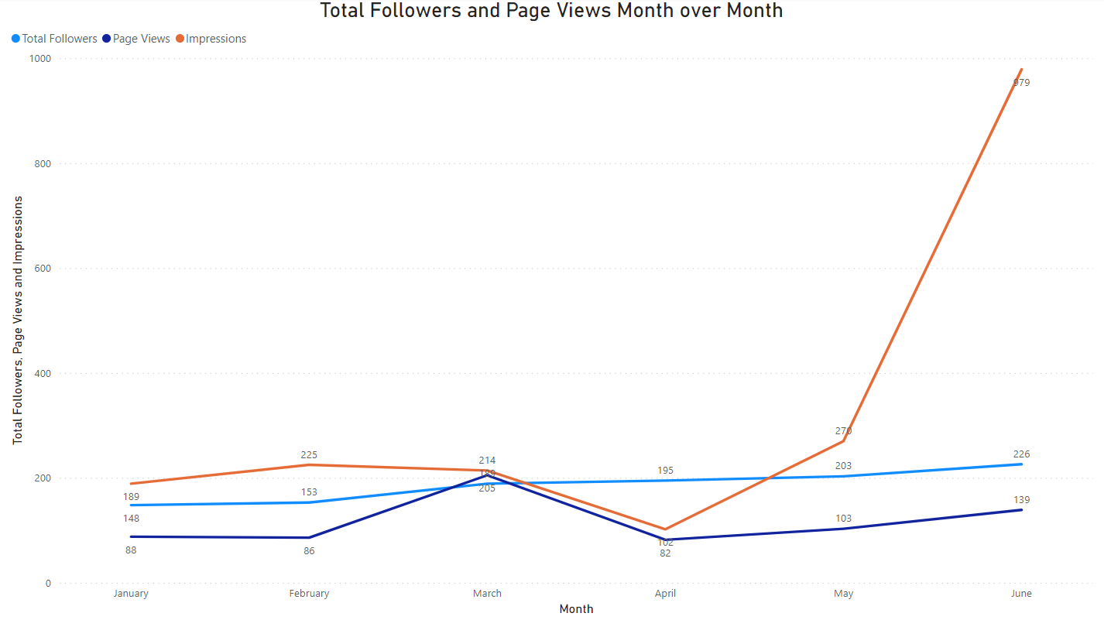

Month over month comparison
Month | Number of Posts
January | 1
February | 1
March | 1
April | 0
May | 3
June | 6

Slide 4
insights
All numbers were up for June. We also made 6 posts in June, twice as many as any other month.
Our reposts, impressions, and general engagement rate went dramatically up for June. While on the month over month graph it looks as though the overall number of followers has merely continued at the same steady pace by comparison, the number of followers gained in June is actually almost 3x the number of followers gained in May (23 vs 8 respectively.)
We tried posting an Article type post for the first time in June. The CTR is slightly lower than it is for Image type posts but it also had 44.6% less engagement than our June Image posts on average. More data is needed to determine if article-type posts consistently generate less engagement than Image type posts.
Our most popular post in June by reactions, reposts and engagement rate was a post on June 6th announcing how we are going to be doing an educational series on our foundation. However, none of the other posts for June referenced this series.

Slide 5
recommendations
Try making more posts that continue the foundation series theme. In addition to committing to post the series, this was our most popular post so there is interest in the series.
Try finishing the recommended page setup steps by following relevant pages and showcasing commitments
Try posting during the most active times: around 12 pm on Tuesdays, Wednesdays and Thursdays. (Since most of our visitors are from California, it should be 12 pm PST.)
Continue posting several times a month to drive views and engagement. Despite posting twice as much as last month, posts are still correlated with noticeable spikes in views, engagement, etc.

