Slide 1

Multi-key Homomorphic Encryption from TFHE
Hao Chen, Yongsoo Song (Microsoft Research)
Ilaria Chillotti (Cosic, KU Leuven)
ASIACRYPT 2019
December 11, 2019
Kobe, Japan

Slide 2










Homomorphic Encryption (HE)
$$\left[a\right]$$
$$\left[b\right]$$
$$\left[c\right]$$
$$\left[ab+c\right]$$
eval
Decryption
$$ab+c$$

Slide 3




Multi-key Homomorphic Encryption (MKHE)
$$\left[a\right]$$
$$\left[b\right]$$
$$\left[c\right]$$
$$\left[ab+c\right]$$
$$ab+c$$
Notes:
MKHE is a generalized notion of HE.

Slide 4







Building (2-round) MPC protocol from MKHE (MW’16)
Local KeyGen & Encryption
& Distributed decryption!
$$\left[b\right]$$
$$\left[ab+c\right]$$
$$\left[a\right]$$
$$\left[c\right]$$
Notes:
building a secure protocol from MKHE without a trusted party

Slide 5
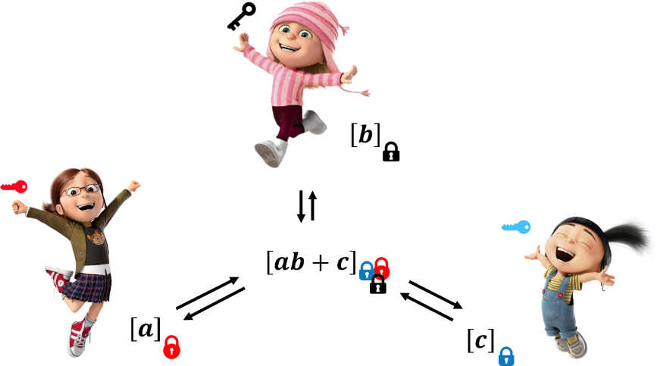
Advantages of (MPC from) MKHE
Homomorphic Encryption (HE)
Trusted party
(semi-honest)
Distributed authority
(stronger notion of security)
Reusable,
Less-interactive
(Fully) Dynamic
Nothing about other parties needs to be known for ahead of setup or encryption.
Any operation on any ciphertexts at anytime
Computation Cost: GC/SS < HE < MKHE
How much exactly?
Non-reusable,
Communication expensive
Garbled Circuit, Secret Sharing
Notes:
Compare

Slide 6
History of MKHE
NTRU
López-Alt et al. (STOC’12)
GSW
Clear-McGoldrick (Crypto’15)
Mukherjee-Wichs (EC’16)
Peikert-Shiehian (TCC’16)
LWE
Brakerski-Perlman (Crypto’16)
This work: MK-TFHE (AC’19)
Ring LWE (packing)
Chen-Zhang-Wang (TCC’17)
Chen-Dai-Kim-Song (CCS’19)
Our Results
Design efficient MKHE from TFHE
Boolean gate & Bootstrapping
First (PoC) implementation of MKHE
Two Methods for MK External Products (RLWE-RGSW)
Improved version of previous method [MW16,BP16]
New approach with better storage, complexity, noise growth
Notes:
History

Slide 7


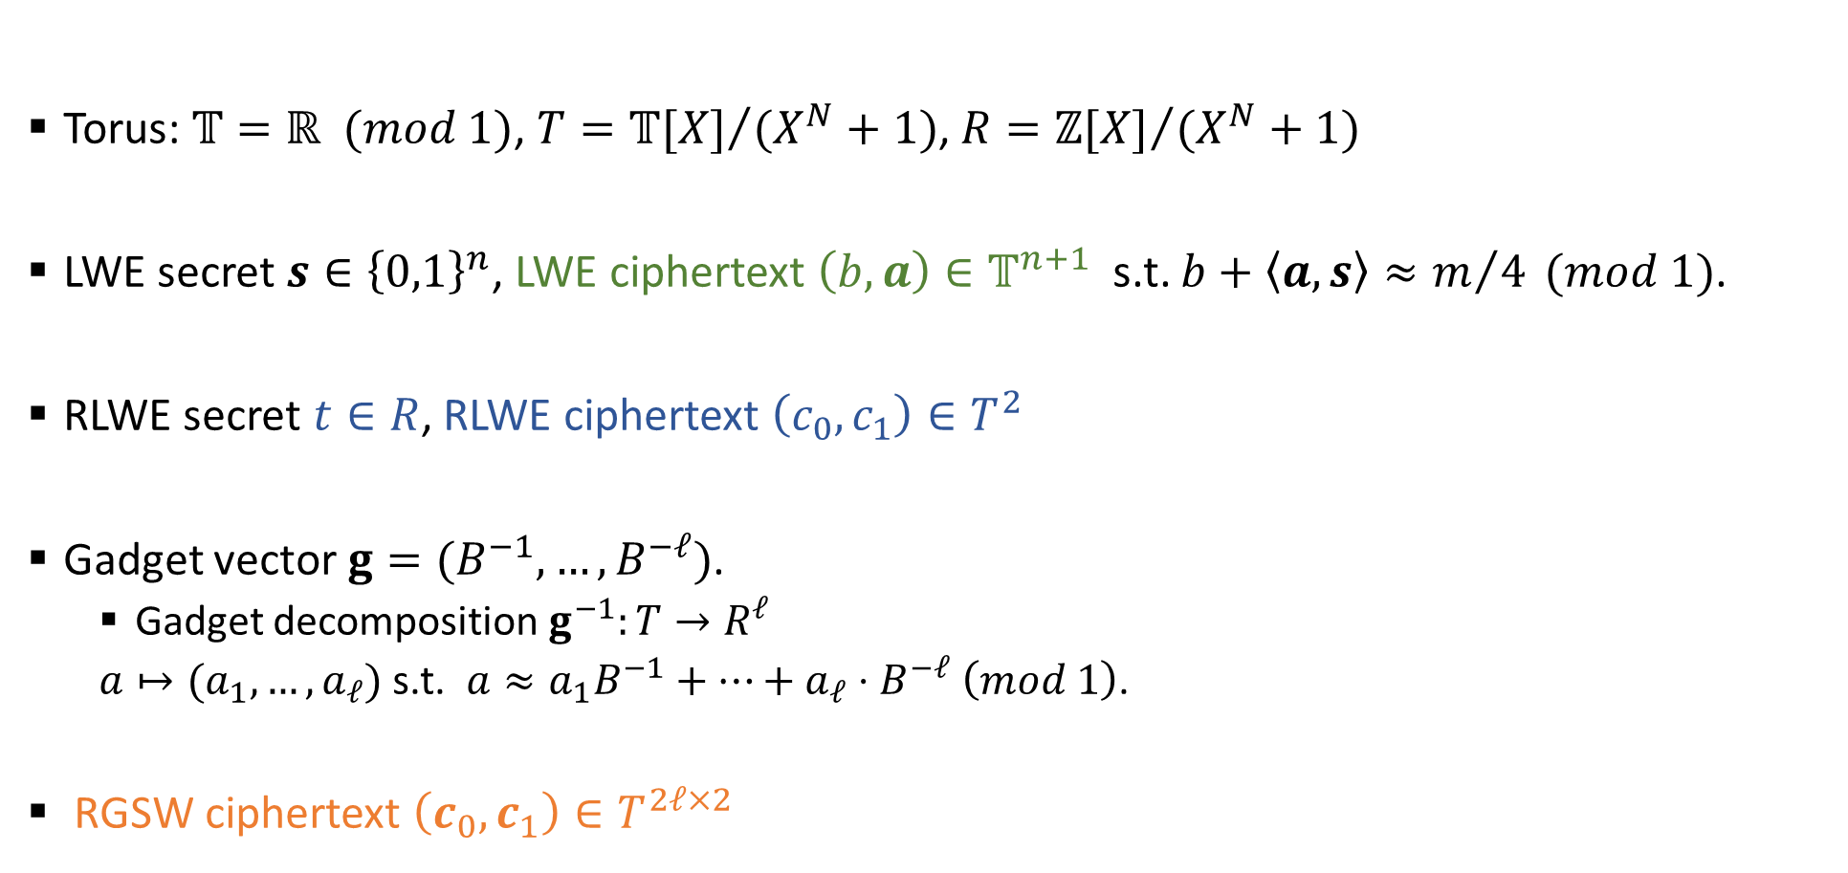


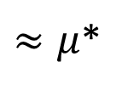








Overview of TFHE: Fast FHE over the Torus
Torus: $𝕋=ℝ (mod 1)$, $T={𝕋[X]}/{(X^{N}+1)}$, $R={ℤ[X]}/{(X^{N}+1)}$
LWE secret $s∈{\left\{0,1\right\}}^{n}$, LWE ciphertext $\left(b,a\right)∈𝕋^{n+1}$ s.t. $b+\left\langle a,s\right\rangle ≈m/4 (mod 1)$.
RLWE secret $t∈R$, RLWE ciphertext $\left(c_{0},c_{1}\right)∈T^{2}$
Gadget vector $g=(B^{−1},…, B^{−ℓ})$.
Gadget decomposition $g^{−1}:T→R^{ℓ}$
$a↦(a_{1},…, a_{ℓ})$ s.t. $a≈a_{1}B^{−1}+…+a_{ℓ}⋅B^{−ℓ} \left(mod 1\right)$.
RGSW ciphertext $\left(c_{0},c_{1}\right)∈T^{2ℓ×2}$
$$c_{0}$$
$$c_{1}$$
$$c_{0}$$
$$c_{1}$$
$$g$$
$$0$$
$$1$$
$$1$$
$≈μ$*
$$t$$
$$t$$
$$0$$
$$g$$

Slide 8

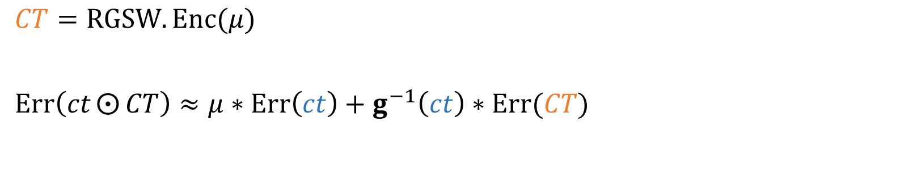
Overview of TFHE: External (Internal) Product
$⨀$: RLWE (RGSW) $×$ RGSW $→$ RLWE (RGSW)
$\left(ct, CT\right) ↦ ct⨀{CT}=g^{−1}\left(ct\right)∗CT$
$⨀$ $=$ $∗$ $=$
$⨀$ $=$ $∗$ $=$
$CT=RGSW.Enc(μ)$
$Err\left(ct⨀{CT}\right)≈μ∗Err\left(ct\right)+g^{−1}\left(ct\right)∗Err(CT)$

Slide 9
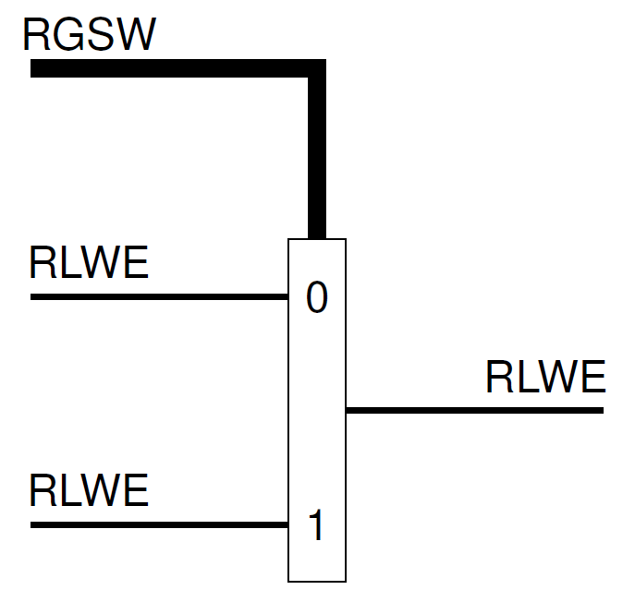
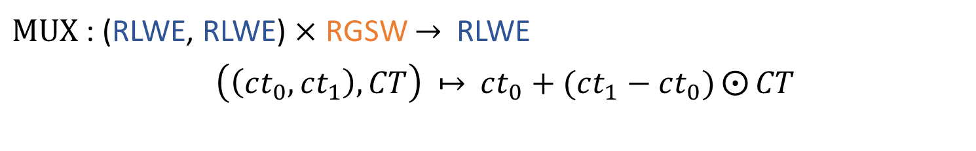
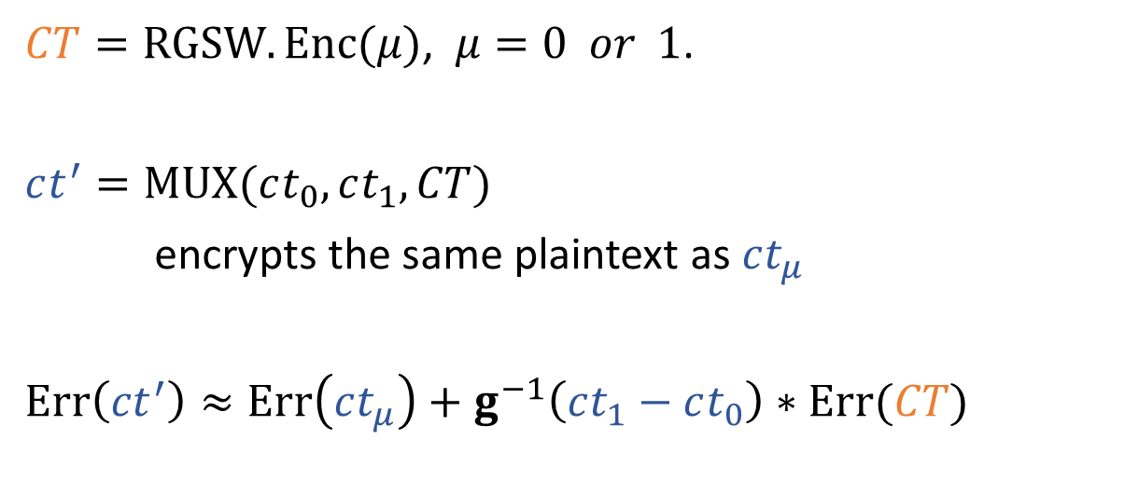
Overview of TFHE: MUX Gate (aka choice ftn)
$MUX$ : (RLWE, RLWE) $×$ RGSW $→$ RLWE
$\left(\left(ct_{0}, ct_{1}\right), CT\right)$ $↦$ $ct_{0}+(ct_{1}−ct_{0})⨀{CT}$
$CT=RGSW.Enc(μ)$, $μ=0 or 1$.
$ct^{′}=MUX(ct_{0}, ct_{1},CT)$
encrypts the same plaintext as $ct_{μ}$
$Err\left(ct^{′}\right)≈Err\left(ct_{μ}\right)+g^{−1}\left(ct_{1}−ct_{0}\right)∗Err(CT)$
* borrowed from Ilaria’s slide

Slide 10
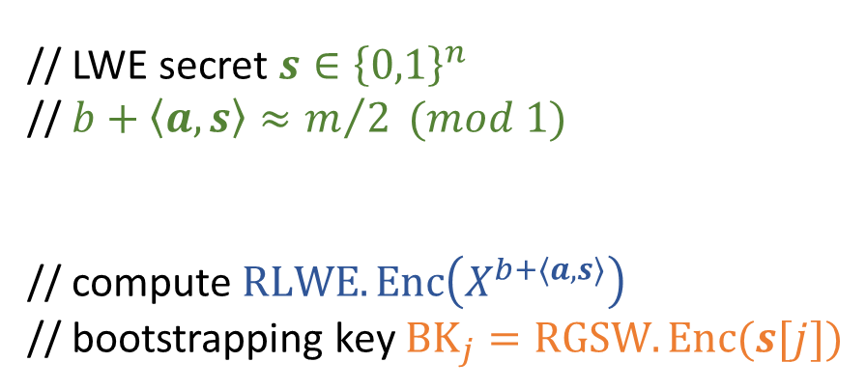


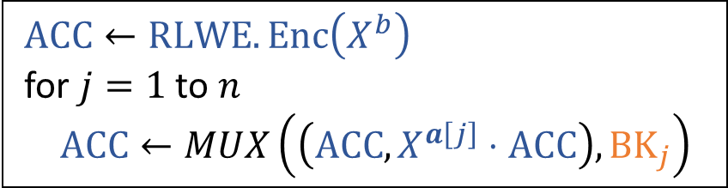
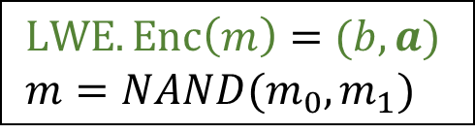

Overview of TFHE: Gate Bootstrapping
$$LWE.Enc(m_{0})$$
$$LWE.Enc(m_{1})$$
Linear Transformation
$LWE.Enc\left(m\right)=(b,a)$
$m=NAND(m_{0},m_{1})$
// LWE secret $s∈{\left\{0,1\right\}}^{n}$
// $b+\left\langle a,s\right\rangle ≈m/2 (mod 1)$
// compute $RLWE.Enc\left(X^{b+\left\langle a,s\right\rangle }\right)$
// bootstrapping key $BK_{j}=RGSW.Enc(s[j])$
Accumulator
$ACC←RLWE.Enc\left(X^{b}\right)$
for $j=1$ to $n$
$ACC←MUX\left(\left(ACC, X^{a\left[j\right]}⋅ACC\right), BK_{j}\right)$
Extraction & Key Switching
$LWE.Enc\left(m\right)$

Slide 11




















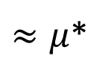



MK TFHE: Setup
LWE secret $s_{i}∈{\left\{0,1\right\}}^{n}$,
MK-LWE ciphertext $\left(b,a_{1},a_{2},…, a_{k}\right)∈𝕋^{nk+1}$ s.t. $b+\sum_{i}{\left\langle a_{i},s_{i}\right\rangle }≈m/4 (mod 1)$.
RLWE secret $t_{i}∈R$, MK-RLWE ciphertext $\left(c_{0},c_{1}, …, c_{k}\right)∈T^{k+1}$
RGSW ciphertext $\left(c_{0},c_{1},…, c_{k}\right)∈T^{(k+1)ℓ×(k+1)}$
$$c_{0}$$
$$c_{1}$$
$$⋯$$
$$c_{k}$$
$$c_{0}$$
$$c_{1}$$
$$c_{2}$$
$$g$$
$$0$$
$$0$$
$$1$$
$$1$$
$$t_{1}$$
$≈μ$*
$$t_{1}$$
$$0$$
$$g$$
$$0$$
$$t_{2}$$
$$t_{2}$$
$$0$$
$$0$$
$$g$$

Slide 12
MK TFHE: Our Hope
$$LWE.Enc(m_{0})$$
$$LWE.Enc(m_{1})$$
Linear Transformation
$LWE.Enc\left(m\right)=(b,a)$
$m=NAND(m_{0},m_{1})$
// LWE secret $s∈{\left\{0,1\right\}}^{n}$
// $b+\left\langle a,s\right\rangle ≈m/2 (mod 1)$
// compute $RLWE.Enc\left(X^{b+\left\langle a,s\right\rangle }\right)$
// bootstrapping key $BK_{j}=RGSW.Enc(s[j])$
Accumulator
$ACC←RLWE.Enc\left(X^{b}\right)$
for $j=1$ to $n$
$ACC←MUX\left(\left(ACC, X^{a\left[j\right]}⋅ACC\right), BK_{j}\right)$
Extraction & Key Switching
$LWE.Enc\left(m\right)$

Slide 13
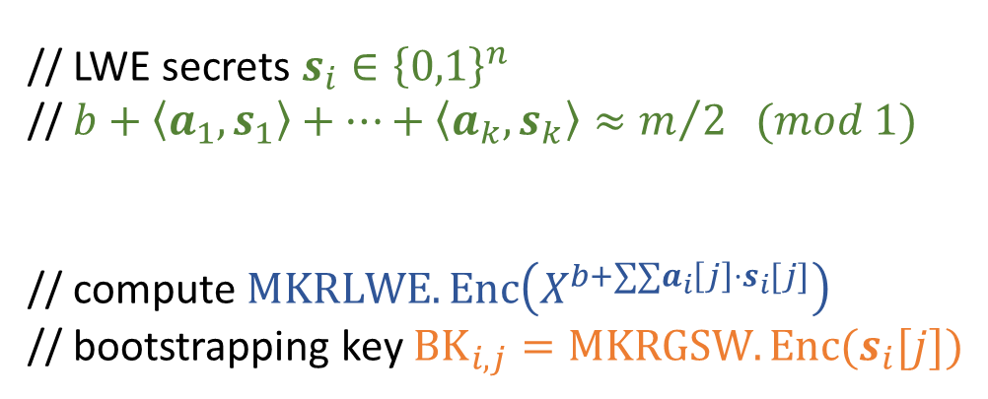


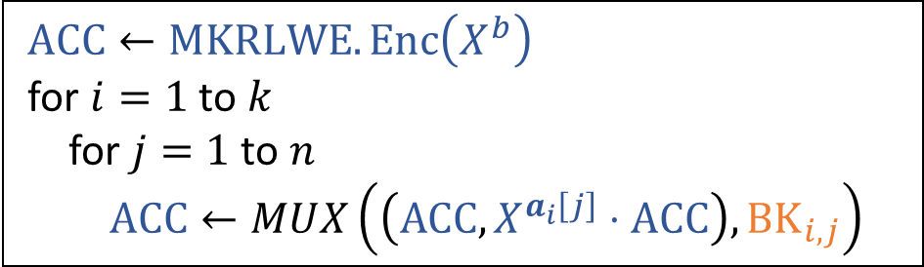
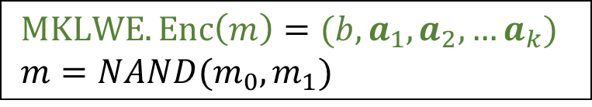

MK TFHE: Our Hope
$$MKLWE.Enc(m_{0})$$
$$MKLWE.Enc(m_{1})$$
Linear Transformation
$MKLWE.Enc\left(m\right)=(b,a_{1},a_{2},…a_{k})$
$m=NAND(m_{0},m_{1})$
// LWE secrets $s_{i}∈{\left\{0,1\right\}}^{n}$
// $b+\left\langle a_{1},s_{1}\right\rangle +…+\left\langle a_{k}, s_{k}\right\rangle ≈m/2 (mod 1)$
// compute $MKRLWE.Enc\left(X^{b+∑∑a_{i}\left[j\right]⋅s_{i}[j]}\right)$
// bootstrapping key $BK_{i,j}=MKRGSW.Enc(s_{i}[j])$
Accumulator
$ACC←MKRLWE.Enc\left(X^{b}\right)$
for $i=1$ to $k$
for $j=1$ to $n$
$ACC←MUX\left(\left(ACC, X^{a_{i}\left[j\right]}⋅ACC\right), BK_{i,j}\right)$
Q. Who can generate Boot Key? How?
Q. How to design a new External Product between a single-key & MK-RLWE ciphertexts?
Extraction & Multi Key Switching
$MKLWE.Enc\left(m\right)$

Slide 14
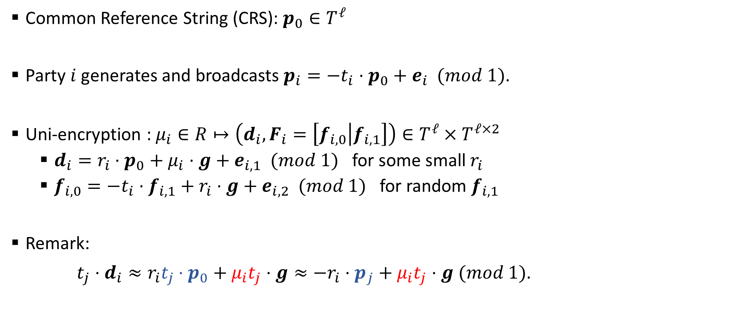
MK TFHE: External Product (Setup)
Common Reference String (CRS): $p_{0}∈T^{ℓ}$
Party $i$ generates and broadcasts $p_{i}=−t_{i}⋅p_{0}+e_{i} (mod 1)$.
Uni-encryption : $μ_{i}∈R↦\left(d_{i}, F_{i}=\left[f_{i,0} | f_{i, 1}\right]\right)∈T^{ℓ}×T^{ℓ×2}$
$d_{i}=r_{i}⋅p_{0}+μ_{i}⋅g+e_{i,1} (mod 1)$ for some small $r_{i}$
$f_{i,0}=−t_{i}⋅f_{i,1}+r_{i}⋅g+e_{i,2} (mod 1)$ for random $f_{i,1}$
Remark:
$t_{j}⋅d_{i}≈r_{i}t_{j}⋅p_{0}+μ_{i}t_{j}⋅g≈−r_{i}⋅p_{j}+μ_{i}t_{j}⋅g (mod 1)$.

Slide 15


















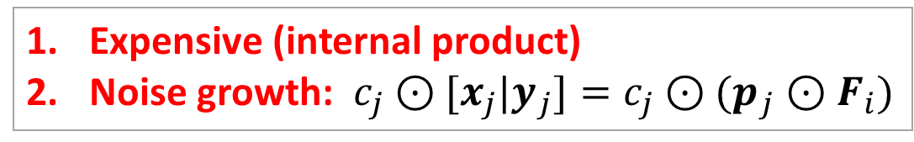







MK TFHE: External Product (First Method)
$i$-th col
Improvement of GSW ciphertext extension [MW’16]
Uni-encryption : $μ_{i}∈R↦\left(d_{i}, F_{i}=\left[f_{i,0} | f_{i, 1}\right]\right)∈T^{ℓ}×T^{ℓ×2}$
$d_{i}=r_{i}⋅p_{0}+μ_{i}⋅g+e_{i,1} (mod 1)$
$f_{i,0}=−t_{i}⋅f_{i,1}+r_{i}⋅g+e_{i,2} (mod 1)$
Remark: $t_{j}⋅d_{i}≈−r_{i}⋅p_{j}+μ_{i}t_{j}⋅g$
Given uni-encryption $\left(d_{i}, F_{i}\right)$ of $μ_{i}$ and public keys $\left\{p_{j}\right\}$,
For each $j$, generate $\left[x_{j} | y_{j}\right]=p_{j}⊙F_{i}$
(which satisfies $x_{j}+s_{i}⋅y_{j}≈r_{i}⋅p_{j}$)
Then, return the MK RGSW encryption of $μ_{i}$
($μ_{i}=s_{i}\left[1\right], …, s_{i}[n]$ in MK TFHE)
$$d_{i}$$
$$+$$
$$x_{0}$$
$$0$$
$$y_{0}$$
$$0$$
$$⋯$$
$$⋯$$
$$x_{1}$$
$$d_{i}$$
$$y_{1}$$
$$0$$
$$⋯$$
$$⋯$$
$$⋯$$
$$⋯$$
$$⋯$$
$$⋯$$
$$x_{k}$$
$$0$$
$$y_{k}$$
$$d_{i}$$
Expensive (internal product)
Noise growth: $c_{j}⊙[x_{j}|y_{j}]=c_{j}⊙(p_{j}⊙F_{i})$
$$⋯$$
$$⋯$$

Slide 16

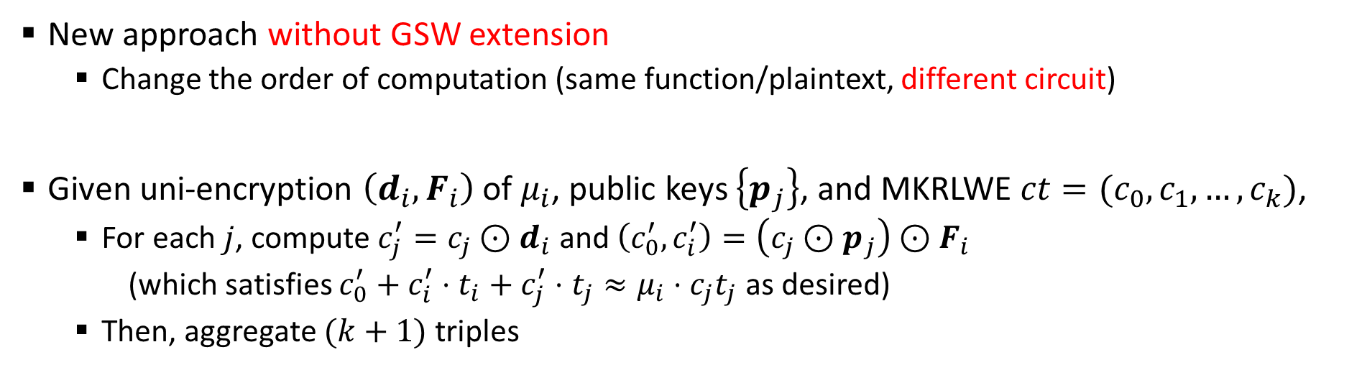
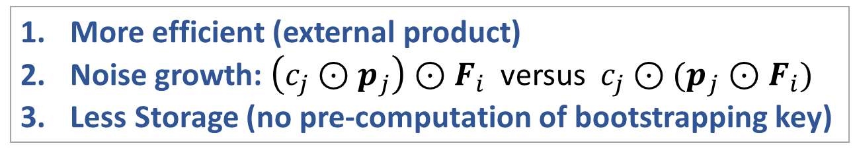
MK TFHE: External Product (Second Method)
New approach without GSW extension
Change the order of computation (same function/plaintext, different circuit)
Given uni-encryption $\left(d_{i}, F_{i}\right)$ of $μ_{i}$, public keys $\left\{p_{j}\right\}$, and MKRLWE $ct=(c_{0},c_{1},…, c_{k})$,
For each $j$, compute $c_{j}^{′}=c_{j}⊙d_{i}$ and $\left(c_{0}^{′},c_{i}^{′}\right)=\left(c_{j}⊙p_{j}\right)⊙F_{i}$
(which satisfies $c_{0}^{′}+c_{i}^{′}⋅t_{i}+c_{j}^{′}⋅t_{j}≈μ_{i}⋅c_{j}t_{j}$ as desired)
Then, aggregate $(k+1)$ triples
More efficient (external product)
Noise growth: $\left(c_{j}⊙p_{j}\right)⊙F_{i}$ versus $c_{j}⊙(p_{j}⊙F_{i})$
Less Storage (no pre-computation of bootstrapping key)

Slide 17
MK TFHE: Implementation
$$MKLWE.Enc(m_{0})$$
$$MKLWE.Enc(m_{1})$$
Linear Transformation
Built on top of the TFHE library
Available on GitHub: https://github.com/ilachill/MK-TFHE
$MKLWE.Enc\left(m\right)=(b,a_{1},a_{2},…a_{k})$
$m=NAND(m_{0},m_{1})$
Accumulator
$ACC←MKRLWE.Enc\left(X^{b}\right)$
for $i=1$ to $k$
for $j=1$ to $n$
$ACC←MUX\left(\left(ACC, X^{a_{i}\left[j\right]}⋅ACC\right), BK_{i,j}\right)$
// External product (Second Method)
Extraction & Multi Key Switching
$MKLWE.Enc\left(m\right)$

Slide 18
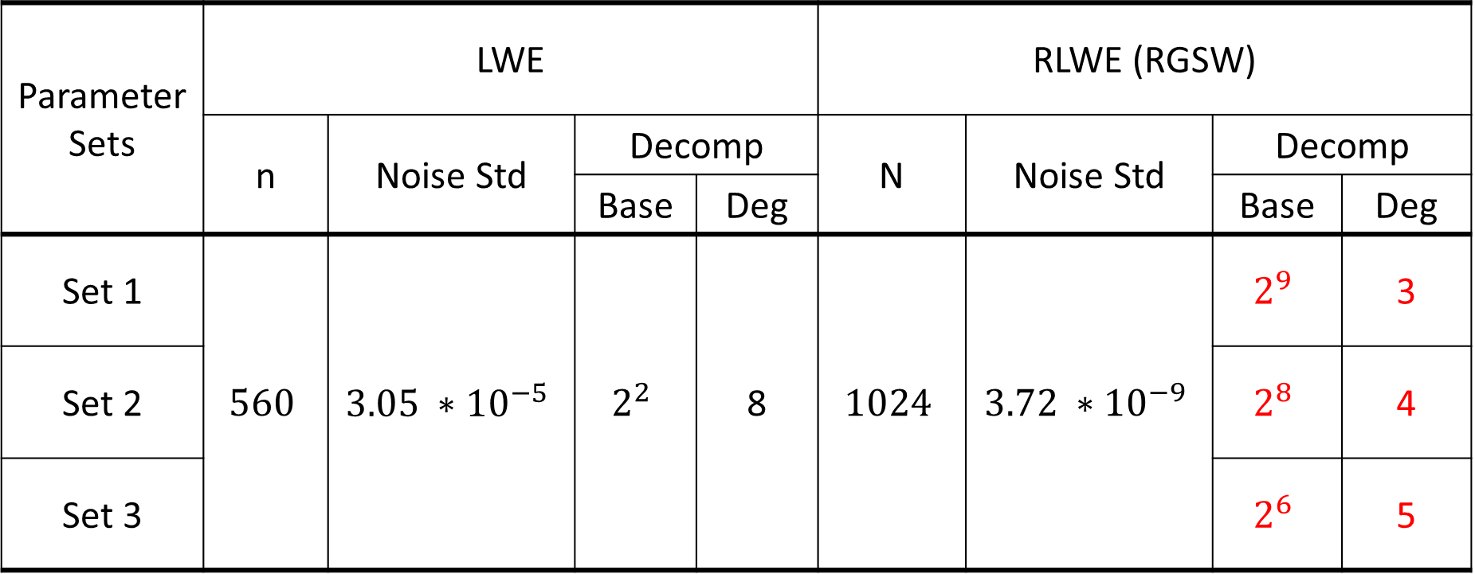
MK TFHE: Parameter
Parameter Sets | LWE |  |  |  | RLWE (RGSW)
 | n | Noise Std | Decomp |  | N | Noise Std | Decomp
 |  |  | Base | Deg |  |  | Base | Deg
Set 1 | $$560$$ | $$3.05 ∗{10}^{−5}$$ | $$2^{2}$$ | 8 | $$1024$$ | $$3.72 ∗{10}^{−9}$$ | $$2^{9}$$ | 3
Set 2 |  |  |  |  |  |  | $$2^{8}$$ | 4
Set 3 |  |  |  |  |  |  | $$2^{6}$$ | 5
About 110 bits of security according to the LWE estimator

Slide 19
MK TFHE: Experimental Results
Parameter Sets | Fresh Ciphertext | # of parties | Multi-Key Ciphertext | NAND + Boot
Set 1 | 2.19 KB | 2 | 4.38 KB | 0.27 s
Set 2 |  | 2 | 4.38 KB | 0.43 s
 |  | 4 | 8.77 KB | 1.45 s
Set 3 |  | 2 | 4.38 KB | 0.50 s
 |  | 4 | 8.77 KB | 1.90 s
 |  | 8 | 17.32 KB | 7.16 s
Core i7-4910MQ at 2.90GHz laptop, running on a single thread

Slide 20



