Slide 1

Multi-key Homomorphic Encryption with Packed Ciphertexts
Hao Chen, Wei Dai, Yongsoo Song (Microsoft Research, Redmond)
Miran Kim (UT Health Science Center at Houston)
ACM CCS 2019
Nov 12, London

Slide 2










Homomorphic Encryption (HE)
$$\left[a\right]$$
$$\left[b\right]$$
$$\left[c\right]$$
$$\left[ab+c\right]$$
$$ab+c$$

Slide 3




Multi-key Homomorphic Encryption (MKHE)
$$\left[a\right]$$
$$\left[b\right]$$
$$\left[c\right]$$
$$\left[ab+c\right]$$
$$ab+c$$

Slide 4







Building Secure Protocol w/ MKHE (MW’16)
Distributed decryption!
$$\left[b\right]$$
$$\left[ab+c\right]$$
$$\left[a\right]$$
$$\left[c\right]$$

Slide 5
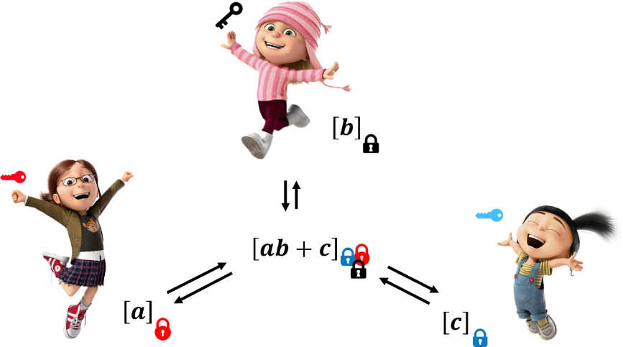
Advantages of MKHE
Homomorphic Encryption (HE)
Trusted party (semi-honest)
Distributed authority (stronger notion of security)
Non-Interactive
Interactive
Reusable, (Fully) Dynamic
Non-reusable
Garbled Circuit, Secret Sharing (MPC)

Slide 6




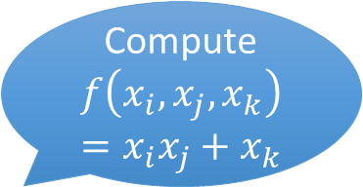


On-the-fly Protocol (LaTV’12)
Compute
$$f\left(x_{i},x_{j},x_{k}\right)=x_{i}x_{j}+x_{k}$$
$${\left[a_{i}\right]}_{sk_{i}}$$
(Fully) Dynamic
The program (set of parties, circuit) don’t have to be specified before encryption.
Any (new) party can join the computation.
Minimal interaction
2-round (Encryption, Distributed decryption)
Communication ~ input & output size
Computational Complexity
Depends on the number of parties which are involved in a computational task.
$$[a_{i}a_{j}+a_{k}]$$
$$⊇$$

Slide 7
History of MKHE
NTRU
López-Alt et al. (STOC’12)
GSW
Clear-McGoldrick (Crypto’15)
Mukherjee-Wichs (EC’16)
Peikert-Shiehian (TCC’16)
LWE
Brakerski-Perlman (Crypto’16)
Chen-Chillotti-Song (AC’19)
Ring LWE (packing)
Chen-Zhang-Wang (TCC’17)
This work (CCS’19)
Our Contributions
Design efficient MKHEs over BFV and CKKS
- Best asymptotic (amortized) complexity
New relinearization (key-switching) methods
- Optimization techniques
Multi-key Fully Homomorphic Encryption
- Apply the idea of HE bootstrapping to our schemes
Empirical results
- First implementation of MKHEs with packing
- Application to oblivious CNN evaluation

Slide 8
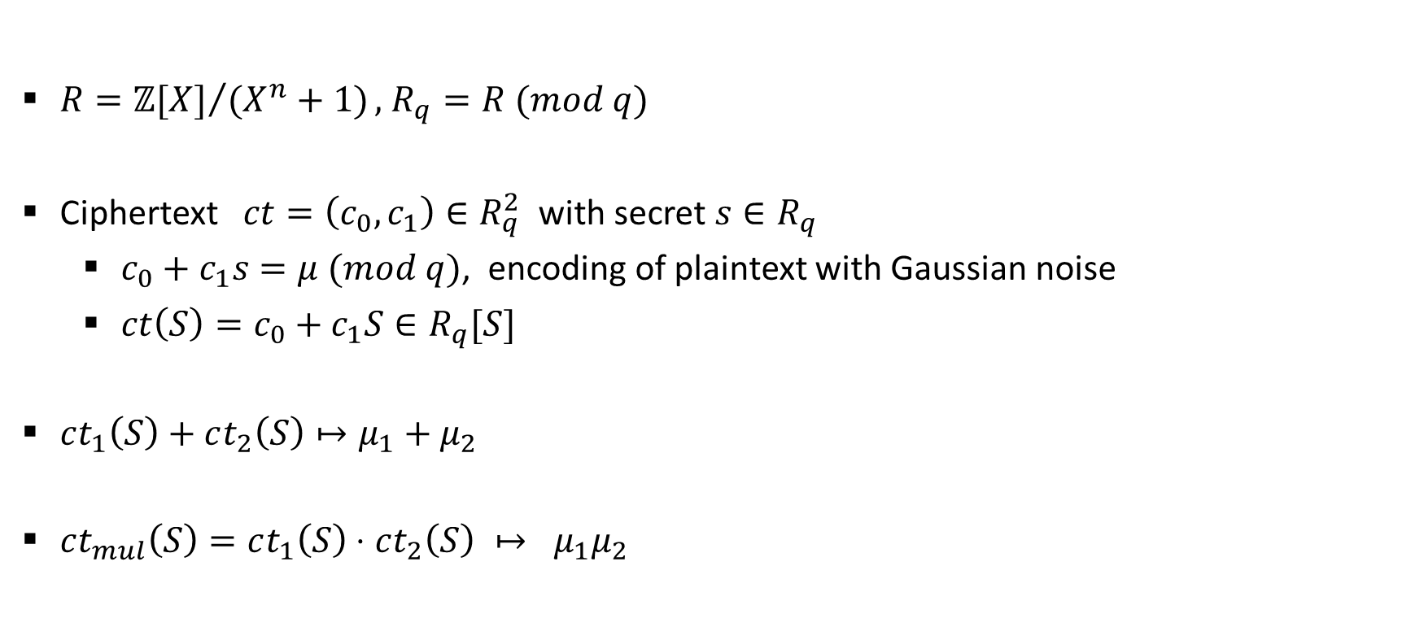
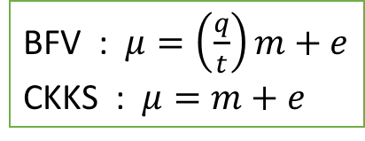
(Incomplete) Overview of HE over ring
$R={ℤ[X]}/{(X^{n}+1)},$ $R_{q}=R (mod q)$
Ciphertext $ct=\left(c_{0},c_{1}\right)∈R_{q}^{2}$ with secret $s∈R_{q}$
$c_{0}+c_{1}s=μ (mod q)$, encoding of plaintext with Gaussian noise
$ct\left(S\right)=c_{0}+c_{1}S∈R_{q}[S]$
$ct_{1}\left(S\right)+ct_{2}\left(S\right)↦μ_{1}+μ_{2}$
$ct_{mul}\left(S\right)=ct_{1}\left(S\right)⋅ct_{2}\left(S\right) ↦ μ_{1}μ_{2}$
BFV : $μ=\left(\frac{q}{t}\right)m+e$
CKKS : $μ=m+e$

Slide 9
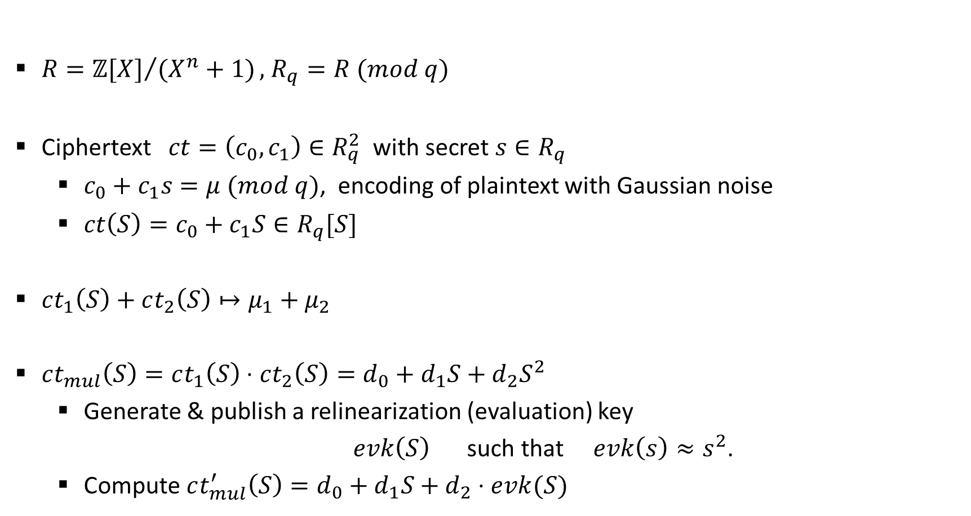
(Incomplete) Overview of HE over ring
$R={ℤ[X]}/{(X^{n}+1)},$ $R_{q}=R (mod q)$
Ciphertext $ct=\left(c_{0},c_{1}\right)∈R_{q}^{2}$ with secret $s∈R_{q}$
$c_{0}+c_{1}s=μ (mod q)$, encoding of plaintext with Gaussian noise
$ct\left(S\right)=c_{0}+c_{1}S∈R_{q}[S]$
$ct_{1}\left(S\right)+ct_{2}\left(S\right)↦μ_{1}+μ_{2}$
$ct_{mul}\left(S\right)=ct_{1}\left(S\right)⋅ct_{2}\left(S\right)=d_{0}+d_{1}S+d_{2}S^{2}$
Generate & publish a relinearization (evaluation) key
$evk\left(S\right)$ such that $evk\left(s\right)≈s^{2}$.
Compute $ct_{mul}^{′}\left(S\right)=d_{0}+d_{1}S+d_{2}⋅evk(S)$
BFV : $μ=\left(\frac{q}{t}\right)m+e$
CKKS : $μ=m+e$

Slide 10
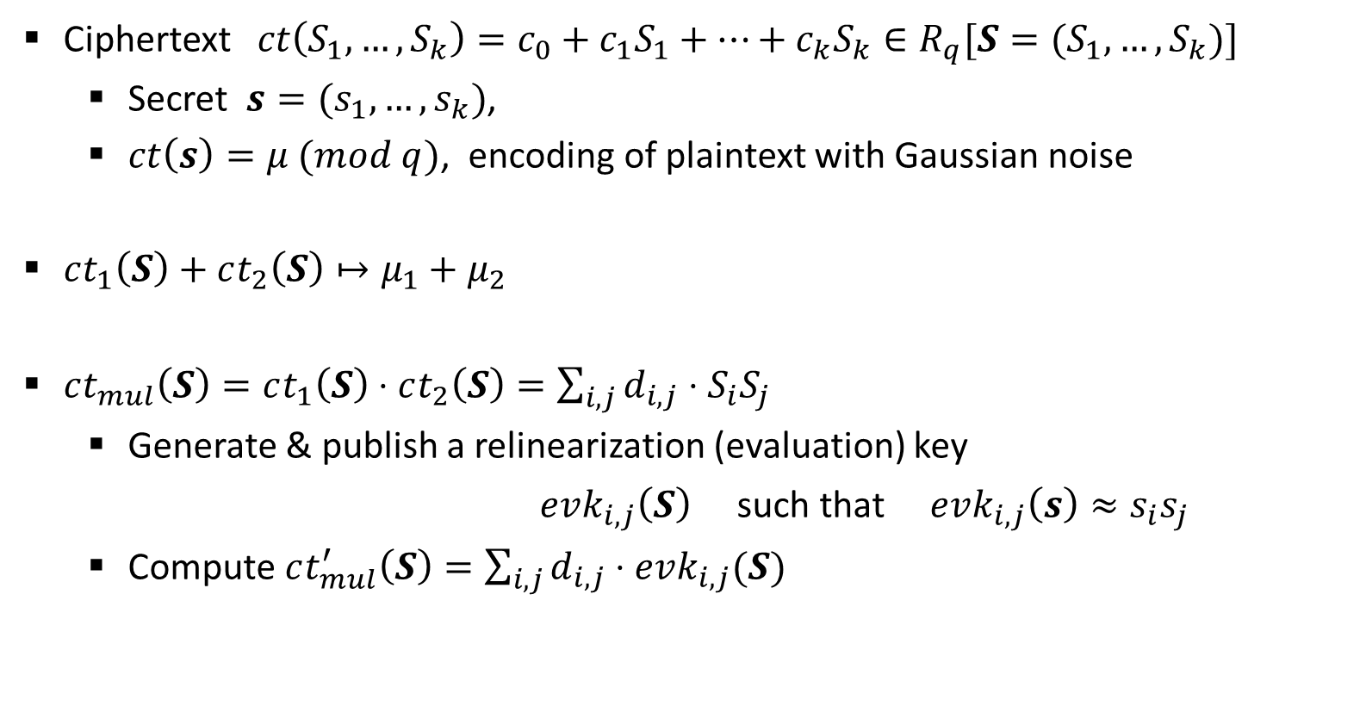
(Incomplete) Overview of MKHE over ring
Ciphertext $ct\left(S_{1},…, S_{k}\right)=c_{0}+c_{1}S_{1}+…+c_{k}S_{k}∈R_{q}[S=(S_{1}, …, S_{k})]$
Secret $s=(s_{1},…, s_{k})$,
$ct\left(s\right)=μ (mod q)$, encoding of plaintext with Gaussian noise
$ct_{1}\left(S\right)+ct_{2}\left(S\right)↦μ_{1}+μ_{2}$
$ct_{mul}\left(S\right)=ct_{1}\left(S\right)⋅ct_{2}\left(S\right)=\sum_{i,j}{d_{i,j}⋅S_{i}S_{j}}$
Generate & publish a relinearization (evaluation) key
$evk_{i,j}\left(S\right)$ such that $evk_{i,j}\left(s\right)≈s_{i}s_{j}$
Compute $ct_{mul}^{′}\left(S\right)=\sum_{i,j}{d_{i,j}⋅evk_{i,j}(S)}$
By whom?

Slide 11
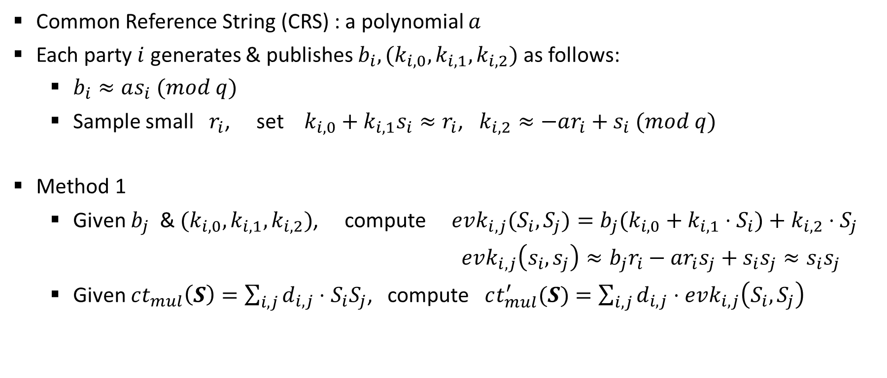
(Incomplete) Relinearization
Common Reference String (CRS) : a polynomial $a$
Each party $i$ generates & publishes $b_{i}, (k_{i,0},k_{i,1}, k_{i,2})$ as follows:
$b_{i}≈as_{i} (mod q)$
Sample small $r_{i}$, set $k_{i,0}+k_{i,1}s_{i}≈r_{i}$, $k_{i,2}≈−ar_{i}+s_{i} (mod q)$
Method 1
Given $b_{j}$ & $(k_{i,0}, k_{i,1}, k_{i,2})$, compute $evk_{i,j}(S_{i},S_{j})=b_{j}(k_{i,0}+k_{i,1}⋅S_{i})+k_{i,2}⋅S_{j}$
$evk_{i,j}\left(s_{i}, s_{j}\right)≈b_{j}r_{i}−ar_{i}s_{j}+s_{i}s_{j}≈s_{i}s_{j}$
Given $ct_{mul}\left(S\right)=\sum_{i,j}{d_{i,j}⋅S_{i}S_{j}}$, compute $ct_{mul}^{′}(S)=\sum_{i,j}{d_{i,j}⋅evk_{i,j}\left(S_{i},S_{j}\right)}$

Slide 12
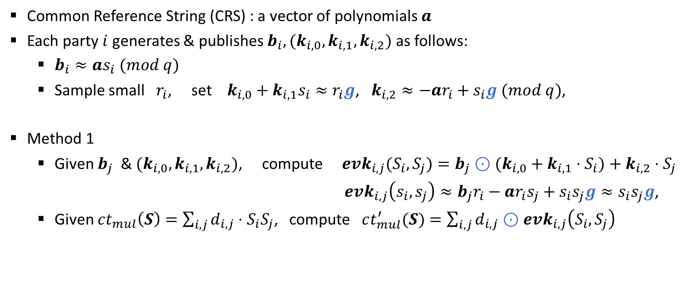

Relinearization (Method 1)
Gadget vector $g$ & decomposition
$u↦g^{−1}(u)$,
s.t. $g^{−1}\left(u\right)⋅g=u (mod q)$
(External) product $⊙$
$u⊙v=g^{−1}\left(u\right)⋅v (mod q)$.
Common Reference String (CRS) : a vector of polynomials $a$
Each party $i$ generates & publishes $b_{i}, (k_{i,0},k_{i,1}, k_{i,2})$ as follows:
$b_{i}≈as_{i} (mod q)$
Sample small $r_{i}$, set $k_{i,0}+k_{i,1}s_{i}≈r_{i}g$, $k_{i,2}≈−ar_{i}+s_{i}g (mod q)$,
Method 1
Given $b_{j}$ & $(k_{i,0}, k_{i,1}, k_{i,2})$, compute $evk_{i,j}(S_{i},S_{j})=b_{j}⊙(k_{i,0}+k_{i,1}⋅S_{i})+k_{i,2}⋅S_{j}$
$evk_{i,j}\left(s_{i}, s_{j}\right)≈b_{j}r_{i}−ar_{i}s_{j}+s_{i}s_{j}g≈s_{i}s_{j}g$,
Given $ct_{mul}\left(S\right)=\sum_{i,j}{d_{i,j}⋅S_{i}S_{j}}$, compute $ct_{mul}^{′}(S)=\sum_{i,j}{d_{i,j}⊙evk_{i,j}\left(S_{i},S_{j}\right)}$

Slide 13
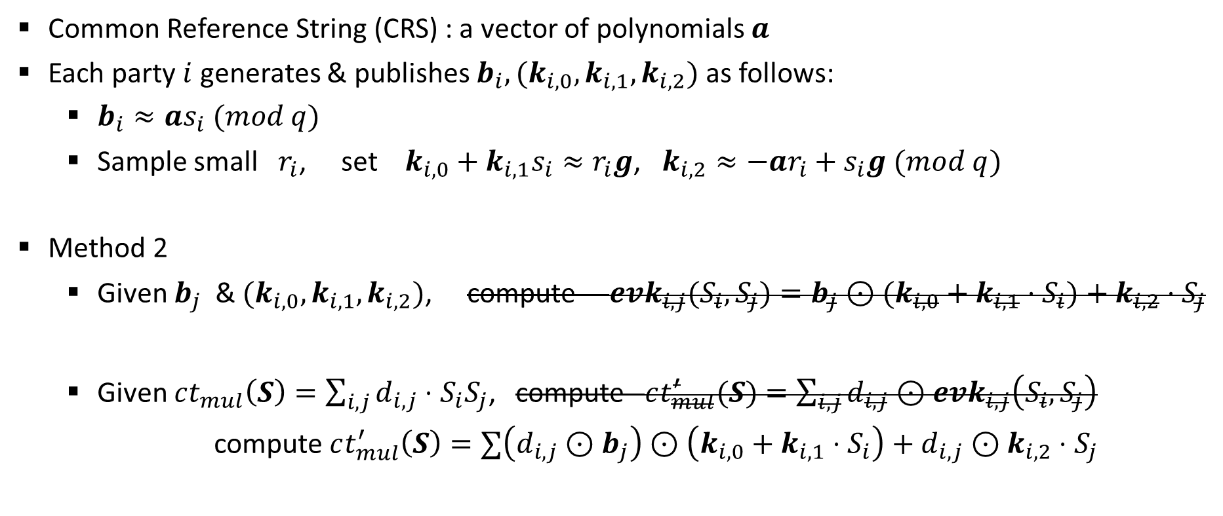
Relinearization (Method 2)
Gadget vector $g$ & decomposition
$u↦g^{−1}(u)$,
s.t. $g^{−1}\left(u\right)⋅g=u (mod q)$
(External) product $⊙$
$u⊙v=g^{−1}\left(u\right)⋅v (mod q)$.
Common Reference String (CRS) : a vector of polynomials $a$
Each party $i$ generates & publishes $b_{i}, (k_{i,0},k_{i,1}, k_{i,2})$ as follows:
$b_{i}≈as_{i} (mod q)$
Sample small $r_{i}$, set $k_{i,0}+k_{i,1}s_{i}≈r_{i}g$, $k_{i,2}≈−ar_{i}+s_{i}g (mod q)$
Method 2
Given $b_{j}$ & $(k_{i,0}, k_{i,1}, k_{i,2})$, compute $evk_{i,j}(S_{i},S_{j})=b_{j}⊙(k_{i,0}+k_{i,1}⋅S_{i})+k_{i,2}⋅S_{j}$
$evk_{i,j}\left(s_{i}, s_{j}\right)≈b_{j}r_{i}−ar_{i}s_{j}+s_{i}s_{j}g≈s_{i}s_{j}g$,
Given $ct_{mul}\left(S\right)=\sum_{i,j}{d_{i,j}⋅S_{i}S_{j}}$, compute $ct_{mul}^{′}(S)=\sum_{i,j}{d_{i,j}⊙evk_{i,j}\left(S_{i},S_{j}\right)}$
compute $ct_{mul}^{′}\left(S\right)=∑\left(d_{i,j}⊙b_{j}\right)⊙\left(k_{i,0}+k_{i,1}⋅S_{i}\right)+d_{i,j}⊙k_{i,2}⋅S_{j}$

Slide 14
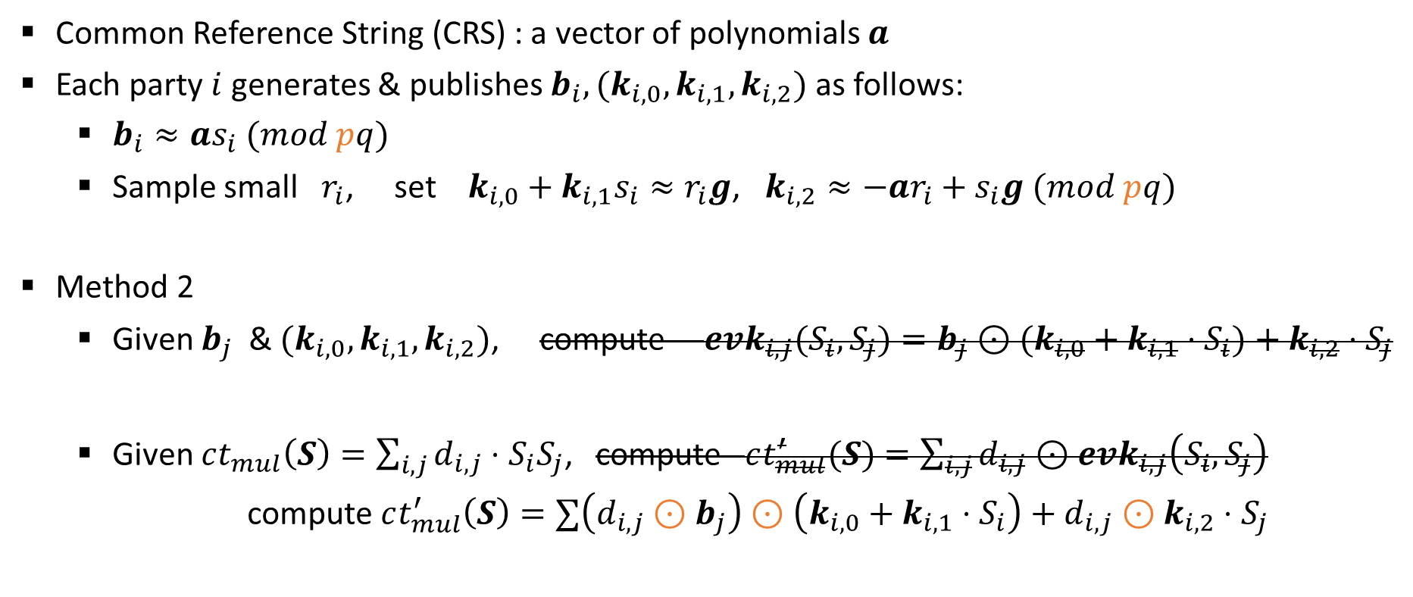

Relinearization (Method 2+)
Gadget vector $g$ & decomposition
$u↦g^{−1}(u)$,
s.t. $g^{−1}\left(u\right)⋅g=u (mod q)$
(External) product $⊙$
$u⊙v=p^{−1}⋅\left\lfloor g^{−1}\left(u\right)⊙v (mod pq)\right\rfloor$.
Common Reference String (CRS) : a vector of polynomials $a$
Each party $i$ generates & publishes $b_{i}, (k_{i,0},k_{i,1}, k_{i,2})$ as follows:
$b_{i}≈as_{i} (mod pq)$
Sample small $r_{i}$, set $k_{i,0}+k_{i,1}s_{i}≈r_{i}g$, $k_{i,2}≈−ar_{i}+s_{i}g (mod pq)$
Method 2
Given $b_{j}$ & $(k_{i,0}, k_{i,1}, k_{i,2})$, compute $evk_{i,j}(S_{i},S_{j})=b_{j}⊙(k_{i,0}+k_{i,1}⋅S_{i})+k_{i,2}⋅S_{j}$
$evk_{i,j}\left(s_{i}, s_{j}\right)≈b_{j}r_{i}−ar_{i}s_{j}+s_{i}s_{j}g≈s_{i}s_{j}g$,
Given $ct_{mul}\left(S\right)=\sum_{i,j}{d_{i,j}⋅S_{i}S_{j}}$, compute $ct_{mul}^{′}(S)=\sum_{i,j}{d_{i,j}⊙evk_{i,j}\left(S_{i},S_{j}\right)}$
compute $ct_{mul}^{′}\left(S\right)=∑\left(d_{i,j}⊙b_{j}\right)⊙\left(k_{i,0}+k_{i,1}⋅S_{i}\right)+d_{i,j}⊙k_{i,2}⋅S_{j}$

Slide 15
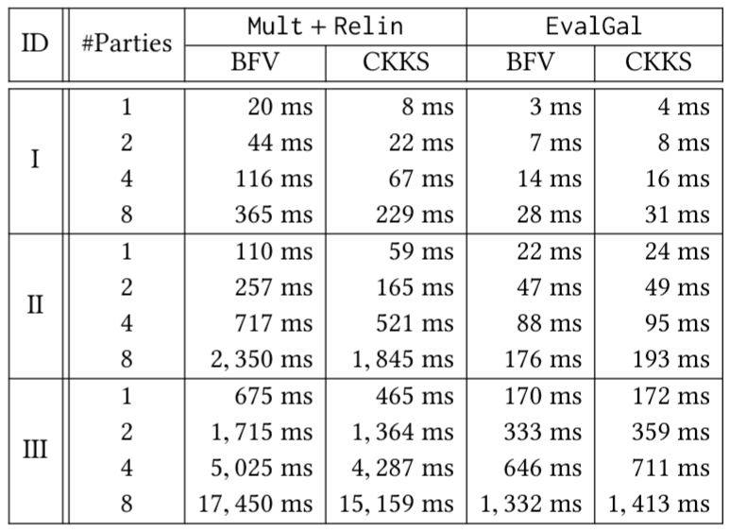
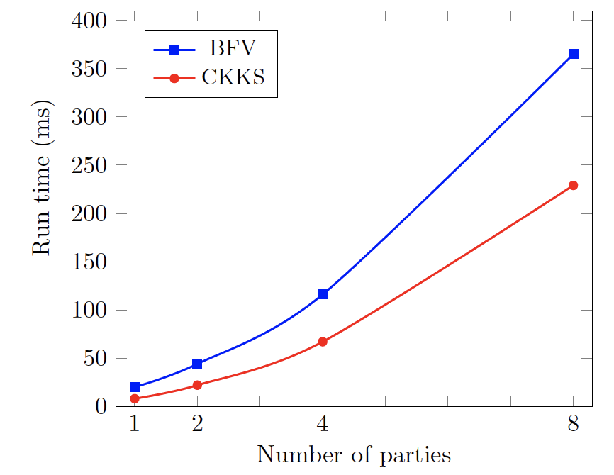
Performance
log n = 13
log n = 13
log n = 14
log n = 15

Slide 16
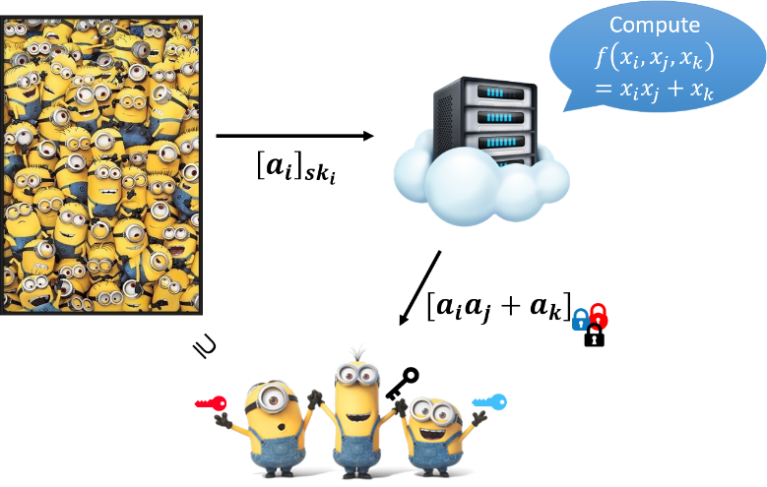

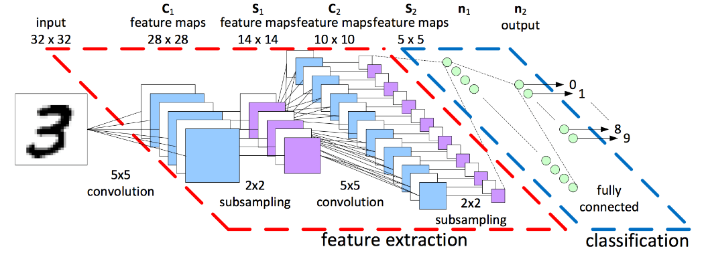
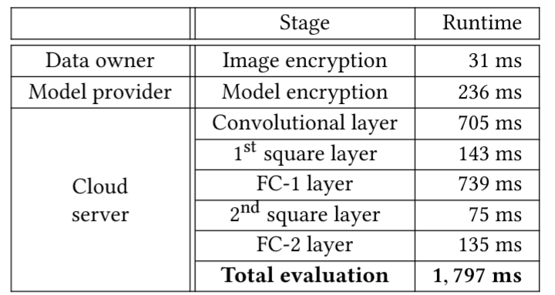
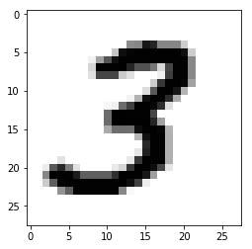
MNIST Inference

Slide 17



Notes:
you can see the details in our paper on the eprint. Thank you for the time.

