Slide 1

Transcript Intelligence
Findings & Recommendations
Peter Kao | Product & Engineering Leadership Review

Slide 2
The headline finding
A single bug sat unescalated for 25 days — and it was visible from every seat in the company the whole time.
19 / 103
3 of 3
25 days
37 days
calls touched one topic — the export bug — more than any other
call types it showed up in: support, AM renewal calls, and engineering syncs
from first customer complaint to internal escalation
from first complaint to shipped fix
The rest of this deck walks through how we found that (categorization + sentiment, the two required tasks), then three more insights the same data surfaces once you look across channels instead of within just one.
Executive summary

Slide 3

A quick, honest note on the data
The assignment's sample dataset of real transcripts wasn't provided for this exercise.
1
100% synthetic, fully disclosed
103 fictional B2B SaaS transcripts generated to match the assignment's three call types — explicitly allowed by the assignment's own FAQ.
2
Built with real signal, not noise
Three deliberate storylines (a cross-channel bug, a competitor threat, a feature launch) are woven through the data with no labels, so categorization and sentiment have something genuine to find.
3
The method is what's being evaluated
Every technique shown — clustering, sentiment scoring, the insights — is built to run unchanged on real transcripts. Swap the data source; the pipeline doesn't change.
Full transparency notes: data/README.md in the repo

Slide 4
What we'll cover
01
Topic categorization
How we grouped 103 calls into 13 data-driven themes — and the one that crosses every channel
02
Sentiment analysis & trends
Why off-the-shelf sentiment tools fail on polite B2B dialogue, and what actually works
03
Three more insights
What else this data can tell different stakeholders, beyond the required tasks
04
Recommendations
What we'd act on first

Slide 5
Topic Categorization
01
Hybrid embeddings + clustering, validated against known answers

Slide 6



Why hybrid, not pure rules or pure LLM-per-call
Rule-based
Zero-shot LLM / call
Hybrid (chosen)
Requires knowing categories up front — but discovering the unexpected (a bug visible in 3 channels) is the point.
Highest quality, but one API call per transcript, and still needs a pre-set category list. Not reproducible here without an API key.
Embeddings + clustering find structure with no prior assumptions; a lightweight labeling pass (keywords + example) makes clusters readable — an LLM call per cluster, not per call.
K (cluster count) was chosen deliberately too: silhouette score alone keeps climbing as K approaches N on a small dataset — that rewards singleton clusters, not meaningful themes. We picked the smallest K (13) where cluster purity against known-synthetic labels was high (76%) and no cluster fell below n=3.
scripts/categorize.py

Slide 7
13 categories fell out of the data
What stands out
Largest single category: the export/reporting bug (19 calls, ~18% of everything)
Second largest is a genuine good-news story: the Smart Alerts launch driving upsell conversations
Most categories sit entirely within one call type — support problems stay in support, planning stays internal
13 clusters, K chosen via purity validation (see appendix in notebook)

Slide 8
Only one category crosses every channel
Every other major category lives almost entirely inside one call type: Smart Alerts enthusiasm shows up with account managers, churn reviews happen internally, login issues stay in support. The export bug is the exception — it shows up in support tickets, renewal conversations, and engineering syncs alike.
That cross-channel footprint is itself a signal
A topic visible from every seat in the company isn't a one-off — it's systemic enough that nobody needs a dashboard to notice it. The real question is why it still took 25 days to escalate. (§4 below)

Slide 9

Sentiment Analysis & Trends
02
What the data says — and why getting there took three tries

Slide 10
Off-the-shelf sentiment tools don't work on polite frustration
Actual customer quote from the dataset:
96 / 103
“I appreciate that, but this is the third time I’ve called about this exact thing — I was told it was fixed in September.”
calls VADER scored “positive” — including active churn threats
~50%
VADER (lexicon-based) reads this as POSITIVE — it sees “appreciate,” not “third time.”
disagreement rate between VADER and a transformer cross-check (DistilBERT)
Conclusion: generic sentiment tools (trained on movie reviews / tweets) don’t transfer to professional, consequence-heavy B2B dialogue, where tone and actual stakes are decoupled. We needed contextual judgment, not a lexicon.
Our approach: LLM-based contextual scoring — full rationale in scripts/sentiment.py
scripts/sentiment.py

Slide 11
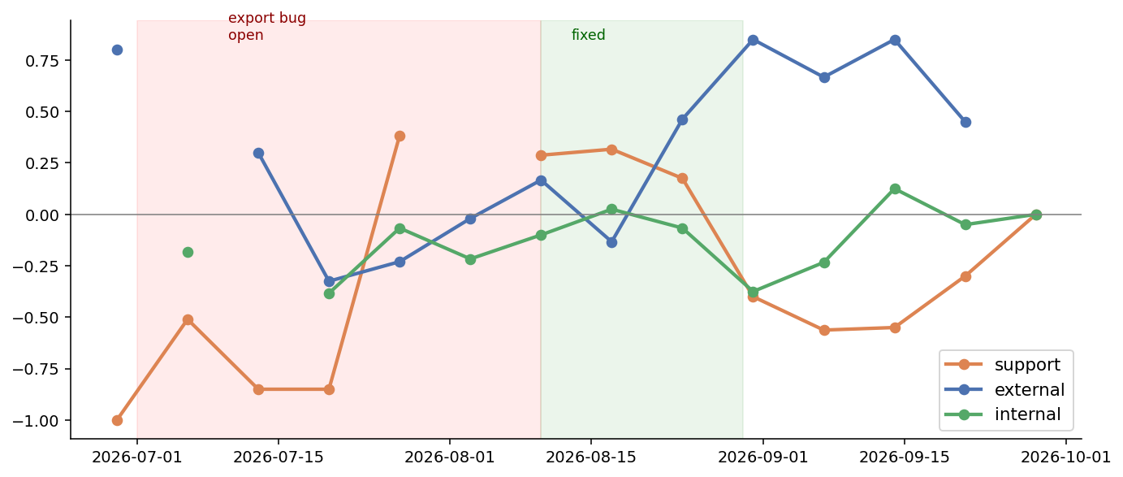
Weekly sentiment by call type
Support sentiment tracks the export bug cleanly — sharp dip while it’s open, recovery right as the fix ships. The second dip in late August is unrelated noise (a cluster of login/billing complaints landing the same week), not a relapse — called out explicitly in the notebook rather than cropped out.

Slide 12
The full arc: one bug, three channels, 43 days
Jul 4
Jul 9
Jul 23
Jul 29
Aug 10
Aug 16
SUPPORT
INTERNAL
INTERNAL
EXTERNAL
INTERNAL
SUPPORT
First customer
complaint
Eng acknowledges,
sits in backlog
Pulled forward
(+14d in backlog)
Tied to renewal
risk (+25d total)
Fix ships
(+37d total)
Customer confirms
resolved (+43d)
25 days
37 days
+1.6
before this was treated as urgent internally — despite 3 separate support calls about it
from first complaint to shipped fix
sentiment swing in support calls, week of the fix vs. week before (−0.85 → +0.75)
Recommendation: surface “this topic has appeared in N calls across support/external in the last 30 days” directly on the eng backlog — don’t rely on someone noticing the pattern from memory.

Slide 13

Beyond the Required Tasks
03
Three more things this data can tell different stakeholders

Slide 14
Insight: where should the backlog focus first
For: support & engineering leads prioritizing a backlog
Priority score = call volume × negativity, by category. Export/Reporting Bug ranks #1 by a wide margin — it's both the single highest-volume category in the whole dataset and solidly negative. A second, independent method agrees with the qualitative read from §2 — a useful gut-check before taking a finding to leadership.
Categories not shown here
Scored net-zero or positive, so they don't need backlog attention right now — notably Smart Alerts Launch and Healthy Renewal, both high-volume and positive. Protect what's working there; don't over-invest in fixing it.

Slide 15

Insight: sentiment score ≠ churn risk
For: sales & CS leaders building a churn-risk dashboard
The quiet, dangerous signal
Naive keyword-flagging over-fires too
“We’ve been evaluating Lumina Analytics as an alternative” scores only −0.35 — milder than an angry call about a bug that’s already fixed. A sentiment-only alert under-ranks the more dangerous signal.
6 of 15 keyword-flagged “risk” calls are internal teams calmly discussing strategy or a feature launch that just happens to name a competitor — not customer-expressed risk at all.
15
6
2 signals
calls mention competitor / evaluating language
of those scored neutral or positive — missed by a sentiment-only alert
needed, scored separately: sentiment vs. relationship risk
Recommendation: build churn-risk classification as its own LLM-judged signal, not a sentiment threshold and not a keyword list.

Slide 16


Two more ideas, described but not built yet
Account health rollup
Auto-generated pre-call briefings
Who'd use it: account managers & CS leaders
Who'd use it: AMs and support agents walking in cold
Aggregate category + sentiment + recency per account into a rolling health score, refreshed after every call — so a trend is visible before a renewal, not discovered during it.
One-paragraph summary of everything that's come up for an account recently, across all three channels, generated before any call.
Why not built here
Why not built here
Needs persistent per-account identity across calls in the data (today's synthetic accounts are assigned per-call). A data-generation change worth sign-off, not quietly built around.
Directly targets the gap this data already surfaces itself in the internal roadmap call: “support tickets and account escalations aren't visible to engineering in one place.”

Slide 17



What we'd act on first
Surface cross-channel volume on the eng backlog
Separate churn-risk scoring from sentiment scoring
A simple “this topic has appeared in N calls across channels in 30 days” counter would have cut the 25-day escalation lag.
Build it as its own LLM-judged signal — a calm “we're evaluating alternatives” is a bigger risk than an angry resolved-bug complaint.
Prioritize by volume × negativity, not either alone
Fix per-account identity in any future data work
The priority ranking (§4) is a cheap, repeatable way to validate “what should we fix first” beyond gut feel.
Unlocks the account health rollup and pre-call briefing ideas — the two highest-leverage ideas we didn't build yet.

Slide 18

Thank you
Questions — and happy to walk through any part of the notebook live.
Repo: notebooks/01_transcript_intelligence_analysis.ipynb • scripts/categorize.py • scripts/sentiment.py

