Slide 1



The nanotechnology perspective from business point of view
Petko Elenkin
Sofia University “St. Kliment Ohridski”

Slide 2
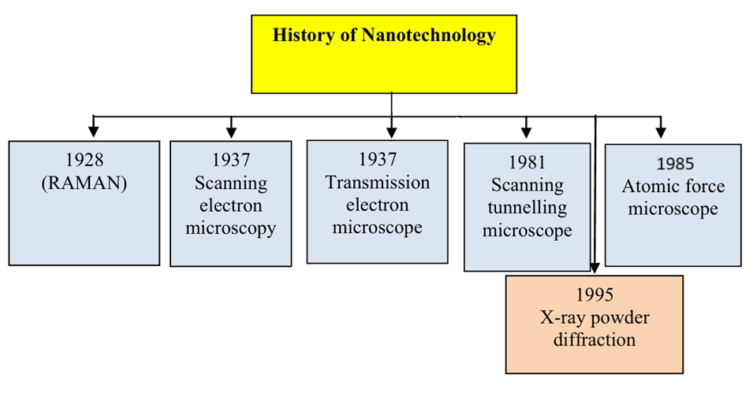
History

Slide 3
Two common methodologies
Bottom-up | Top-down
Sol-gel, vapour deposition, atomic layer deposition | Chemical etching, sputtering, mechanical/optical thermal process
Start-ups, labs | Industry, labs
Very flexible and low-cost | Controllable, precise
Hardly scalable (take CVD for example) | Costly!
How
Who
Benefits
Drawbacks

Slide 4
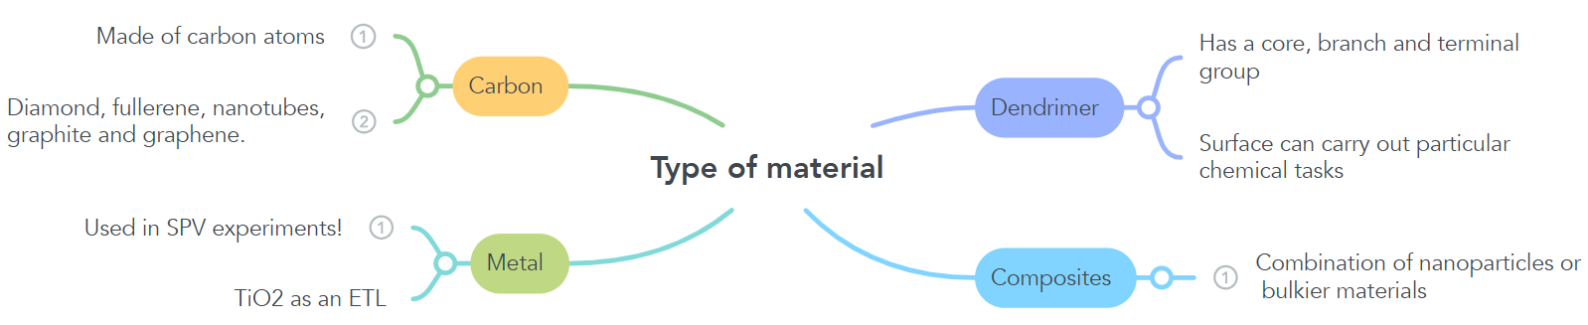
Classification based on involved materials

Slide 5
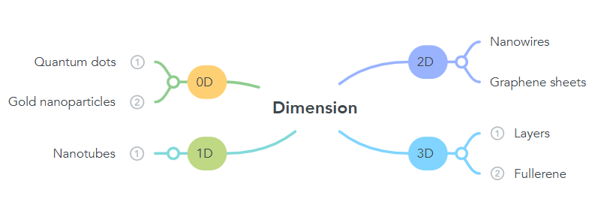
Classification based on dimension

Slide 6
4 areas of application out of the many!
Water treatment
Raman spectroscopy
Optoelectronics
Cancer treatment

Slide 7
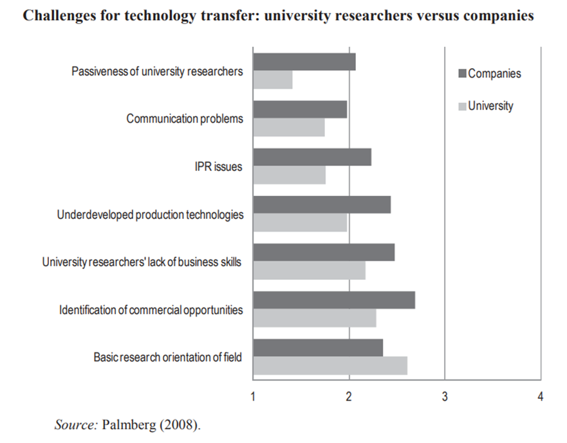
Research in Finland (1/3)

Slide 8
2/3
Thoughts of executives 2003/05/09
US
lack of infrastructure equipment;
fragmented markets;
few early adopters;
High initial investment costs;
Competent academic entrepreneurs;
Poor process scalability;
EHS concerns;
Germany (mostly startups)
Costs and funding;
Lack of skilled personel;
Partners;
Market potential;
Australia
Finland
Lack of customer demand for nanotech products;
Lack of skilled personel;
Scarce commercial applications;
Hard times in achieving reliable mass production;
Shortage of funding;

Slide 9
Maine and Garnsey (2006) 3/3
Topic: nanotechnology value chains based on company interviews
Goal: identify challenges of new ventures (start-ups)
Result:
“replication of laboratory attributes in prototypes and production processes is very complex, demanding and expensive”

Slide 10

Thank you for the attention!
pelenkin@uni-sofia.bg

