Slide 1
Machine Learning
Examples you know ?

Slide 2
Machine Learning
Examples you know ? the ‘woaw effect’ of daily life
ChatGPT and other conversational agents
Image generators (image to text, text to image, etc)
Google beats the world-champion of Go (and starcraft 2 ?)
Picture classification (10, 100, 1000 categories)
DeepL (natural langage translation)
Health: lots of talking, not lots of action (yet?)
Less glamorous:
- targeted marketing (Amazon...)
- Financial Markets
+ Many others …
Examples so old that we forget:
spam filters
Face detection in cameras, from 2000’ (this is just SVM !)
Smile detection → similar
…

Slide 3
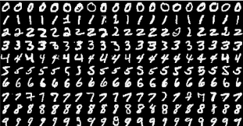
MNIST (1998) from 4% to 0.21% error

Slide 4
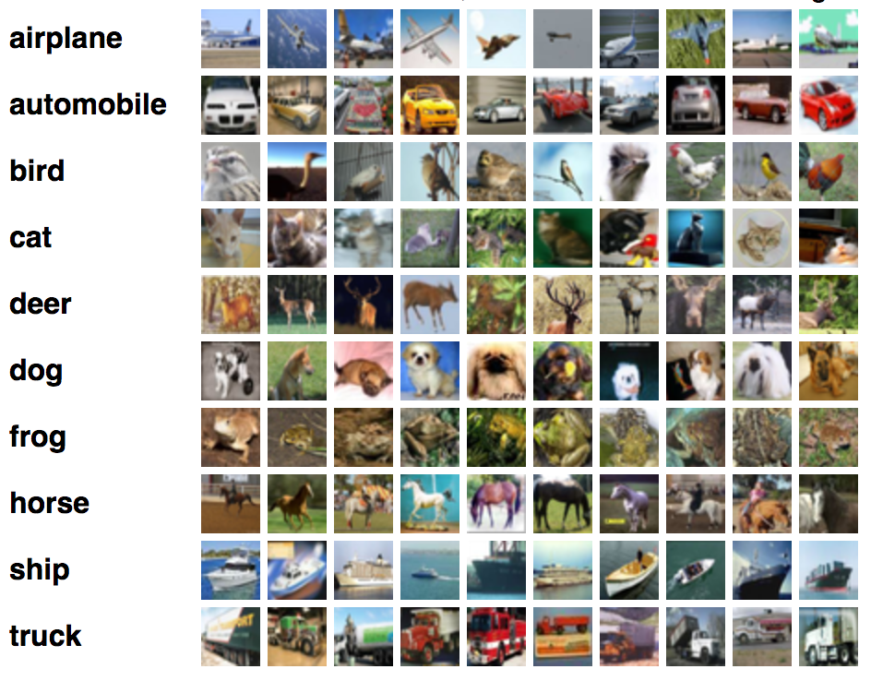
CIFAR10:
21% error in 2010, 1% in 2018

Slide 5
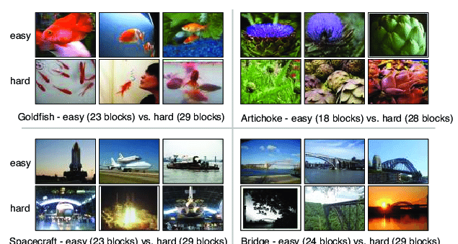
ImageNet: today: Beyond-human accuracy

Slide 6
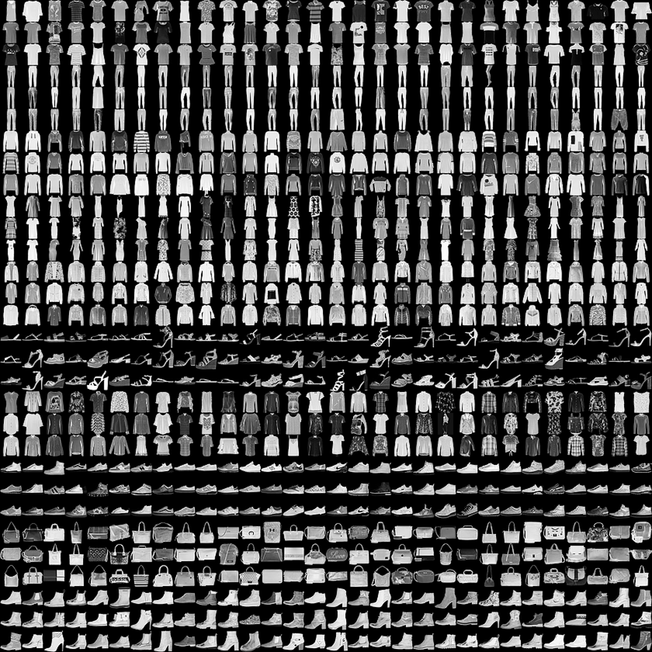
Fashion-Mnist

Slide 7
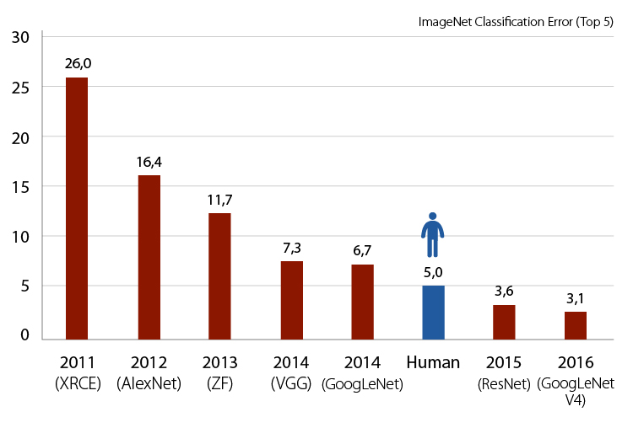
Error rate over time
Autres performances, rapportées ici: https://rodrigob.github.io/are_we_there_yet/build/classification_datasets_results.html

Slide 8
Data Sets / Benchmarks
MNIST: 1998 (based on NIST) → (this class)
between 4% and 0.21% error
CIFAR10: 21% error in 2010, 1% in 2018
CIFAR100: 55% accuracy 2012, 91.3% in 2018
ImageNet: from ~30%?(2011) to 15% (2012) … … to 5% (2015) !
Why? 2012 = development of Deep Learning
→ renewed interest in ML
Other performances, see :https://rodrigob.github.io/are_we_there_yet/build/classification_datasets_results.html

Slide 9
Why this surge of success ?
Several factors explain the recent success (since ~2012) of ML (and thus, the renewal of interest for ML):
Large sets of data available (increasingly true)
GPUs = cheap, fast intensive computations
Automatic differentiation / user-friendly software
New algorithms (CNNs taken seriously after 2012, and many others since)
In this class we talk about the algorithms (basic ones).
But the first 3 points are very important !! Each ones reinforces the other.

