Slide 1
BITRR-004-20
(Connector Check Macro)
Willem R. Leonardo
MIS
February 8, 2021

Slide 2
Table of Contents
System Information
How to access?
How to use?
Important Note
Compared List

Slide 3
1. System Information
Connector Check Macro
Is a Comparison System used for WH2 data such as MTF and CAE
This system getting all the data from MTF file then confirm the existent of each data connector or line.

Slide 4
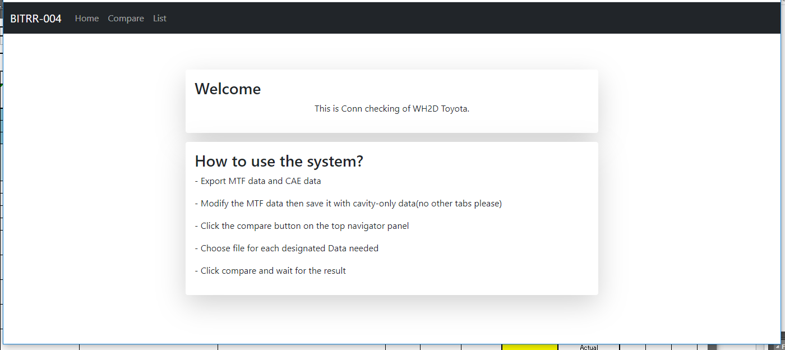
2. How to access?
To login, go to http://10.49.5.115/bitrr004/
No login required.

Slide 5
3. How to use?
Upon arrival to the Home page click the Compare Word
See next page.

Slide 6
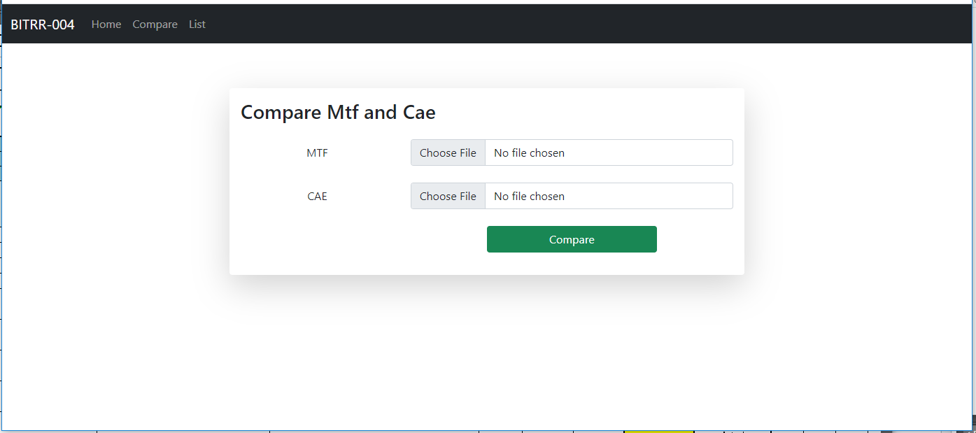
3. How to use?
Click Choose and select the Data for each fields.
MTF data for MTF and CAE data for CEA
(Please see read important note page).
Then click compare

Slide 7
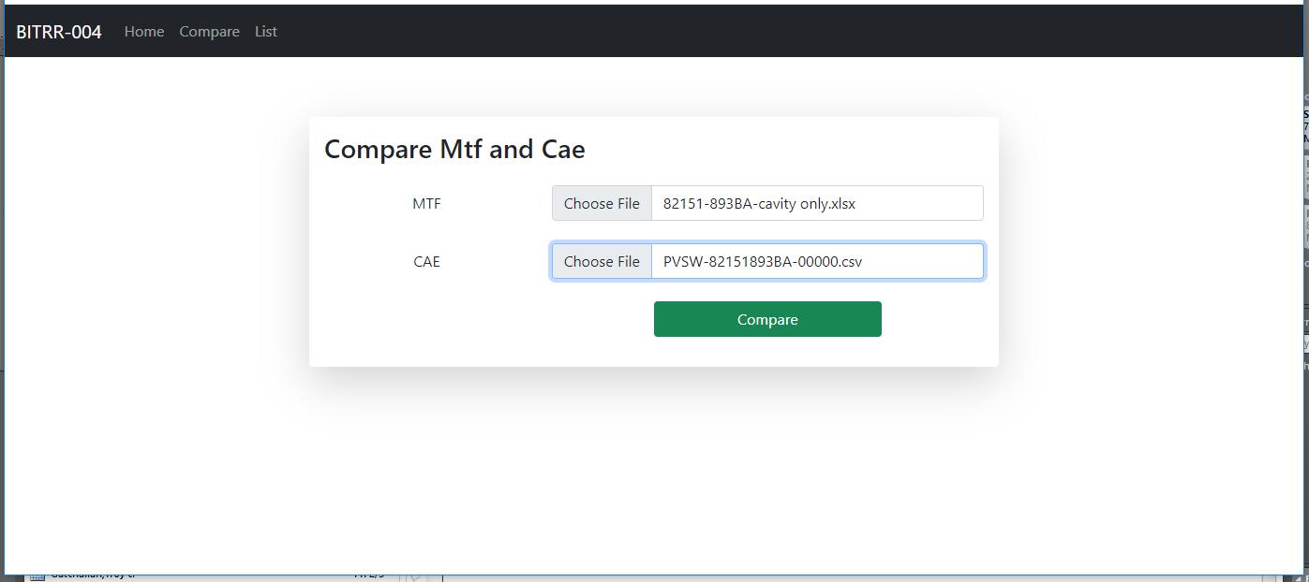
3. How to use?
Make sure to select the file to avoid issues or bug
Compare will take time about 5-10mins.

Slide 8
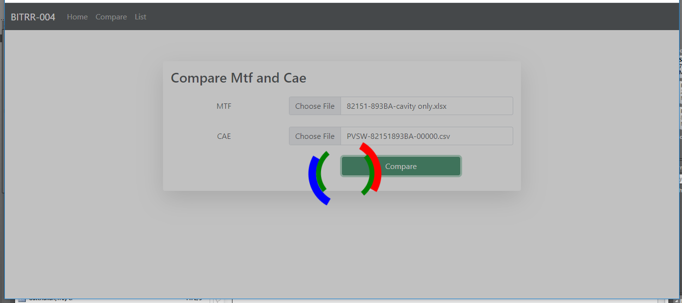
3. How to use?
Loading will appear to avoid user to click send many times.
System will also save the data information for future reference to avoid multiple saved data.

Slide 9
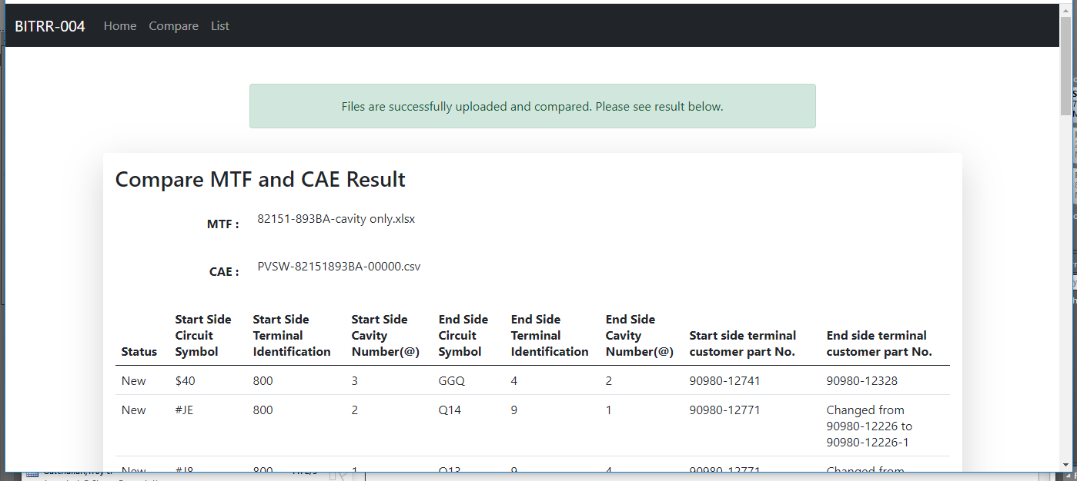
3. How to use?
After the comparison is done the system will inform you

Slide 10
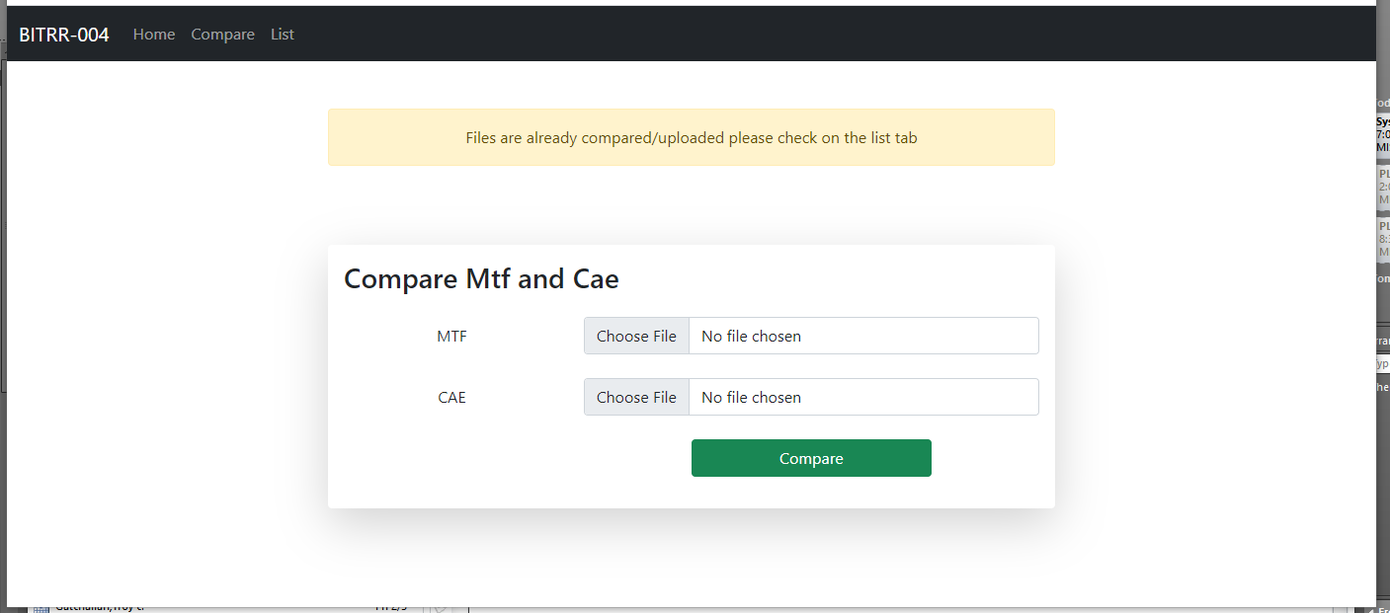
3. How to use?
If you tried to compare the same data again the system will inform you.

Slide 11
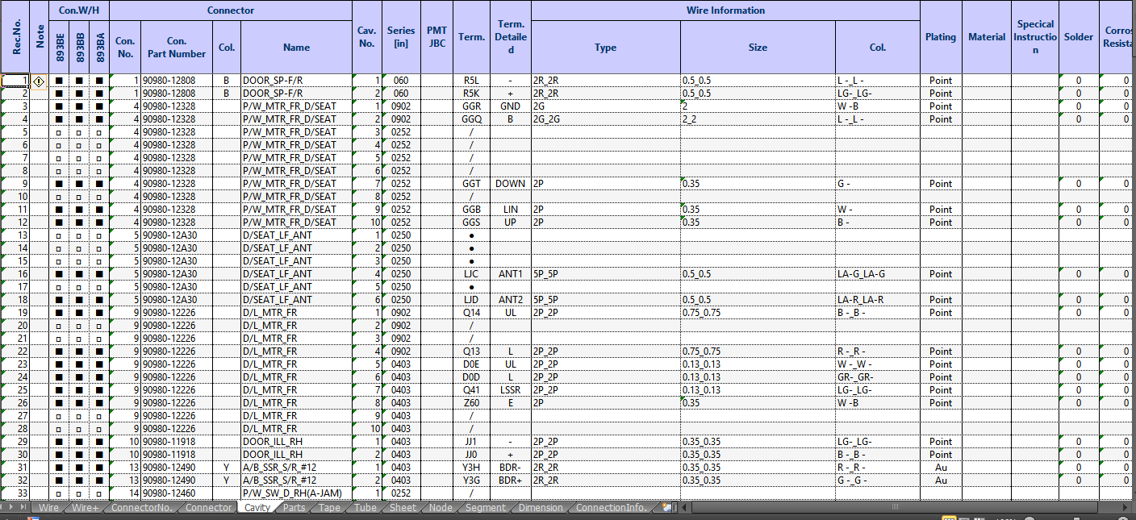
4. Important Note
For the MTF file make sure that the file data is Cavity tab only to avoid errors.

Slide 12
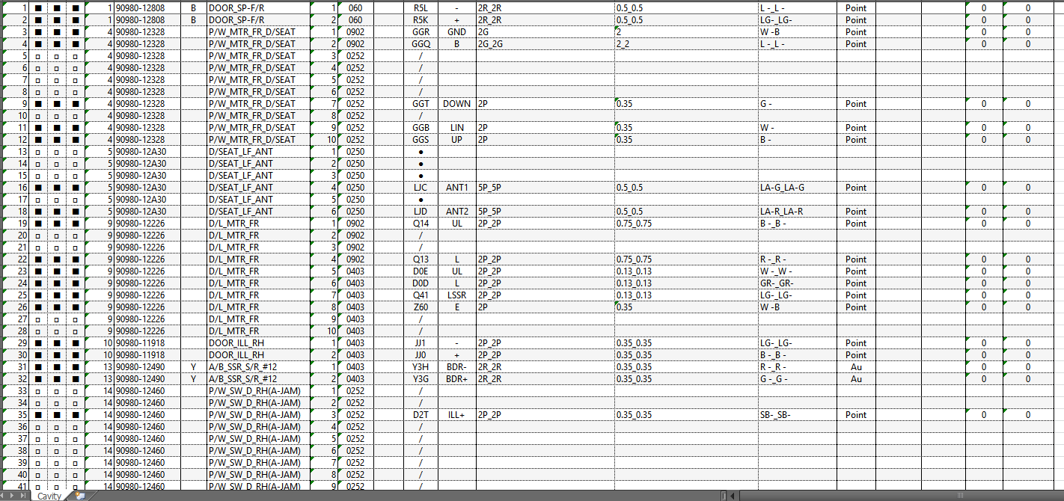
4. Important Note

Slide 13
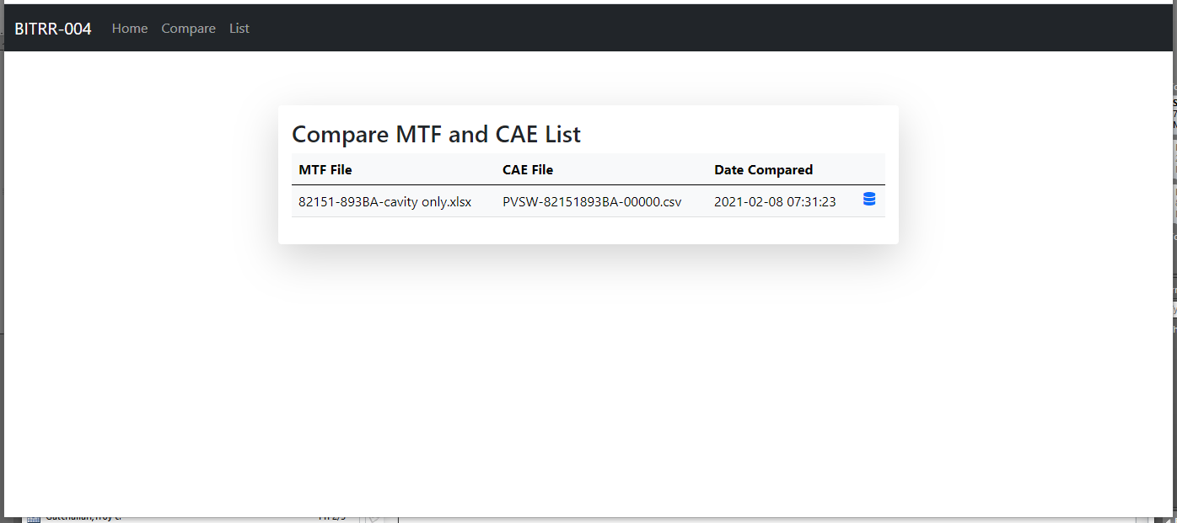
5. Compared List
This list is consist of data that previously compared from the past comparison.
Press this to view the comparison

Slide 14
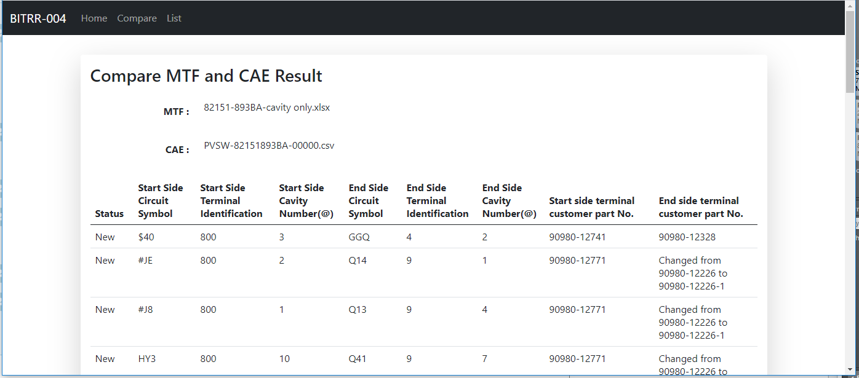
5. Compared List
View result.

Slide 15
Thank you

Slide 16

Approve | Checker | Prepared

