Slide 1
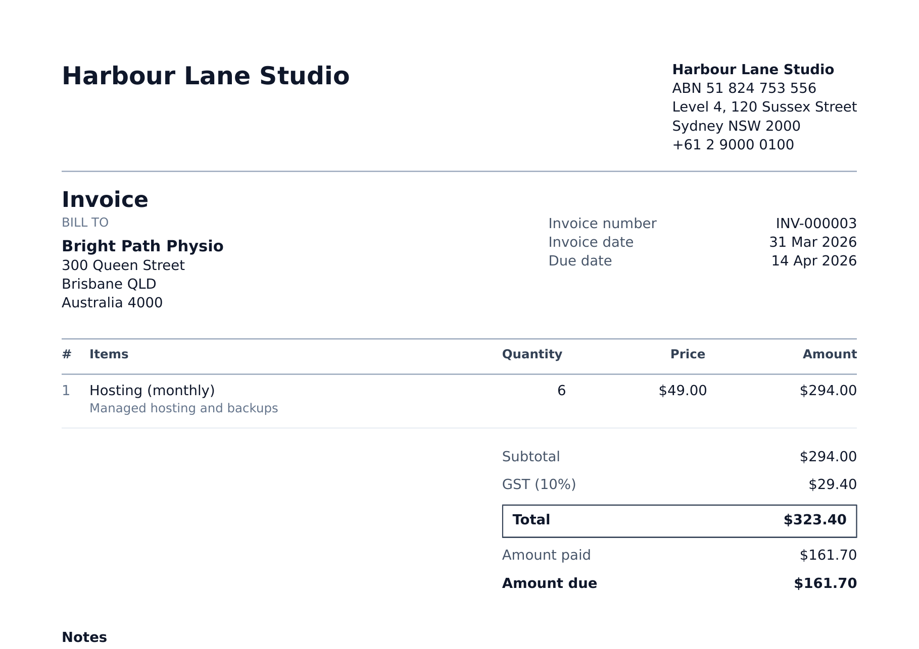

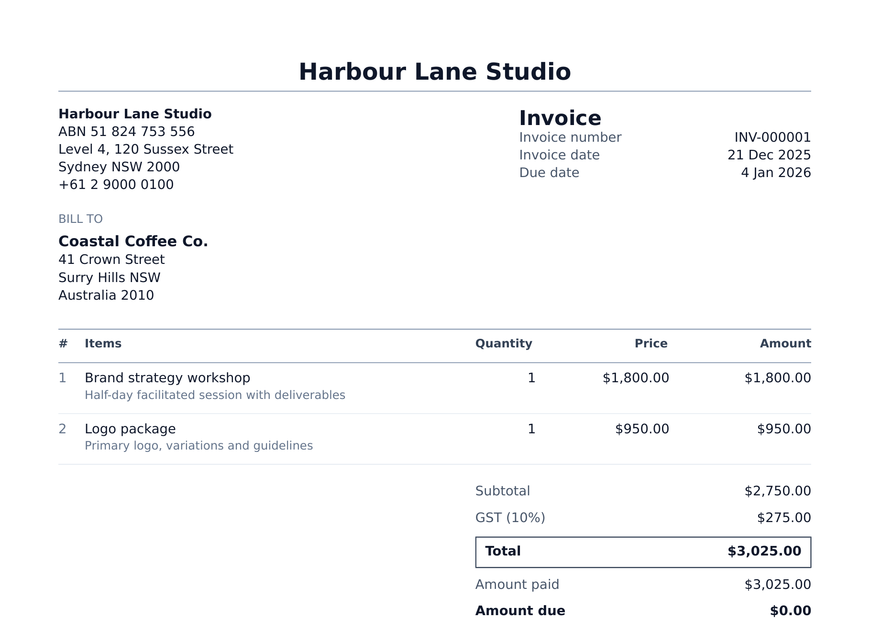
Open-source invoicing for Australian small businesses
GST and ABN ready. Self-hosted. MIT licensed.
Zenith Hackathon · October 2026
Notes:
Kydi is open-source invoicing built for Australian small businesses. GST and ABN on every invoice, and you run it yourself, so the software and the data are yours. Those are real invoices Kydi produced for a Sydney demo company. (about 15 seconds)

Slide 2
Small businesses wait weeks to get paid
THE PROBLEM
Average Australian small business, June 2026 quarter
$15,257
22.9 days to get paid
lost to late payment by the average small business last financial year
42%
of new Small Business Ombudsman cases are payment disputes
26% in 2020–21
42% in 2023–24
Sources: Xero Small Business Insights, June 2026 quarter (Aug 2026); Xero research, March 2026. Australian Small Business and Family Enterprise Ombudsman, submission to Treasury, August 2024.
Notes:
Writing an invoice is easy. Getting paid is not. Xero's data says the average Australian small business waits almost 23 days to be paid, and six of those days are after the due date. That costs the average business around fifteen thousand dollars a year, and payment disputes are now 42 percent of new cases at the Small Business Ombudsman, up from 26. (about 30 seconds)

Slide 3
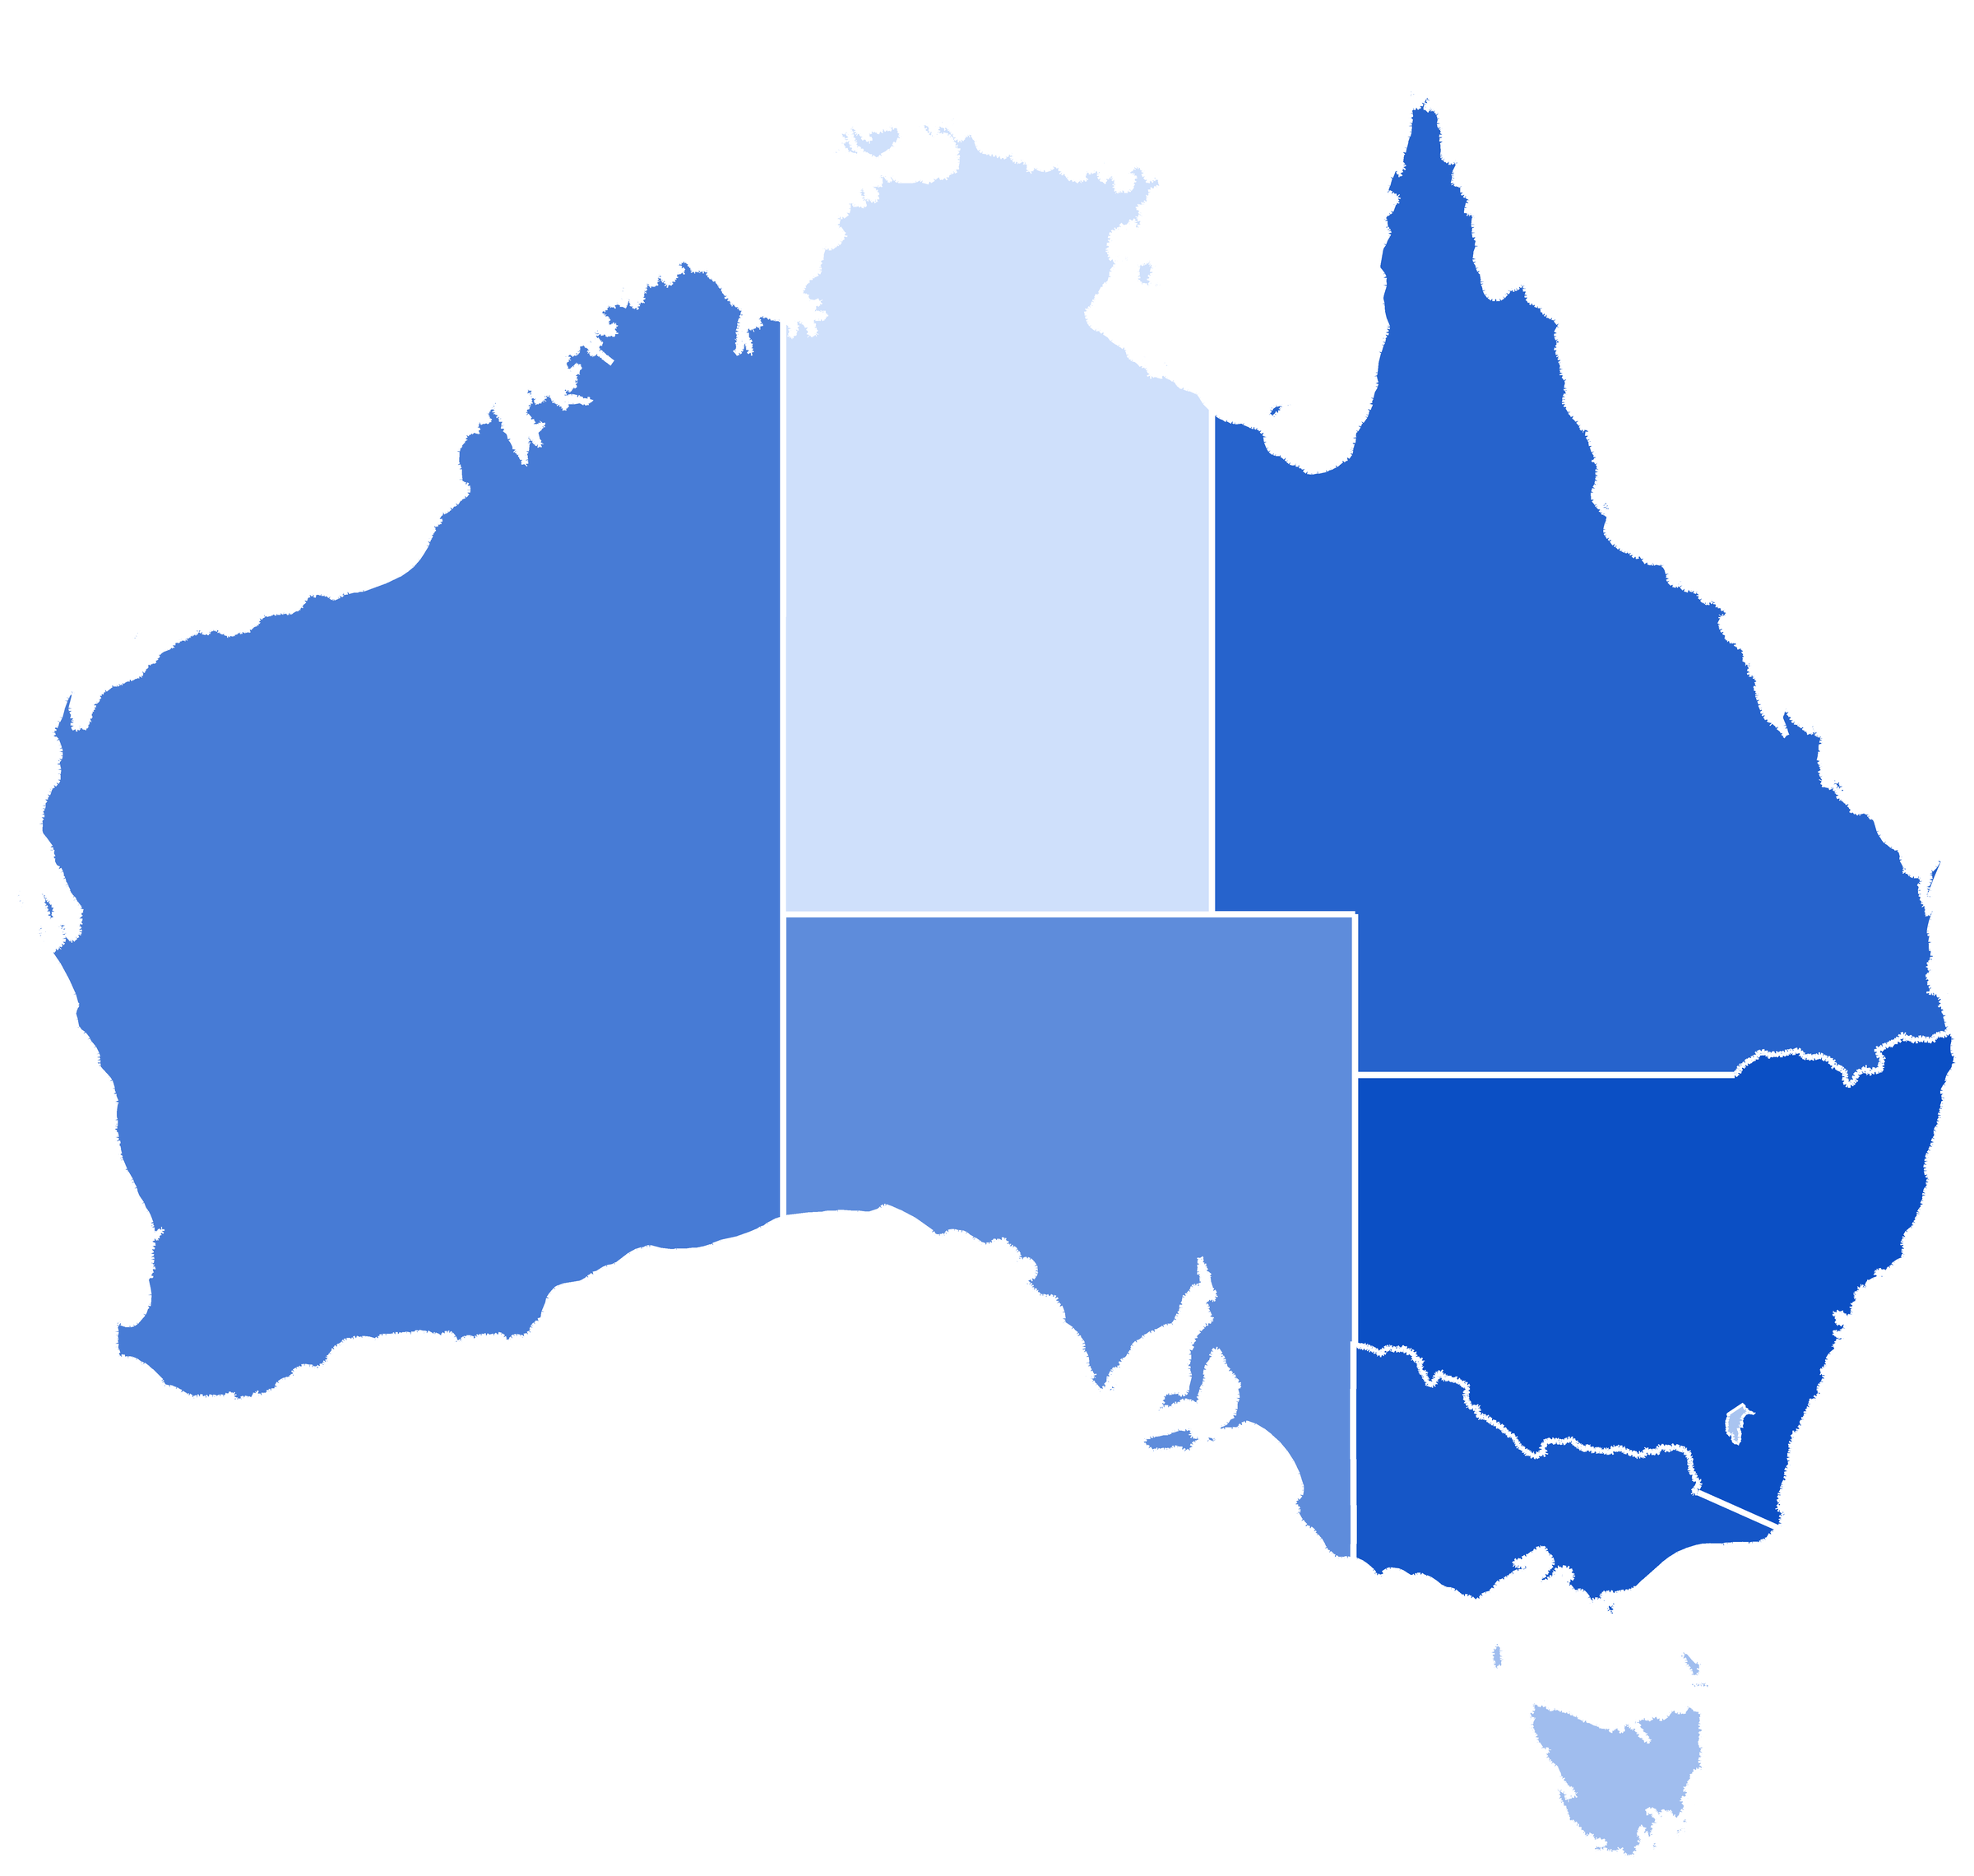
2.8 million Australian businesses send invoices
THE MARKET
2.81M
Actively trading businesses by state and territory
actively trading businesses, June 2026
65%
NT
17K
QLD
543K
WA
279K
have no employees: 1.82 million owner-operators
SA
174K
NSW
943K
1.1M
ACT 38K
independent contractors, 7.6% of everyone employed
VIC 774K
TAS 45K
Sources: ABS, Counts of Australian Businesses, June 2026 (released Aug 2026). ABS, Working Arrangements, August 2025.
Notes:
The market is large and mostly tiny businesses. 2.8 million businesses are actively trading, nearly two thirds have no employees, and there are 1.1 million independent contractors. Every one of them issues tax invoices, and most can't justify a full accounting suite to do it. (about 25 seconds)

Slide 4
Incumbent software keeps getting dearer
THE ALTERNATIVES
KYDI
$0
MIT licence, your own server, unlimited invoices, users and companies
Xero Comprehensive, July 2026
$100 → $107 a month
The third Xero price rise in recent years
Sources: vendor pricing pages, Oct 2026, AUD before promotions; MYOB Lite billed $315 a year. Xero Ignite/Grow and QuickBooks via Rounded, 2026.
Notes:
Today the choice is to rent. Xero, MYOB, QuickBooks and FreshBooks start around 25 to 40 dollars a month and climb to 60 to 80 once you grow, and Xero has just raised prices for the third time in recent years. Kydi costs nothing to run: MIT-licensed, on your own server, with no limits on invoices, users or companies. (about 30 seconds)

Slide 5
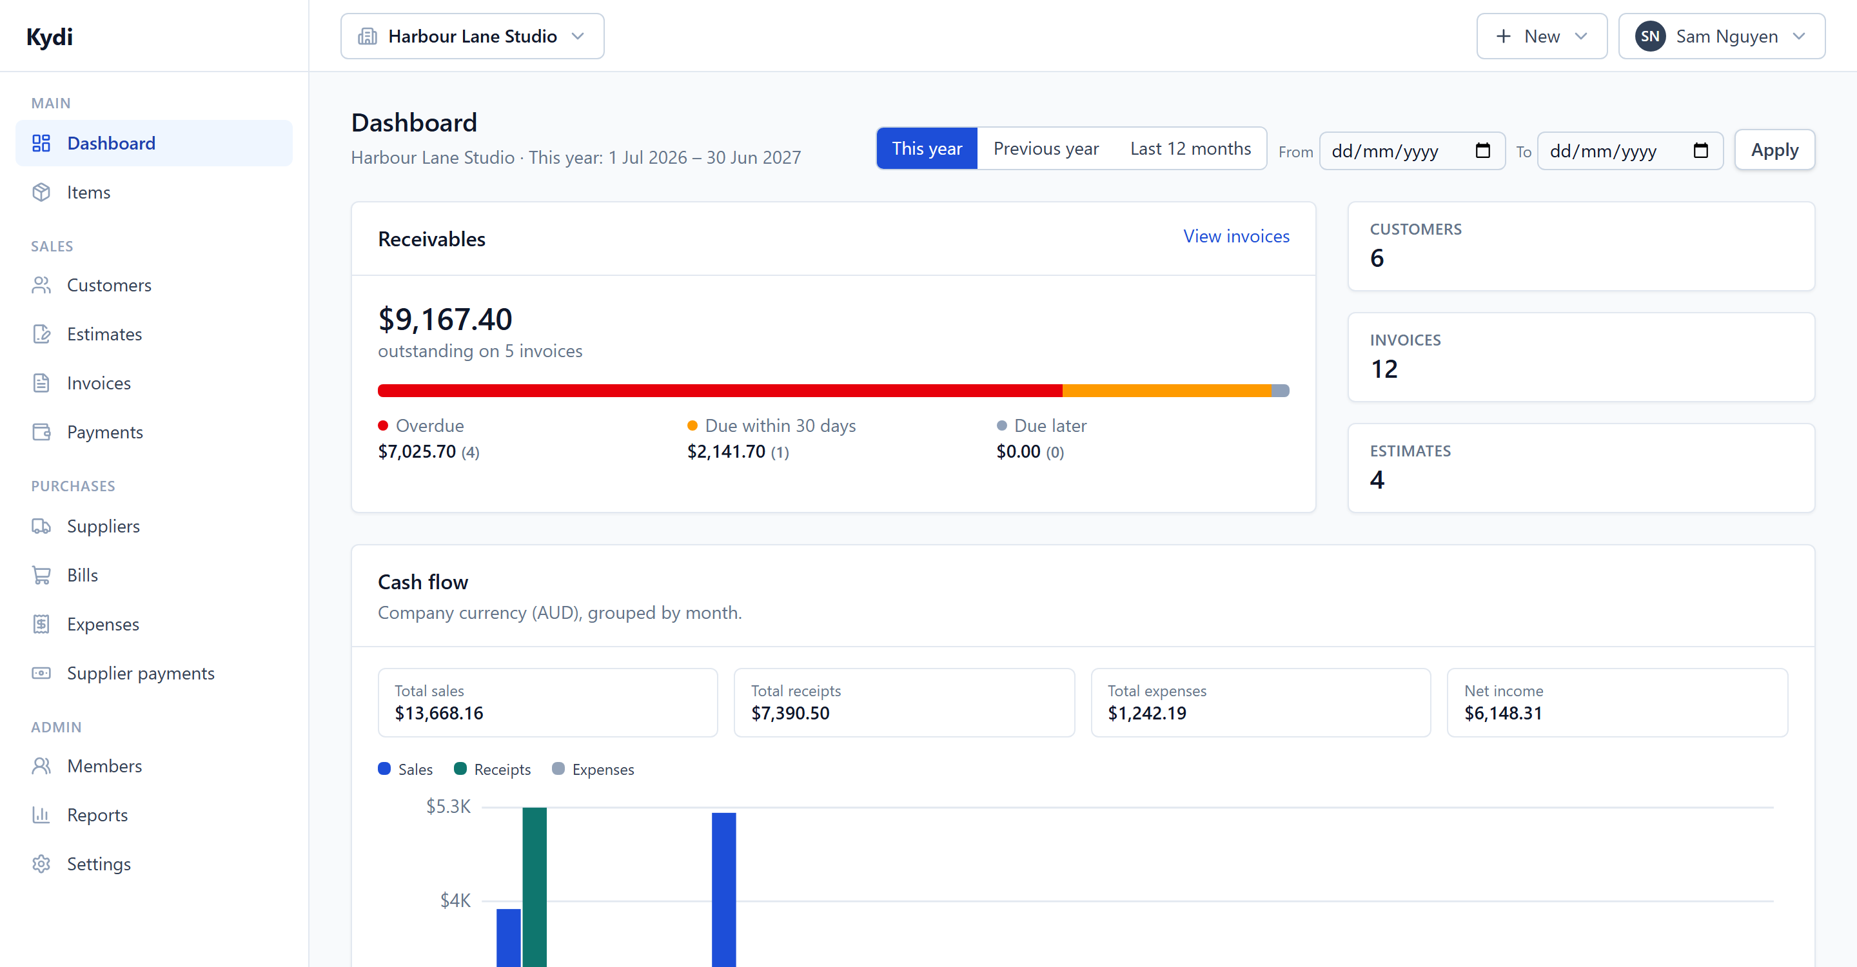
One app for the whole billing loop
THE PRODUCT
1
Quote
Customers accept online
2
Invoice
One click, or on a schedule
3
Deliver
Emailed, with view tracking
4
Get paid
Overdue invoices flagged
5
Report
Cash flow, P&L, GST summary
Kydi dashboard for a Sydney demo company: receivables split into overdue, due soon and later, with cash flow by month.
Notes:
Kydi runs the whole loop. A customer accepts an estimate in their portal, it becomes an invoice in one click or a recurring one that sends itself, payments are matched against invoices and anything overdue is flagged. The dashboard shows what you're owed and how late it is. Suppliers, bills and expenses sit alongside, so profit and loss is real. (about 30 seconds)

Slide 6
Built for how Australian businesses invoice
MADE FOR AUSTRALIA
1
ABN on every document
Invoices, estimates and receipts carry your ABN; customer ABNs for sales of $1,000 or more
1
3
2
GST done properly
10% GST on sales and credits on purchases, with tax-inclusive or exclusive prices
3
Australian conventions
AUD by default, Australian dates and a July to June financial year
2
Also included
NZD and other currencies with live exchange rates
Tax summary report to prepare your BAS
Invoice generated by Kydi for a demo company; the ABN shown is fictitious. Tax invoice requirements: Australian Taxation Office.
Notes:
It's built for how Australians invoice. Your ABN prints on every document, GST is handled at ten percent on sales with credits on purchases, prices can be GST-inclusive, and it defaults to Australian dollars, Australian dates and a July to June financial year. Trans-Tasman customers get NZD with live rates, and the tax summary report gives you what you need for your BAS. (about 30 seconds)

Slide 7
Built in two days, ready to run today
WHERE WE ARE
25,000
145
44
88
lines of strict TypeScript
automated tests
data models
screens
Ships today
Deploys in one command
Invoices, estimates, credits
Recurring invoices
Payments and receipts
Suppliers, bills, expenses
Customer portal
Six PDF templates
Teams, roles, companies
REST API
Database, storage and secrets are created for each install on Zenith Hosting, or run it anywhere with Docker.
Next.js 15
TypeScript
PostgreSQL 16
Docker
Figures from the Kydi repository on 17 October 2026; first commit 16 October 2026.
Notes:
We built this during the hackathon: twenty-five thousand lines of strict TypeScript, 145 automated tests, 44 data models and 88 screens. Everything you've seen works today, and one command deploys it on Zenith with its own database and secrets. (about 20 seconds)

Slide 8
E-invoicing and price rises open the door
WHY NOW
5 days
400,000+
3 in 10
Commonwealth agencies pay Peppol e-invoices within 5 days, against 20 for other invoices
Australian businesses already reachable on the Peppol e-invoicing network
invoices from large businesses are not paid within 30 days
What Kydi adds next
NEXT
THEN
LATER
ATO tax-invoice heading and checks on every invoice
Send and receive Peppol e-invoices through an access point
One-click hosting so non-technical owners can run Kydi
Sources: Department of Finance, RMG 417 Supplier Pay On-Time or Pay Interest Policy. ATO eInvoicing, 2026. Payment Times Reporting Regulator, Cycle 10 (Jul–Dec 2025): 69.8% paid within 30 days.
Notes:
Why now? Government agencies pay Peppol e-invoices in five days instead of twenty, 400,000 Australian businesses are already on the network, and three in ten invoices from big businesses still aren't paid within a month. Small suppliers need e-invoicing, and the incumbents keep raising prices. Next we add ATO tax-invoice checks, then Peppol sending and receiving, then one-click hosting so any sole trader can run their own Kydi. (about 35 seconds)

Slide 9
Invoicing Australian businesses own
github.com/petmav/kydi
MIT licence · self-host with Docker · deploy on Zenith
Zenith Hackathon · October 2026
Notes:
Kydi: invoicing Australian businesses own. It's on GitHub under MIT and deploys on Zenith today. Thank you. (about 10 seconds)

