Slide 1
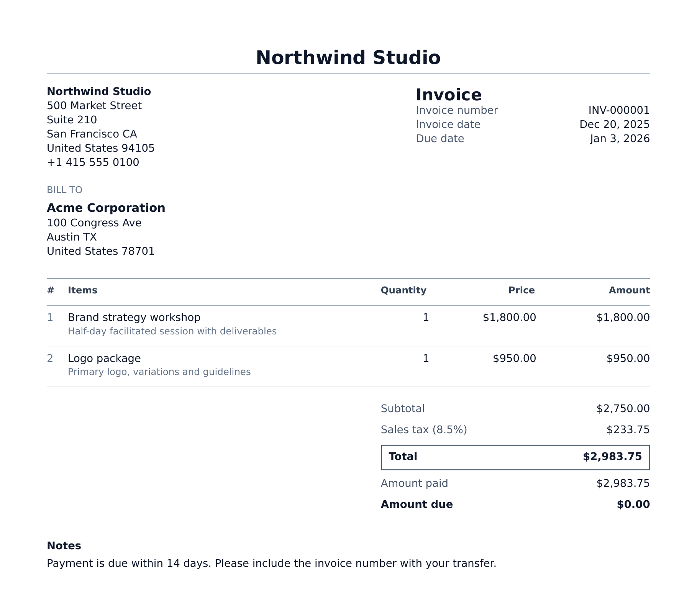
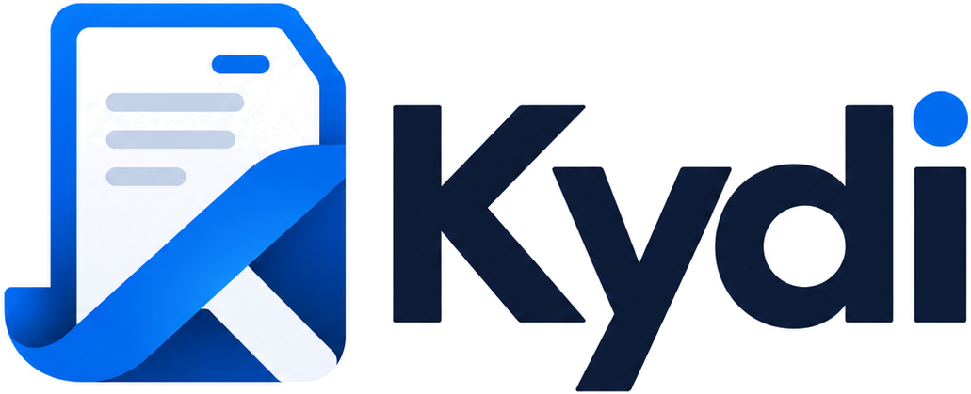
Open-source invoicing for freelancers and small businesses
Self-hosted, MIT-licensed, one-command deploy on Zenith.
Invoice PDF generated by Kydi
Zenith Hackathon · October 2026
Notes:
Kydi is open-source invoicing for freelancers and small businesses. You run it on your own server or deploy it in one command on Zenith, and you keep your data. That is a real invoice Kydi produced, from a demo company we use in testing. (about 15 seconds)

Slide 2
Getting paid is the hardest part of the job
56%
$17,500
47%
of US small businesses are owed money on unpaid invoices
owed, on average, to each of those businesses
have invoices more than 30 days overdue
United Kingdom
Government-commissioned estimate
£11bn a year
14,000
lost to late payment across the economy
businesses close each year because of it
Sources: Intuit QuickBooks, Small Business Late Payments Report 2025 (US survey, n = 2,487). London Economics for the UK Government, July 2025.
Notes:
Writing an invoice is easy. Getting it paid is not. Intuit's 2025 survey found that 56 percent of US small businesses are owed money on unpaid invoices, about seventeen and a half thousand dollars each, and nearly half have invoices more than a month overdue. In the UK the government puts the cost of late payment at eleven billion pounds a year and around fourteen thousand business closures. The tools people use should make chasing and reconciling payments routine. (about 35 seconds)

Slide 3
Tens of millions of people need to send invoices
72.9M
independent workers in the US in 2025
36.2M
small businesses in the US, 99.9% of all firms
Invoicing software is a $4.8bn–$15.9bn market growing 7–17% a year. Analyst estimates vary with how the market is scoped.
Sources: MBO Partners, State of Independence 2025. SBA Office of Advocacy, Small Business FAQ 2026. Market size: Straits Research (2025), Market Research Future (2025), Stratistics MRC (2025).
Notes:
Who needs this? In the US alone there are almost 73 million independent workers, 28 million of them full-time, and 36 million small businesses. Every one of them sends invoices. Analysts size invoicing software at somewhere between five and sixteen billion dollars, growing seven to seventeen percent a year. The estimates disagree on scope, but they agree on direction. (about 25 seconds)

Slide 4
Incumbents charge rent on your own books
Product | Licence | Your data lives
QuickBooks Online | Proprietary | Intuit's cloud
Xero | Proprietary | Xero's cloud
FreshBooks | Proprietary | FreshBooks' cloud
Invoice Ninja | Elastic License 2.0 | Yours or theirs
Kydi | MIT | Your server
Wave and Invoice Ninja also offer limited free tiers. Kydi has no tiers: every feature, unlimited invoices.
Sources: vendor pricing pages (US, before promotional discounts), retrieved October 2026: QuickBooks Simple Start, Xero Early, FreshBooks Lite, Wave Pro, Invoice Ninja Pro.
Notes:
Today the default choice is to rent. QuickBooks starts at 38 dollars a month, Xero at 27, FreshBooks at 23, and prices keep climbing while your records sit in someone else's cloud. Open-source options exist, but the best known uses a licence that stops others from hosting it as a service. Kydi is MIT: free to run, fork, host and resell, with no feature tiers. (about 30 seconds)

Slide 5
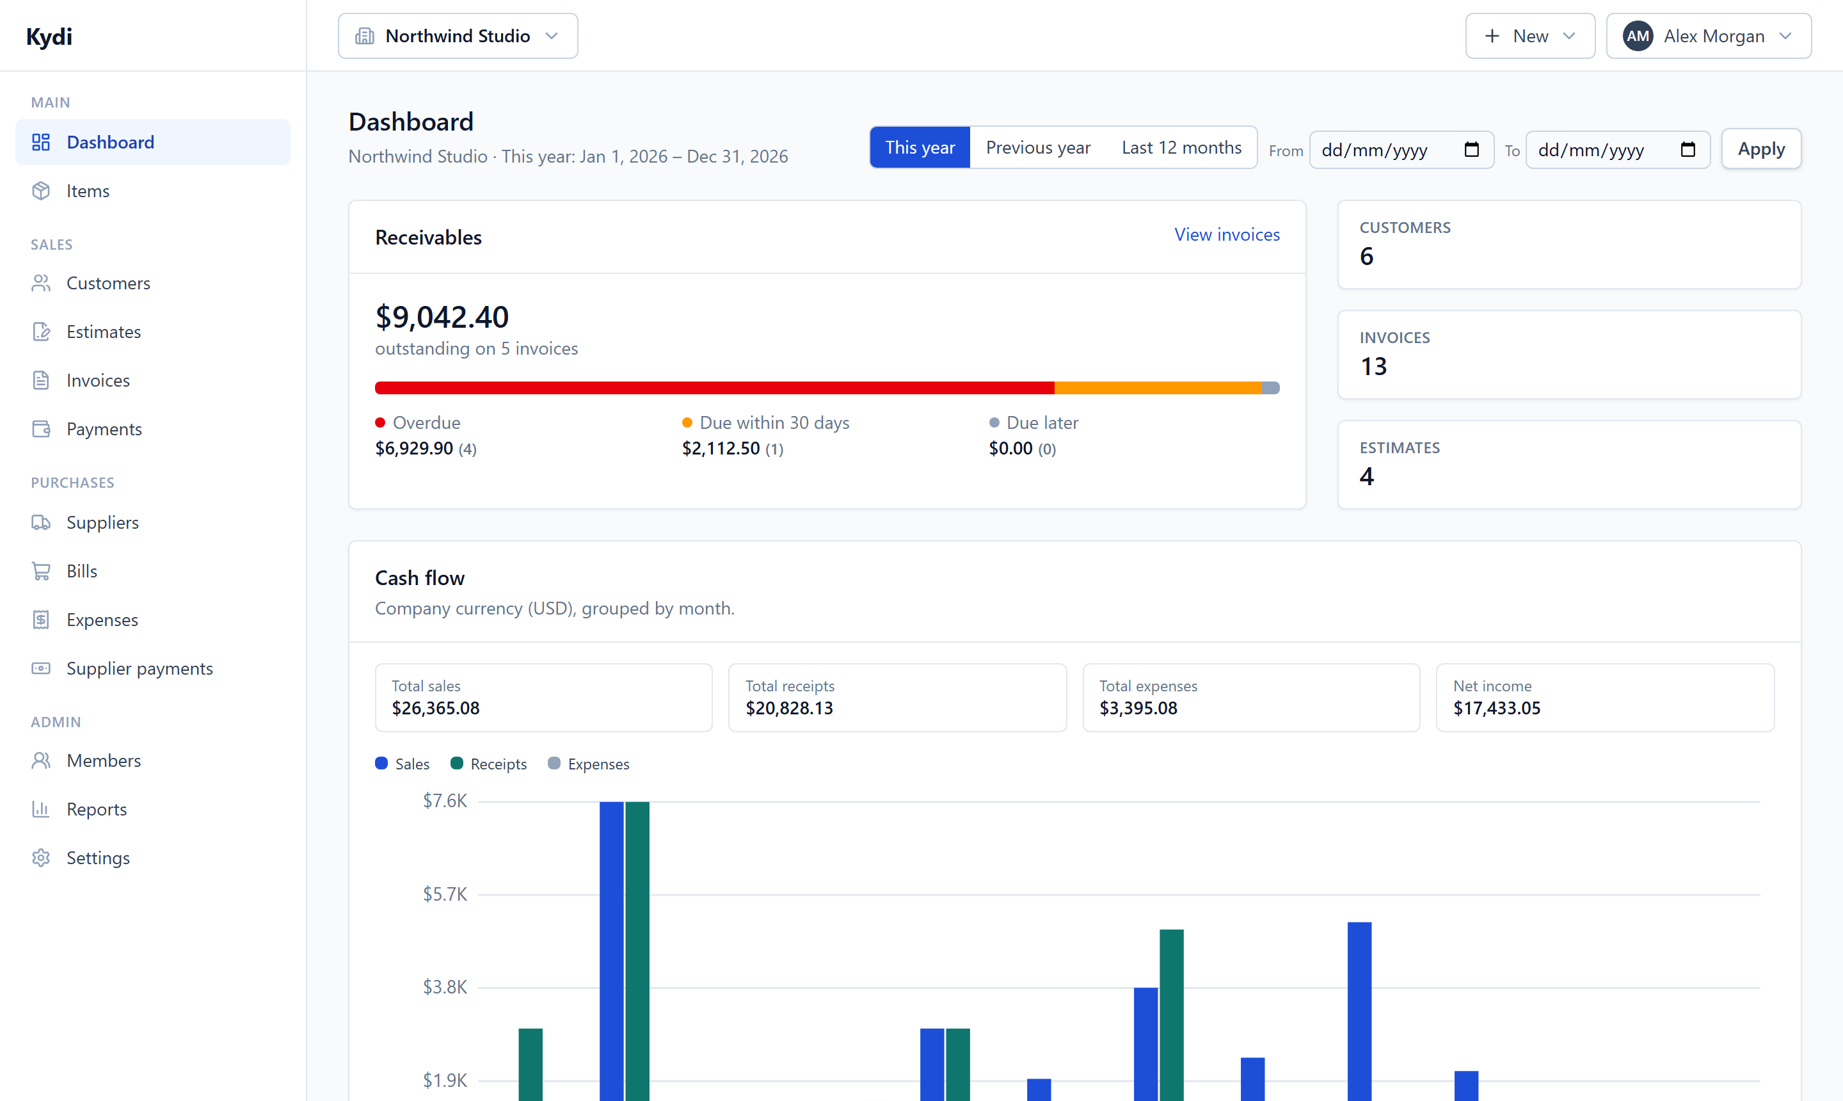
One app for the whole billing loop
01
Quote
Estimates that customers accept or reject in their own portal
02
Invoice
Convert in one click, or put it on a recurring schedule
03
Deliver
Email with the PDF attached and see when it was viewed
04
Get paid
Allocate payments across invoices; overdue is flagged for you
05
Report
Cash flow, profit and loss, tax summary, bills and suppliers
Kydi dashboard, demo company. Receivables split by overdue, due soon and later; cash flow by month.
Notes:
Kydi covers the whole loop. Send an estimate, the customer accepts it in their portal, it becomes an invoice in one click or a recurring one that sends itself. Payments are allocated against invoices, overdue ones are flagged automatically, and the dashboard shows exactly what is owed and how late. Purchasing sits alongside: suppliers, bills and expenses, so profit and loss is real. (about 35 seconds)

Slide 6
Built in two days, ready to run today
25,000
145
Ships today
Invoices, estimates, credits
Recurring invoices
Payments and receipts
Expenses and receipts
Suppliers and bills
Customer portal
Six PDF templates
Multi-currency, live rates
Teams, roles, many companies
REST API
lines of strict TypeScript
automated tests
44
88
data models
screens
Next.js 15 · PostgreSQL 16 · Docker. One command deploys it on Zenith Hosting, with a database, storage and secrets generated per install.
Figures from the Kydi repository on 17 October 2026: first commit 16 October 2026.
Notes:
We built this over the hackathon: twenty-five thousand lines of strict TypeScript, 145 automated tests, 44 data models and 88 screens. It is not a demo shell. Invoices, recurring billing, payments, purchasing, a customer portal, six PDF templates, multi-currency and a REST API all work today, and one command deploys it on Zenith with its own database and generated secrets. (about 30 seconds)

Slide 7
Regulation is making structured invoices mandatory
Jan 2025
Sep 2026
Jan 2027
Sep 2027
Jan 2028
Jul 2030
Today
Germany: every business must accept e-invoices
France: all firms receive; large and mid-size firms issue
Germany: firms above €800K turnover must issue
France: small and micro-businesses must issue
Germany: every business must issue
EU (ViDA): e-invoices for cross-border B2B sales
What Kydi adds next
EN 16931 e-invoices
Factur-X, ZUGFeRD and UBL output from the invoices people already send
Peppol delivery
Send and receive structured invoices through an access point
One-click hosting
A listed Zenith app, so non-technical owners can run their own Kydi
Sources: EY Tax News, ViDA adopted March 2025. Germany (Growth Opportunities Act) and France timelines as summarised by VATit and eConnect, 2025–26.
Notes:
Timing matters. Germany already requires every business to accept e-invoices, France started this September, and by 2028 every German business must issue them. The EU follows for cross-border sales in 2030. A PDF attached to an email will not be enough. Our next step is standard e-invoice output, Factur-X, ZUGFeRD and UBL, then Peppol delivery, and a listed one-click Zenith app so a sole trader can run their own Kydi without touching a server. (about 35 seconds)

Slide 8
Invoicing you own
github.com/petmav/kydi
MIT licence · self-host with Docker · deploy on Zenith Hosting
Zenith Hackathon · October 2026
Notes:
Kydi: invoicing you own. The code is on GitHub under MIT, and you can deploy it on Zenith today. Thank you. (about 10 seconds)

