Slide 1
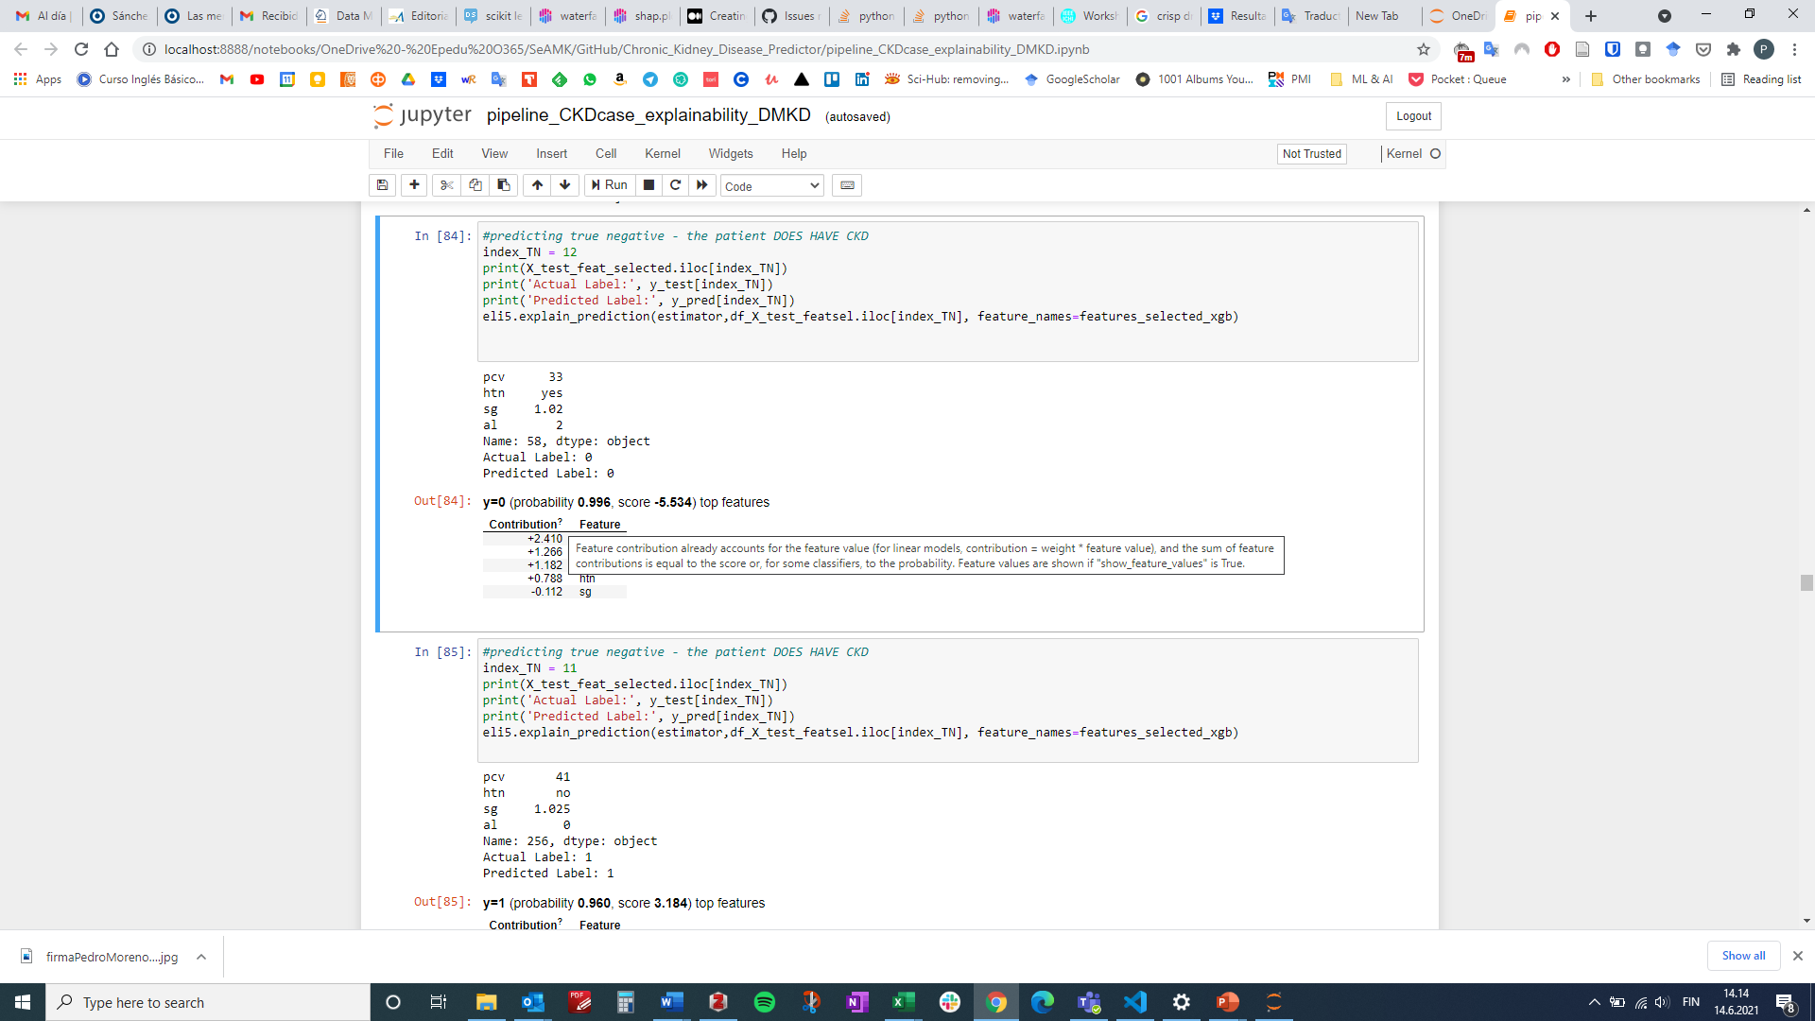

Slide 2
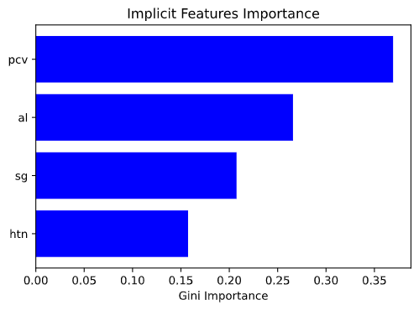
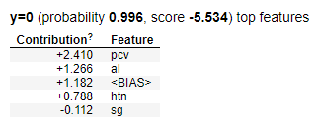
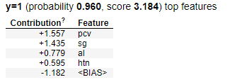
Implicit Feature importance
0.3693
0.2658
0.2075
0.1574
a)
b)

Slide 3
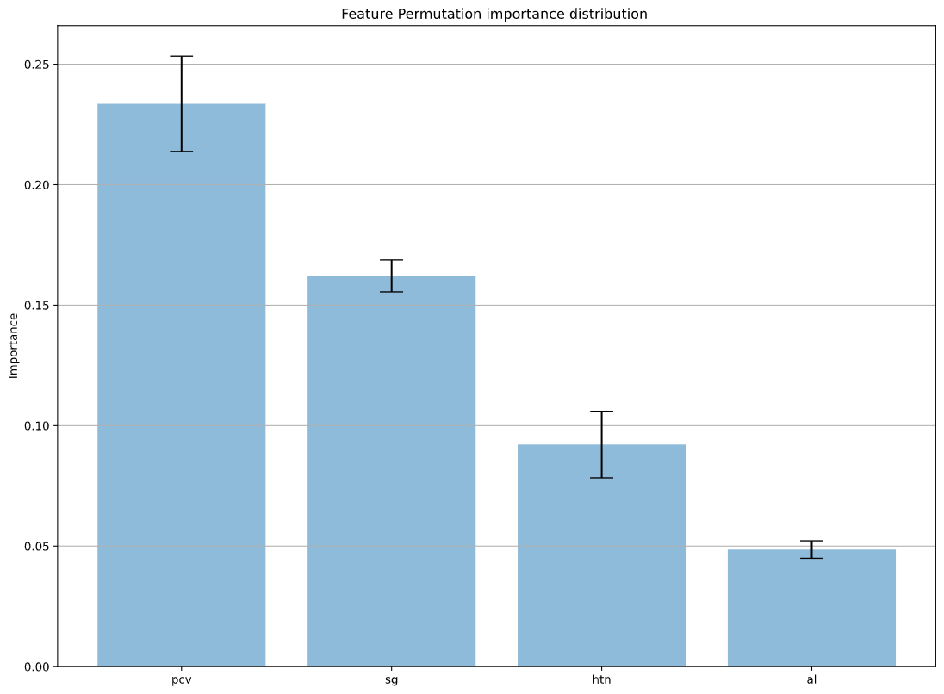
Feature Permutation Importance
feature | weight | std
pcv | 0.233571 | 0.019769
sg | 0.162143 | 0.006624
htn | 0.092143 | 0.013814
al | 0.048571 | 0.003642

Slide 4
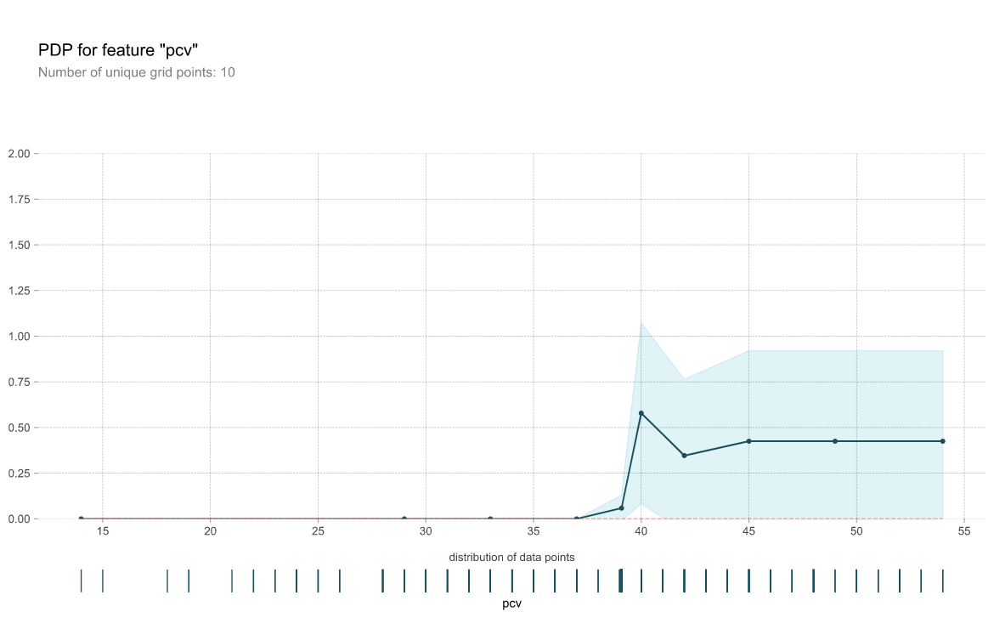
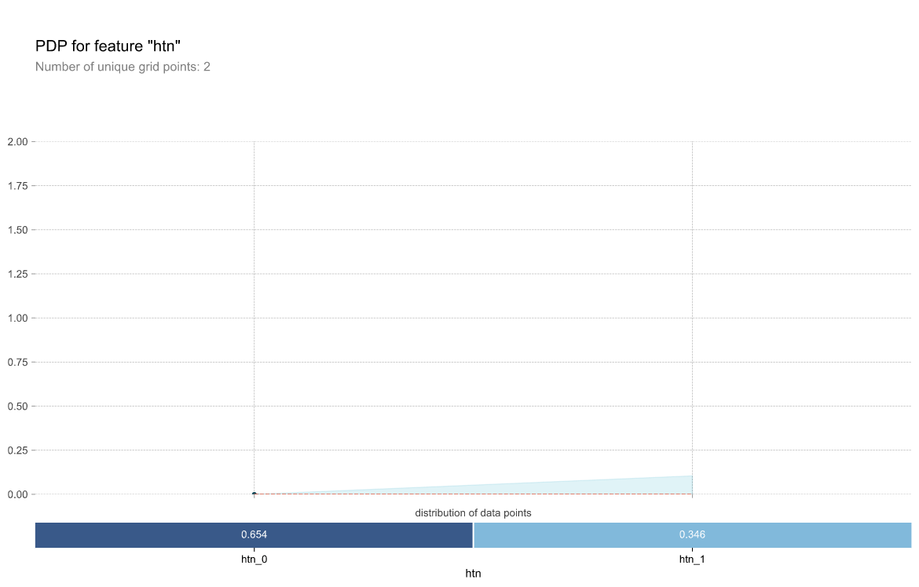
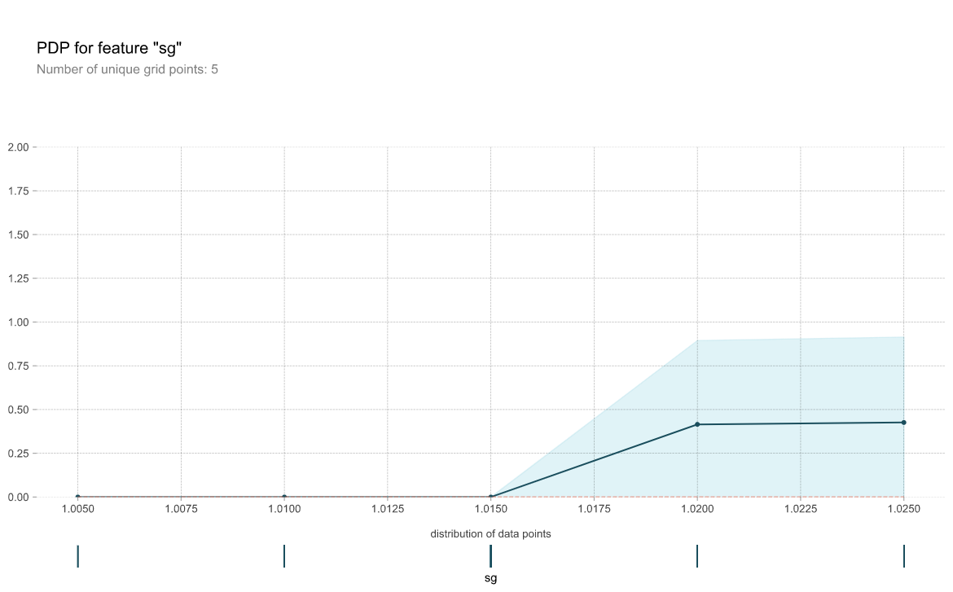
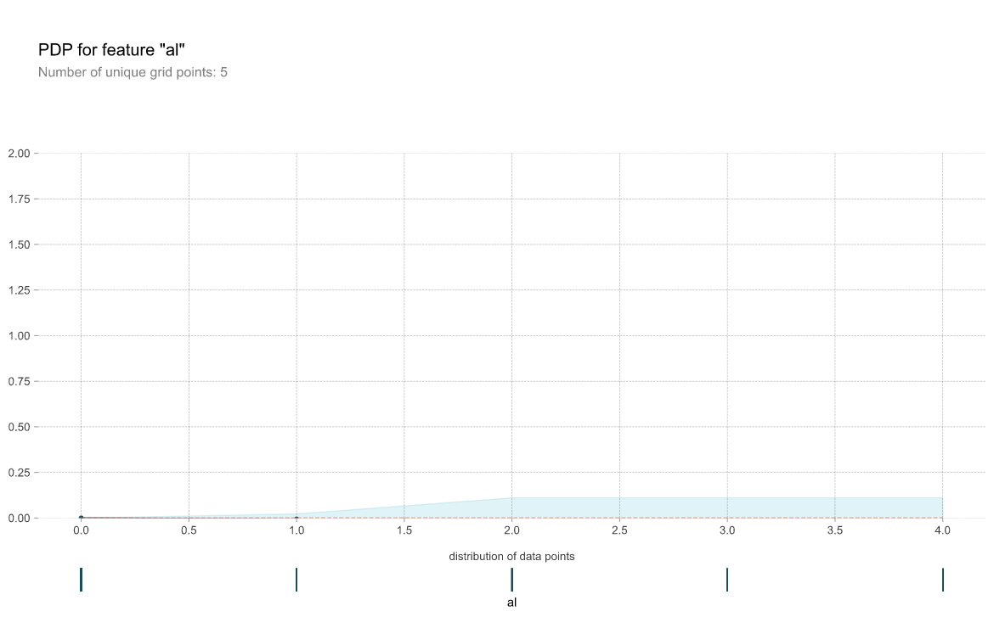
PDP

