Slide 1
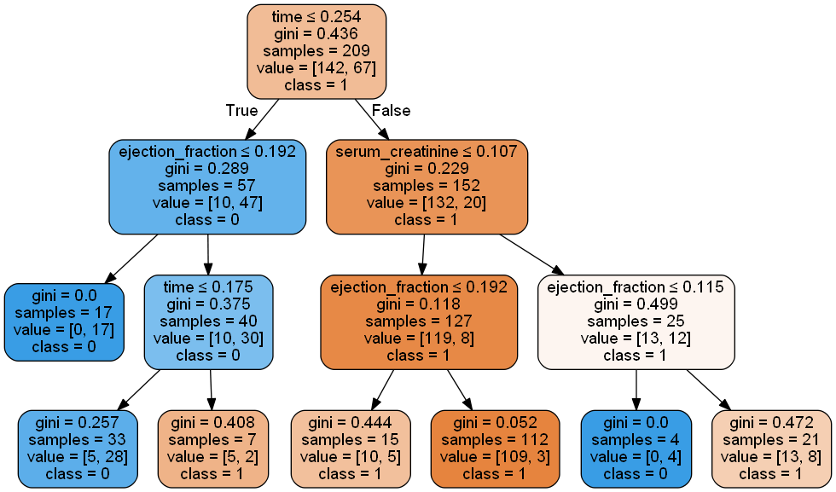
time_1: [[73.596]] ; time_2: [[51.95]] ; ef_1: [[22.475]] ; ef_2: [[27.48]] ; sc_1: [[1.4523]]
73.60
22.48
1.45
51.95
22.48
27.48

