Slide 1
Showcasing Data Science Projects
A stroll through Face Mask Detection, Named Entity Recognition and Live Chatbot Development
Presenter: Peter Ivanov

Slide 2
Introduction
Who am I?
IT guy, father, gamer, astronomer
Purpose of the presentation
Showcase few projects I worked on
Agenda
Face Mask Detector (Image Classification)
Named Entity Recognition (NLP)
Chatbot Service with LLM Retrieval Augmented Generation (Live Demo)

Slide 3
Project 1 - Face Mask Detector
Objective: Classify images into three categories:
Correct mask usage
Incorrect mask usage
No mask
Dataset:
4072 face images (Kaggle dataset)
Highly imbalanced classes
Preprocessing:
Face extraction, data augmentation and image resizing

Slide 4
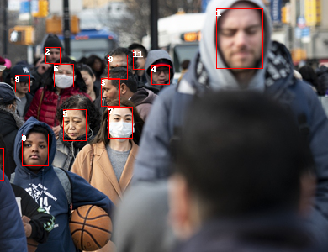
street.jpeg
Found 14 face(s) in street.jpeg.
Face 0: without mask
Face 1: without mask
Face 2: without mask
Face 3: without mask
Face 4: without mask
Face 5: without mask
Face 6: with mask
Face 7: with mask
Face 8: without mask
Face 9: with mask
Face 10: without mask
Face 11: without mask
Face 12: with mask
Face 13: with mask

Slide 5
Face Mask Detector - Model Architecture
CNN-based approach using VGG16
Modifications:
Pretrained VGG16 as feature extractor (untrainable layers)
Added max pooling, flatten, dense, and softmax layers
Training Details:
Optimizer: Adam (LR: 0.001)
Loss function: Categorical Crossentropy
10 epochs, batch size of 8

Slide 6
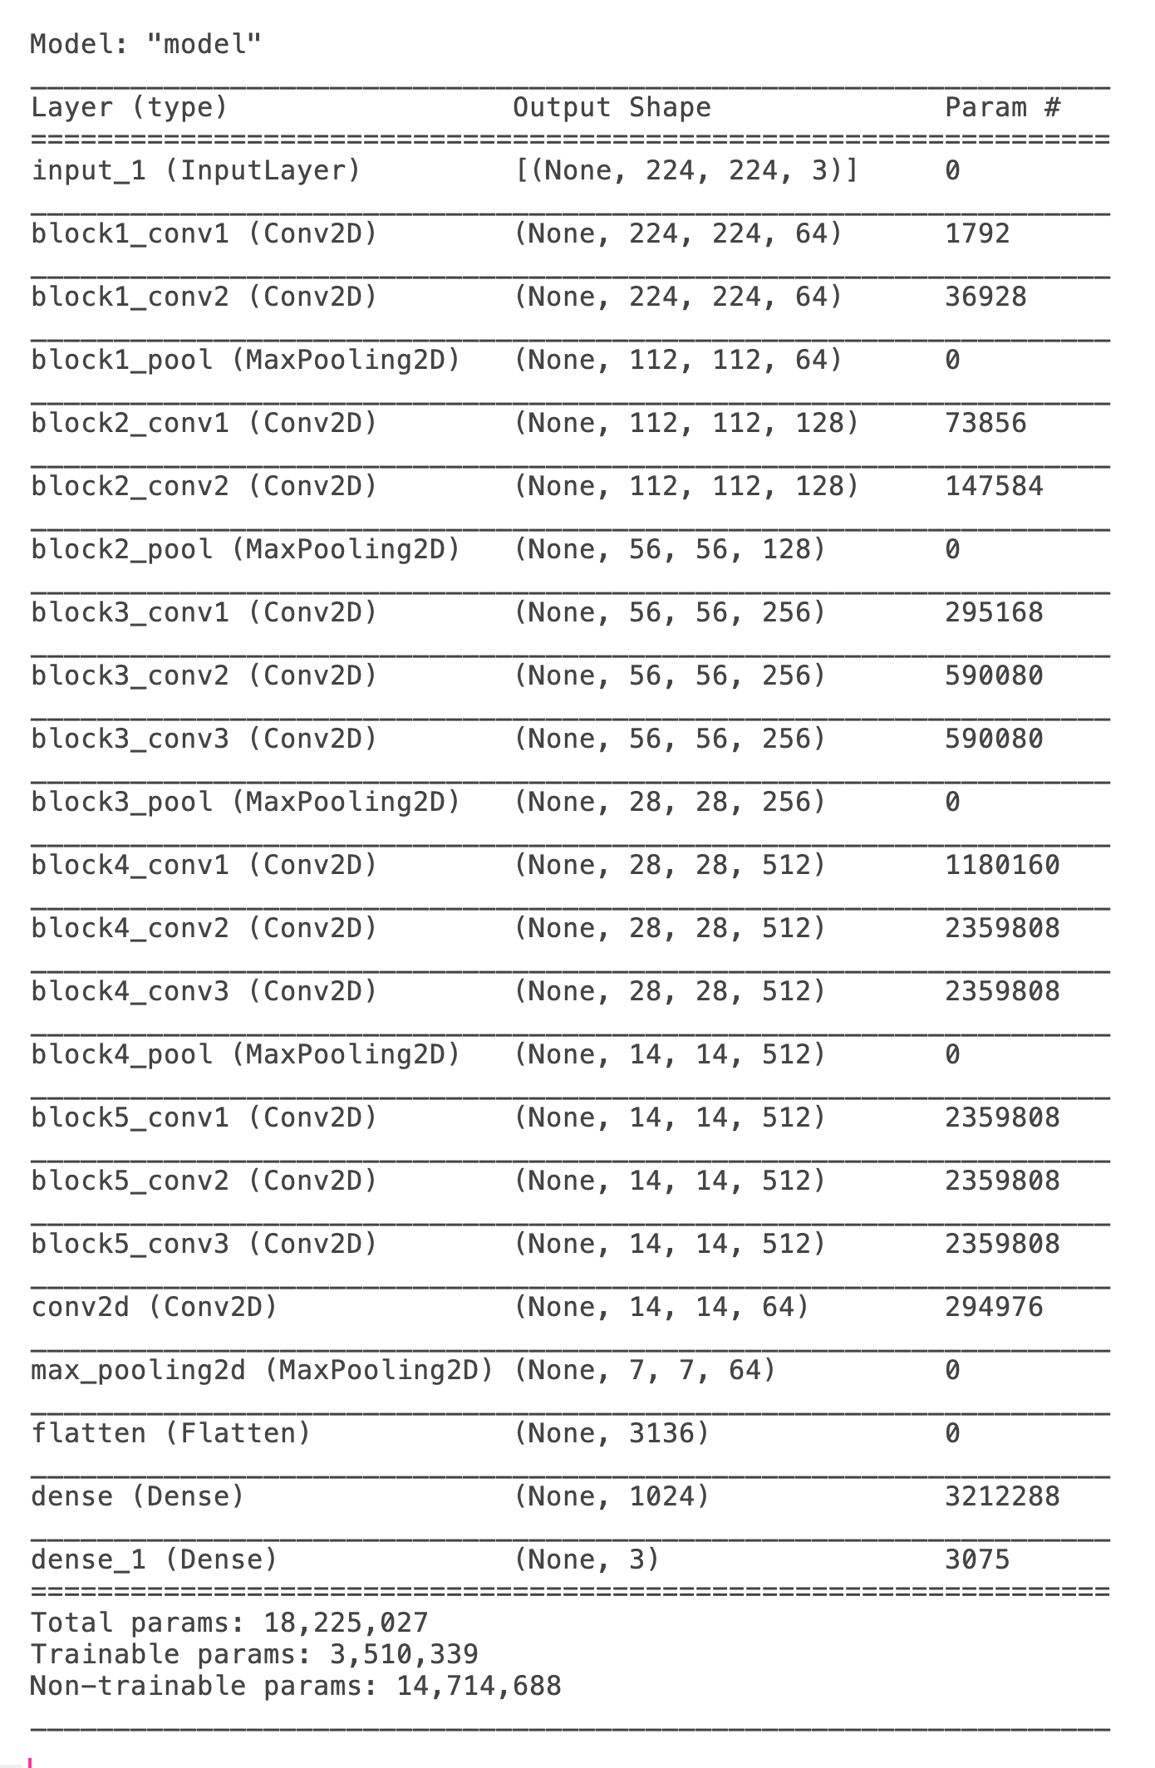
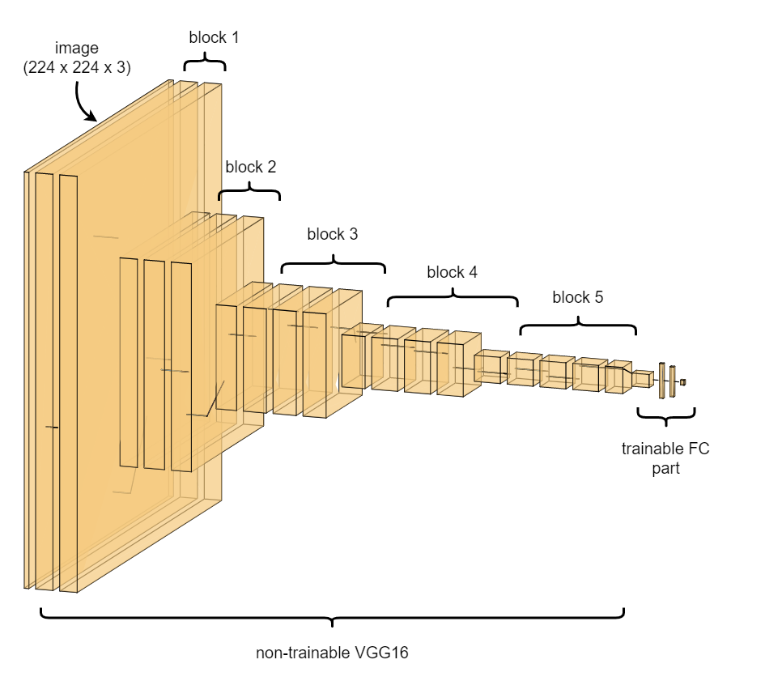
Model setup
The model base is the pretrained VGG16 CNN with the 'ImageNet' weights and all its layers but the densely connected classifier on top of the network.
All the layers of the VGG16 are set to 'untrainable'.
On top of that we add a max_pooling layer, a flattening layer, a dense layer and an output (dense) layer with 3 node and 'softmax' activation.

Slide 7
Face Mask Detector - Results
Accuracy on test data:
With mask: 97.35%
Incorrect wearing: 98.68%
Without mask: 97.50%
Challenges:
Data imbalance
Overfitting on small images
Possible Improvements:
More diverse real-world data
Hyperparameter tuning
Alternative pre-trained models
Full (technical) presentation:
final_project.pptx

Slide 8
Project 2 - Named Entity Recognition (NER)
Objective: Identify key entities (applications, systems, ITIL data) in domain-specific texts.
Why domain-specific NER?
General NER models lack industry-specific knowledge.
Fine-tuning improves accuracy and relevance.

Slide 9
NER - Model & Implementation
Model Choice: DistilBERT (lighter, faster, and efficient version of BERT)
Training Strategy:
Domain-specific fine-tuning
Custom entity labeling
Outcome:
Improved entity extraction accuracy
Faster search & data indexing in company tools
Documentation (technical):
https://gitlab.devops.telekom.de/ichange/data-science/ner_elte/-/wikis/home

Slide 10
NER Summary
Metric (overall) | Test | Human
Precision | 0.973 | 0.467
Recall | 0.949 | 0.101
F1 | 0.961 | 0.167
Accuracy | 0.999 | 0.944
Most probable reasons for low human evaluation:
Undertrained model
Human-annotated train data is crucial

Slide 11
NER - Business Impact Potential
Benefits:
Faster and more accurate keyword search
Linking extracted entities to databases
Future Work:
Expanding the dataset
Exploring LLM-based entity extraction

Slide 12
Project 3 – KAIA@Caesar
Objective: Provide an interactive chatbot capable of answering domain-specific questions.
Key Features:
RAG over ITIL data
Hybrid search
Feedback system
Demo Time!

Slide 13
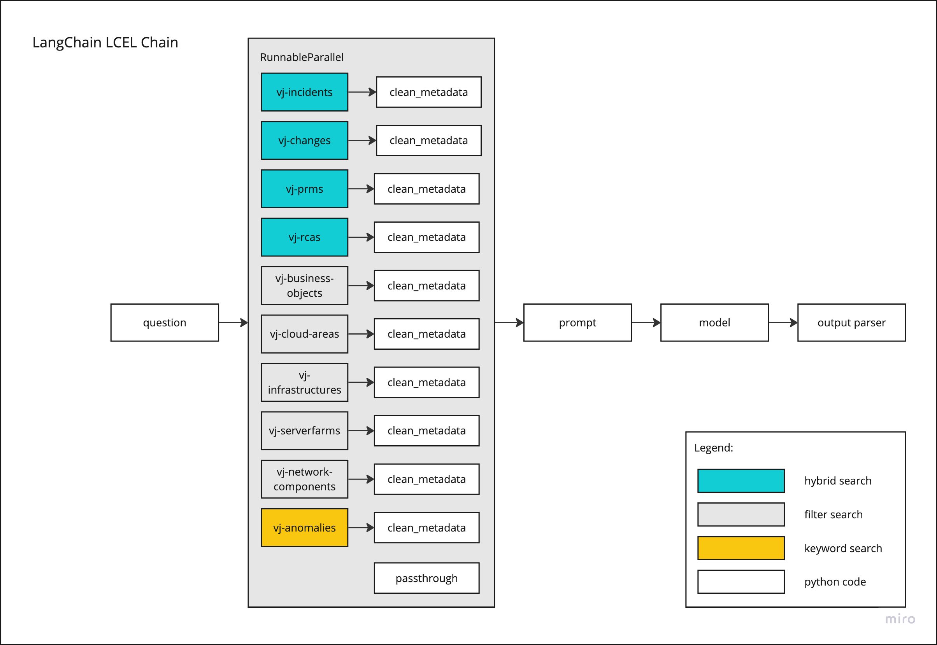
KAIA@Caesar
LangChain LCEL Chain
employs parallel retrieval
Different search types
hybrid search
keyword search
filter query
Minimalistic prompt
gives freedom to the user

Slide 14
Live Chatbot - Demo & Discussion
Live demonstration of KAIA in action
Key use cases and applications
Insight into ITIL data of interest
Generation of excerpts, summaries, timelines, etc.
Potential improvements and scalability
Enhancement with agentic approach
Optimization in retrieval
Develop a RAG validation framework:
dataset, validation testing, CI pipeline

Slide 15
Q&A & Closing Remarks
Summary of Projects:
Face Mask Detection: Image Classification with CNNs
NER Model: Domain-Specific NLP
Live Chatbot: Real-Time AI Assistant
Next Steps:
Stabilisation and continuous improvements of KAIA in production
Exploring the SOTA (state-of-the-art) tech and methods
Exploring new use cases
Thank You!
Questions?

