Slide 1
IBM Data Science Professional Certificate
Capstone Project
Peter Cleavland Palmer

Slide 2
Table of Contents
Introduction
Data
Methodology
Results
Discussion
Conclusion

Slide 3
Introduction
P. James, an electrician, wants to start an electrical company in Orlando, Florida.
He is not sure where in Orlando is the best place to set up an office.
He is looking for is proximity to a lending institution, like a bank or credit union.

Slide 4
Business Problem
The objective is to help Mr. James by using the Foursquare location data, data science techniques, webscraping techniques, and machine learning algorithm.
Can we determine the best neighborhood in Orlando for Mr. James to set up an electrical company?

Slide 5
Data
In order to solve this problem, we will need the following data:
a list of neighborhoods in Orlando;
latitude and longitude of the neighborhoods;
venue data, from Orlando, identifying banks and electrical companies.

Slide 6
Methodology
The methodology can be summarized under the subsections:
import and install libraries;
scrape the website for the neighborhoods;
get the coordinates of the neighborhoods;
create a map of Orlando, Florida;
explore the neighborhoods in Orlando;
analysis of the neighborhoods, form the clusters;
use the clustering algorithm and examine the clusters.

Slide 7
Results
The results obtained by using the k-means clustering algorithm show that we can categorize the neighborhoods, in Orlando, into three categories based on the frequency of occurrence of banks:
cluster 0: neighborhoods in Orlando with no bank;
cluster 1: neighborhoods in Orlando with a low number of banks;
cluster 2: neighborhoods in Orlando with a moderate number of banks.

Slide 8
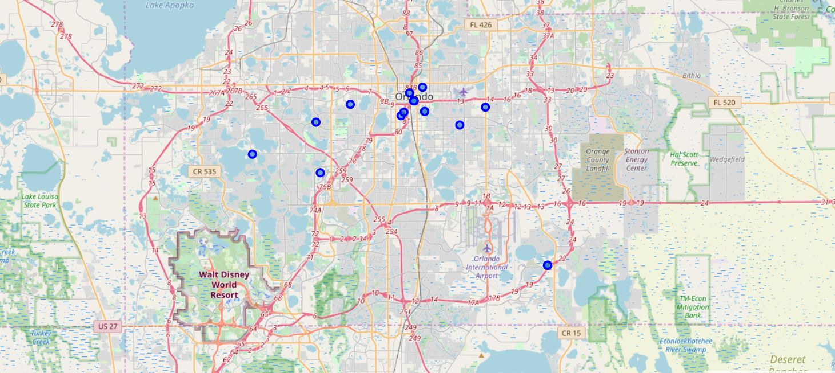
Map of Orlando with Neighborhood Markers

Slide 9
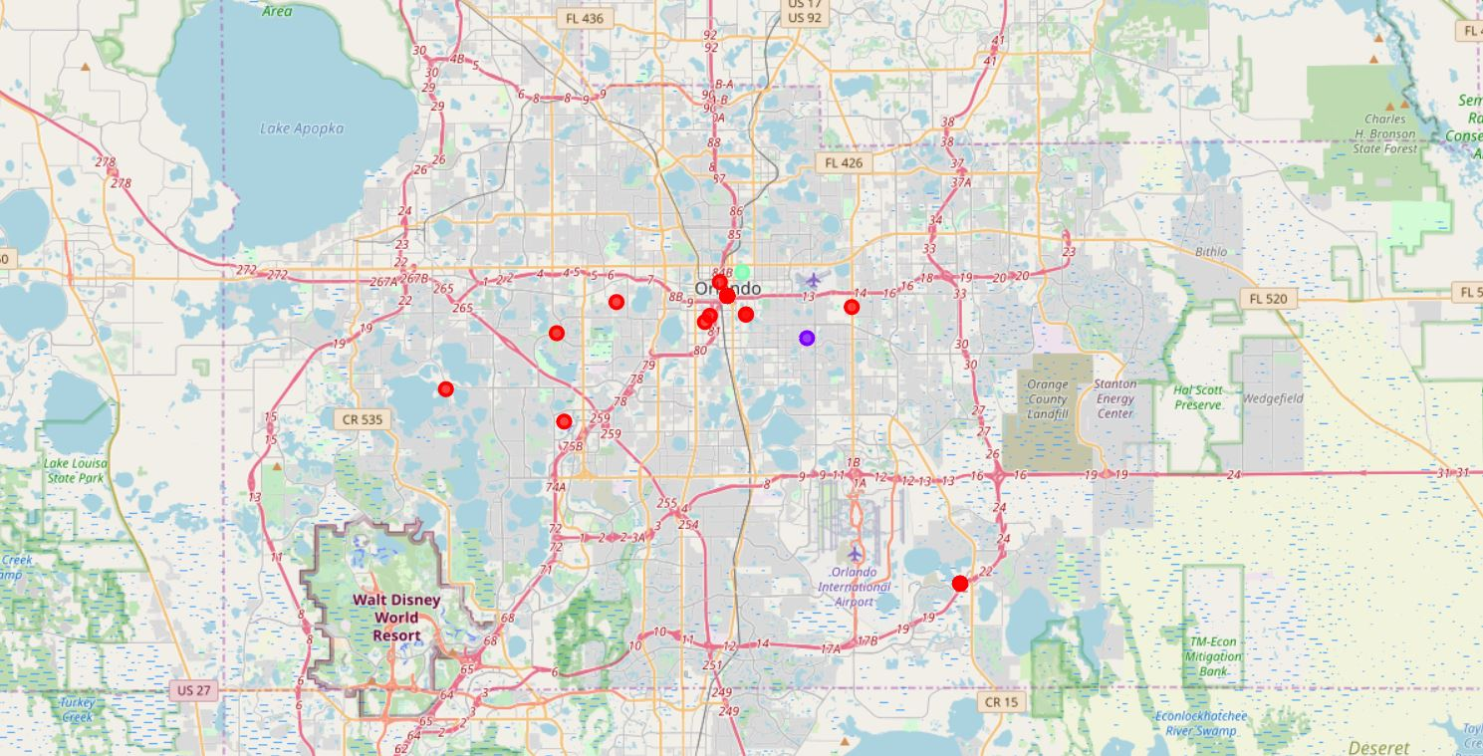
Map of Orlando Neighborhoods in Clusters

Slide 10
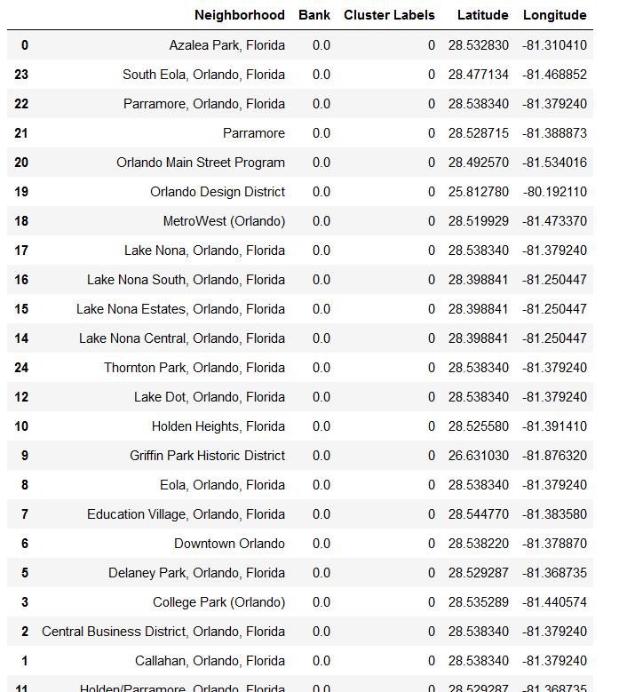
Neighborhoods in Cluster 0

Slide 11

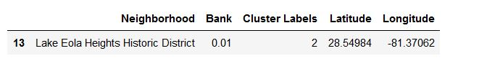
Neighborhoods in Cluster 1
Neighborhoods in Cluster 2

Slide 12
Discussion
We observed that there were no electrical companies in the venues categories.
With added criteria for selecting the clusters, instead of just financial institutions, we could form better clusters.
This research could be extended to dig deeper into the clusters and actually start to look at properties, available for renting.

Slide 13
Conclusion
We were able to suggest two clusters of neighborhoods that would be good candidates.
In order to complete the project, we scraped a website, got coordinates of neighborhoods using geolocater, created maps of Orlando, explored and analyzed the neighborhoods of interest, and used a clustering algorithm to create and examine the clusters.
Opportunities for further work towards finding an actual rental property, for Mr. James.

Slide 14
THANK YOU

