Slide 1
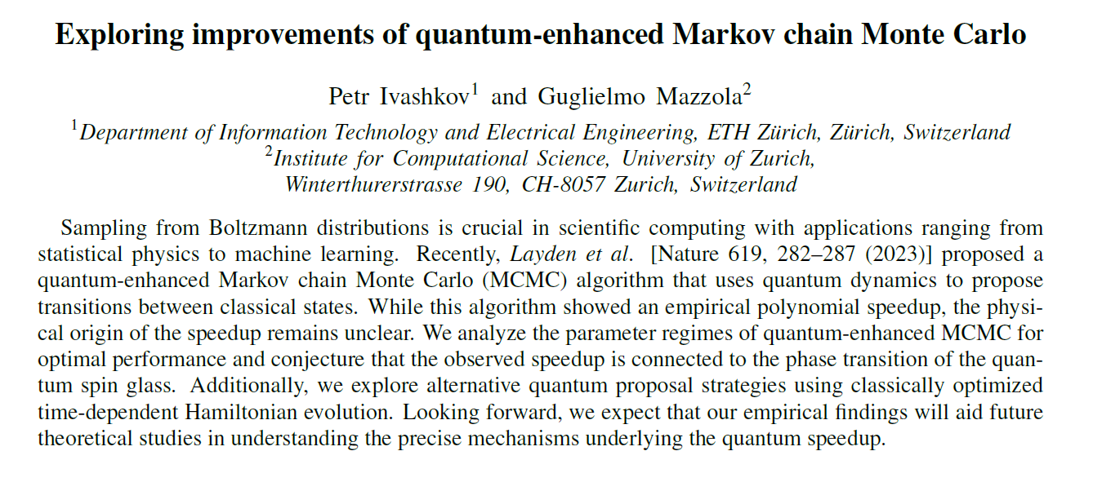
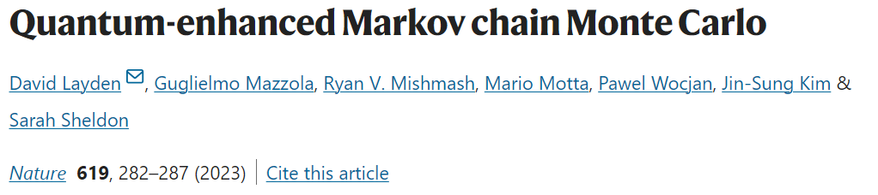
Petr Ivashkov supervised by Guglielmo Mazzola (UZH) and co-supervised by Joseph Renes (ETH)
Notes:
Intro and motivation

Slide 2
Talk outline
Sampling and MCMC basics
Quantum-enhanced MCMC
Optimal parameter regimes
Alternative approaches
Big picture view
Questions are welcome!
Notes:
The plan for today’s talk is the following. We will start by introducing some basics about Markov Chain Monte Carlo methods. Then we will understand what is this quantum-enhanced method from the recent Nature paper and move on to analyzing it a bit more closely. We will of course try to improve it using some alternative methods. And conclude with a big picture view on the problem and the path forward.
The talk will take about N minutes, we should have enough time for questions hopefully. I am happy to take questions in the middle of the talk. So feel free to interrupt at any point.

Slide 3
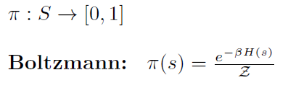
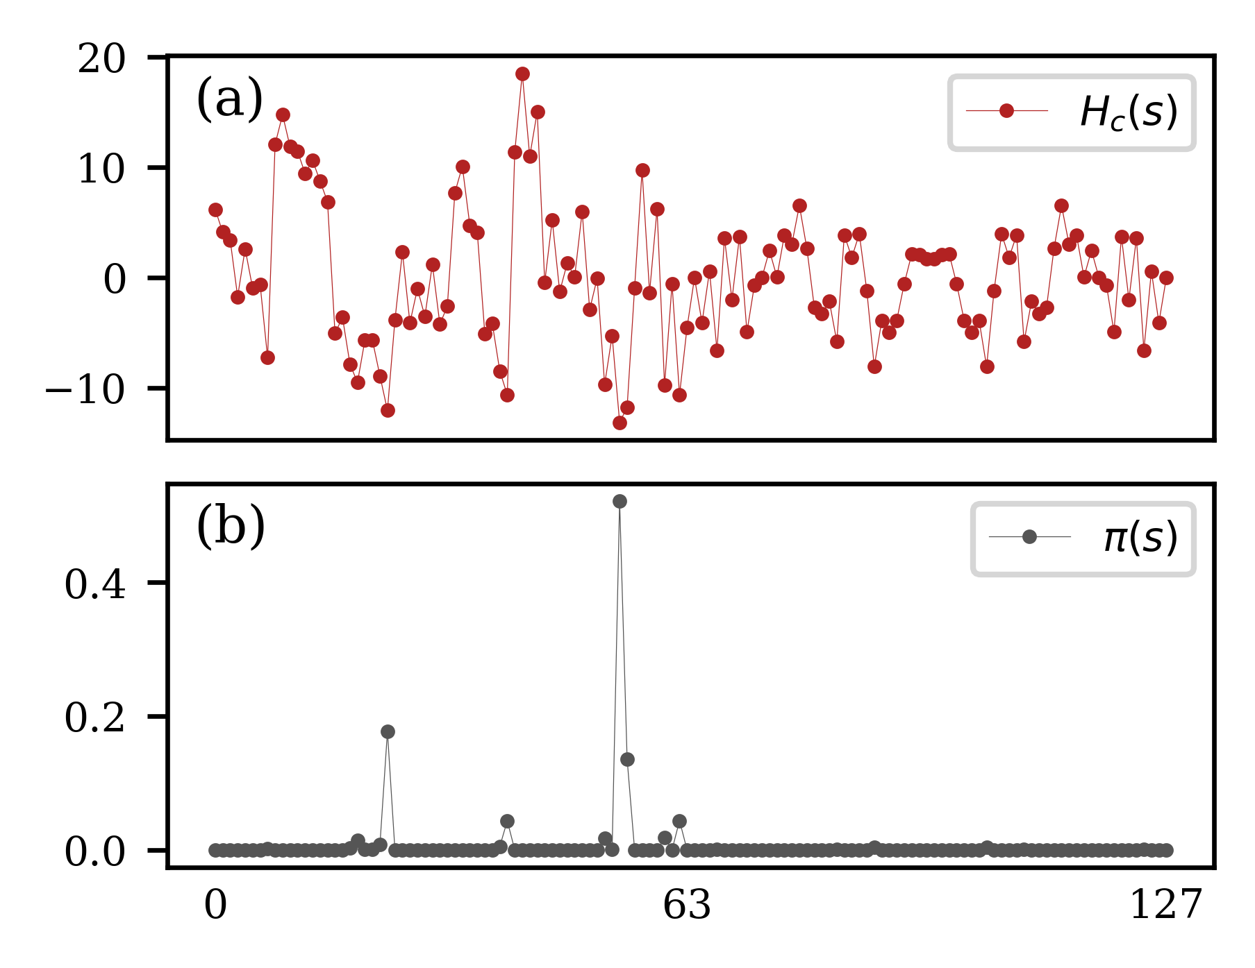

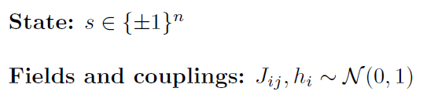


Sampling
Notes:
Sampling from a classical distribution is ubiquitous in scientific computing and has lots of applications in other areas from statistical physics to machine learning and optimization. The problem is to draw samples according to some desired probability distribution. We will focus on Boltzmann distributions of classical Hamiltonians. In particular, we consider the classical spin glass. The configuration space consists of n classical spins, each being either plus or minus one. Imagine you have n sites, each connected to another. The energy is specified by a set of random couplings between every two spins. Additionally, every site has a random field on it, which gives the total Hamiltonian. System is highly frustrated because it is impossible to satisfy all the couplings simultaneously. It has many local minima and a typical landscape looks as follows. The Boltzmann distribution is concentrated on few local minima. We want to draw samples mainly from the regious with high probability.
The problem is, we cannot evaluate the Boltzmann distribution directly. Intractable normalization constant Z. In the language of statistical physics called partition function. The sum runs over exponentially large configuration space and is not practical to compute.

Slide 4
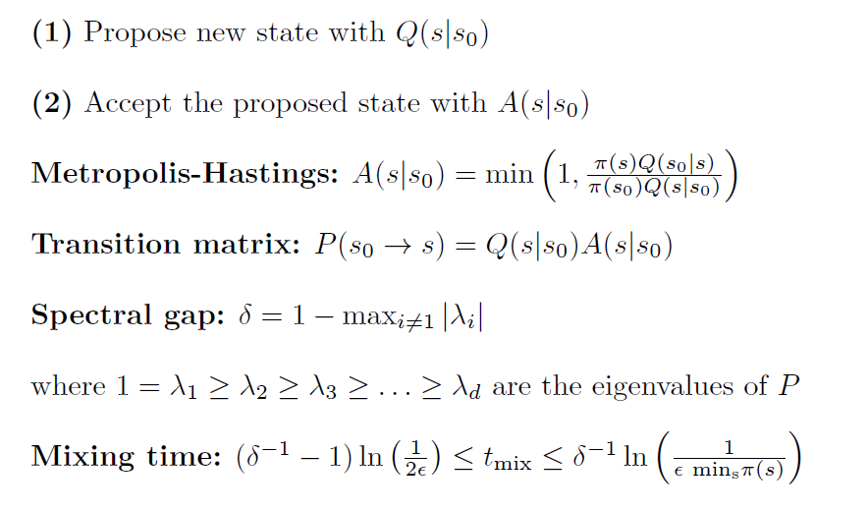
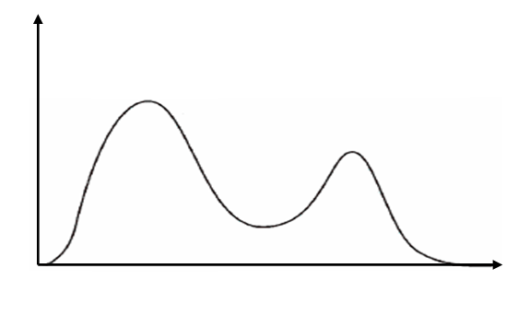
MCMC Basics
s₂
reject
s₀
s₁
Notes:
The most commonly used method to sample from distributions with intractable normalization constant is Markov Chain Monte Carlo. In a nutshell, you construct a chain of transitions between your classical configuration, where starting from one state the next state is proposed according to some rule and accepted according to another rule. If you construct your chain correctly and repeat these transitions long enough, the probability to end up with a given state will be the desired probability distribution. It is called stationary distribution. Every well-behaved Markov Chain has such a stationary distribution.
Every transition is a two step process. The first step is heuristic: you propose a new state according to Q which depends on current and new state. This is where you can play around and come up with smart proposal strategies which eventually determine how fast you Markov chain converges to its stationary distribution. The second step is usually predetermined. To ensure the chain converges to the target distribution new states must be accepted according to this probability: MH. Not the only choice but the most common one. It explicitly depends on the ratio of pi so the Z cancels out.
Object of interest which completely describes the chain transition matrix. Probability to go from s0 to s. The stationary distribution is the eigenvector of this matrix and has eigenvalue 1. What matters is how fast your chain converges to its target distribution. How long you need to wait before you can start drawing samples. Mixing time tightly related to the spectral gap of the P. Applying P to s gives you a probability distribution. Large gap is good, small gap is bad. Remark: diagonalizing is intractable. Next, we will see how to choose a good proposal strategy. Any questions at this point?

Slide 5
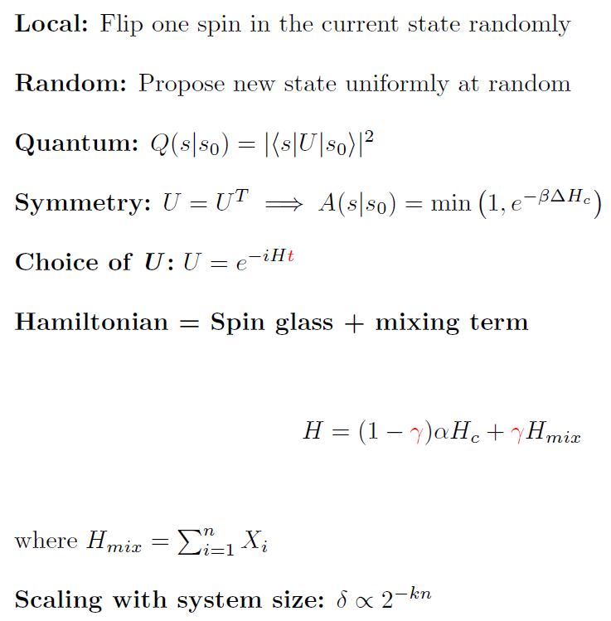
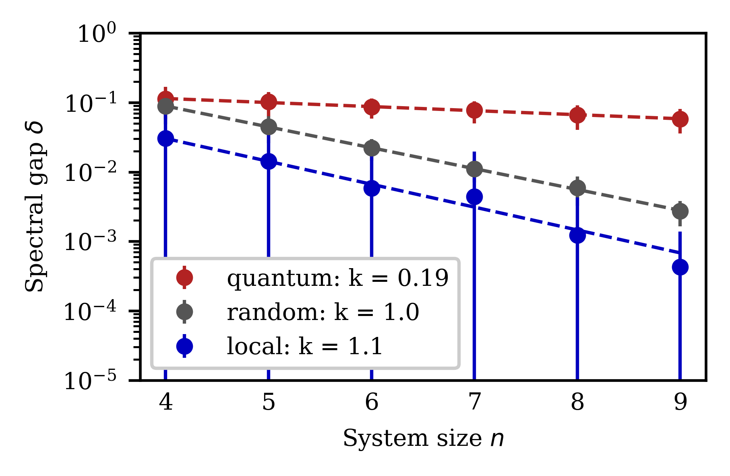
Quantum proposal
Notes:
The slide is called quantum proposal but first lets look at two common classical strategies. First is a local proposal strategy. You just randomly flip one state of the current configuration. Slow at exploring energy landscape although many steps are likely accepted because you are not making big changes in energy.
Second one is what I call random here. You just pick the new configuration uniformly at random, completely uninformed by the current state. Now this strategy surely explores the energy landscape well but many steps will be rejected because distribution is concentrated around few local minima and probability to land in one of those is exponentially small.
The essence of the recent Nature paper is it propose new configurations using a quantum step. Concretely, you start with a classical configuration s0 and encode it as computational basis state of an n-qubit system. For example, spin +1 is mapped to 0 and spin -1 is mapped to state 1. Then you evolve this state under some unitary U, and measure in the computational basis. The Born rule gives you the probability to end up in the classical state s. That’s it, this is your proposal strategy.
Now, if you choose a symmetric U, this will make sure your proposal probability is symmetric and the normalization cancels out. This way do don’t have to evaluate matrix elements of your high dimensional unitary which would of course be intractable. Then, you acceptance looks like this: all the downhill move are accepted and the uphill moves are accepted according to the Boltzmann exponent of the energy difference.
So far we still haven’t said anything about the form of U, expect that it is symmetric. In the paper, the authors consider unitary evolution under a time-independent Hamiltonian which consists of the classical spin glass Hamiltonian and a mixing term. They choose this sum of X terms. Worth noting that this Hamiltonian now corresponds to the so called quantum spin glass model. Now every site has an additional transverse field in the X direction. The strength of the field is controlled by the gamma parameter. This gamma will be very important that why it is in red. The proposal strategy is problem informed.
What does this give us. The numerical results comparing the three strategies are on the plot. Describe. Delta decays exponentially with the system size. What matters is the exponent k, the slope of the logarithmic plot. Small k is good, large k is bad. Ratio of the exponents is the polynomial speedup. Quantum outperforms both local strategies. This is NISQ friendly. Questions.

Slide 6
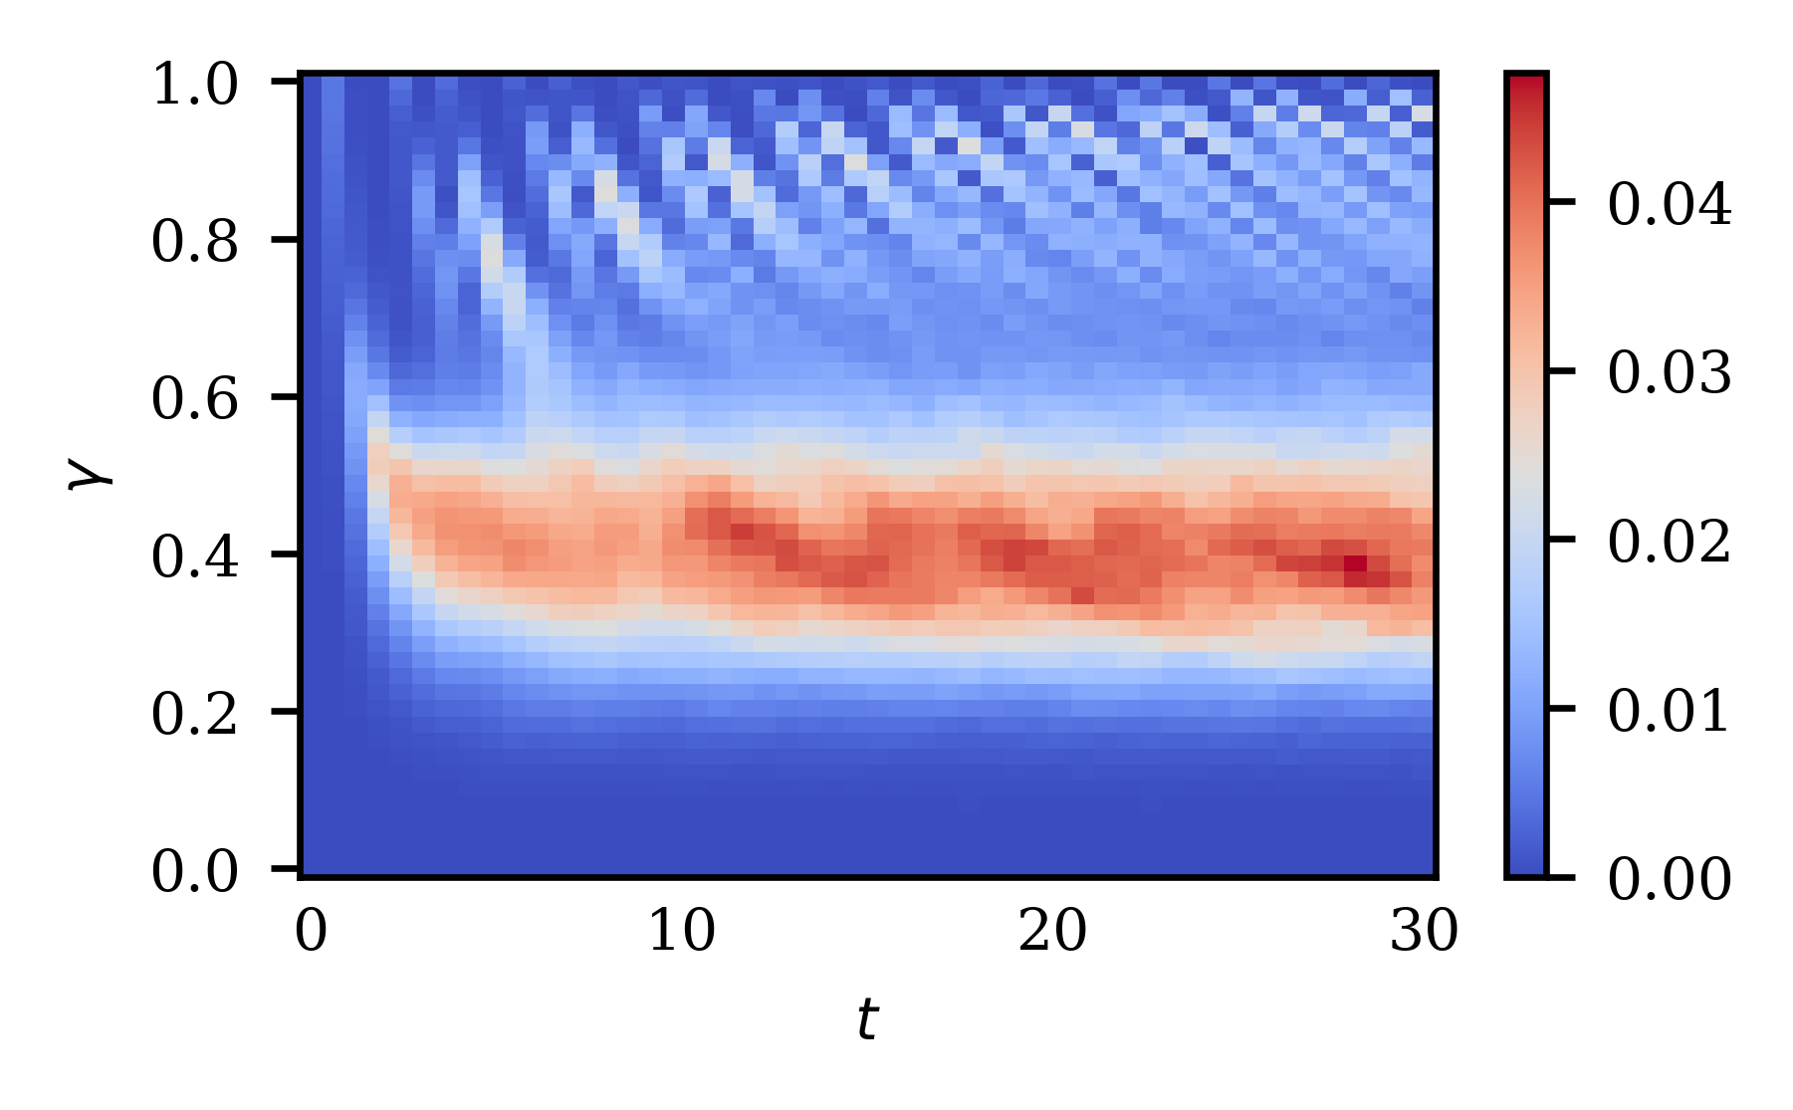
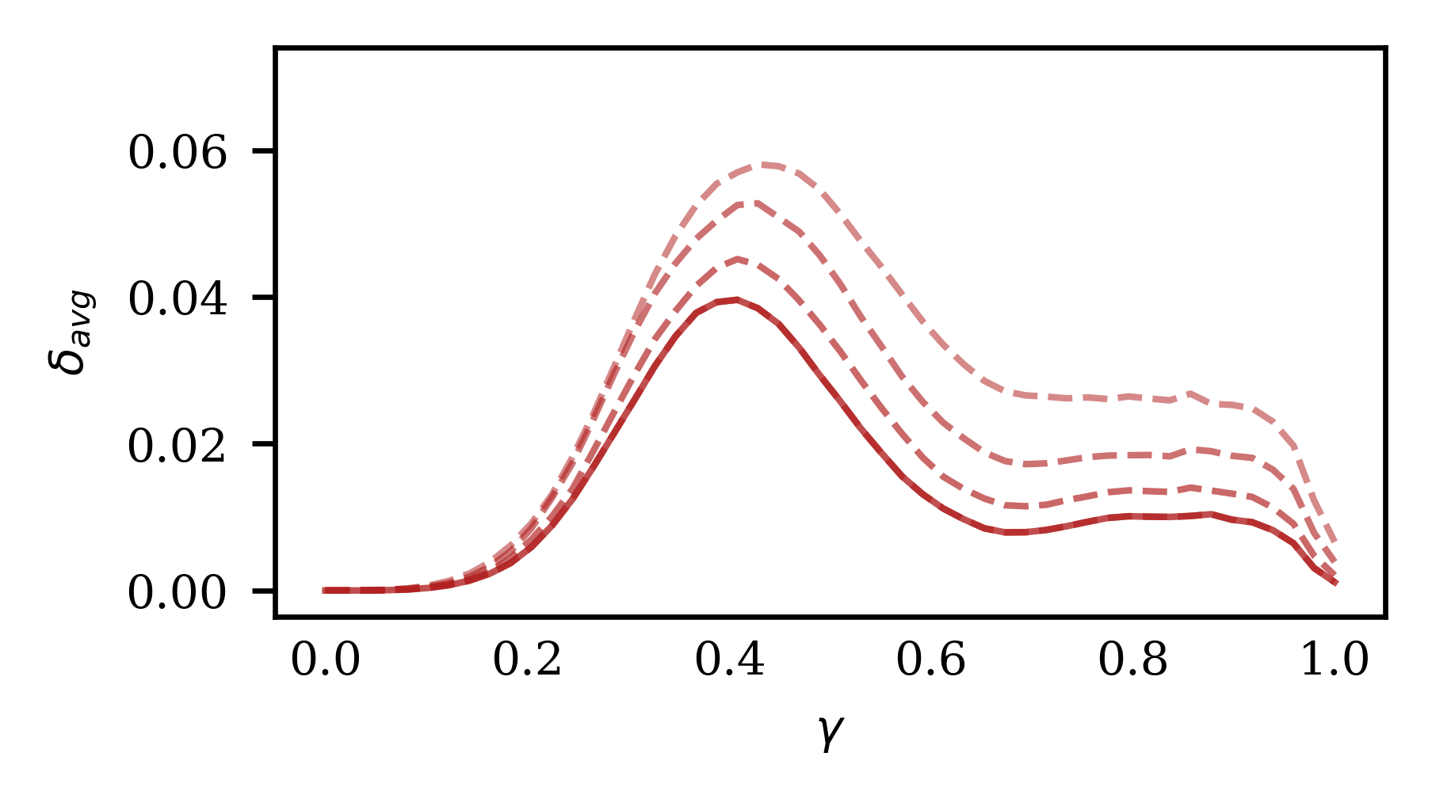
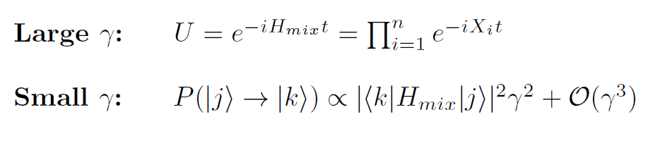
Parameter grid search
Notes:
How do you choose gamma and t. Brute force: do a large grid search. Describe the plot. Hot regions are high spectral gap = good. Overall looks quite complex but we can understand some regions of it well. High gamm, H = Hmix = just rotation around the x-axis. Explain the oscillatory behavior along the time-axis. On the other hand, for small gamma we can apply PT (mixing term is a small perturbation). The, the transition probability is proportional to the matrix element of mixing Hamiltonian. Since it is just a sum of X terms, non-zero transitions only between states that differ by a single spin flip. Essentially, local strategy.
Clearly, interesting stuff is happening in the middle. Pronounced hot region around gamma 0.4-0.5. Make it more obvious by plotting the average along the time-axis on the left. Delta peak across multiple system sizes around 0.45. This the regime where the strengths of the two terms of the Hamiltonian are approximately equal. We may suspect there is phase transition which gives rise to the critical behavior.

Slide 7

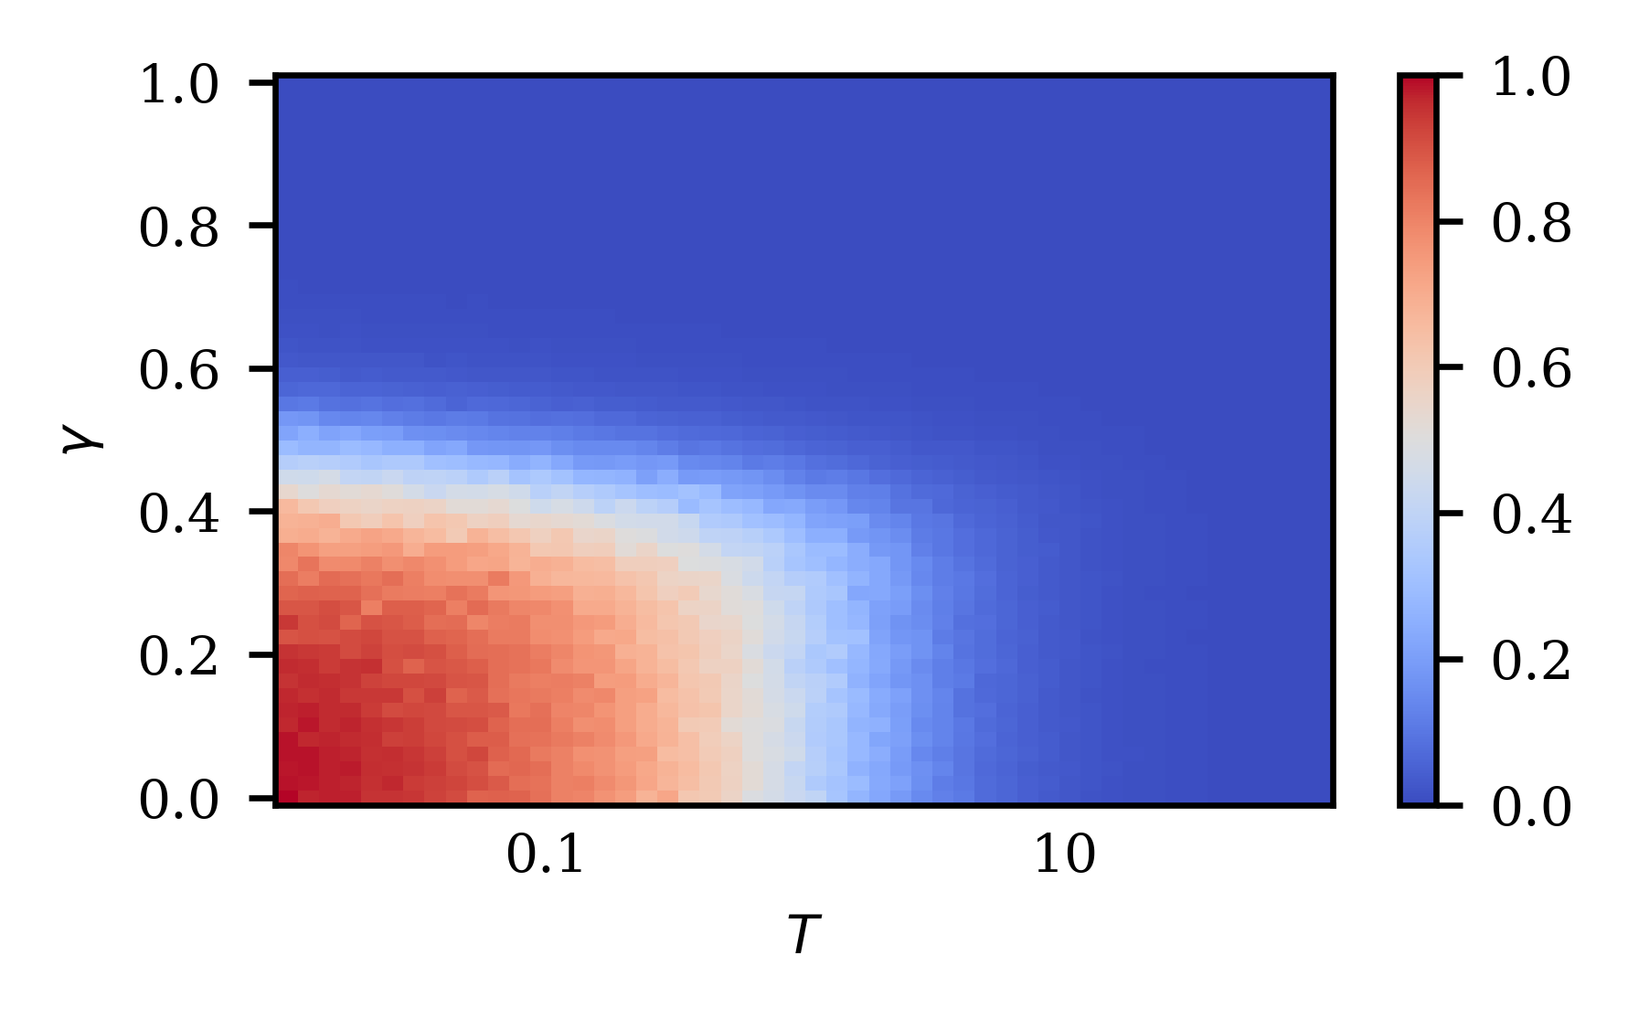
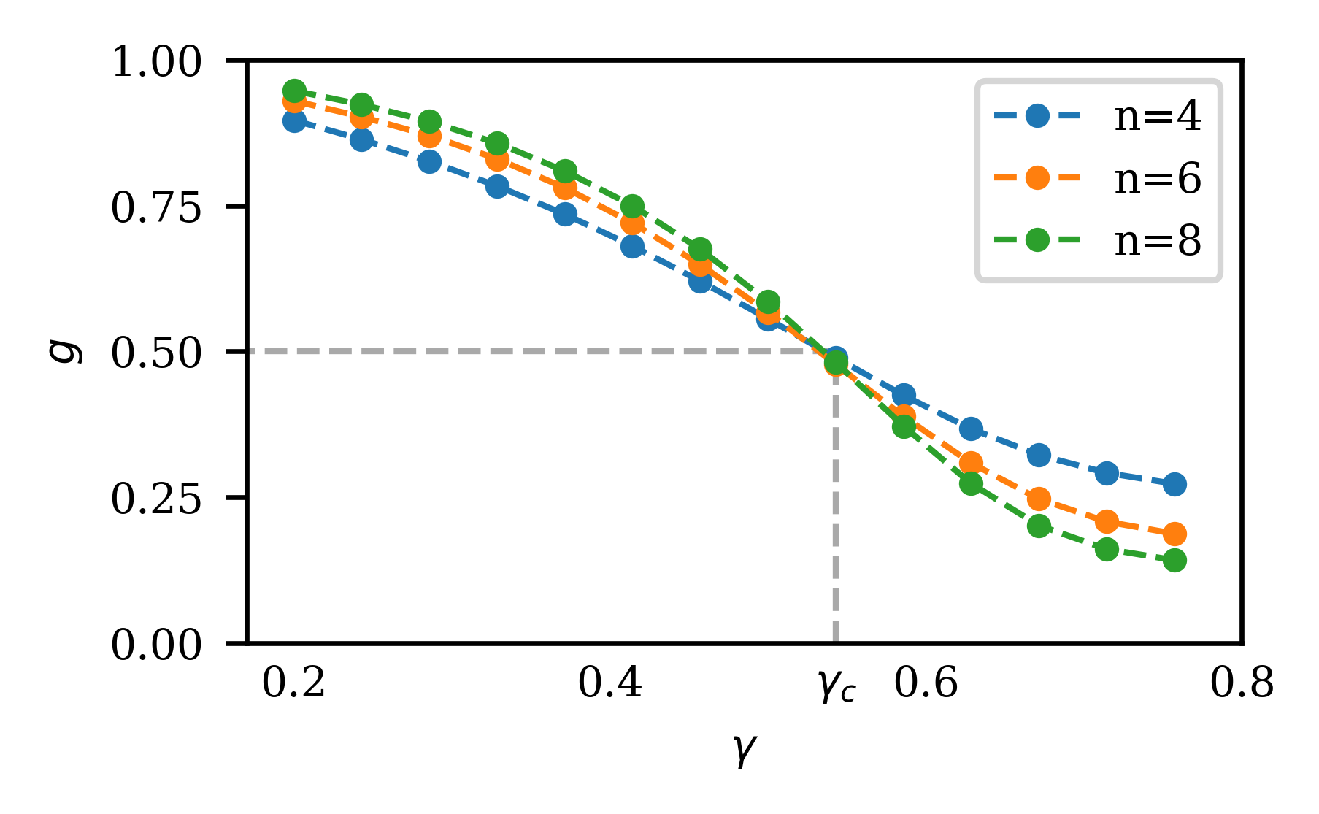
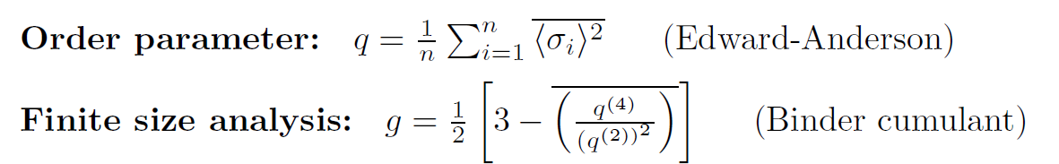
Locating critical γ value
Notes:
And indeed, computing the phase diagram of our Hamiltonian we find a phase transition around gamma 0.5. Left plot = phase diagram, temperature and gamma, quantum and thermal fluctuations. We are interested in quantum. The order parameter is the one for classical spin-glass. The hot red region is a highly localized spin glass phase, frozen in one configuration. Blue is the paramagnetic phase where fluctuations dominate.
We are dealing with finite-size systems, so to locate the exact critical gamma value we use the so called Binder Cumulant. It is defined in terms of the moments of the order parameter and characterized the distribution of the order parameter. Importantly, it has invariant value at the critical point, independent of system size. We exploit it by plotting multiple curves and finding the intersection point on the left plot around 0.55.

Slide 8
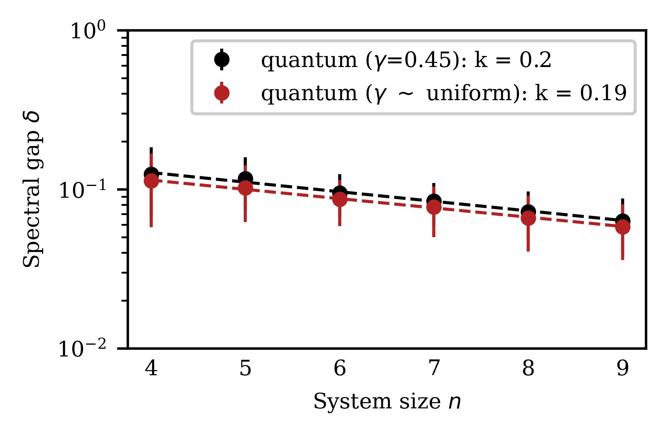
Fixed near-critical γ
Notes:
The original randomized strategy takes random gamma. We find that setting gamma to a fixed value at 0.45, slightly below the critical value can match but not really outperform the randomized strategy. Setting any other fixed gamma value results in lower performance. The exact connection is still not resolved. We will get back to it in the end.

Slide 9
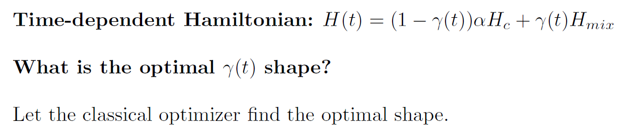
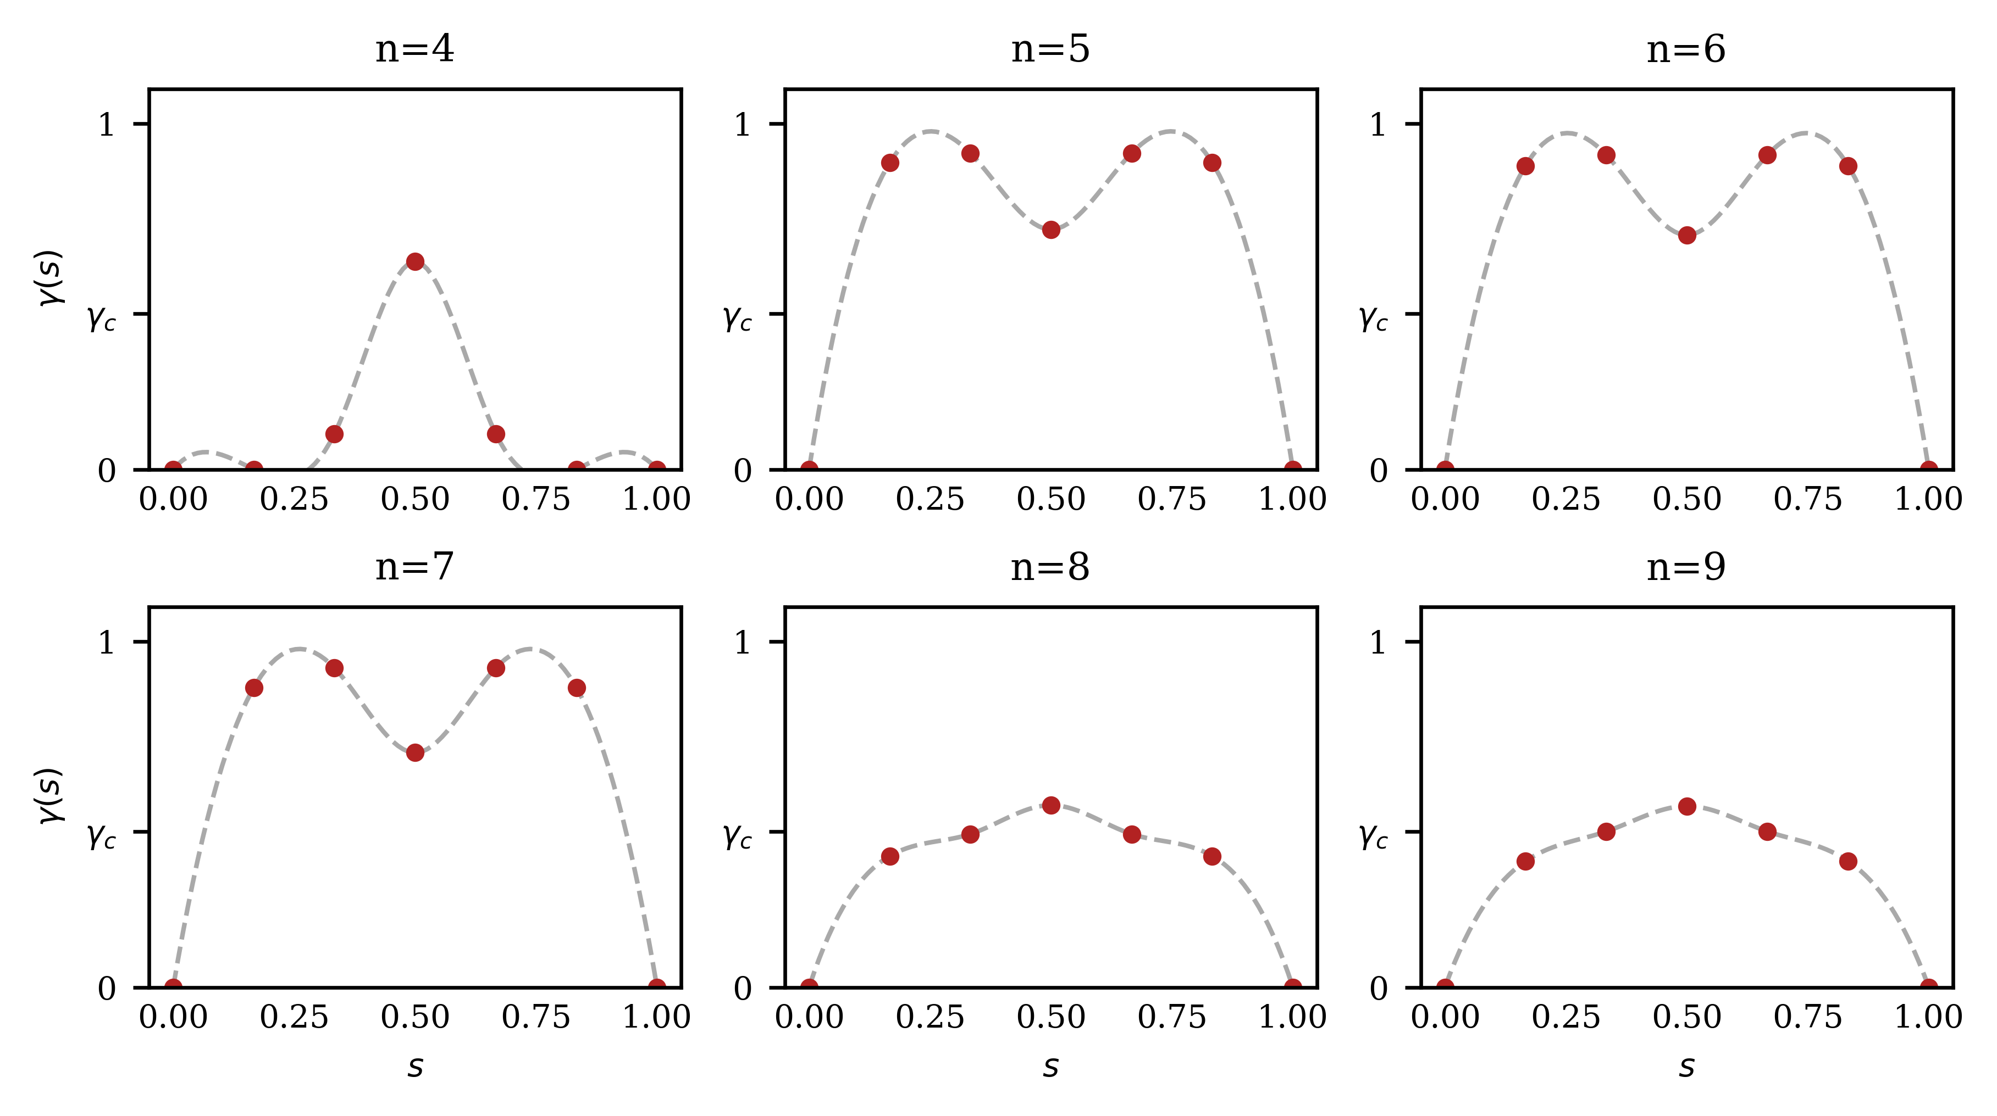
Classically optimized schedules
Notes:
Now, let’s see if we can beat. What if we consider evolution under a time-dependent Hamiltonian. Let’s introduce time dependence by making gamma a function of time. To keep the symmetry, the gamma must be symmetric around the mid-point of evolution but no other constraints. Obvious question, what is a optimal gamma. Hand-off uniformed approach by letting a classical optimizer fund a good schedule. We parametrize the gamma(t) by a few discrete points and interpolate using a polynomial between those points. This give a smooth schedule. Figure of merit is the spectral gap (only feasible for small systems).
Bayesian optimization approach which is good for costly. The plot show 6 different system sizes, from 4 to 9. Remarkably, optimizer finds a consistent schedule for 5,6, and 7 qubit-systems, with two strong peaks in gamma. For 8 and 9 qubits the optimized schedule also looks similar and resembles the time-independent evolution. For time independent, gamma would just the a straight horizontal line.
Time-independent is essitnailly a stra

Slide 10
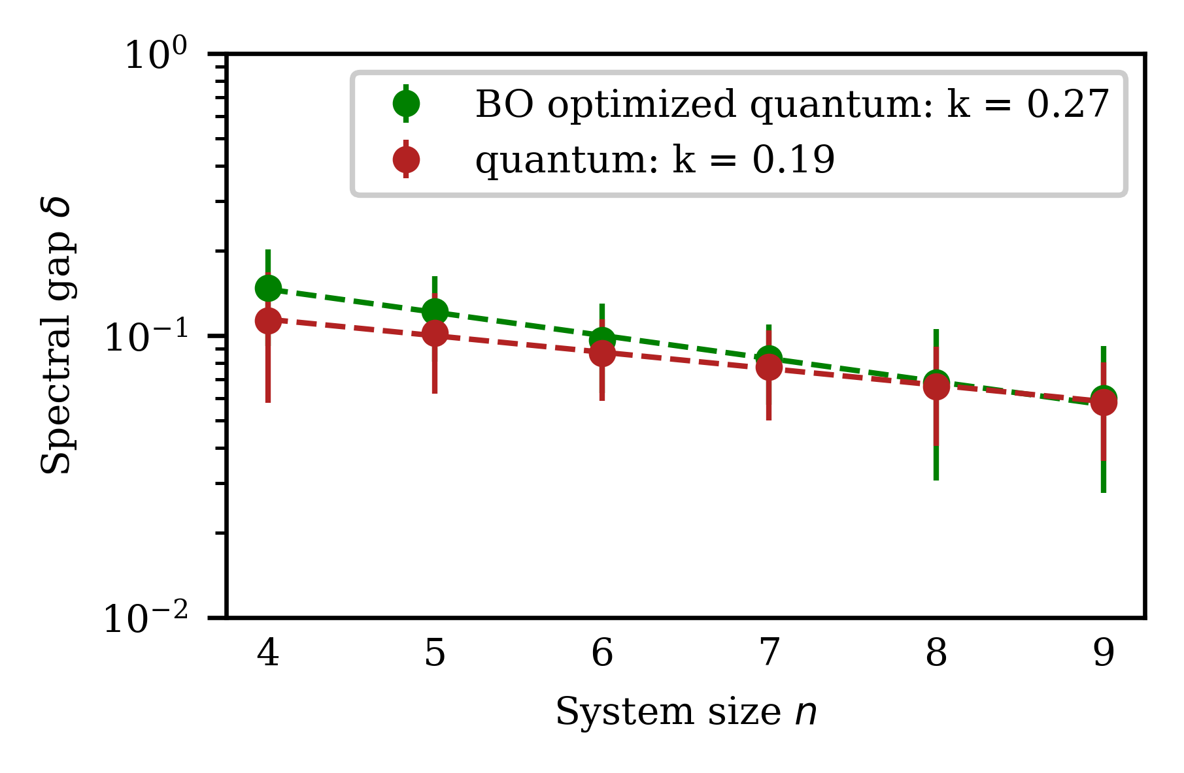
Performance of optimized schedules
Notes:
If we look at the performance of optimized schedules, we see we can beat the randomized time-independent strategy on small systems but for larger sizes the performance is nearly identical, which is unsurprising considering the close resemblance to the independent schedule.
Overall, the results show it is hard to beat the original randomized strategy even using heavy optimization techniques. In fact, the obtained schedules for 8 and 9 qubit systems hint at the optimality of time-independent evolution although proving it formally would be difficult.

Slide 11
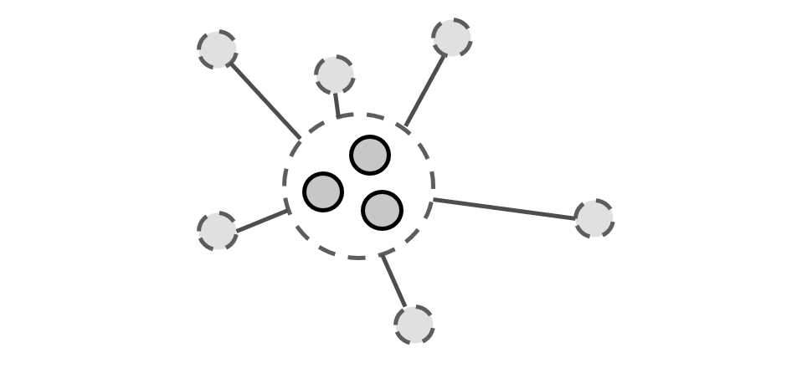

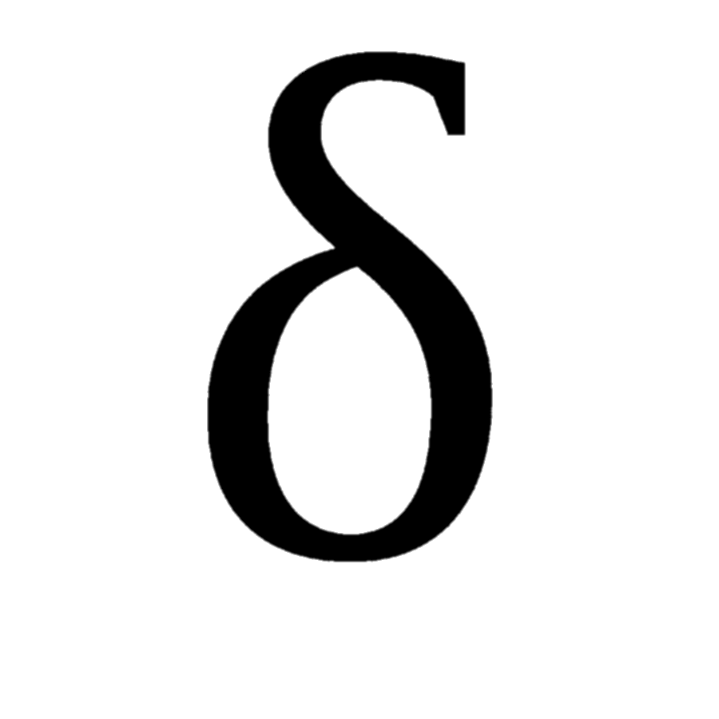
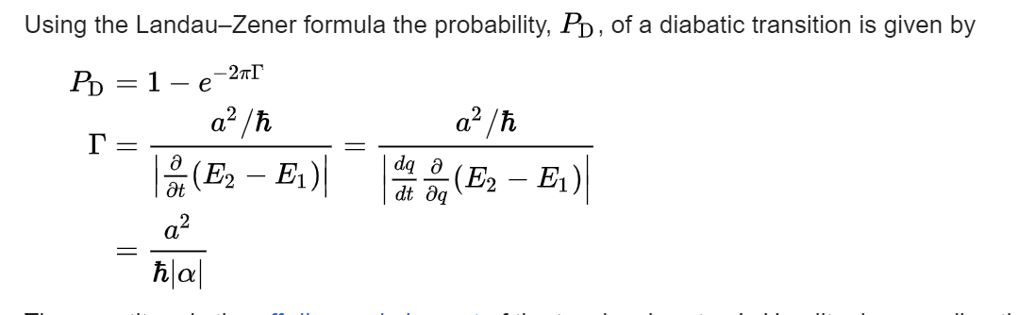
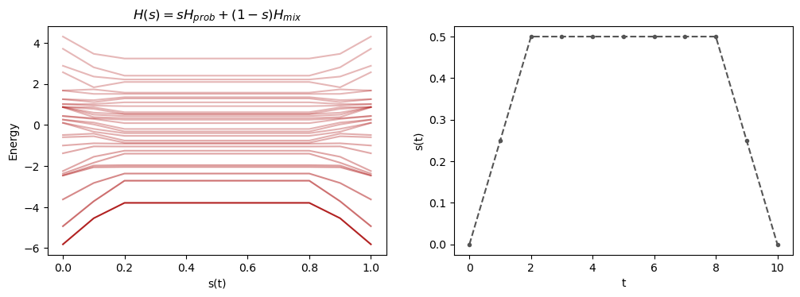
Big picture
Bottleneck analysis
Phase transitions
MCMC convergence
Physics
Empirical analysis
Population flow
Notes:
This brings us to the big picture overview of the problem. Ultimately, we want to establish a connection between the convergence rate of the Markov chain and the physics which produces the proposal distribution. At this point, we don’t understand it yet.
We approached it by pushing from both directions. The first thing we tried to do is analyze the problem empirically, finding that the quality of the proposal has a strong and complicated dependence on the strength of the mixing term. Then, it turned out, the optimal field strength lies very closely the critical value at which the phase transition occurs.
Going forward, a possible approach on the physics side would to analyze the population flow between the instantaneous eigenstates of the Hamiltonian. This is a fruitful framework because it would allow us to use the Landau-Zener formalism to quantify the transitions between Hamiltonian eigenstates during the quantum evolution, which eventually determine the final distribution. It’s interesting that Landau-Zener typically detrimental in the context of adiabatic quantum computing because they take you of the ground state subspace can be useful in our context if they occur between states with similar energy and far in Hamming distance.
On the MCMC side, it seems that the bottleneck analysis can be a path forward. Essentially, you can analyze the bottlenecks of your chain which are the subsets of configuration space which are hard to escape. This gives some direct bounds on the spectral gap. In turn, can be related to localization of instantaneous eigenstates of the Hamiltonian. Ideally, we would like to derive a bound (ideally both upper and lower) on delta in terms of some physical quantities.

Slide 12
Open question
Does the polynomial speedup persist for larger systems?
How hard is it to simulate the quantum proposal classically?
Can we connect convergence rate with physical properties of the system?
What kind of problems is quantum-enhanced MCMC good for?
Notes:
This is ongoing work. Some important open questions remain. First and foremost, does the speedup persists at larger systems. We don’t know. Numerical study of the spectral gap is feasible only for small systems. At some point one would need a large scale quantum device because it is believed that simulating quantum dynamics is hard, in general.
Which naturally raises a question, how hard is it actually to simulate this dynamics. There is another MSc student working on this topic using tensor networks and it seems quite hard.
Now, the question I am mostly interested and working on is whether we can establish a connection with the physics.
Finally, we focused on spin glasses. Are there other good problems? More broadly, what kinds of problems is quantum MCMC good for?

Slide 13
Backup slides

Slide 14
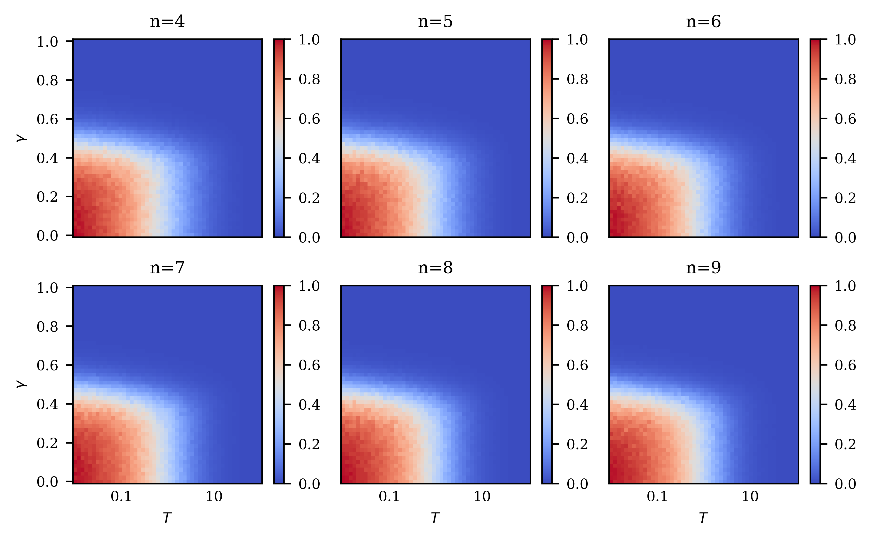
Phase diagrams for different n

Slide 15
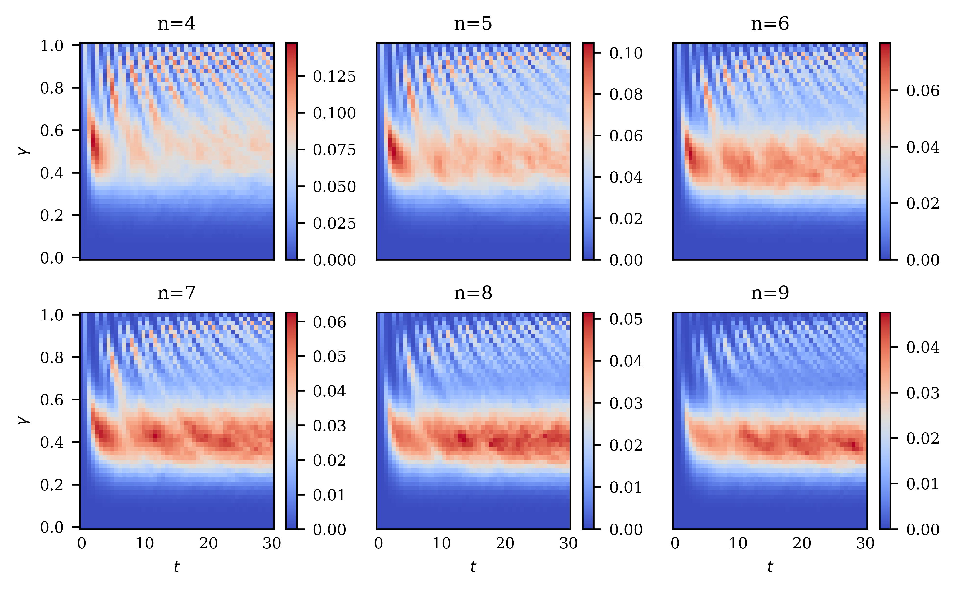
Parameter landscape for different n

Slide 16
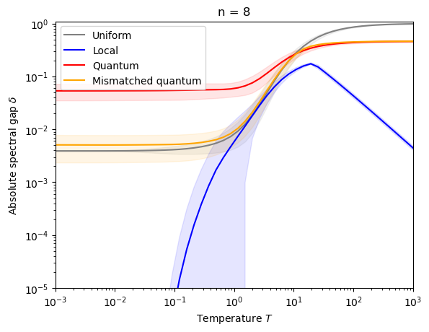
Temperature sweep for n = 8

Slide 17
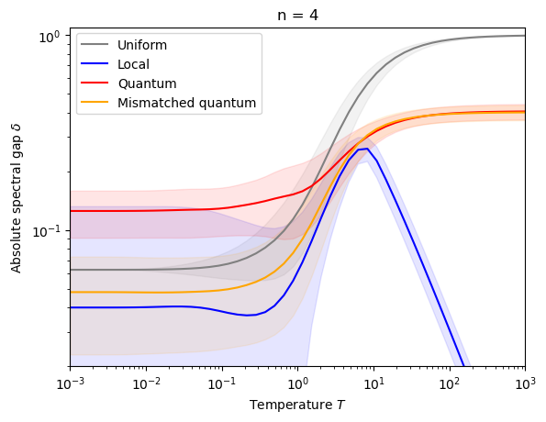
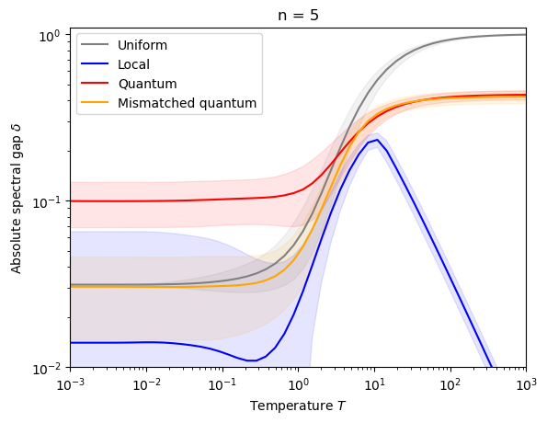
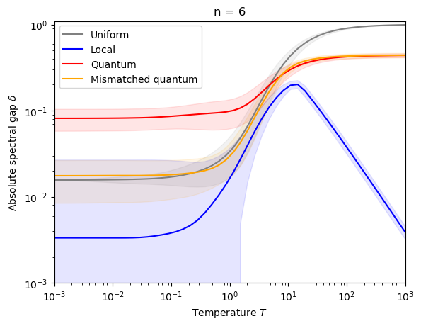
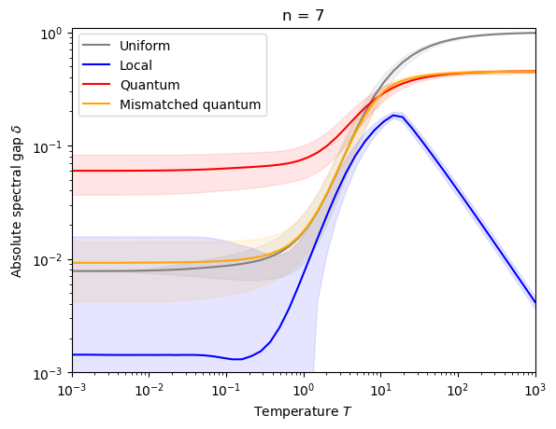
Temperature sweeps for different n

Slide 18
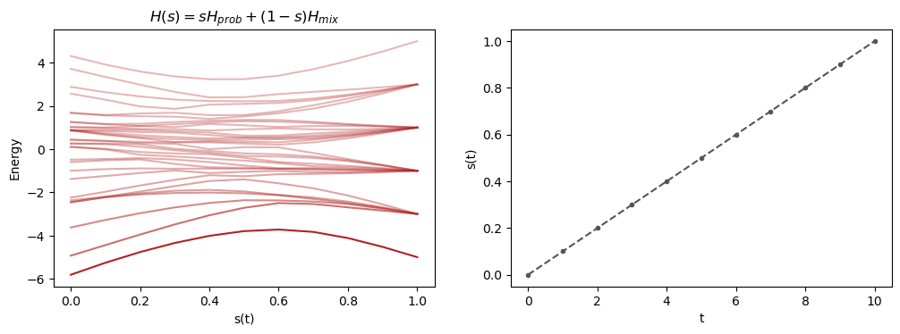
Energy spectrum of the linear schedule

Slide 19
Energy spectrum of reverse annealing

Slide 20
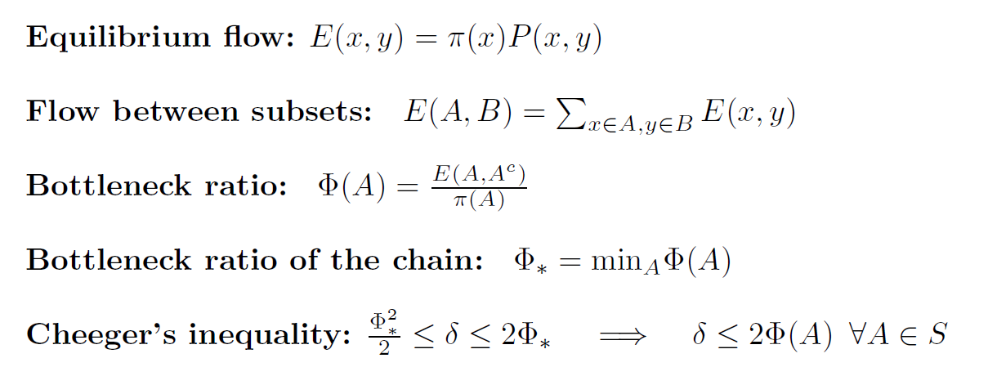
Bottleneck analysis

Slide 21
