Slide 1
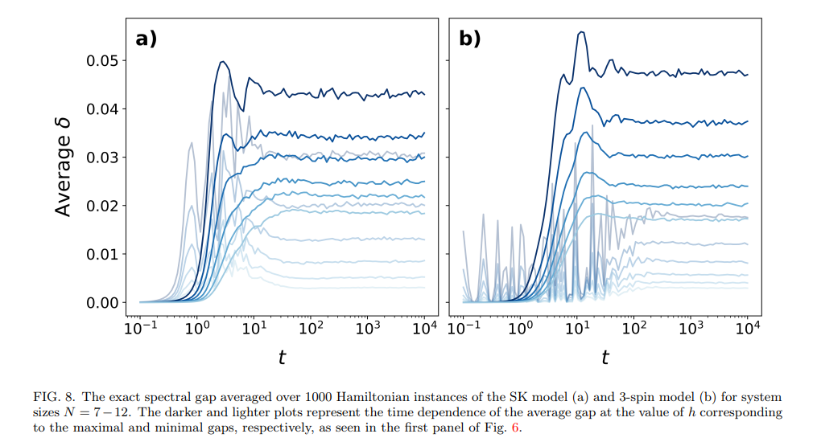
How fast does δ converge with time?
  For SK?
  For p-spin?
TODO: Run numerics on t vs n for SK and p-spin and check how t(n) depend on γ.

Slide 2
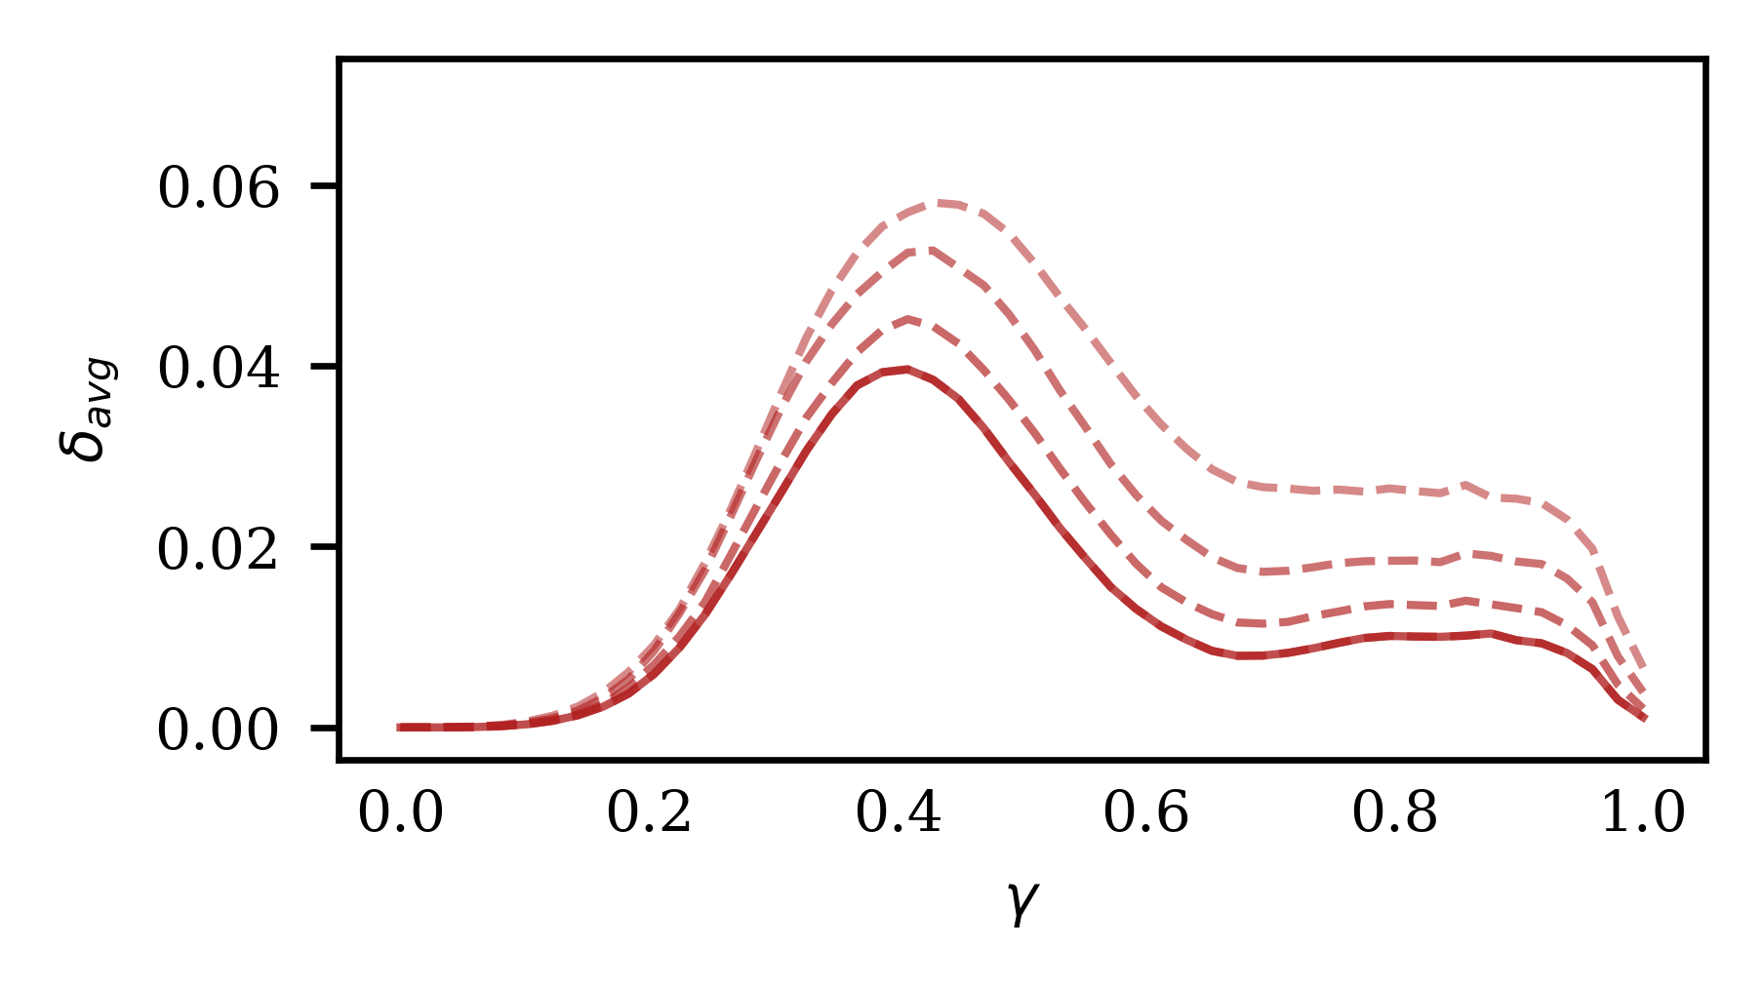
(2) Is the optimal γ related to some phase or phase transition?
TODO: Find another phase diagram for SK
Does it align with the optimal γ?
Does it relate to the localization of eigenstates?

Slide 3
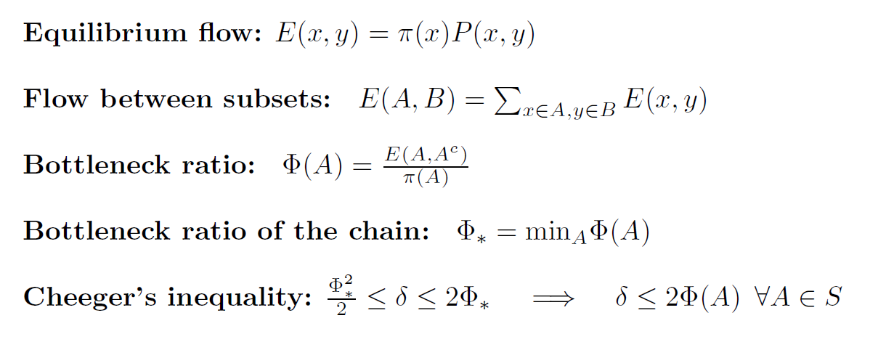
Bottleneck analysis

Slide 4
