Slide 2
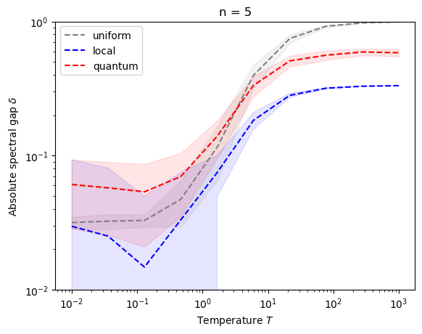
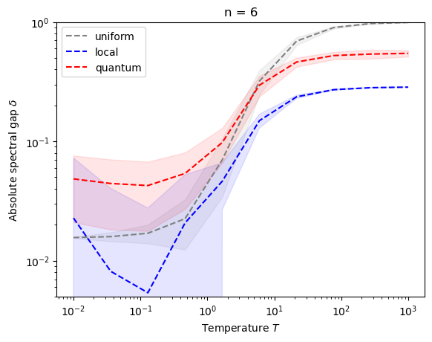
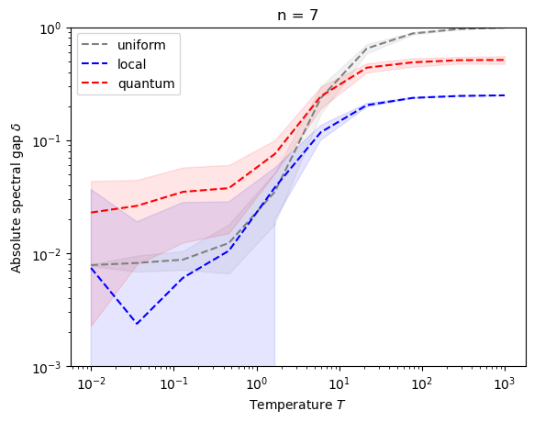
Average over 50 random fully-connected Ising instances sampled from N(0,1)
No averaging over gammas and t

